Slide 1
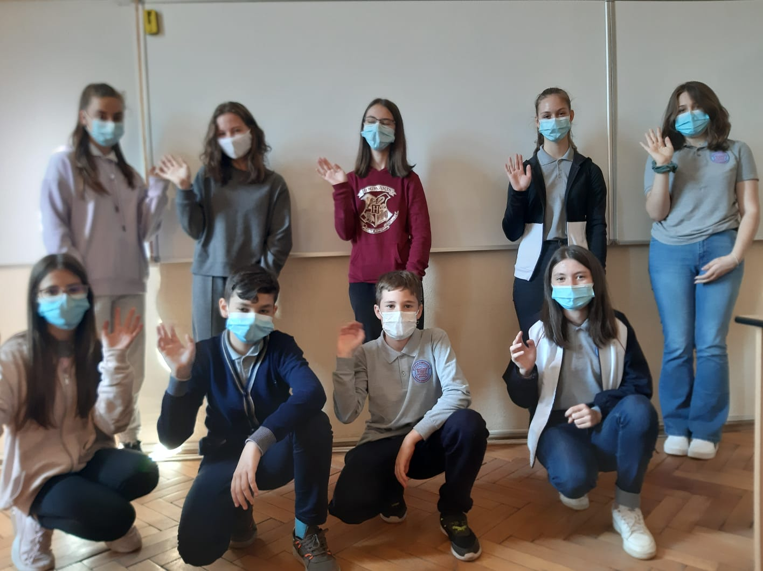
My first business
ACE ERASMUS+
C2 MEETING
Năsăud, Romania

Slide 2
Welcome to our activity!

Slide 3
1.
Making a solid business plan
4.
The materials
We tried to apply what we had learnt during the meeting in Poland
We searched for various materials to create original products and bought or bought them.
2.
Our Activities
The resources
3
5.
We figured out what materials we needed.
The production
3.
The budget
We made by hand lots of products ready to be sold.
We calculated the budget we need to cover all the expences for our business.

Slide 4
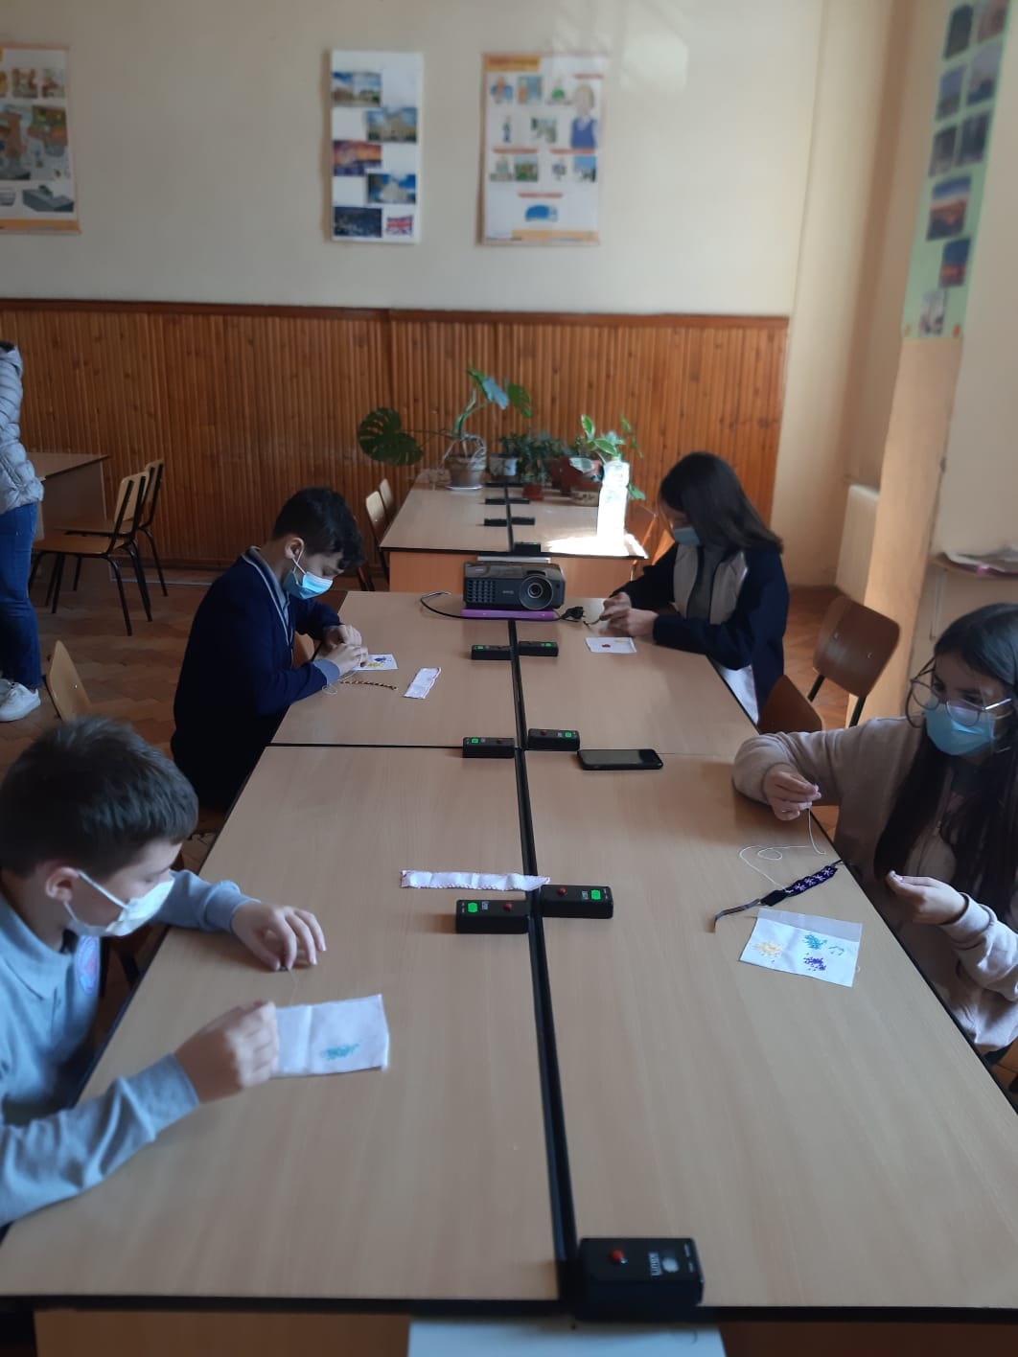
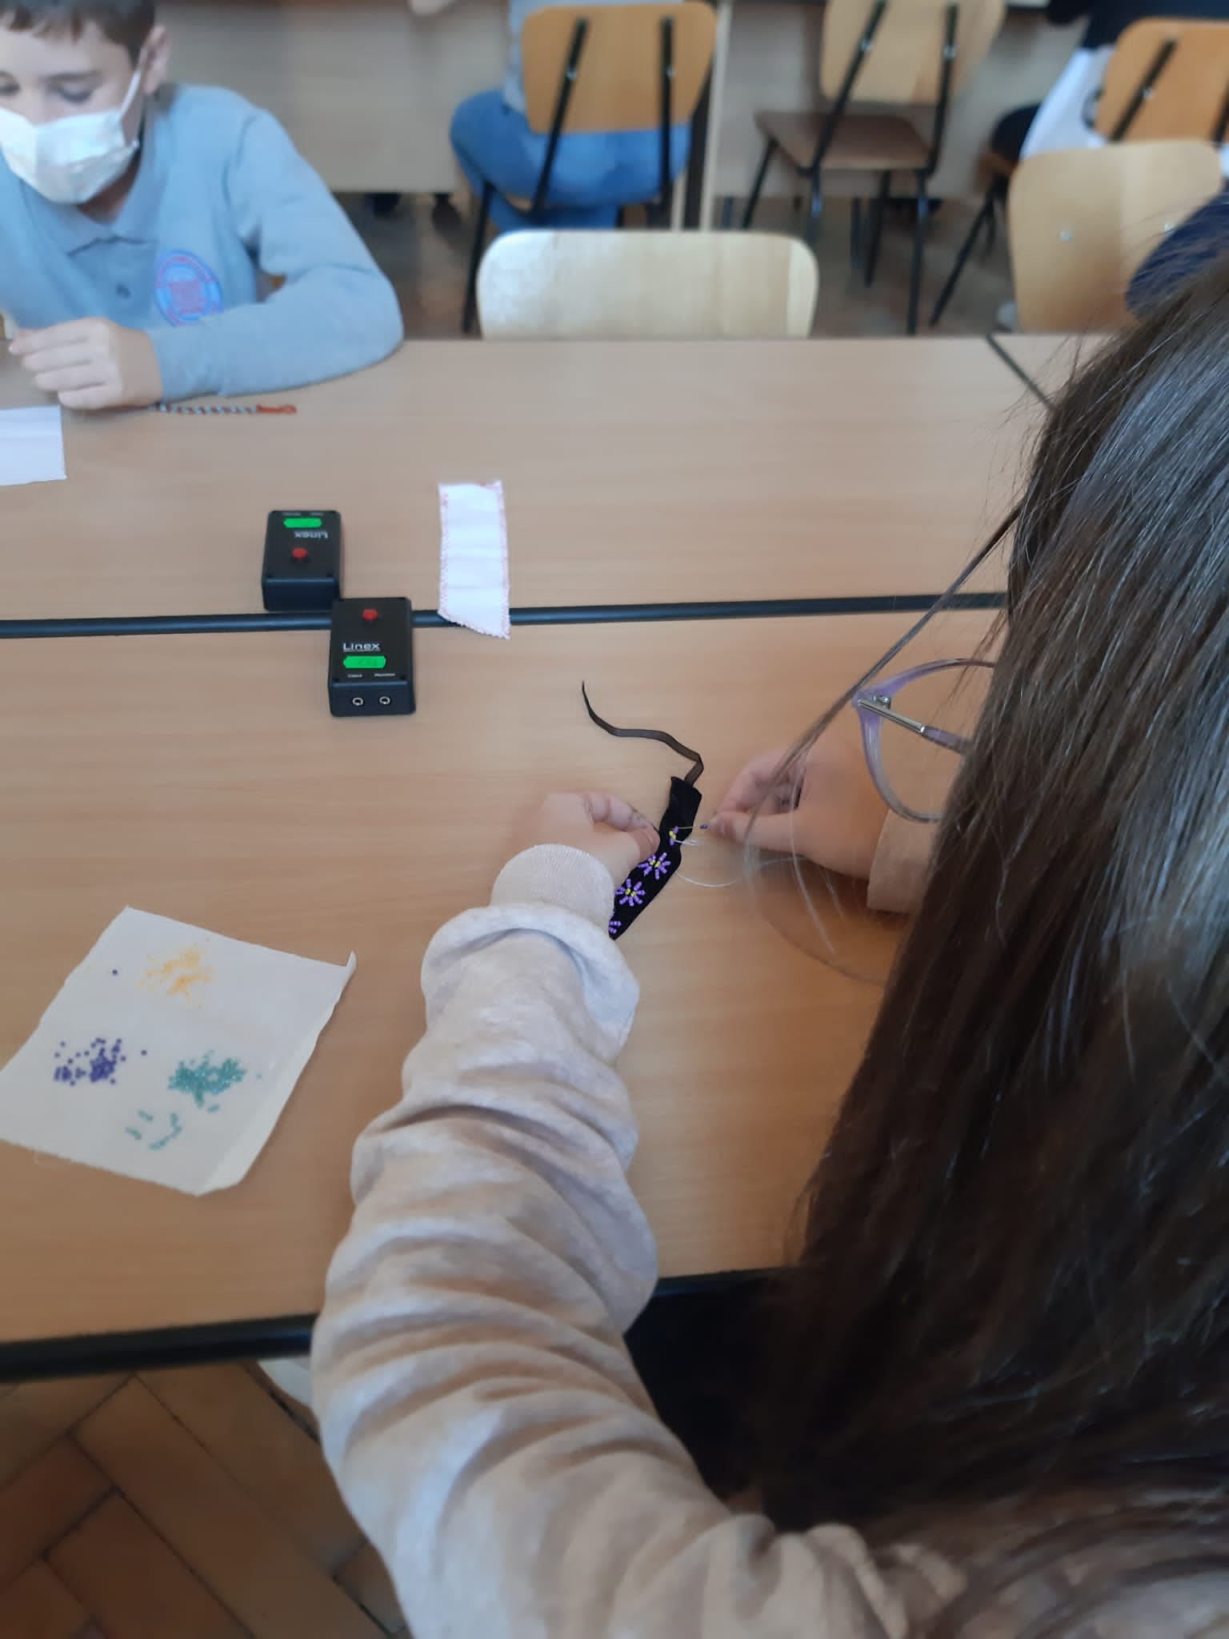
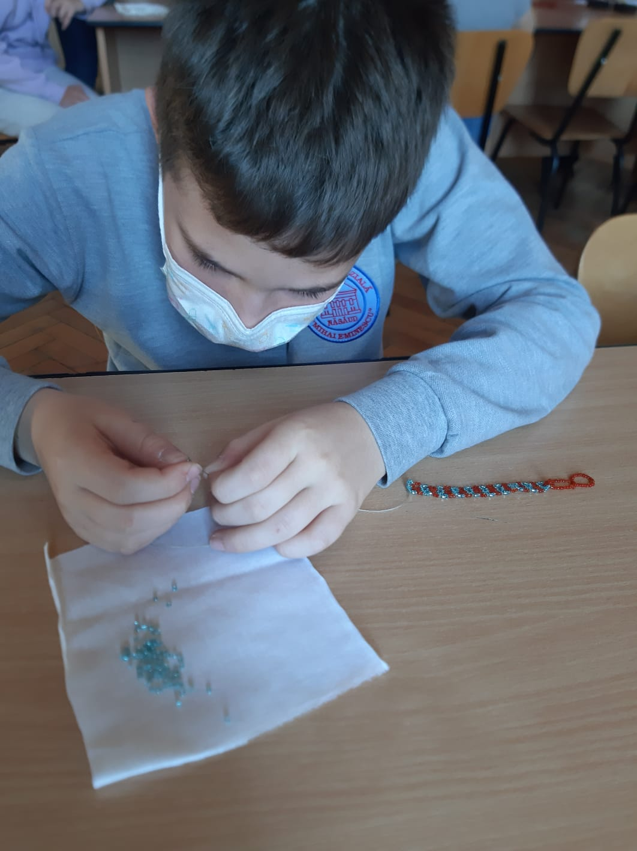
3

Slide 5
Mottos
This is the motto we permanently had in our mind and motivated us.
5
“If you can dream it, you can do it”- Walt Disney “A successful business requires one simple thing: PASSION – Teresa Collins

Slide 6
Occasions to wear the traditional costume
The Feast of the students of Năsăud (May 16th)
The Traditional Costume’s Day (May 16th)
“De Ispas la Năsăud” Folkloric Festival (on the Thursday of the sixth week after Easter)
The International Day of Romanian Blouse (June 24th)
The Days of the Town of Năsăud (include a folklore gala every year)
At Easter and Whitsun (Pentecost)
At weddings
At Christening ceremonies
At church, on Sundays (mostly in villages)
5

Slide 7
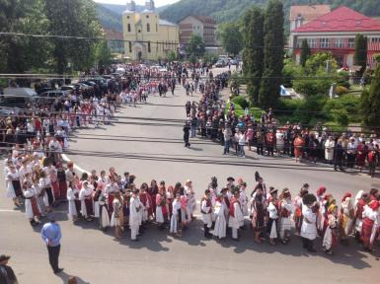
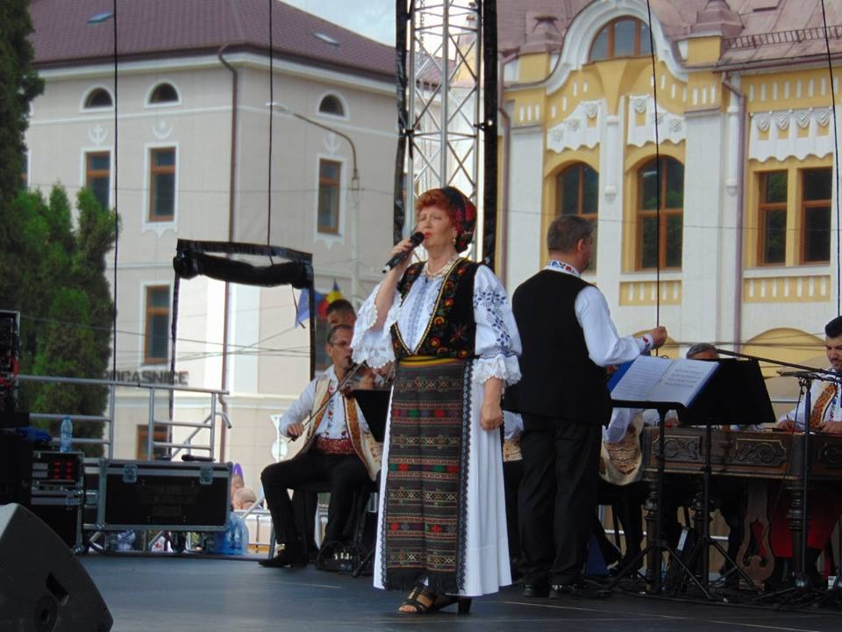
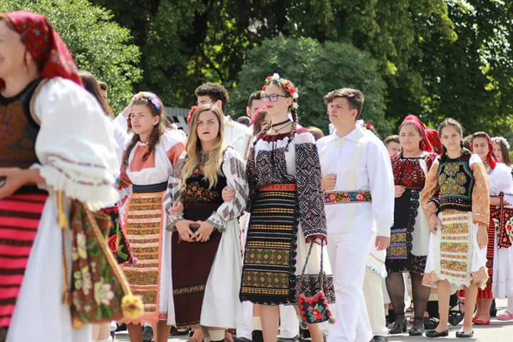
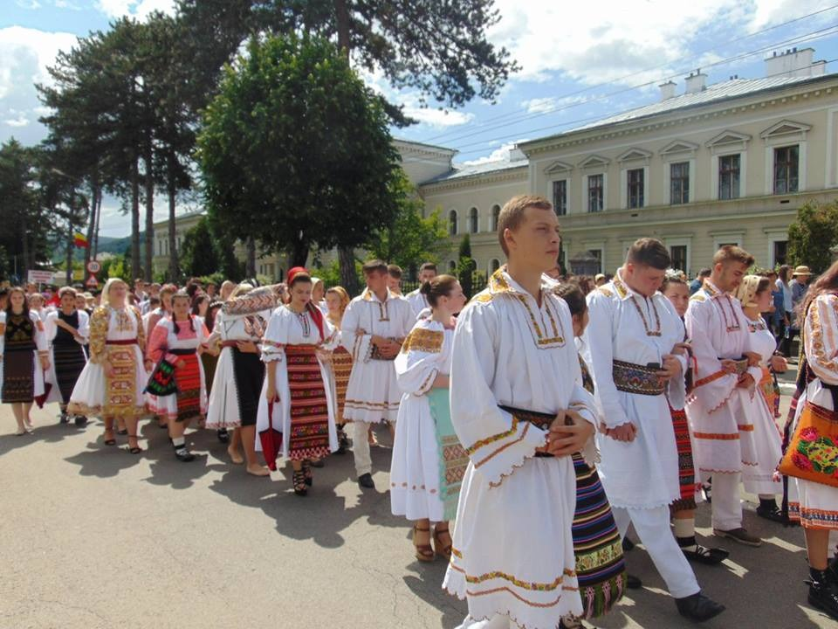
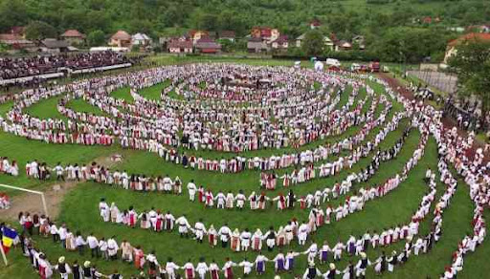
5

Slide 8
The business plan
OBJECTIVES OF THE COMPANY: 1.To arise the people’s awareness about the unicity and beauty of traditional handmade jewellery and finery.
2.To use the money from selling our products for buying schoolbags and school objects for the kids from poor families in our school or from the Foster Home in our town.
NAME OF THE COMPANY: The Jwellery Chest
LOGO OF THE COMPANY:
TARGET GROUP: 800 students in our school and their families; our comunity (teenagers, women)
TOTAL COST OF PRODUCTION: 2450 RON
SALES CHANNELS: face-to-face; on-line
THE TOTAL PROFIT
8

Slide 9
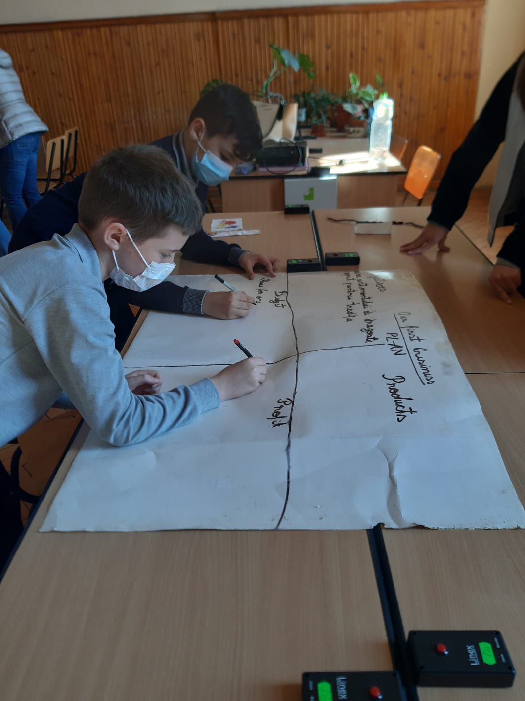
The business plan
Making the plan of our business is the most important and the hardest step. We all worked really hard and we found the best ideas.
9

Slide 10
The supply of our product
How many items should I manufacture? | Bracelets | Necklaces | Broaches | Traditional bags | Handkerchief
 | 50 | 50 | 50 | 50 | 50
10
The supply of my product should be 250 items.

Slide 11
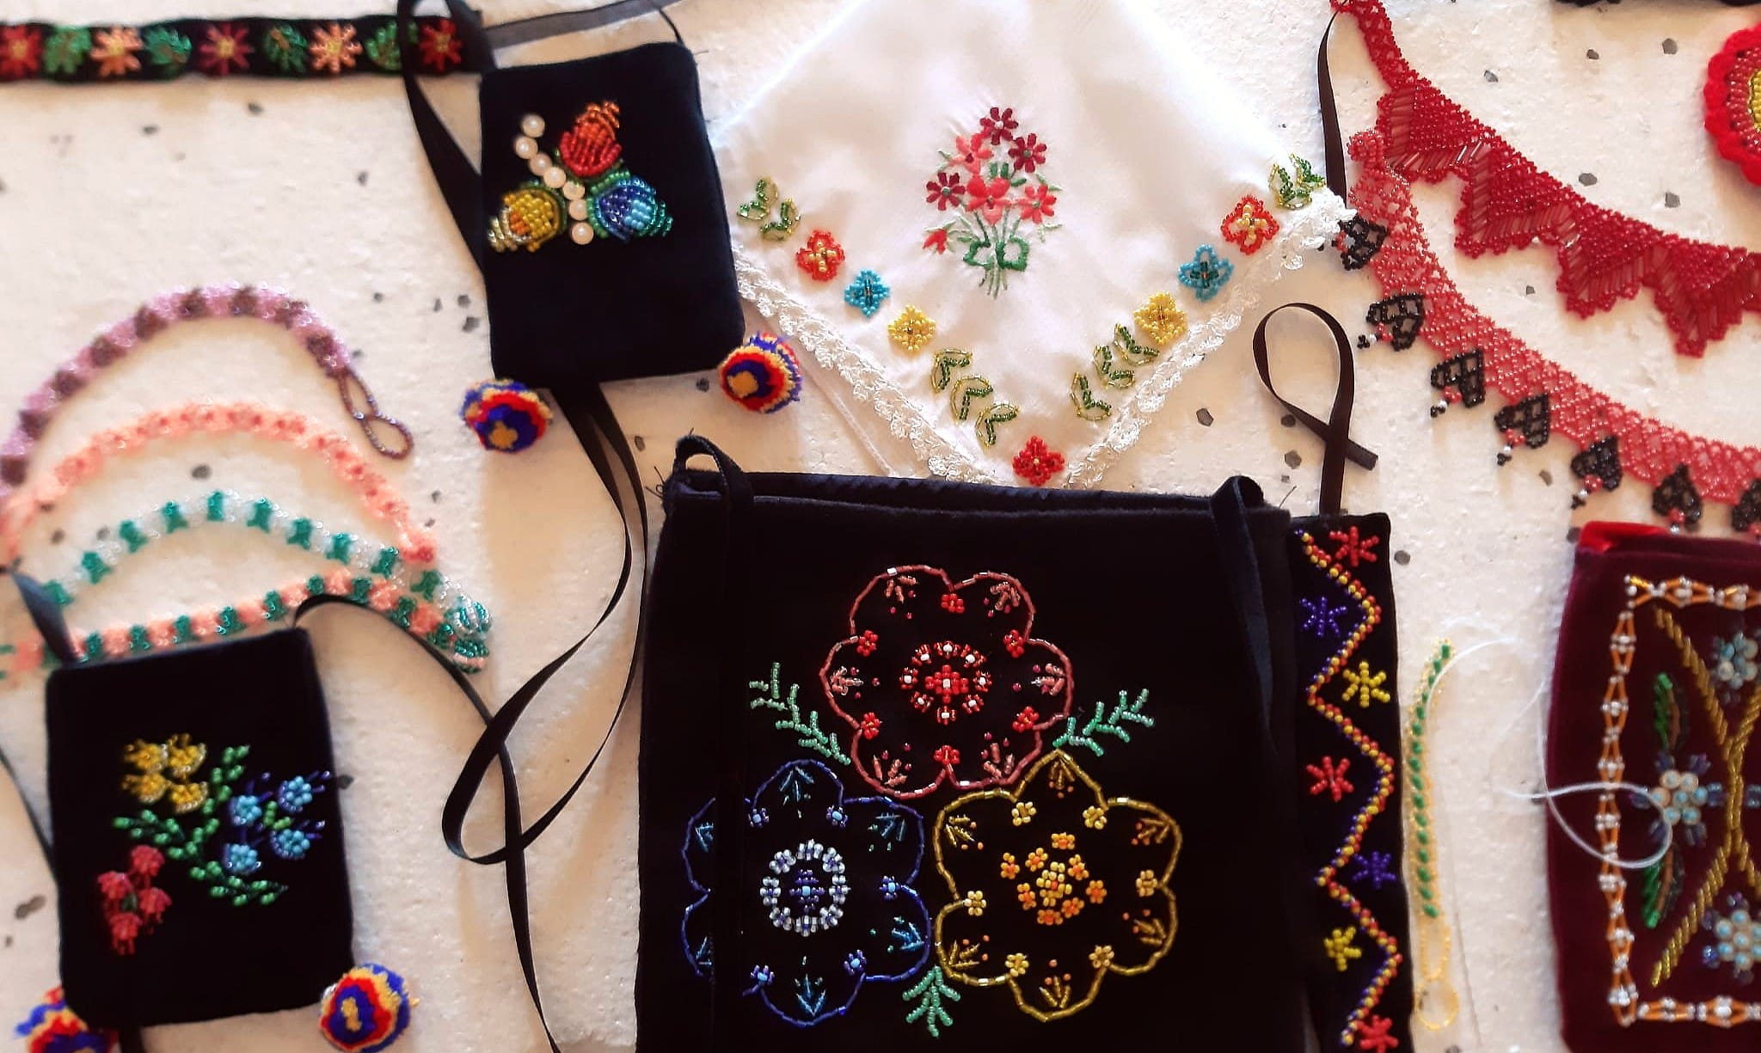
Advertising
11
It is a very important step in our planning the business.
Features of the product: CHEAP, DURABLE, UNIQUE
Enrich

Slide 12
Let’s make it!
How much it costs to make each product?
 | Bracelet | Necklace | Broach | Bag | Handkerchief
1.Designing the product | 1 RON | 2 RON | 2 RON | 5 RON | 2 RON
2.Buying the raw material | 2 RON | 4 RON | 2 RON | 5 RON | 2 RON
3.Production | 1 RON | 2 RON | 2 RON | 3 RON | 2 RON
4.Packing | 1 RON | 1 RON | 1 RON | 1 RON | 1 RON
5.Selling the product | 1 RON | 1 RON | 1 RON | 1 RON | 1 RON
6.Total cost of one item | 6 RON | 10 RON | 9 RON | 15 RON | 9 RON
<number>

Slide 13
CARACTERÍSTICAS DEL PROYECTO
How much do all the items cost?
The cost of one item is
1 bracelet=6 RON
1 necklace=10 RON
1 broach=9 RON
1 bag=15 RON
1 handkerchief=9 RON
The planned number of manufactured items and the total cost of production
50 bracelets……………..50X6=300 RON
50 necklaces…………….50X10=500 RON
50 broaches……………..50X9=450 RON
50 bags…………………...50X15=750 RON
50 handkerchiefs………..50X9=450RON
COST OF PRODUCTION
<number>

Slide 14
 | How much did I spent with one item? | What will be the price for one item? | Profit on one item | Total profit
bracelet | 6 RON | 10 RON | 4 RON | 50 items X 4=200 RON
necklace | 10 RON | 25 RON | 15 RON | 50 items X 15=750 RON
broach | 9 RON | 20 RON | 11 RON | 50 items X 11=550 RON
bag | 15 RON | 30 RON | 15 RON | 50 items X 15=750 RON
handkerchief | 9 RON | 20 RON | 11 RON | 50 items X 11=550 RON
How much will I earn?
<number>
The total cost of production: 2450 RON
Total cost on selling the products: 5250 RON
The total profit: 2800 RON

Slide 15
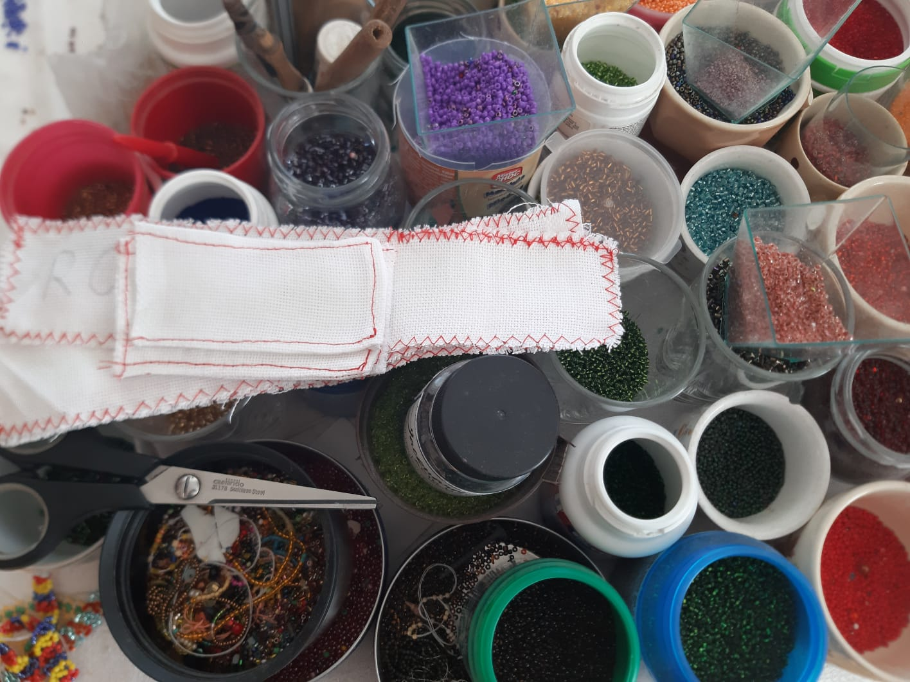
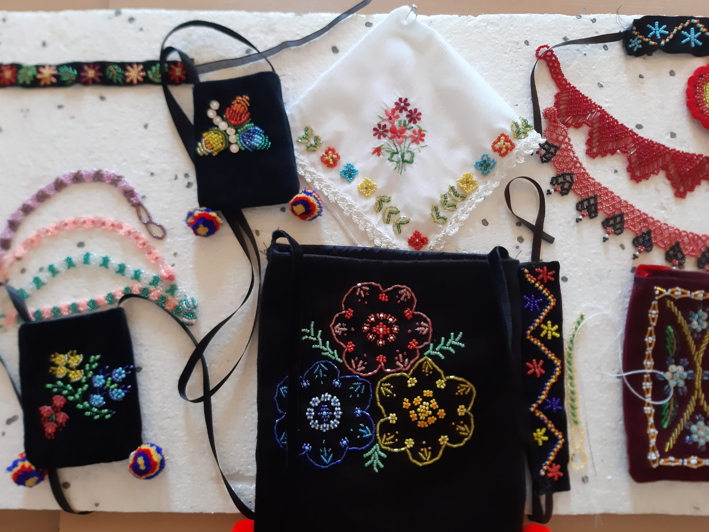
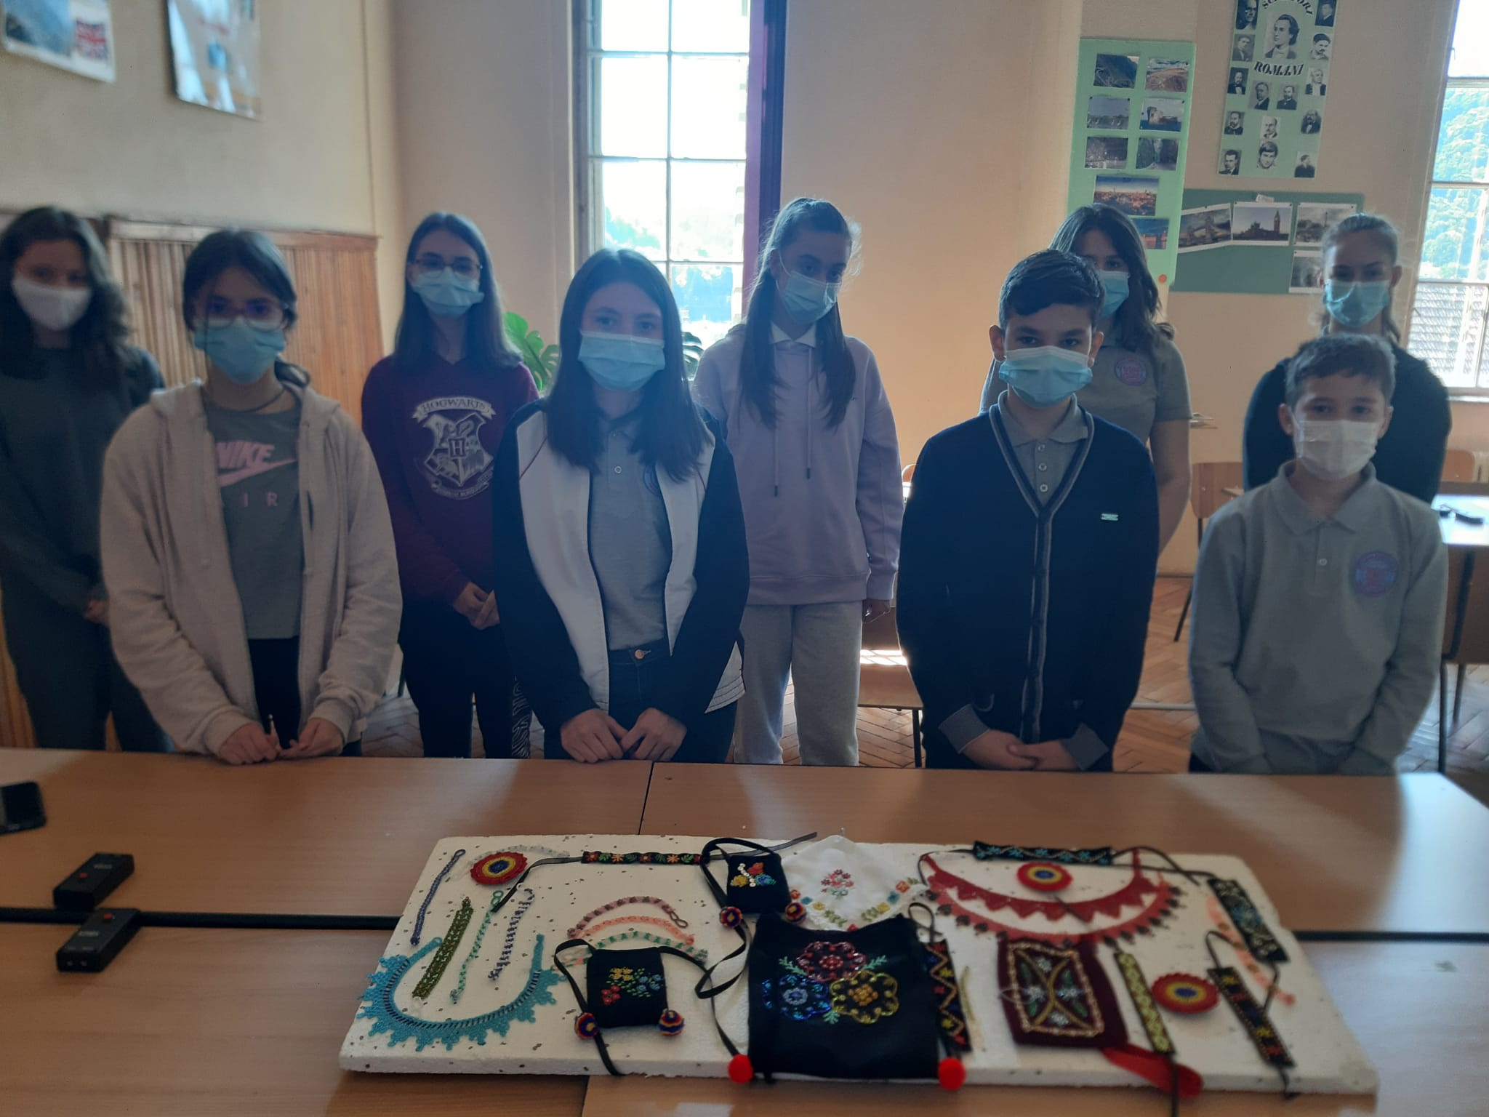
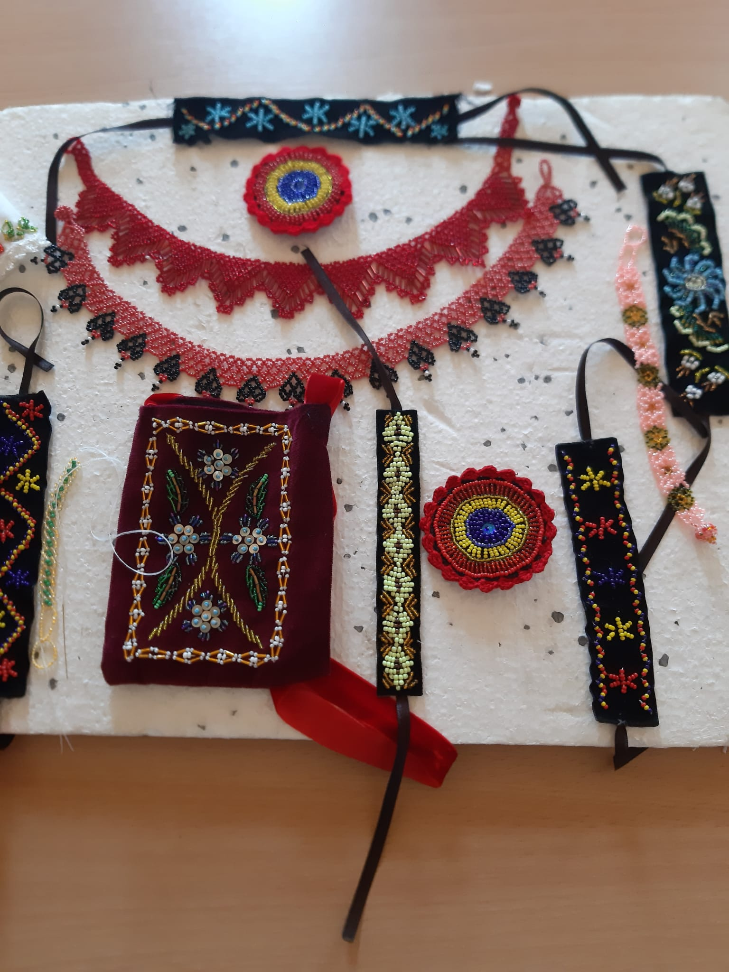
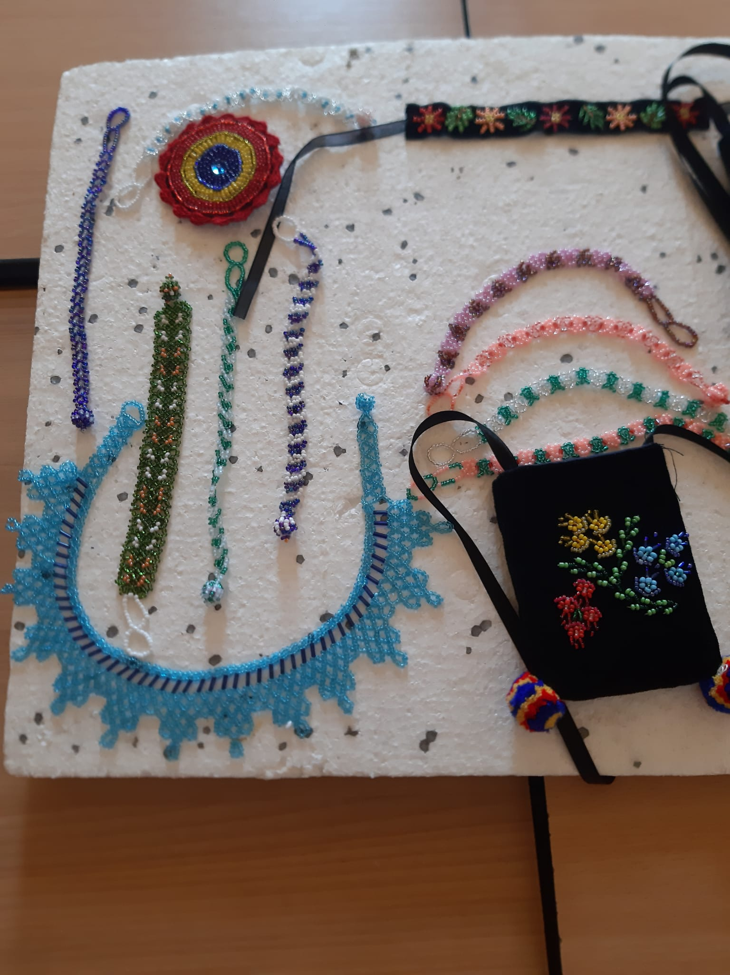
The final product
<number>

Slide 16
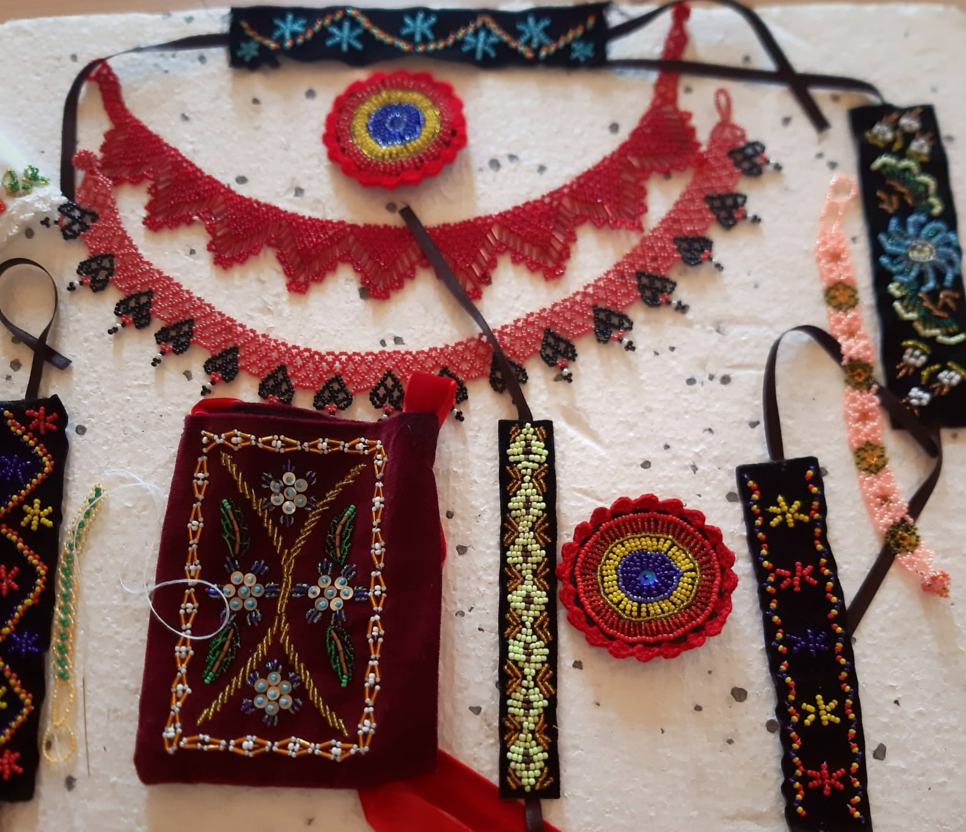
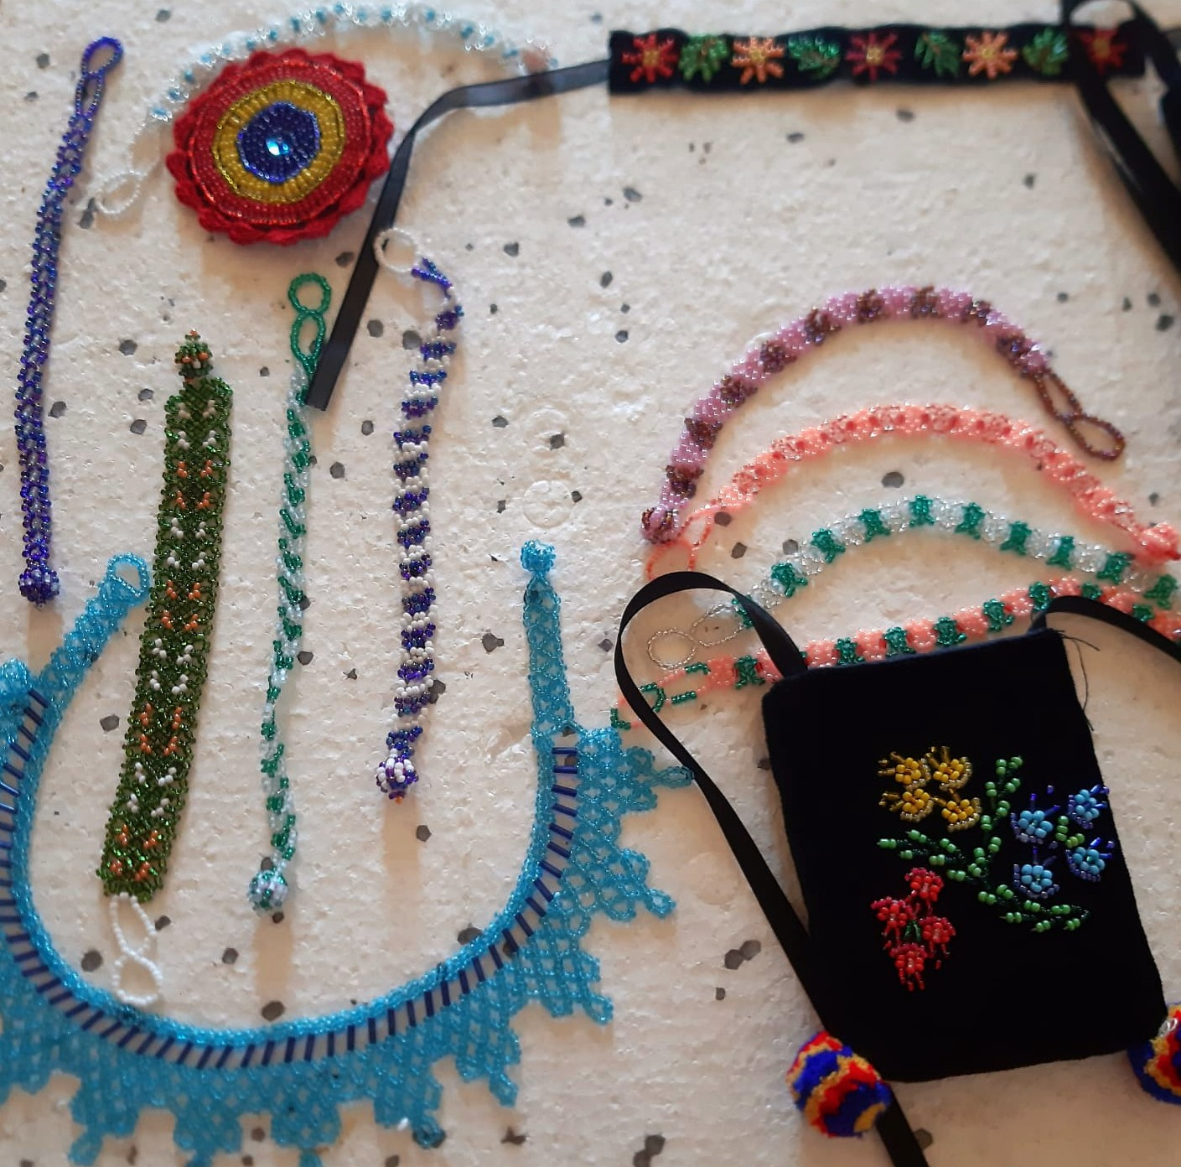
The final product
<number>

Slide 17
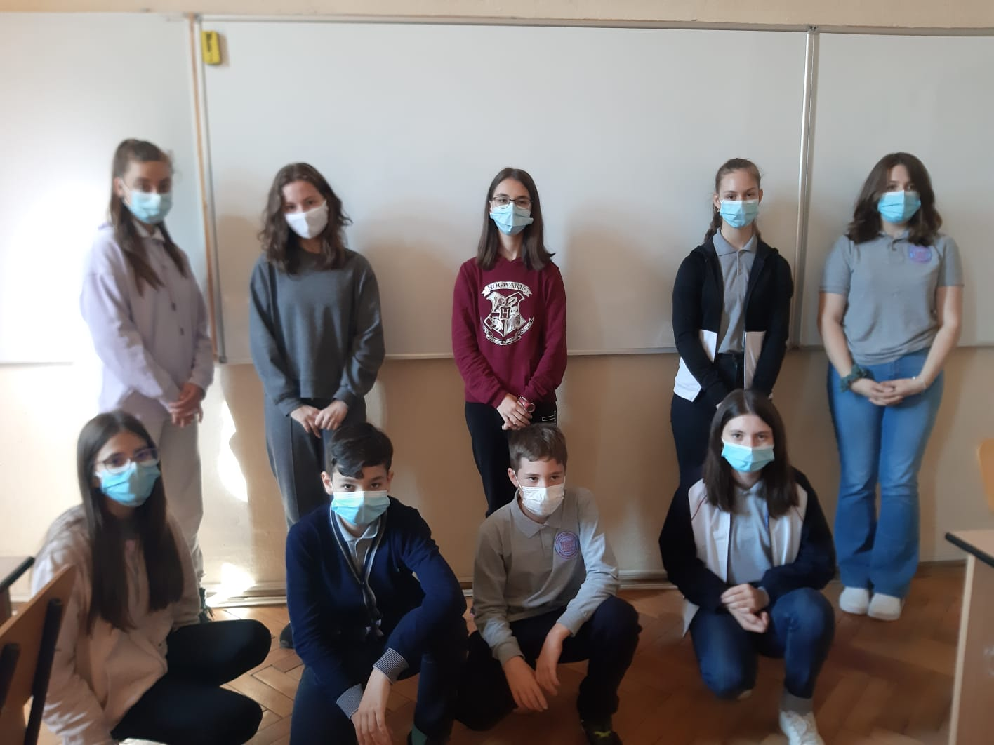
THANK YOU!
<number>
Thank you for your attention!!!
Do you have any questions?
Por favor conserva esta diapositiva para atribuirnos

Slide 18
Notes:
<number>

