Slide 1
National Volunteer Day 1st of April 2021
We celebrated
Earth DAY
with joint volunteer activities in our city,
Nasaud, ROMANIA.

Slide 2
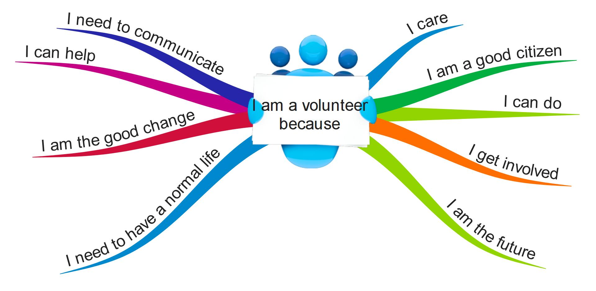

Slide 3
It all starts by an official call from our city hall…

Slide 4
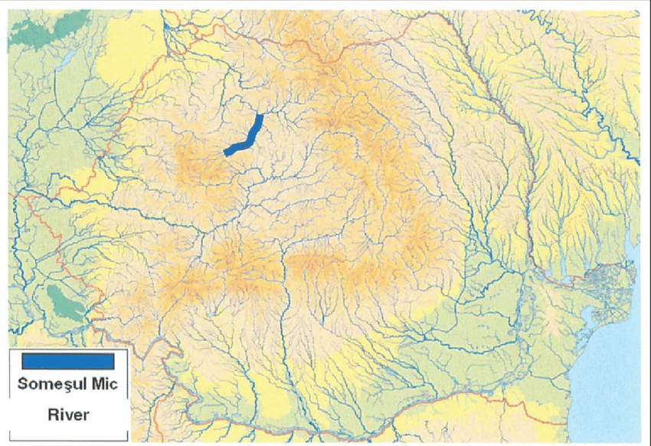
That means that our local river, SOMES, needs our help to became clean (no plastic, no waste)

Slide 5
After a short meeting and a realistic plan, teachers and students from our school decided to dedicate some time for volunteer.

Slide 6
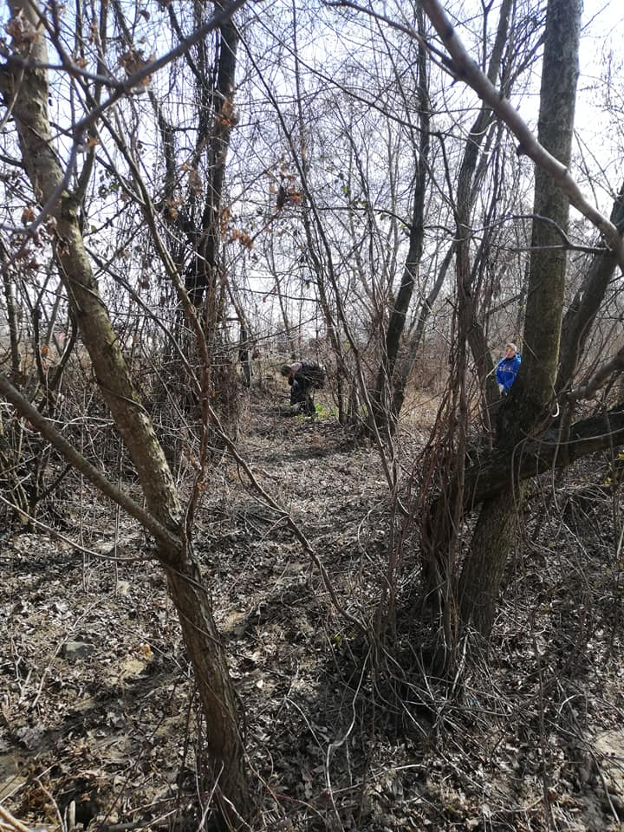
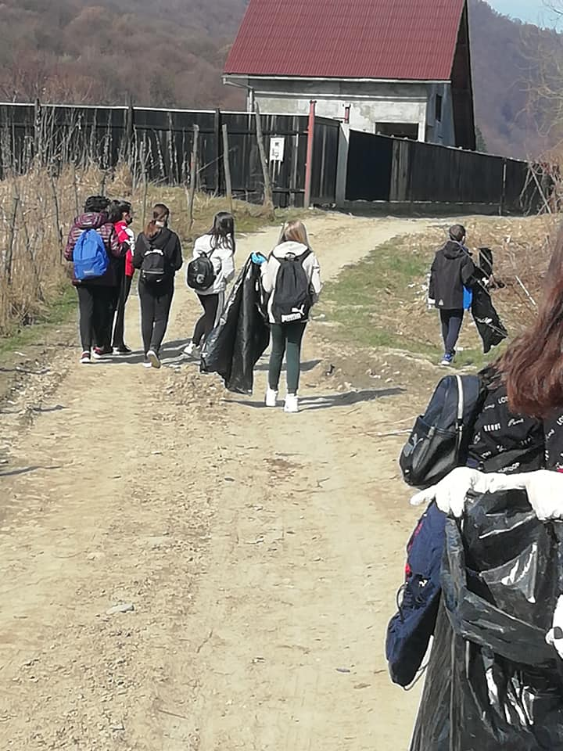
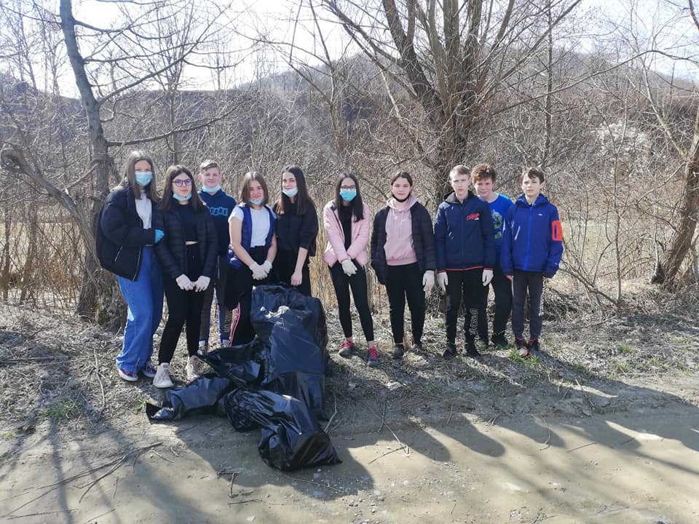
Soooo…here we are…

Slide 7
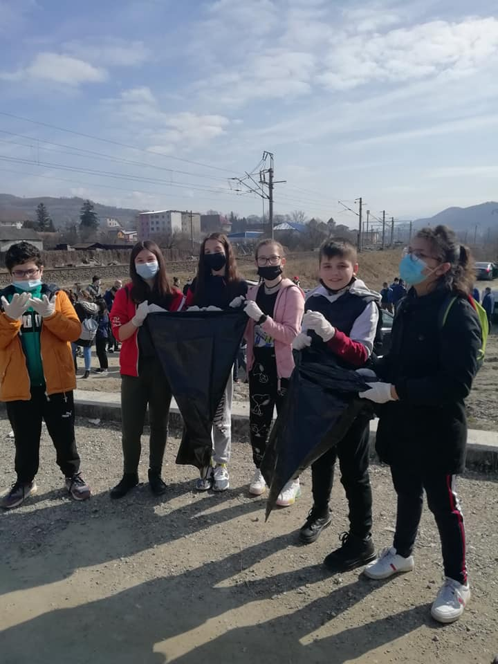
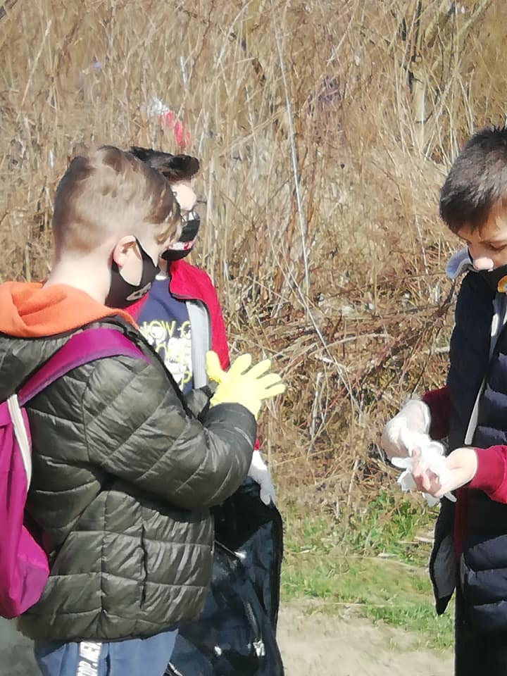
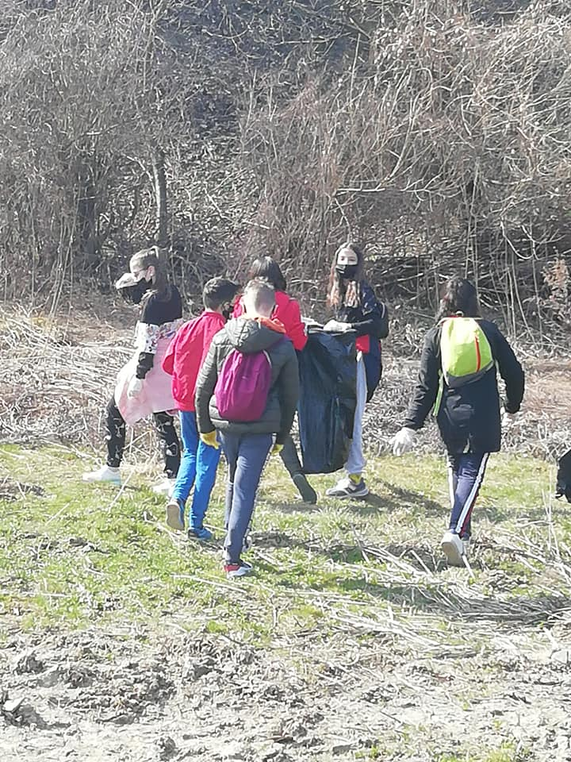
Soooo…here we are…

Slide 8
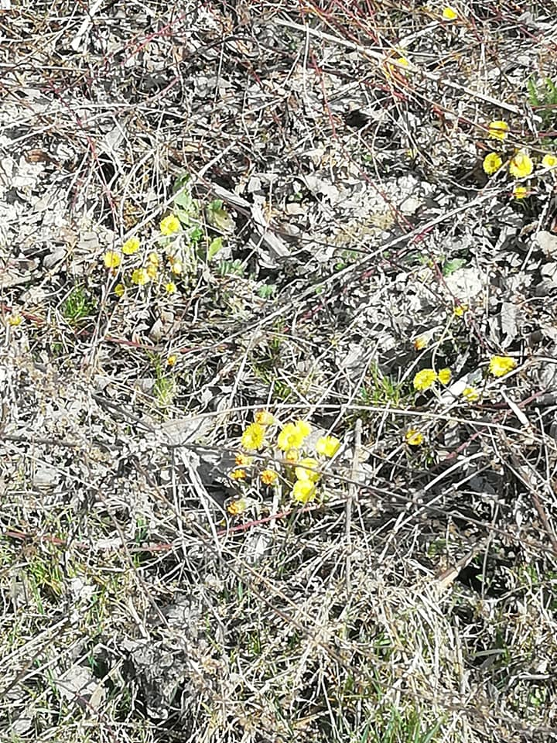
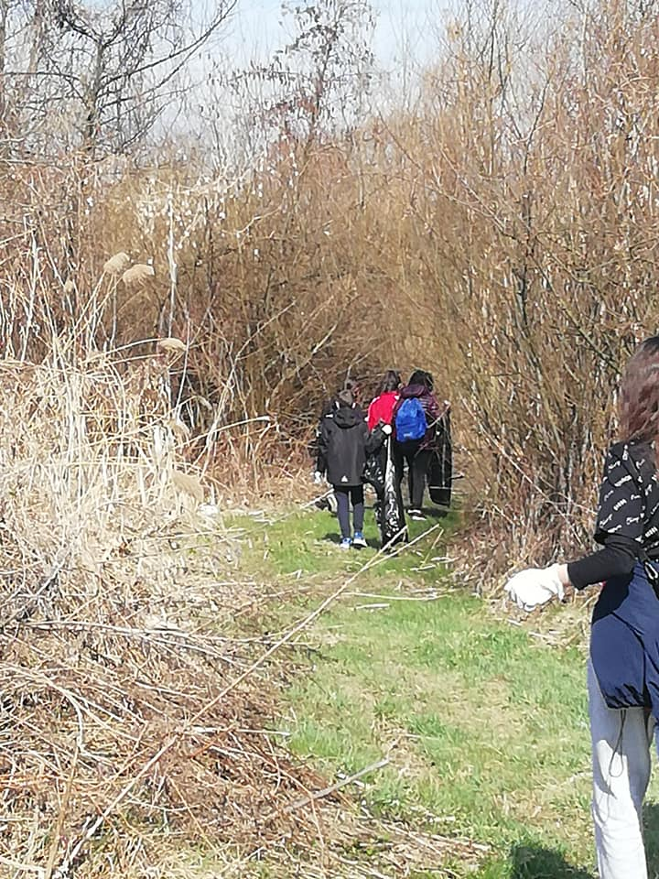
Soooo…here we are…

Slide 9
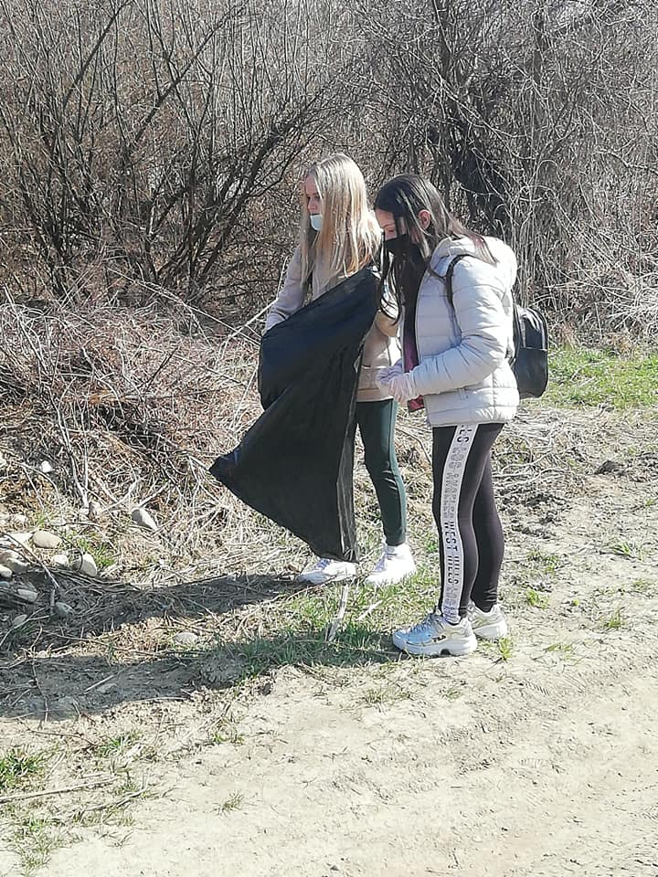
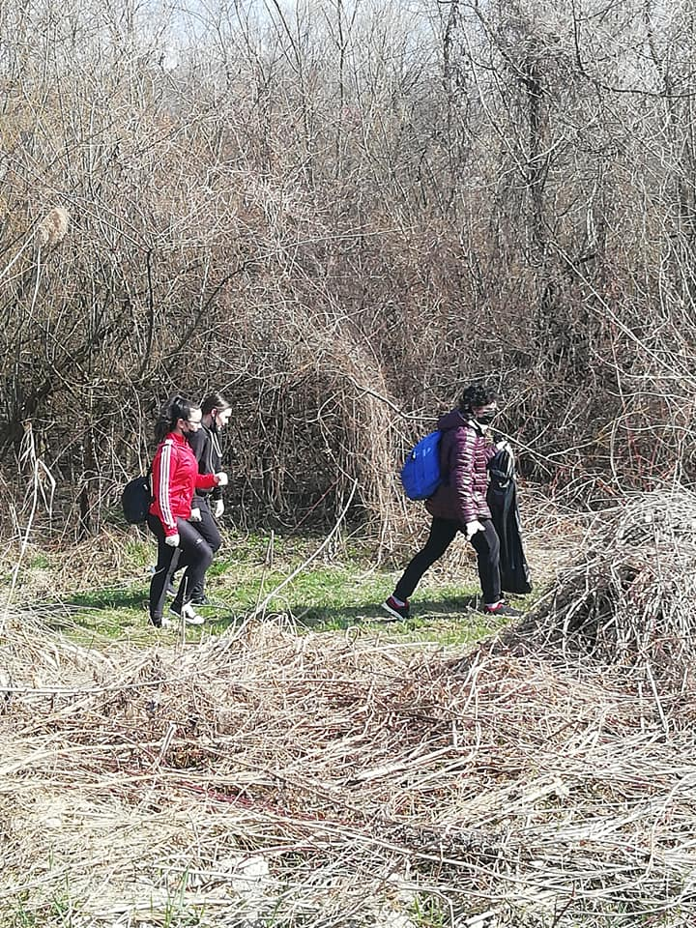
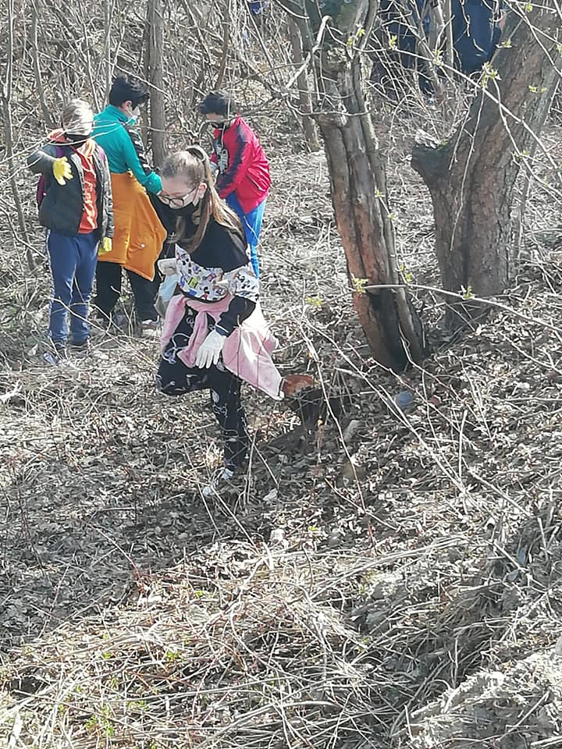
Soooo…here we are…

Slide 10
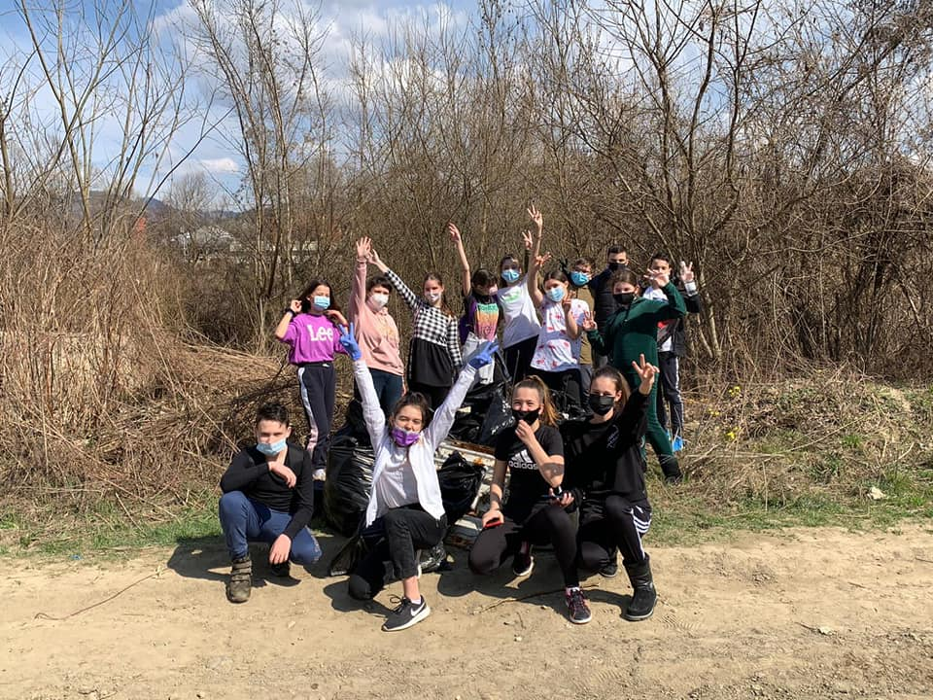
Happy and proud of our work, waiting for the comming Spring.

Slide 11
Soooo…here we are… Active, creative, enterprising European citizens Romanian team (students and teachers) Scoala Gimnaziala Mihai Eminescu Nasaud, ROMANIA

