Slide 1
Active
Creative
Enterprising
Gymnasio Agrias, 2nd meeting with students, 9.10.2019
Subject: awareness of the project and preparation to create logo for it

Slide 2
Active, Creating Enterprising
Project description
The goal of the project "Active, creative, enterprising" is the exchange of practices between partner schools and the development of soft skills and basic skills of students as well as professional qualifications of teachers.
We assume that the project will have a positive impact on developing the language skills of the participants by emphasizing the use of English in practical situations.
We want to inspire teachers and support schools in teaching economics and shaping attitudes towards entrepreneurship, creativity, social and economic activity.

Slide 3
Active, Creating Enterprising
The Logo competition
The competition is carried out in two stages:
school, organized by schools involved in or invited to the project;
international, coordinated by the Primary School No. 3 Dębinka
Each school will select three projects that it will present to its other partners by October 18 2019 on the eTwinning platform.

Slide 4
Active, Creating Enterprising
Basic logotype features
simplicity
recognizability (easy to remember)
clarity /readability of the message
timelessness
ease for duplication
limited colors

Slide 5
Active, Creating Enterprising
When assessing projects, the jury will take into account the preservation of logotype features, work aesthetics, clarity / readability of the message and technical possibilities of their use.
From the works published on eTwinning, the international jury (team of project coordinators) October 31, 2019 will select the best one by.
The final decisions on disputes are made by the school project coordinator, and in the case of the final, representatives of the schools participating in the project collectively (one teacher from each school).

Slide 6
Erasmus+ logos
Our school’s proposition for the project «Being a European: find your way to the future- School, Job and Life in Europe» 2016-2018, which won the majority of the votes and became the official logo of the project.

Slide 7
Erasmus+ logos
Discussion: How the title of each project is related to the features of the logos? Please be observant and answer.

Slide 8
Activity: Guess the title of the project

Slide 11
Let’s be healthy together

Slide 14
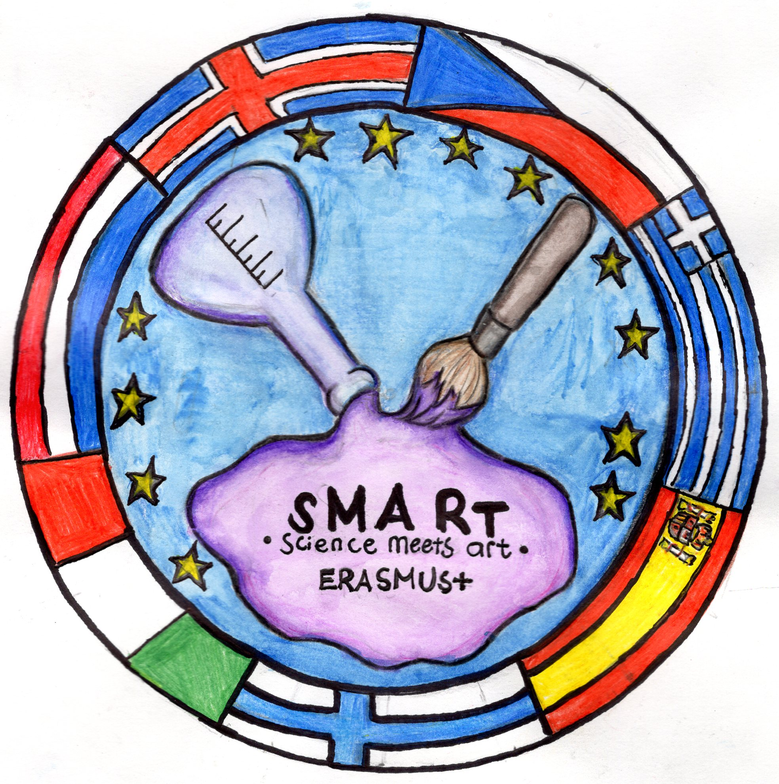
2
3
1
6
5
4
7
Activity: Rate the logos in the scale from 1 to 5, based on the mentioned criteria

