Slide 1
My first business
ACE ERASMUS+
C2 meeting

Slide 2
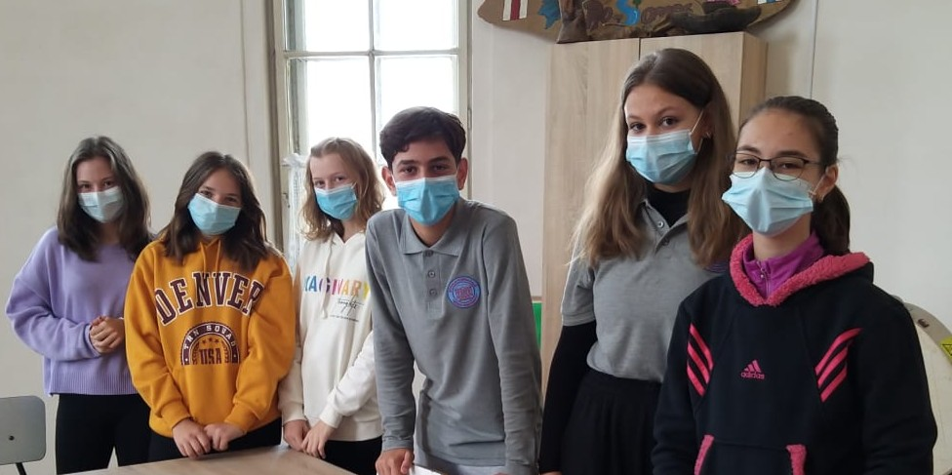
Welcome to our journey!

Slide 3
Our activities
The buisness plan
The resources
The budget
Using the information that we were given in Poland, we put toghether a buisness plan
The next thing we did was founding out what materials we neded
After we figured out what we needed, we did the math and creted a budget
The materials
The production
The final product
We looked for things that fitted our budget and brought them
Then we basically did the actual work
The last part and the best one;)

Slide 4
During our work we learned that the most important thing when starting a business is the motivation to do it. So, here is a quote that helped us get through.
To be successful, you have to have your heart in your business, and your business in your heart.
-Thomas Waston Sr.

Slide 5
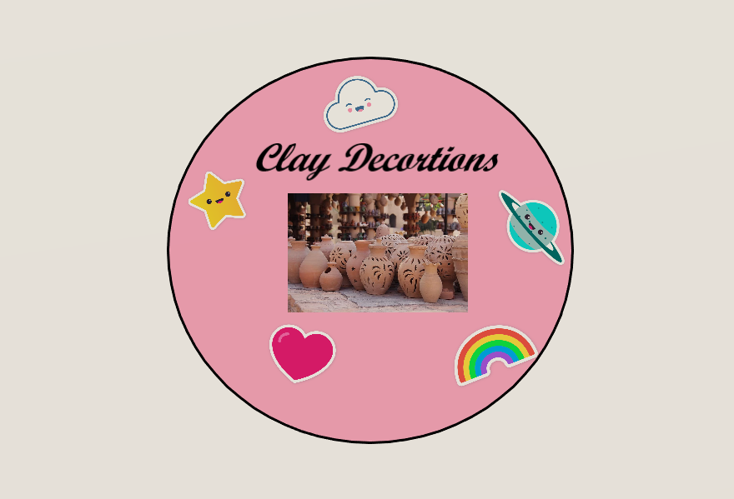
The business plan
Objectives of the company:
1. To bring people close to traditions and their cultural and emotional roots.
2. To decorate the rooms in our local hospital.
3. To spend the money from selling our products for buying Christmas and Easter for elderly people in our town or to pay some of their bills.
Name of the company: Clay Decorations
Logo of the company:
Target group:
1.people who want to have original clay home decorations
2. Visitors of our town
3. The pupils of “Mihai Eminescu” Middle School (who can wear our badges with the name of our school on them
Sales channel: face-to-face sales
The total profit: 2200

Slide 6
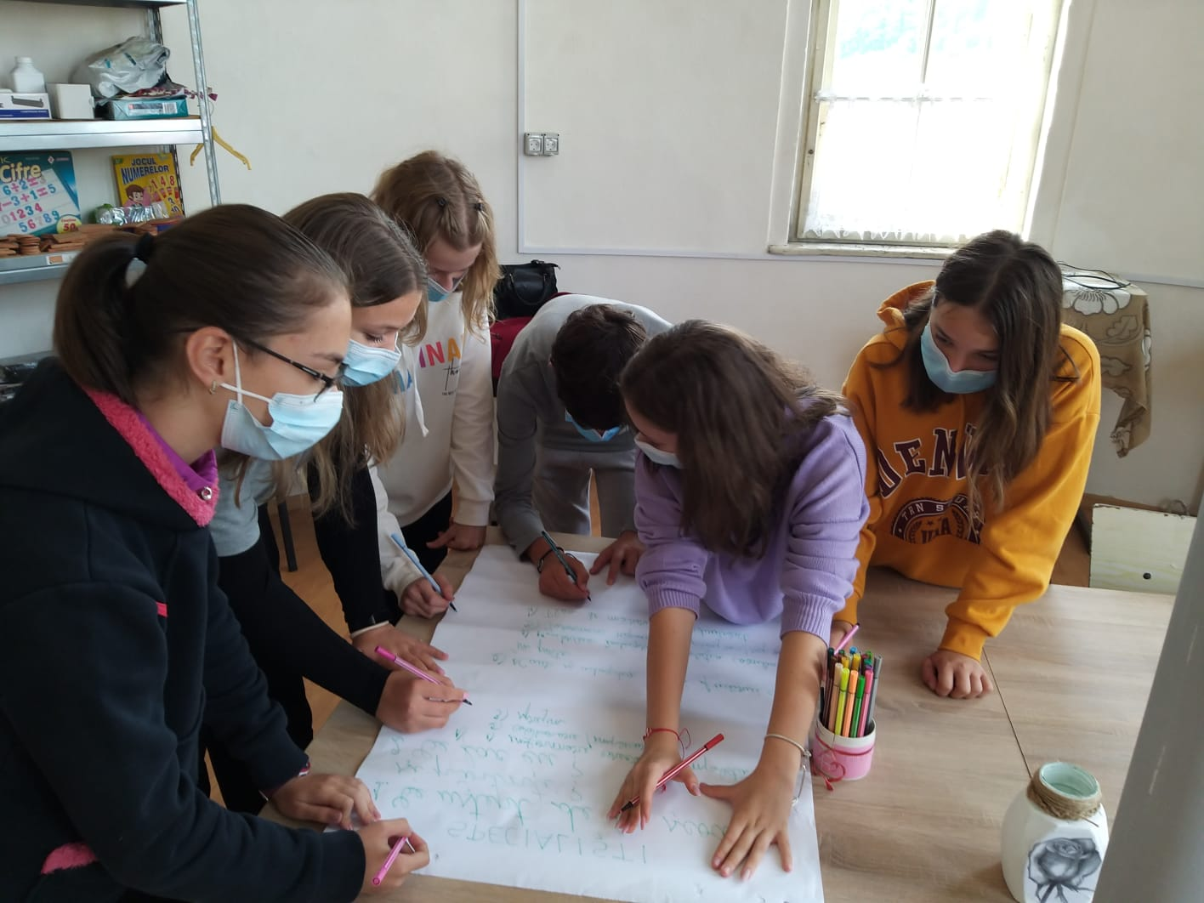
The business plan
This activity is the most important one, because it helps to plan everything out.
Our team worked really hard on this one.

Slide 7
The resources
Human resources
Creativity
Talented students and teachers
The people involved had to be creative and use their imagination
Inventiveness
Seriousness
The final product has to be innovator
A lot of hard work is always the key to success

Slide 8
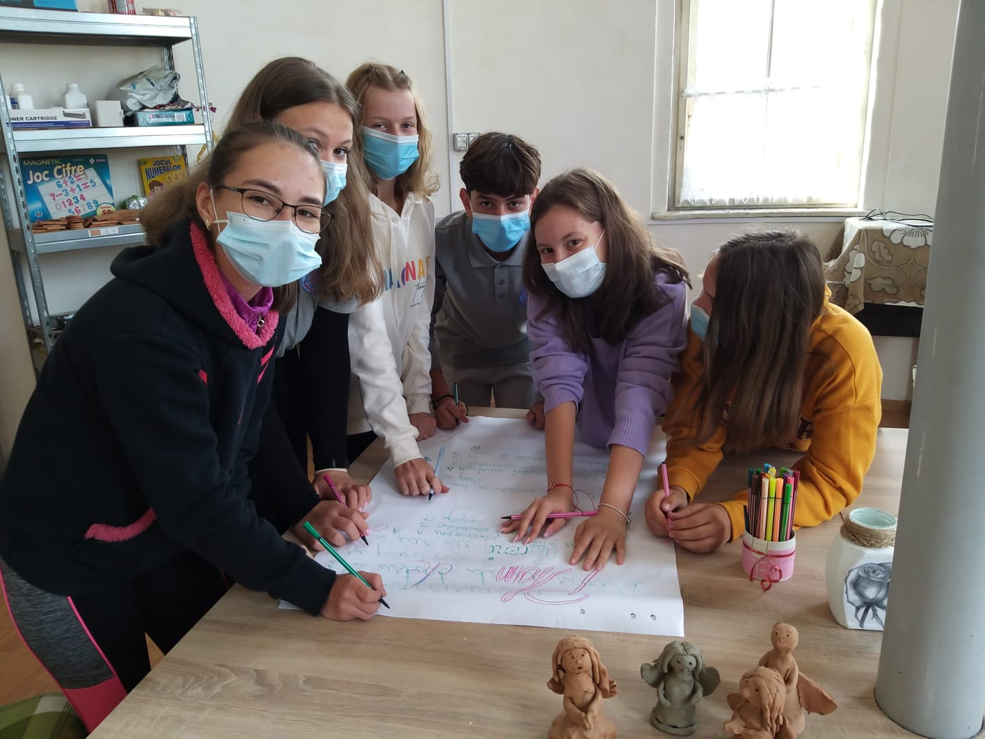
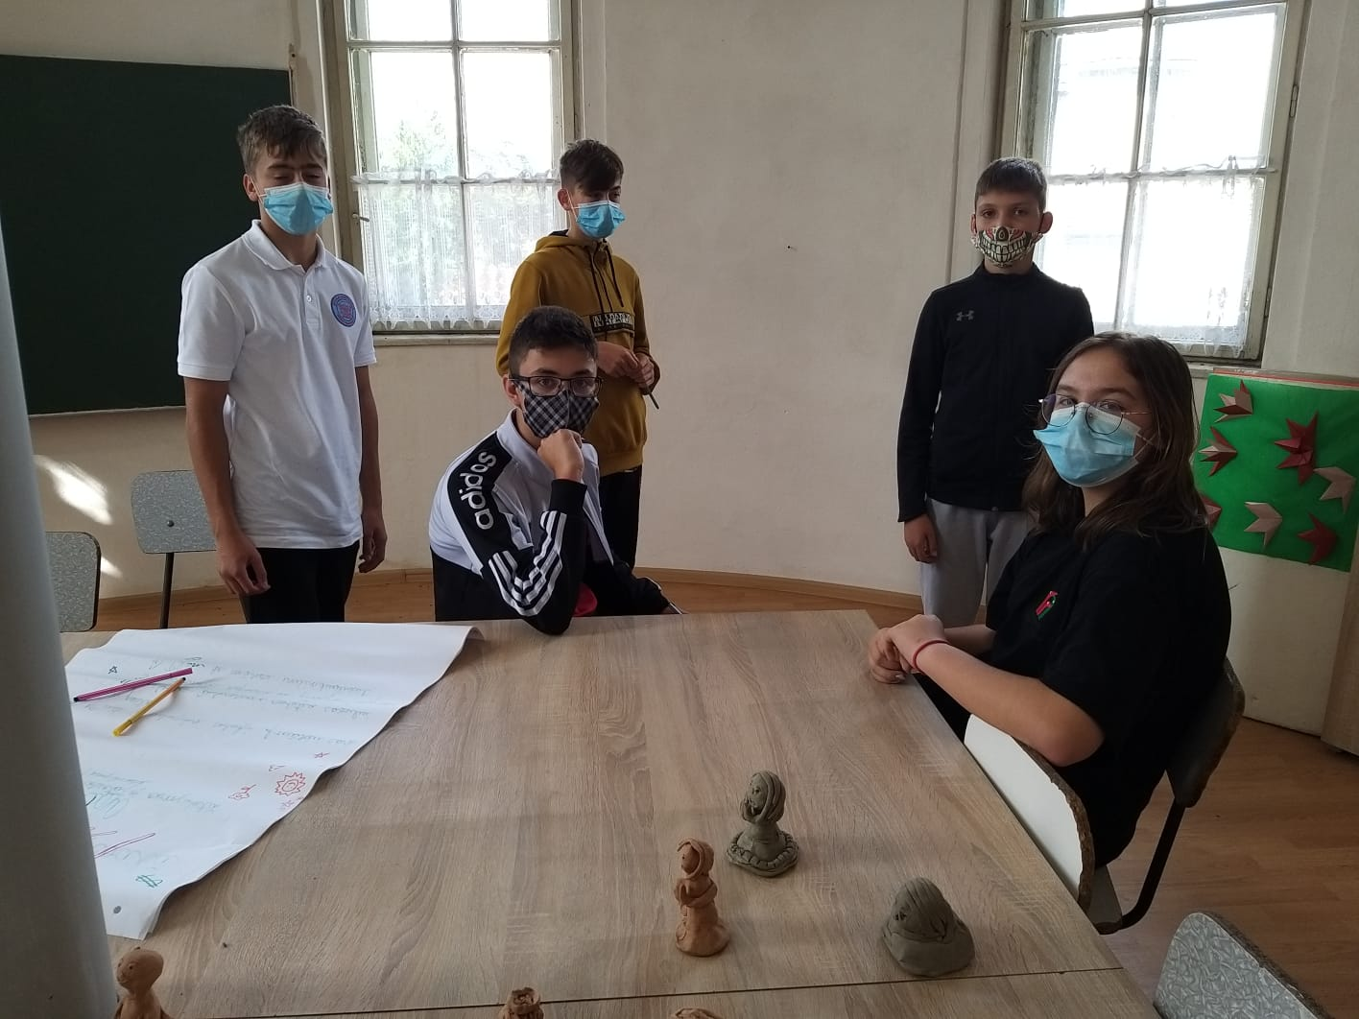
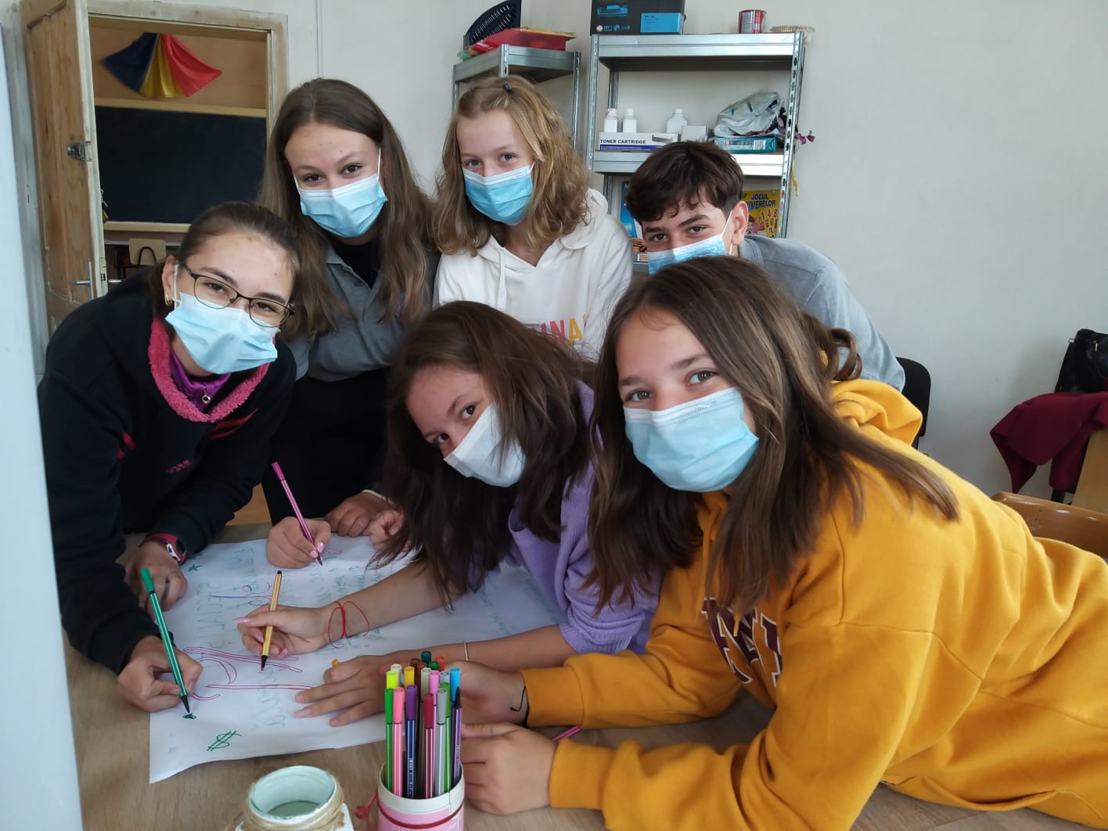
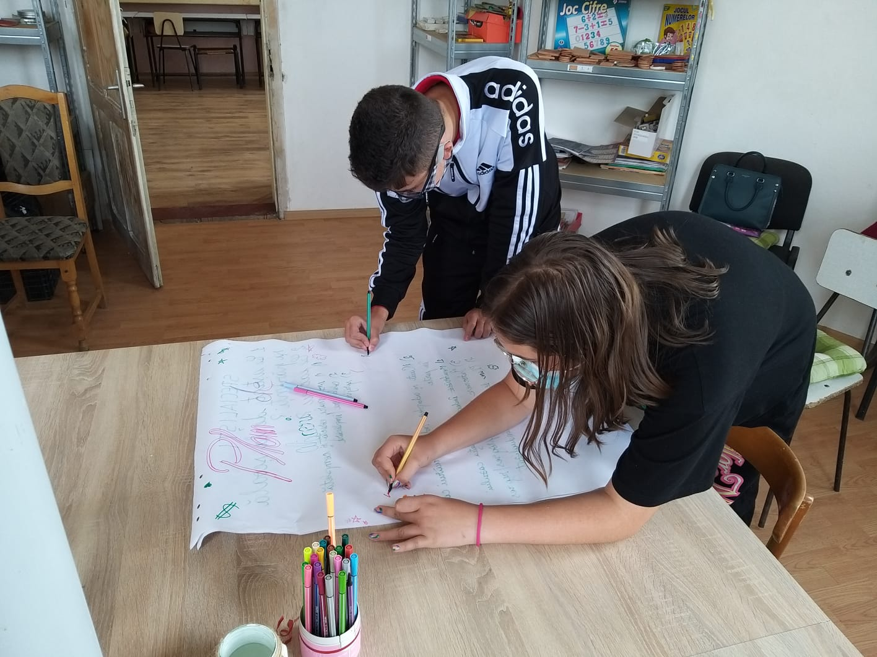
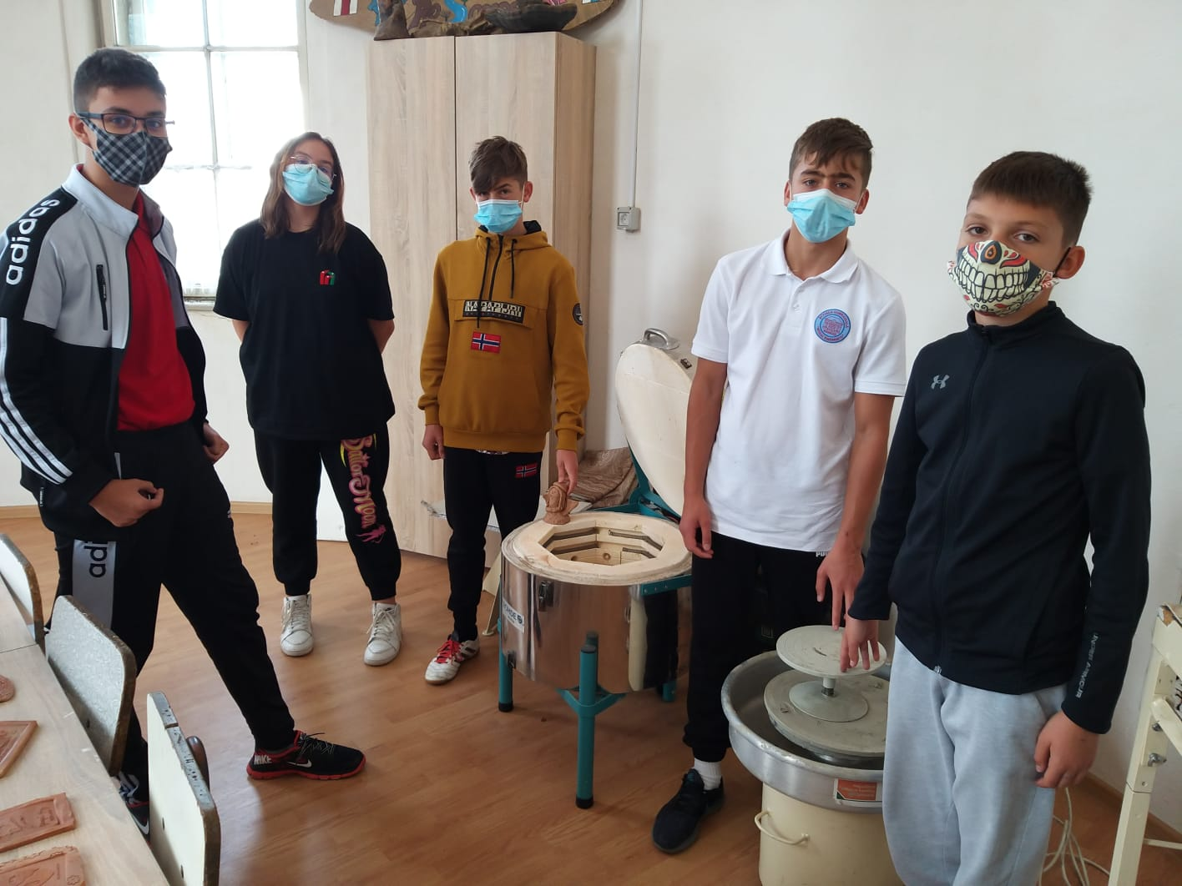

Slide 9
The budget
For this activity, we calculated everything and and planned our next steps.

Slide 10
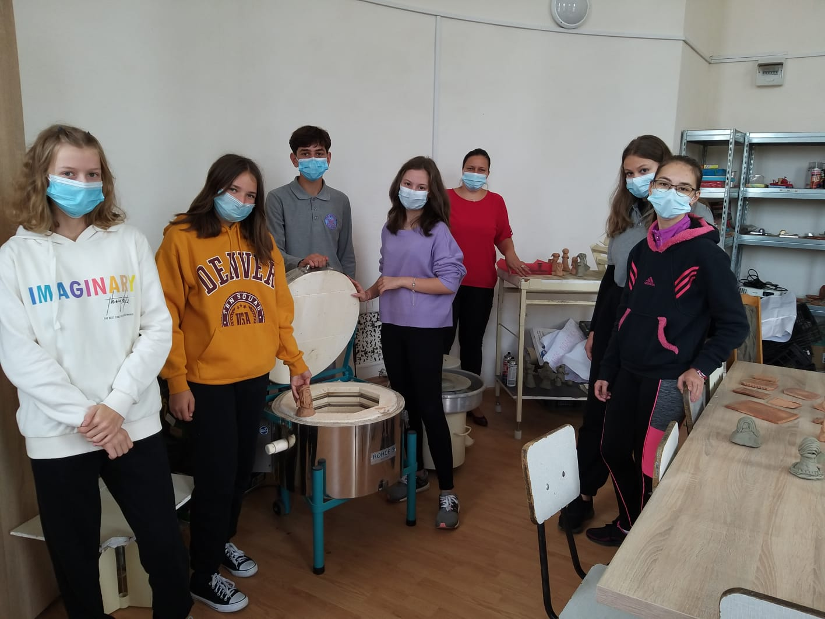
The materials
We went shopping and bought everything we needed.

Slide 11
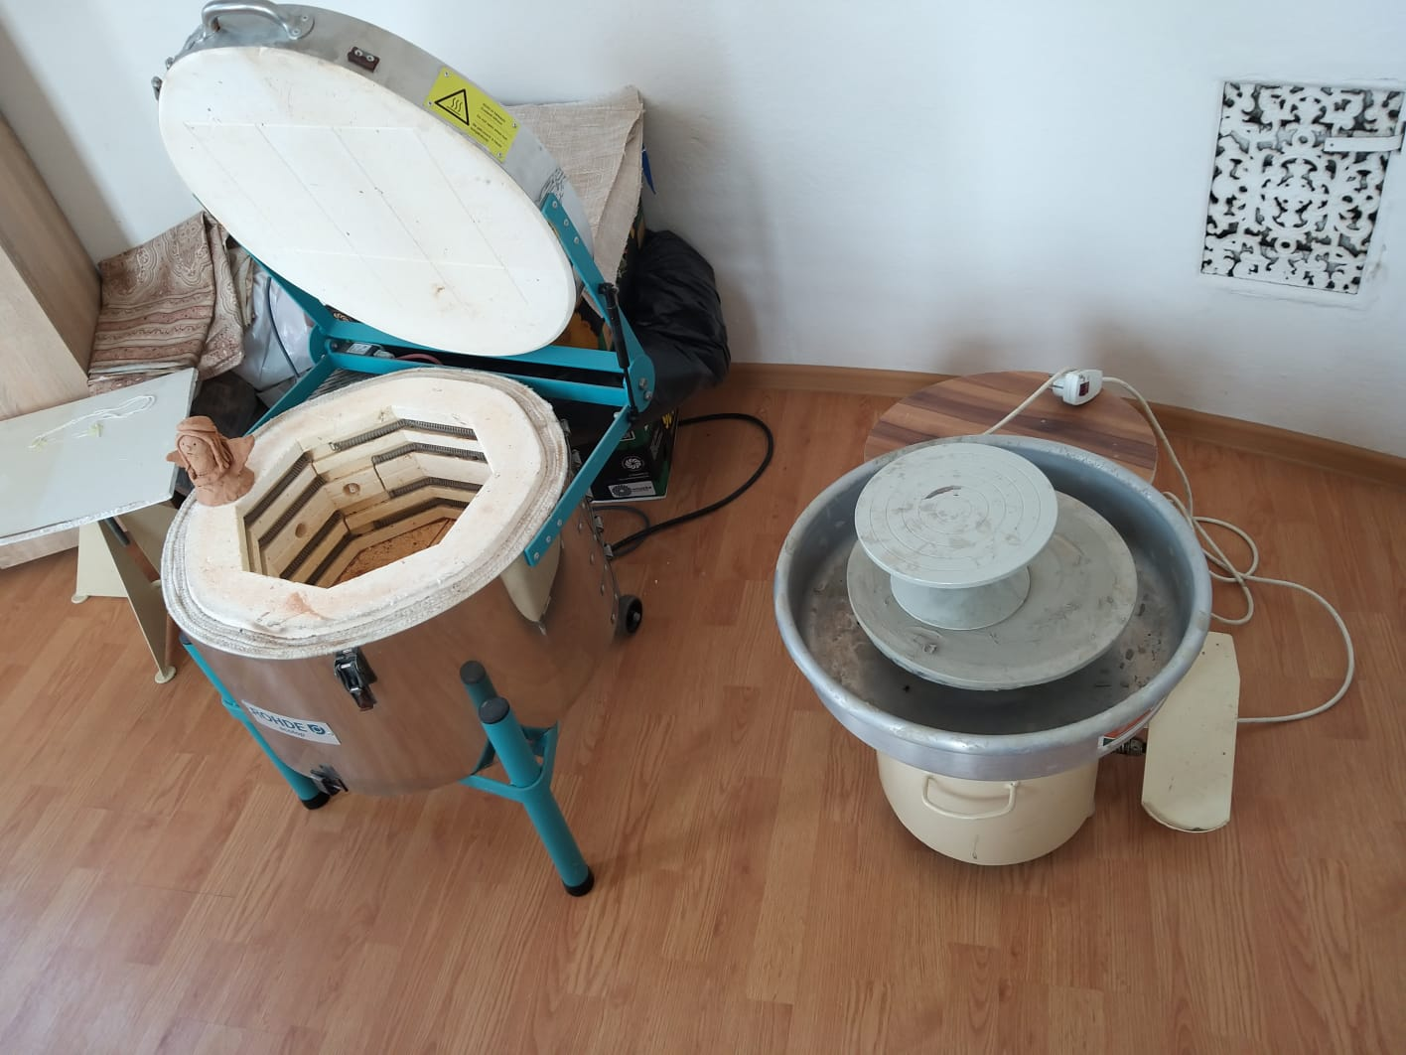
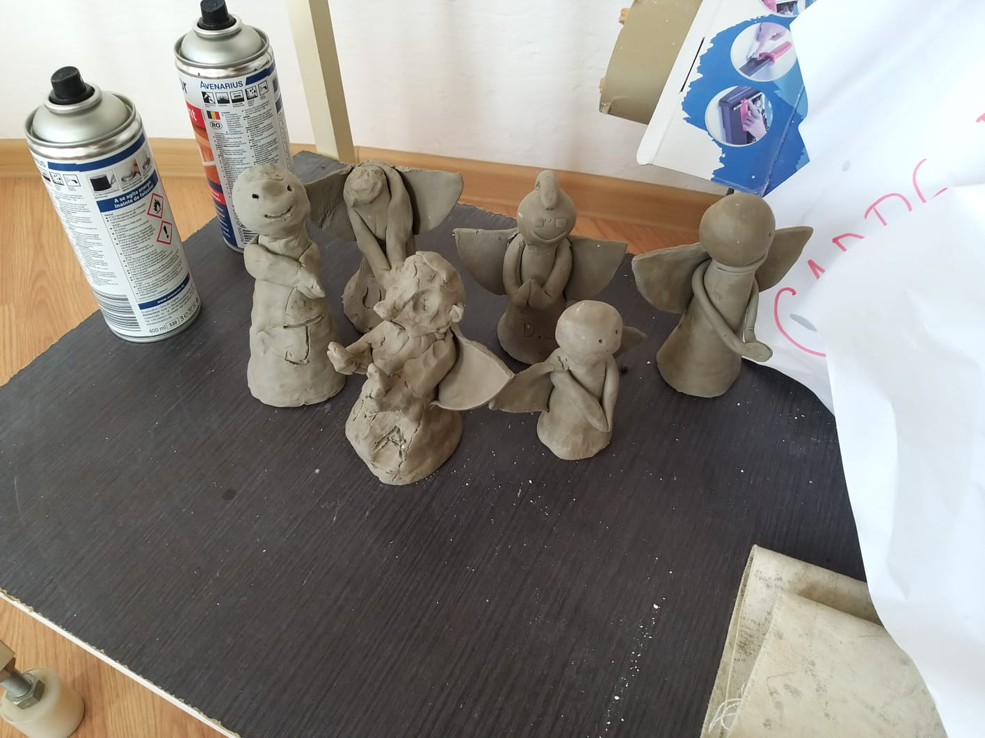
The production
Step by step we did all the preparation work, so we started the actual work, the production part.
As you can see, we also had a lot of fun.

Slide 12
The budget
 | The price to make one item | The price to sell each item | The profit for one item
1 clay badge | 2 RON | 5 RON | 3 RON
1 clay angel | 2 RON | 5 RON | 3 RON
1 clay pot | 5 RON | 15 RON | 10 RON
1 clay mug | 4 RON | 10 RON | 6 RON

Slide 13
The budget
 | The total cost of production for each product | The total amount on selling | The total profit for each product
1 clay badge | 100X2=200 RON | 100X5=500 RON | 100X3=300 RON
1 clay angel | 100X2=200 RON | 100X5=500 RON | 100X3=300 RON
1 clay pot | 100X5=500 RON | 100X15=1500 RON | 100X10=1000 RON
1 clay mug | 100X4=400 RON | 100X10=1000 RON | 100X6=600 RON
TOTAL | 1300 RON | 3500 RON | 2200 RON
The total cost of production: 1300 RON
The total amount on selling: 3500 RON
The total profit: 2200 RON

Slide 14
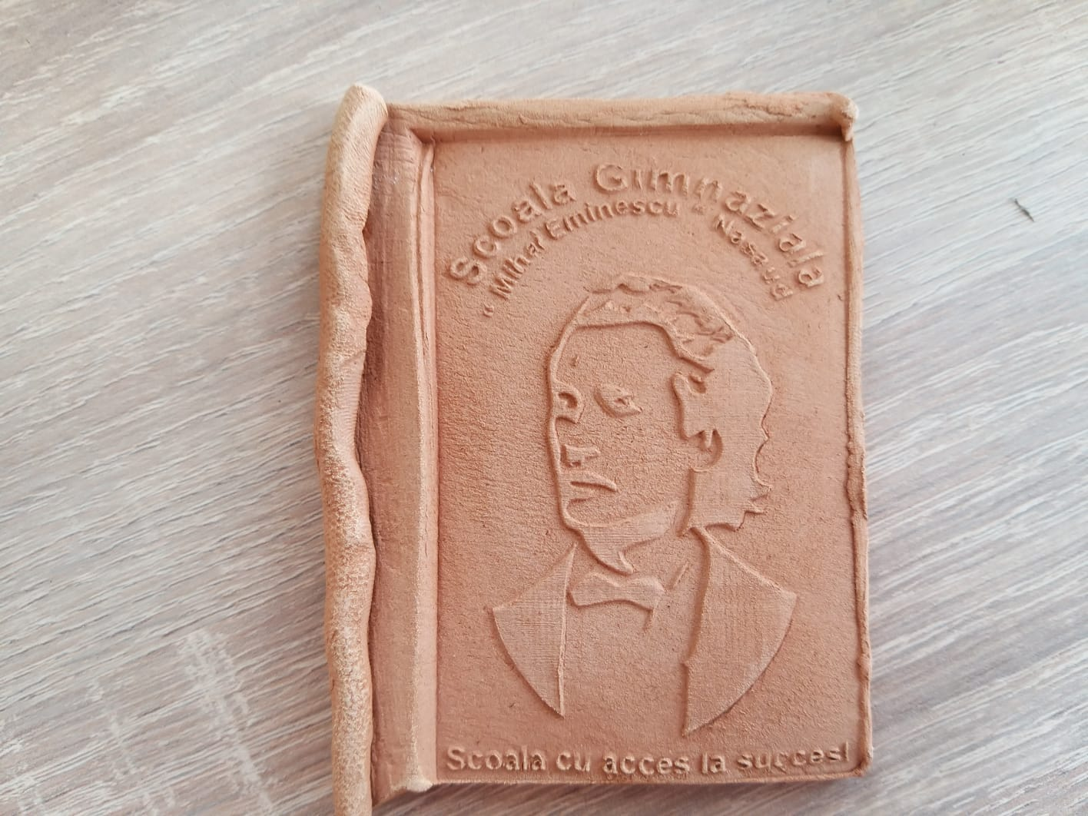
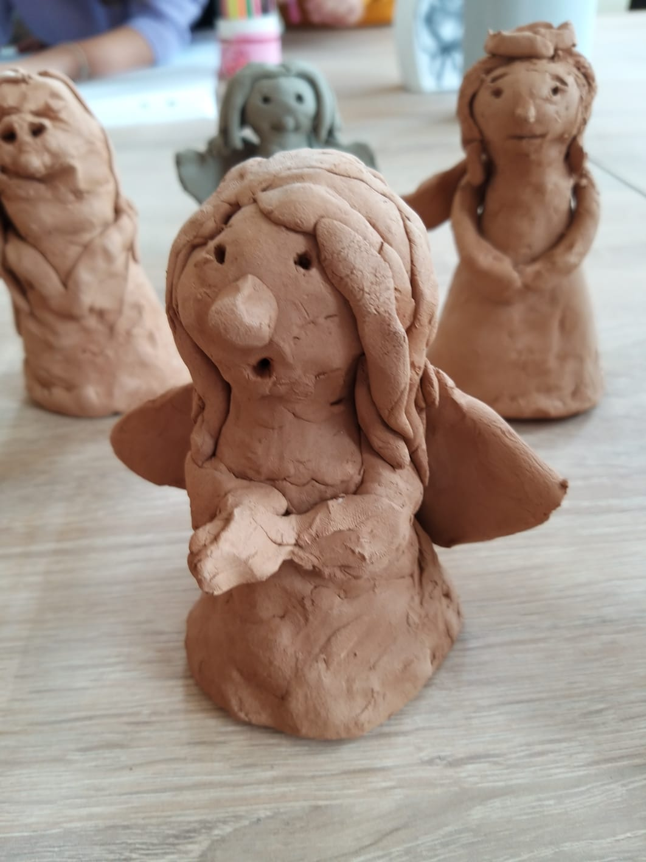
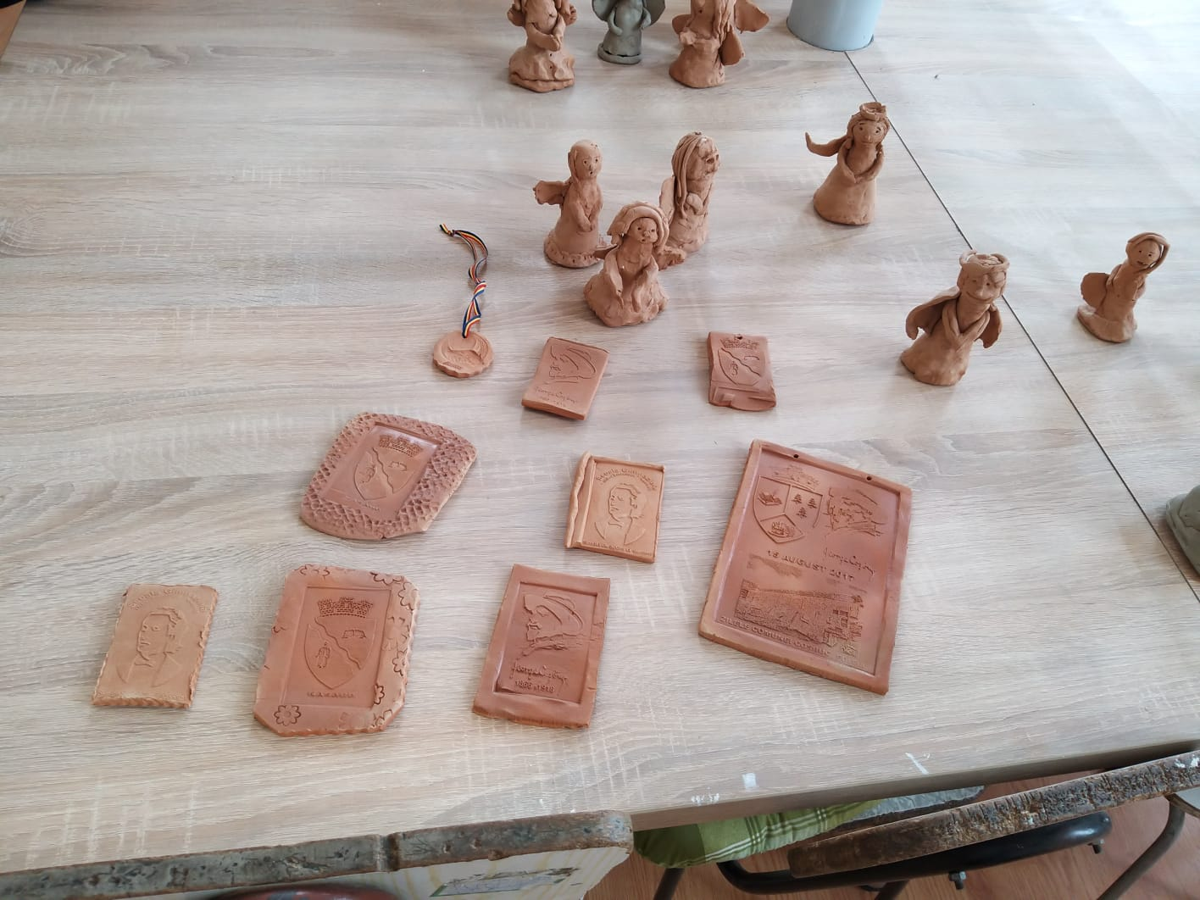
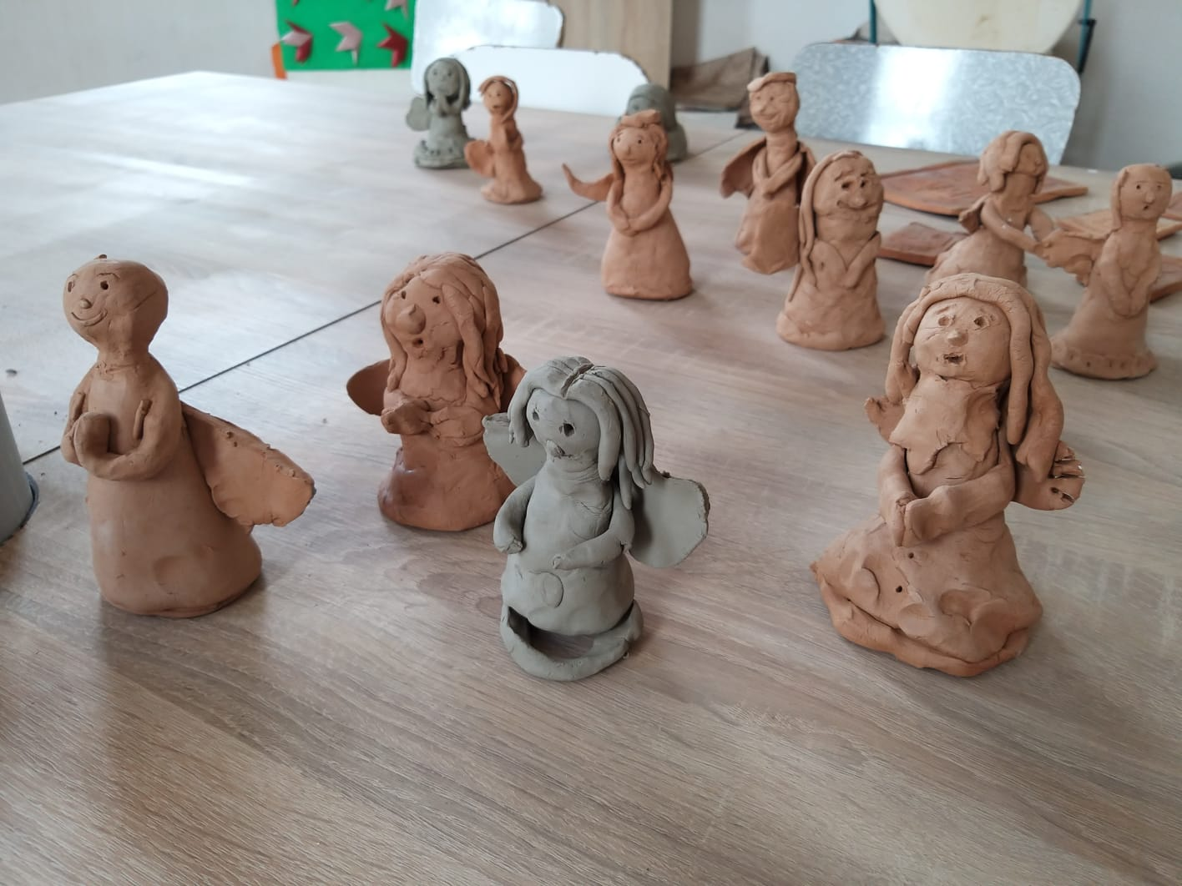
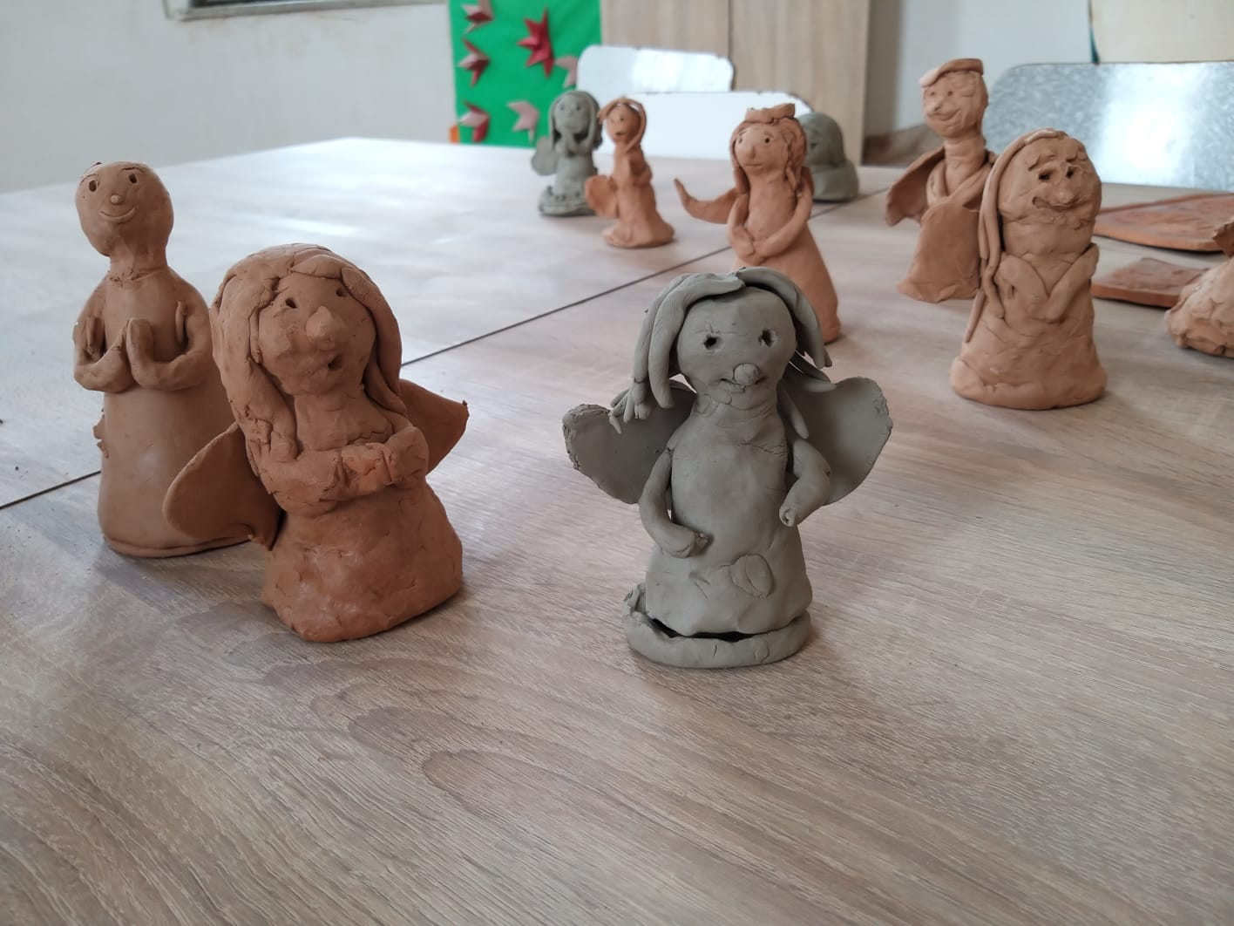
The final product

Slide 15
Quick quiz
Which part do you think was the most interesting one?
Which is the most important thing when preparing a business?
Do you think that the final product is something you would buy if you had the chance?
Start!

Slide 16
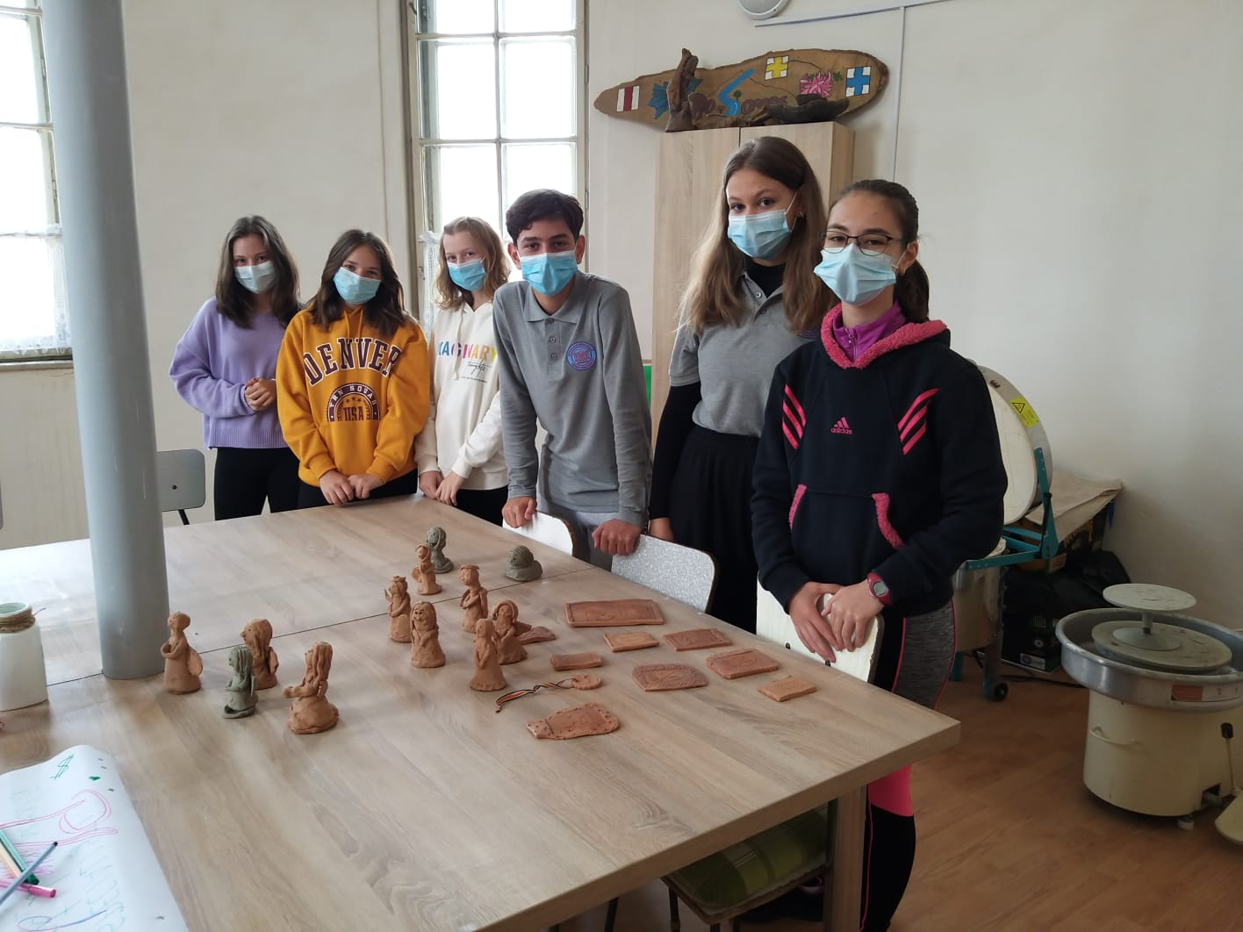
Do you have any questions?
Thank you!

Slide 17
2019-2021
Notes:
<number>

