Slide 1
Historical facts and personalities of Vila nova de famalicão
Work done by: Maria joão costa azevedo

Slide 2
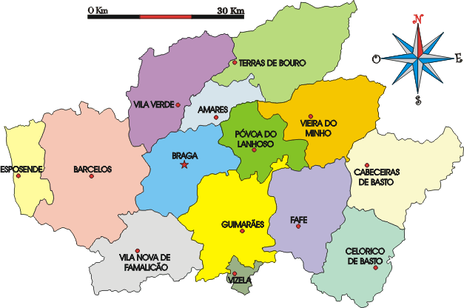
Where is Vila Nova de Famalicão?

Slide 3
Location of Portugal in europe

Slide 4
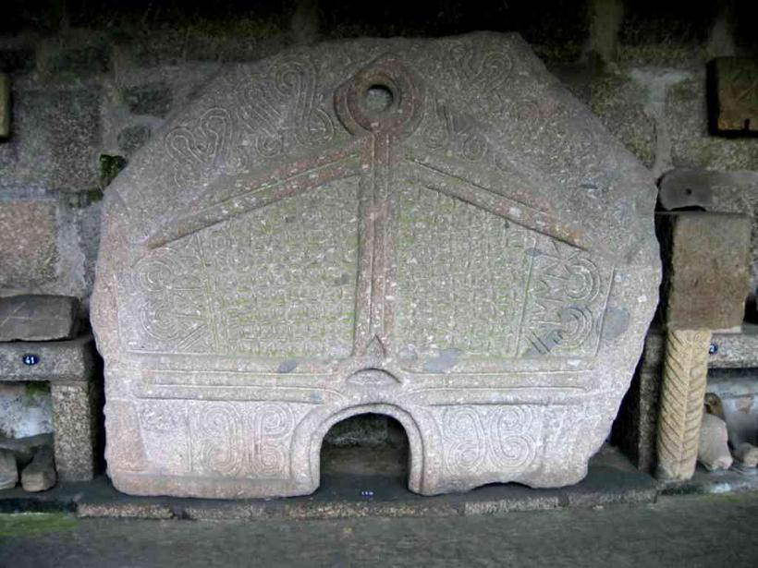
Historical facts

Slide 5
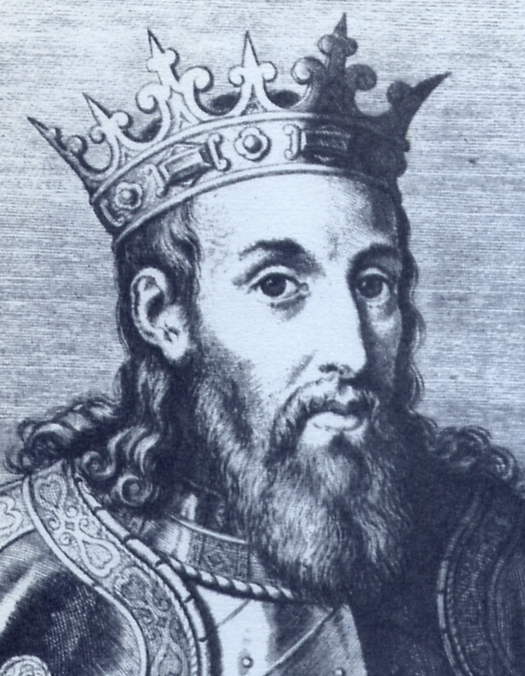
The Charter of the Provincial Council of 1205

Slide 6
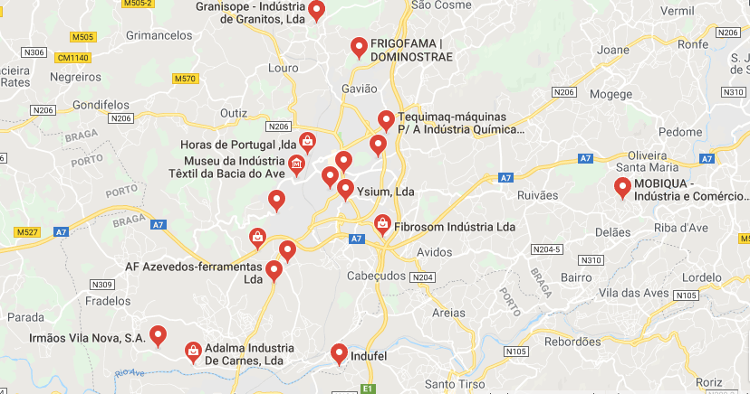
Cultural and industrial center
INDUSTRY:

Slide 11
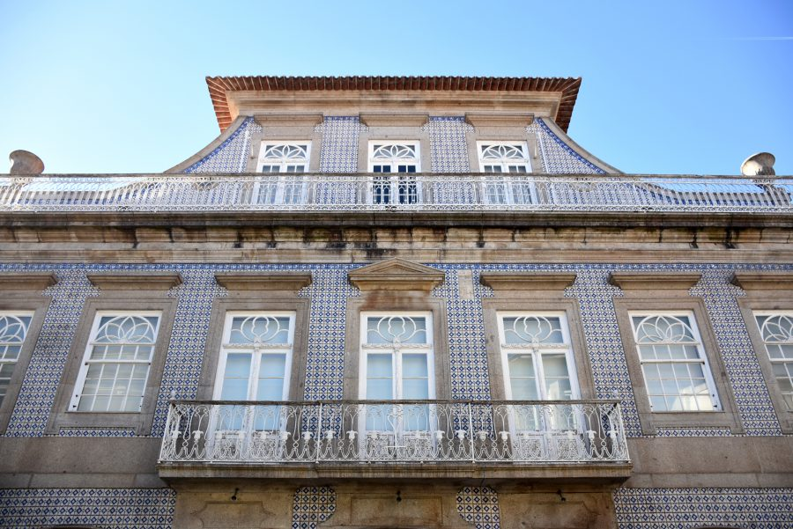
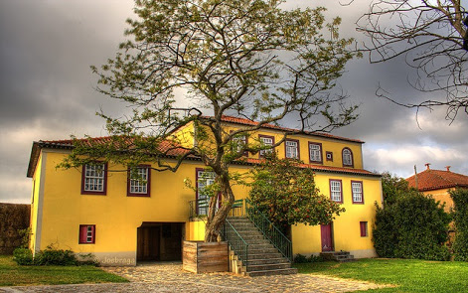
Cultural and industrial center
CULTURE:
Bernardino Machado Museum
House Museum of Camilo Castelo Branco

Slide 12
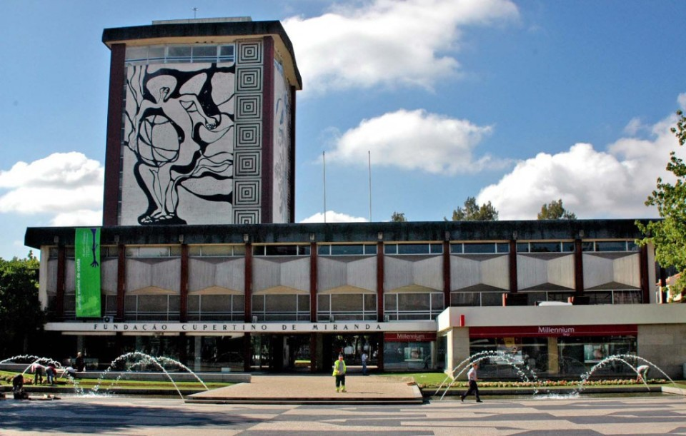
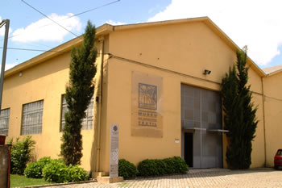
Cultural and industrial center
Cupertino de Miranda Foundation
Textile Industry Museum

Slide 13
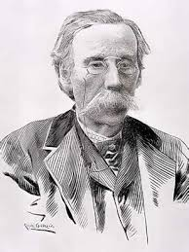
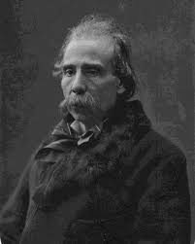
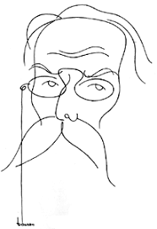
Personalities
CAMILO CASTELO BRANCO

Slide 15
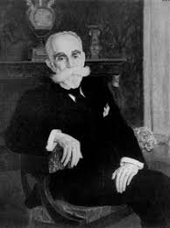
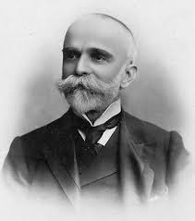
Bernardino machado

Slide 16
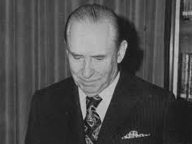
Cupertino de miranda

Slide 17
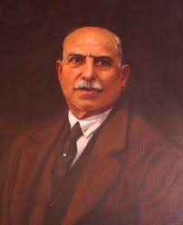
Narciso ferreira

Slide 18
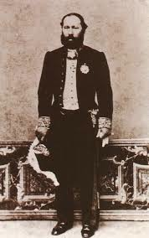
Barão da trovisqueira

Slide 19
I hope you enjoyed !!!

