Slide 1
Odysseus and Polyphemus

Slide 2
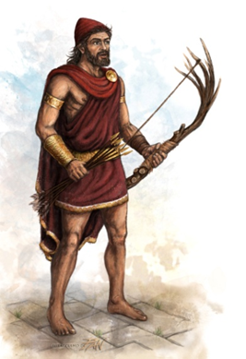
1. The Odissey is the story about how Odysseus, a very brave warrior and king of Ithaca, and his men returned home after 9 years in the Trojan war.

Slide 3
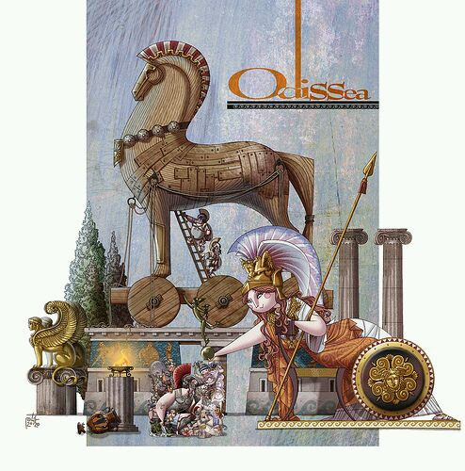
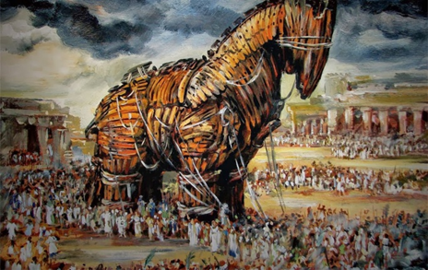
2. They had managed to destroy the fabulous city of Troy thanks to a trick. Odysseus had come up with the idea of hiding into a huge wooden horse and sneaking in this way into the city of Troy. This led to the destruction of Troy.

Slide 4
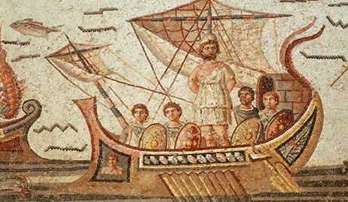
3. While sailing home from the Trojan War, Odysseus and 12 of his men reached an Island.

Slide 5
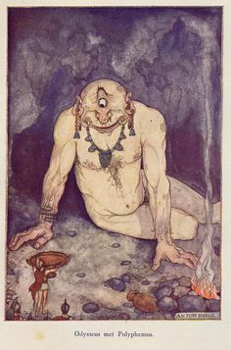
On the Island they found a cave with baskets of food in it. The cave belonged to a Cyclops: the one-eyed giant Polyphemus. He asked: “And who might you be?”
The Cyclops trapped the men in
the cave with a large rock.

Slide 6
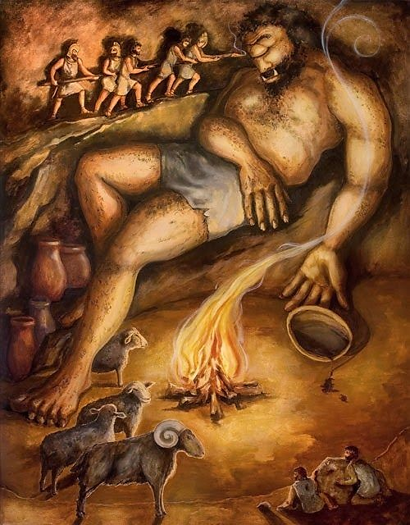
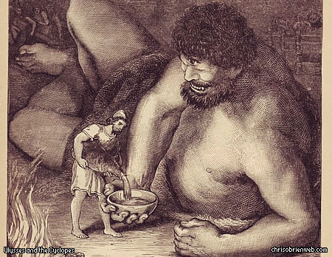
5. Odysseus gave him a strong drink to make him good sleep. Polyphemus asked: “Tell me little man, what’s your name?” “My name is Nobody” said Odysseus.

Slide 7
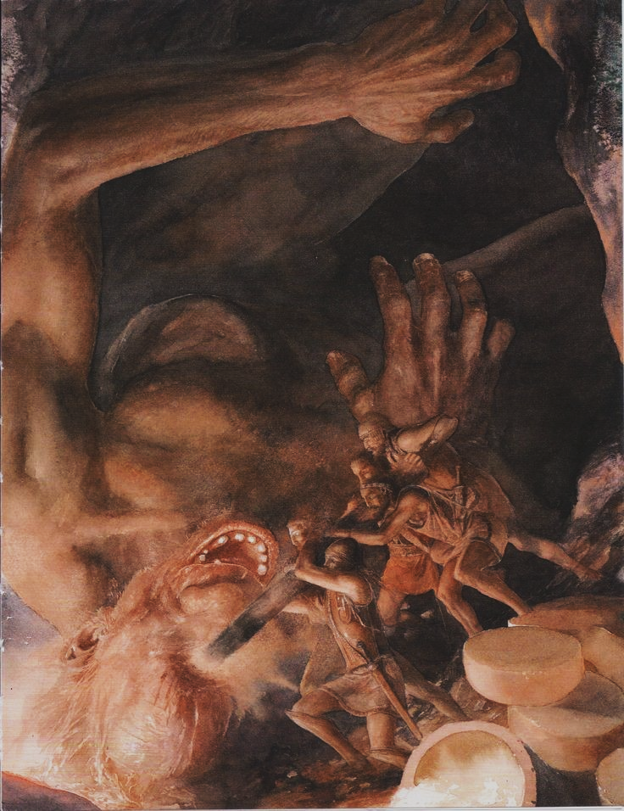
6. When the Cyclops fall asleep, Odysseus and his men blinded him with a pointed stick.

Slide 8
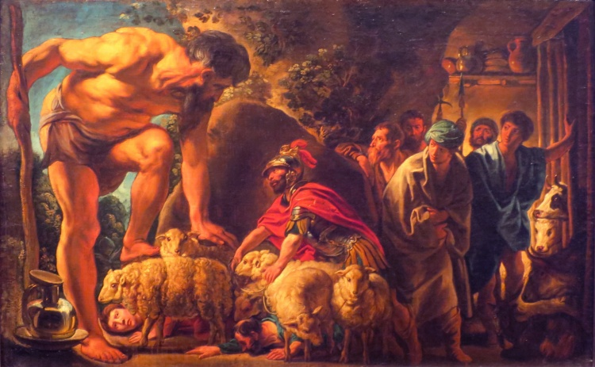
7. In the morning the Cyclops let his sheep out of the cave to graze. He felt the tops of the sheep to make sure that none of the men got out. He didn’t know that Odysseus and his men were escaping by tiding themselves to the bottom of the sheep. They run to the beach and left the Island in their ship.

Slide 9
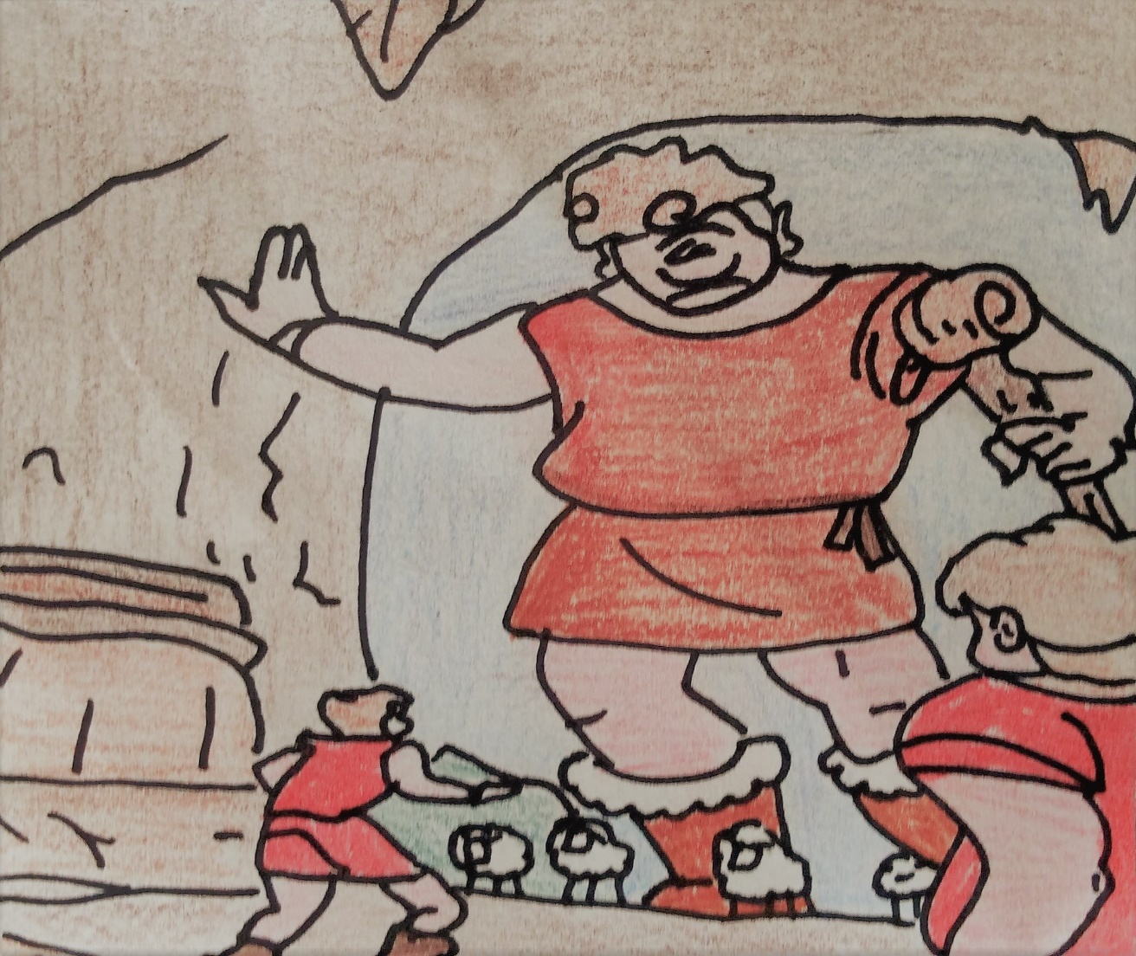
8. When the Cyclops found out that the men had escaped, he began screaming: “Nobody has blinded me in my one eye, and now Nobody is escaping across the sea!”

Slide 10
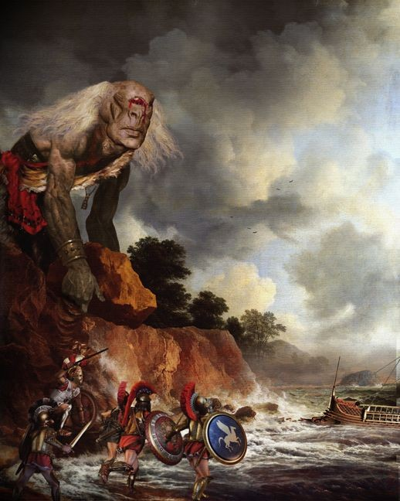
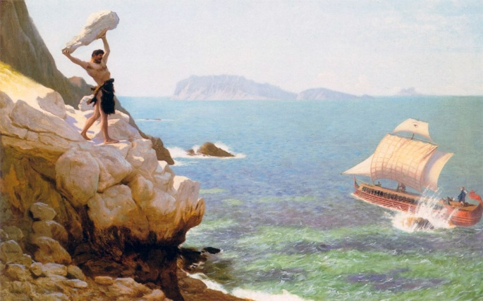
9. He threw a rock at their ship but he missed. The massive rocks thrown by Polyphemus at Odysseus’ ships can be seen nowadays in the province of Catania. The suggestive “Faraglioni” are of volcanic origin and add charm to the beautiful natural reserve of Acitrezza.

Slide 11
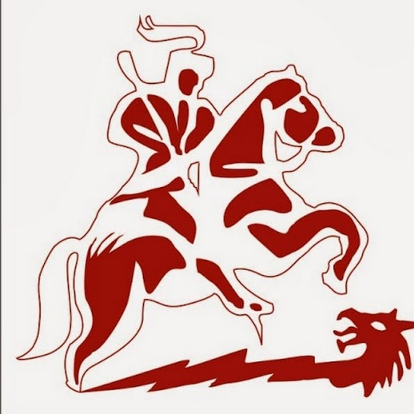
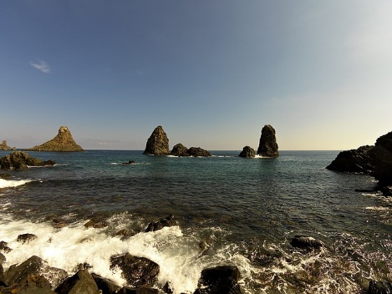
Istituto comprensivo San Giorgio
2018-2020
Acitrezza
Catania
By Salvo Marchese, Morena Alì, Francesco Bonaccorsi

