Slide 1
ENTRETAINMENT'S FACILITIES
IN MURCIA

Slide 2
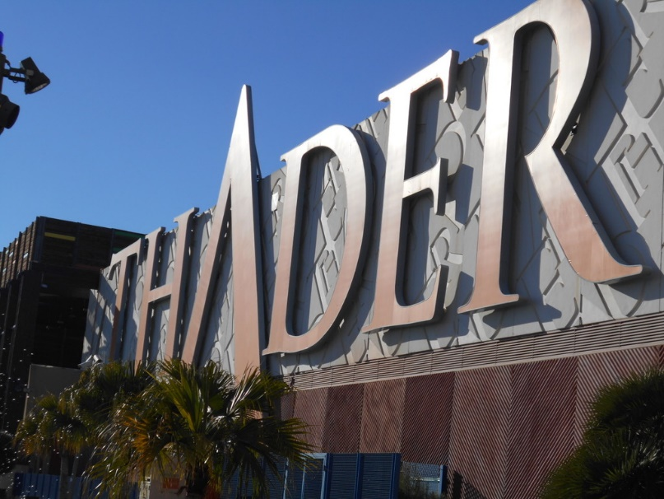
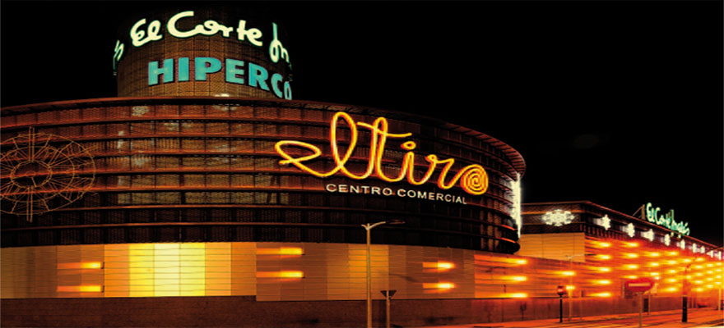
There are a lot of different recourses for entretaiment in Murcia
for example we have…
Shopping centers as ‘New condomina’, ‘thader’ or ‘the Tiro’

Slide 3
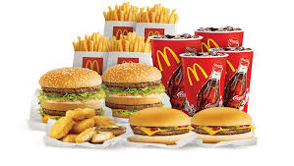
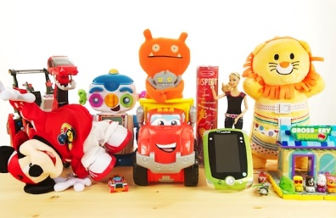
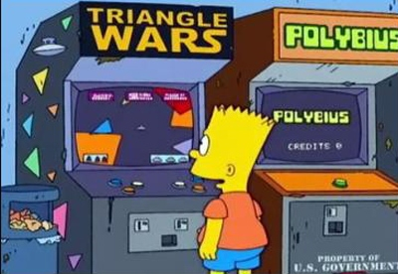
In these shopping centers we have different shops like:
Clothes shops, supermarkets, RESTAURANTS, cinemas, games shops, sport shops, toy shops and a lot of things more.
In some of them there are play centers, where there are play machines, bowlings, VIDEOGAMES…

Slide 4
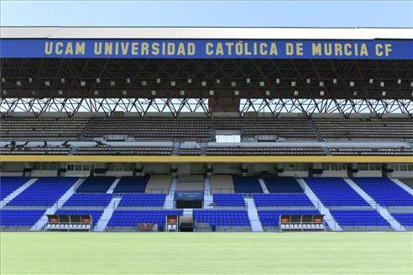
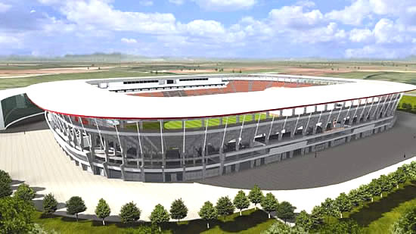
In Murcia there are two important football stadiumS:
New condomina, where real Murcia football team plays
‘the old condomina, where ucam football team plays

Slide 5
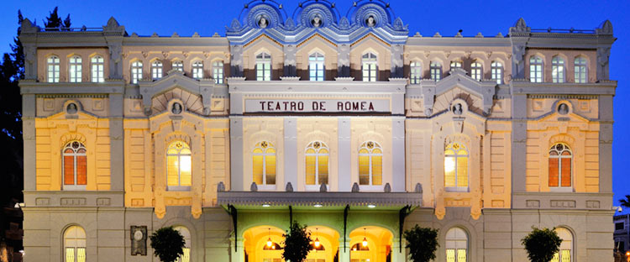
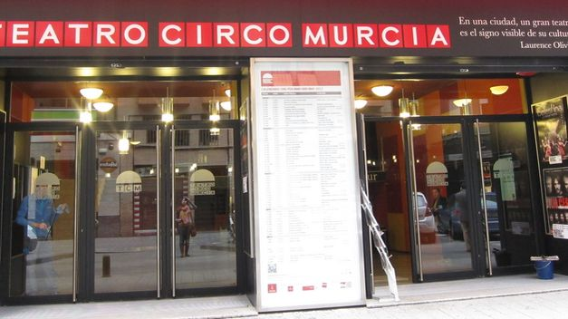
There are two theatres in capital murcia, too
Romea’s theatre
Circus’ theatre

Slide 6
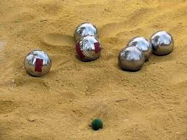
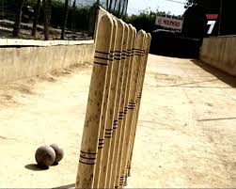
Typical GAMES in Murcia:
Bolos huertanos
petanca
In Murcia many people play these games, but we never have the opportuynity to learn. It looks funny.

Slide 7
Murcia has a tv channel:
‘7 región de Murcia’.
We can find it in seven channel.
The most famous programs presenter is Antonio Hidalgo.

Slide 8
THANK YOU FOR YOUR ATTENTION!

Slide 9
By Pérez beviar, pedro Antonio & Marín Murcia, alejandro
5º a

