Slide 1
GASTRONOMY

Slide 2
DESCRIPTION
THIS IS THE HAM SPANISH
The ham serrano skip of the pig.
A serrano ham comes from a pig that is not of the iberico breed,and it's quality and health benefits are very inferior[...] to that of the iberico jamon,which is that which comes from an iberian pig.
Spanish serrano ham is one of the most typical products of Spanish cuisine.
The ham is cured with salt and dried in the mountain between six and nine months.

Slide 3
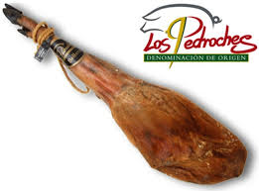
HAM

Slide 4
DESCRIPTION
NAME : THIS IS AN OMELETTE
INGREDIENTS: YOU NEED
SIX EGGS AND SEVEN POTATOES
RECIPE: IS SOURENCE…

Slide 5
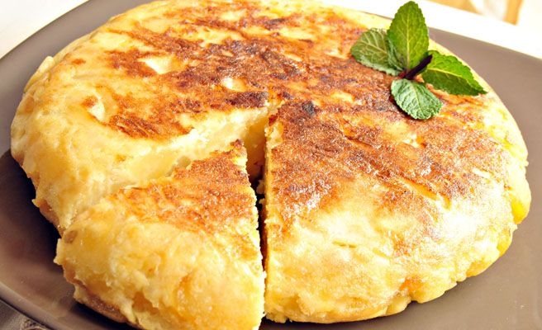
omelette

Slide 6
DESCRIPTION
NAME : THIS IS A murciaN salad
INGREDIENTS : YOU NEED
TOMATO
ONION
OIL
BLACK OLIVES
SALT
EGGS
TUNA

Slide 7
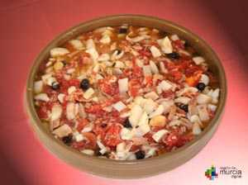
MURCIANA SALAD

Slide 8
I LOVE IT ! IT IS MY FAVOURITE !

