Slide 1
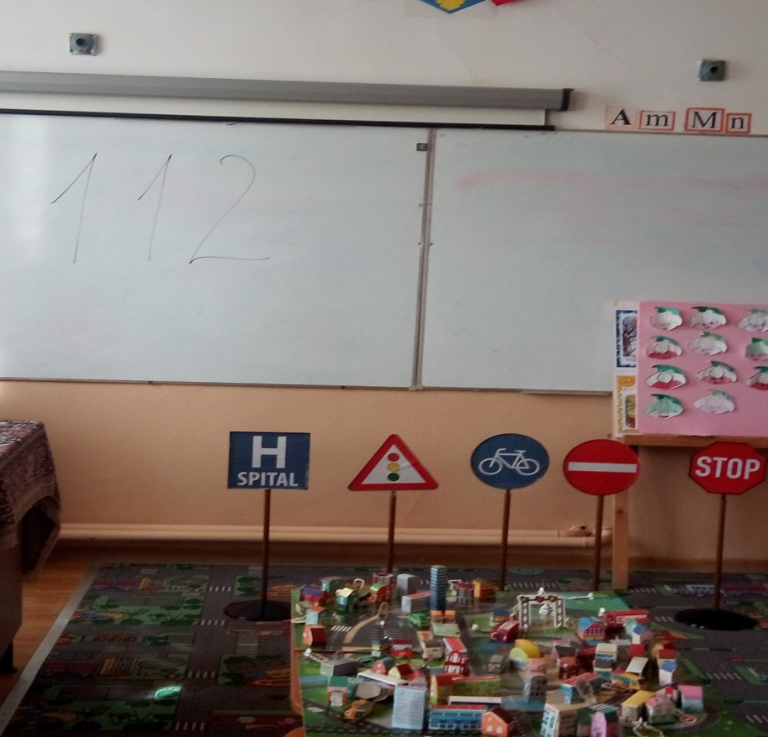
We learn about traffic signs
class I
Teacher Ratoi Larisa-Ioana

Slide 2
making a mock-up of the city

Slide 3
Traffic sign

