Slide 1
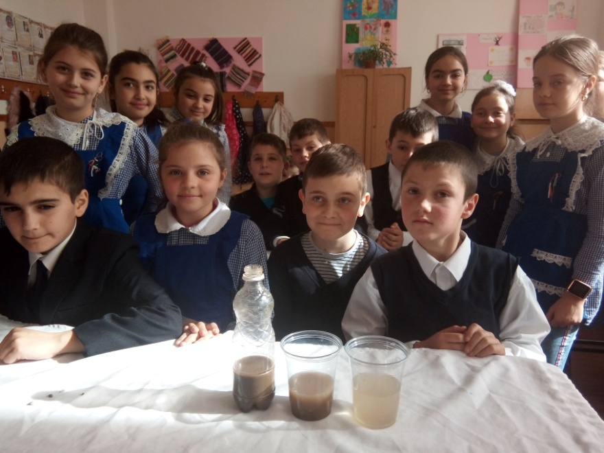
FILTERING WATER
Experiment activity
CLASA A IV-A
DISCIPLINE: science
Inv. Brahas Magda

Slide 2
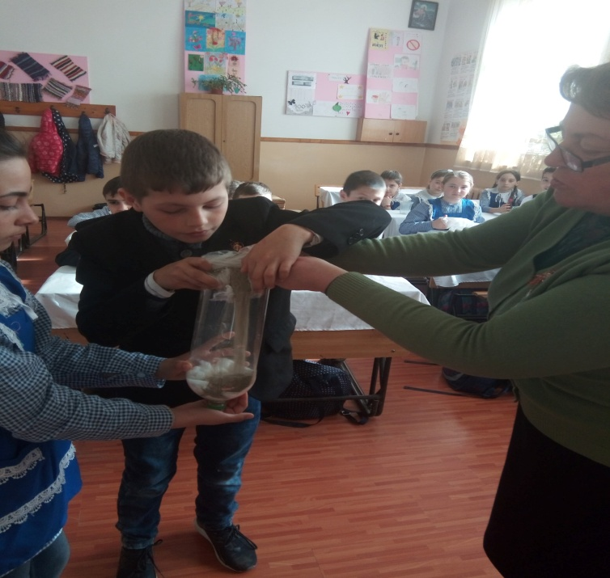
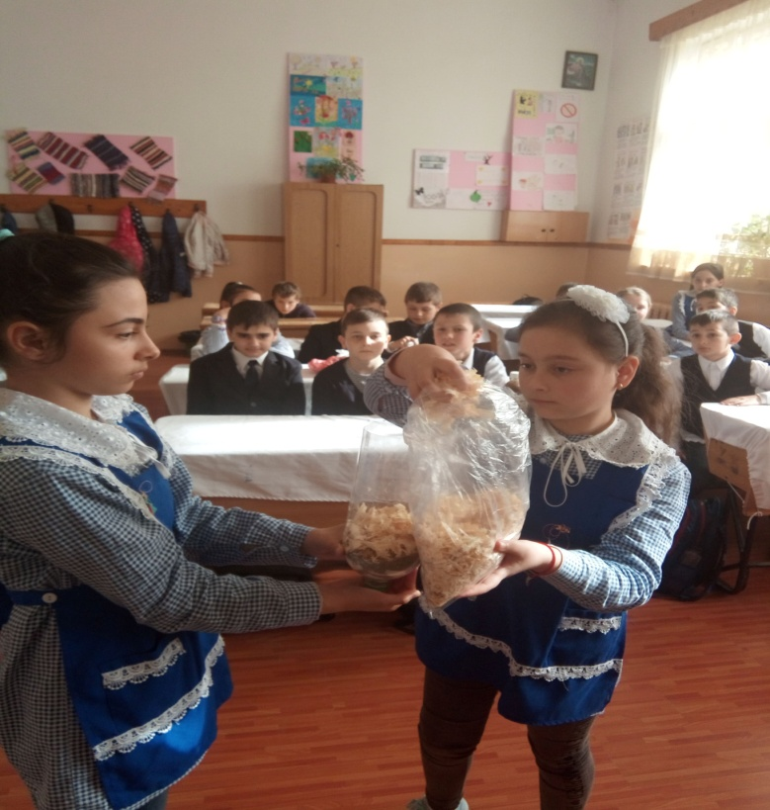
MATERIALS REQUIRED FOR THE EXPERIMENT
GRAVEL
SAND
BAND AID
SAWDUST
COTTON
WATER MIXED WITH SAND

Slide 3
