Slide 1
Traveling in Europe
MICII CERCETĂTORI AI ȘCOLII GIMNAZIALE LUNCA PAȘCANI
ROMÂNIA

Slide 2
Traveling in Europe

Slide 3
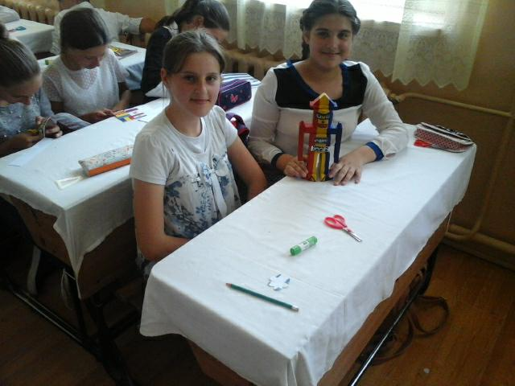
OUR FRIEND ROBO

Slide 4
TECHNIQUE AND CREATION

Slide 5
Practice and understanding

Slide 6
PUZZLE

Slide 7
RESEARCH AND DISCOVERY

Slide 8
HARMONY AND COLLABORATION

Slide 9
Association and application

Slide 10
Association and application

Slide 11
We are a team

