Slide 1
Little scientists building and design Europe. Game - Tool Sharing
Every country thought about an object which was sent to the partners to answer to the established questions

Slide 2
The object proposed by The Netherlands

Slide 3
The students’ answers to the partners’questions
What is it and what do they use it for?
What other uses can it have?
Which machine has replaced this tool?
This tool is a holder for soap, golf balls, mug, pencil glass, tea kettle, candy. This support can also be used to hold a sponge, flower, to cool the boiled egg, to put the salad. There is no machine to replace this tool.

Slide 4
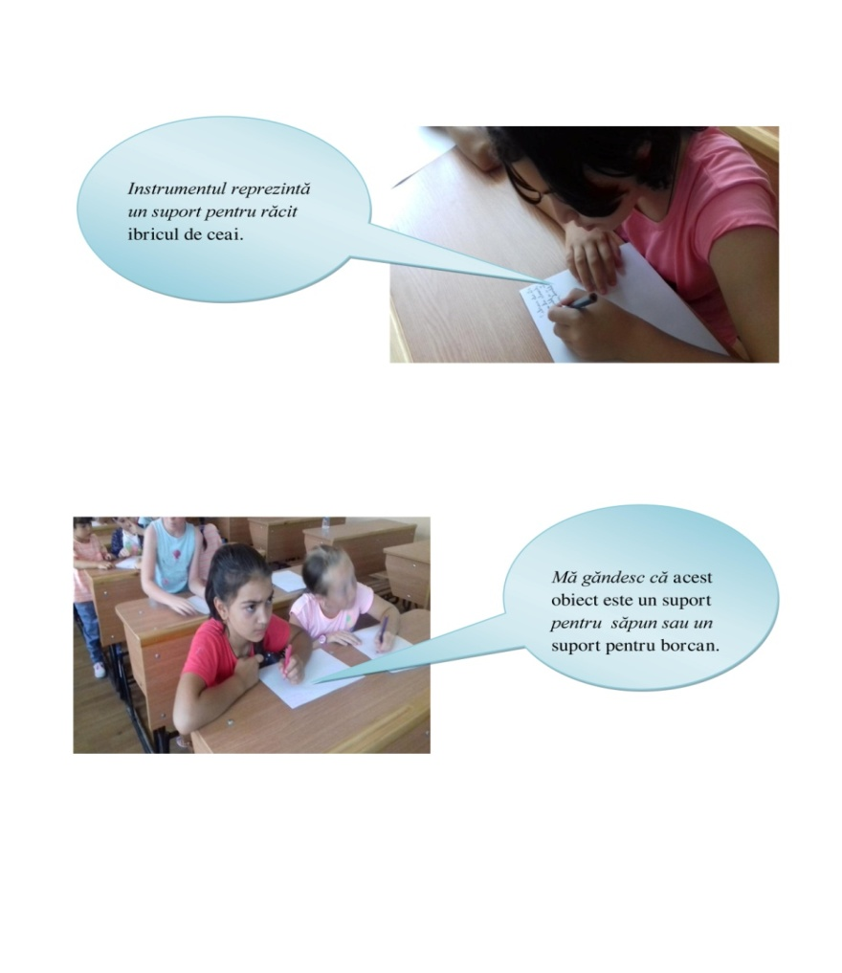
Pictures with the students and their answers in Romanian

Slide 5
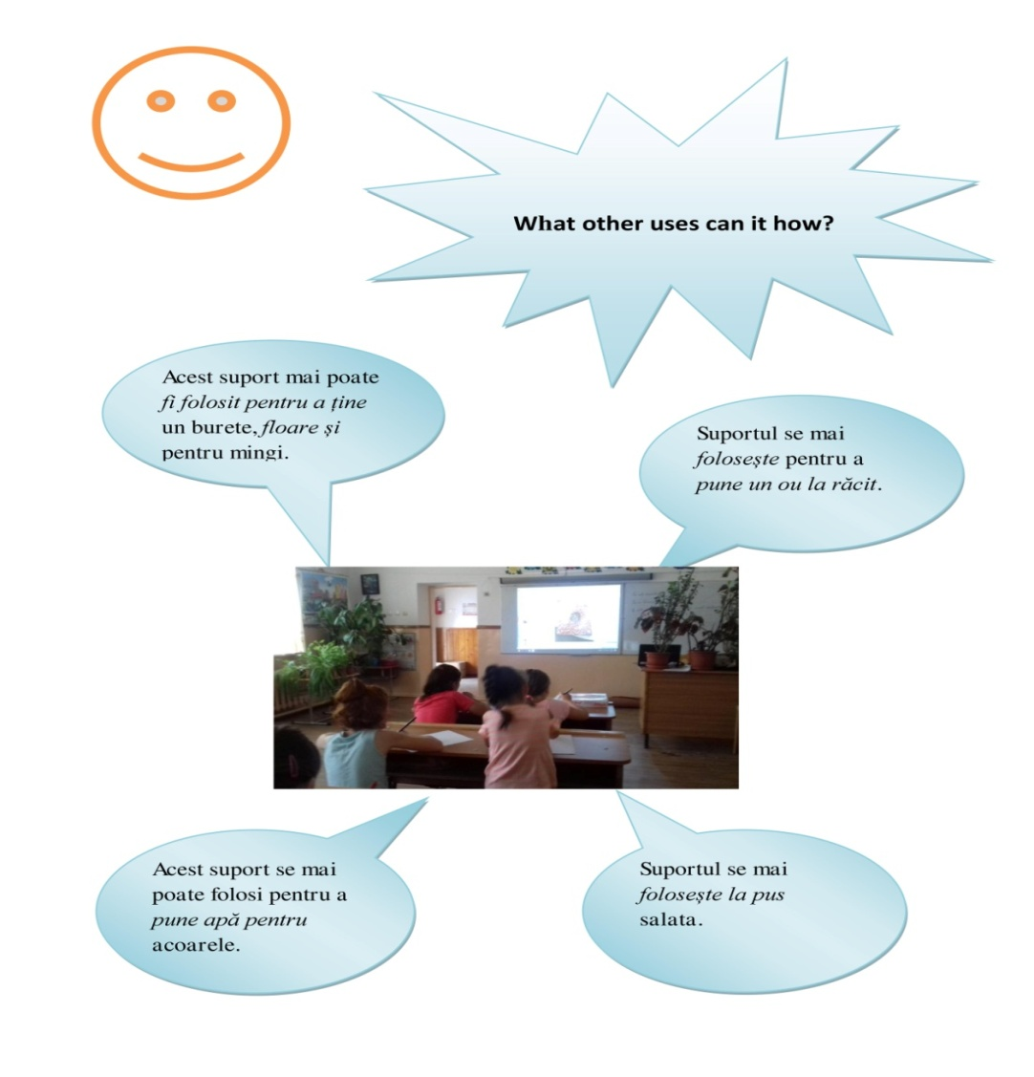
Pictures with the students and their answers in Romanian

Slide 6
Pictures with the students and their answers in Romanian

Slide 7
The object proposed by Lithuania

Slide 8
The students’answers to the partners’questions
What is it and what do they use it for?
What other uses can it have?
Which machine has replaced this tool?
This support can be used to crush the nuts, to staple a jar lid, to open the jar lid. This tool can also be used to make soap balloons and to screw on the lid or screw. This tool can be replaced with a machine for threading / parade covers or a machine for peeling nuts or other fruits.

Slide 9
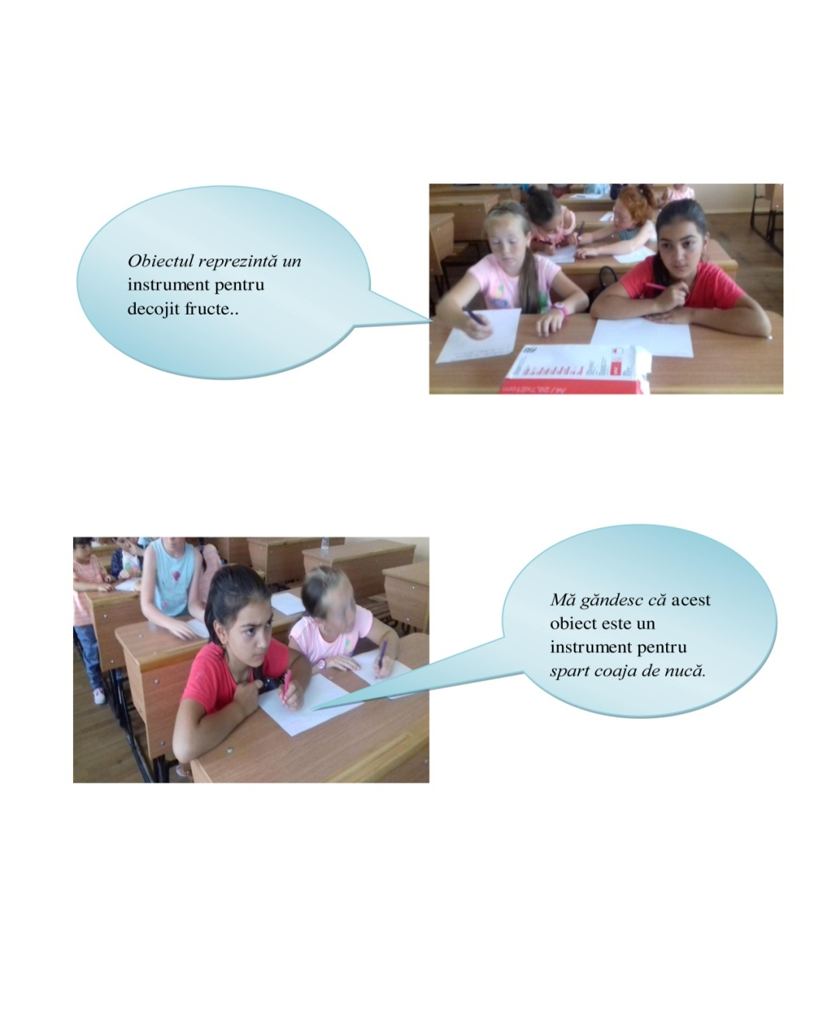
Pictures with the students and their answers in Romanian

Slide 10
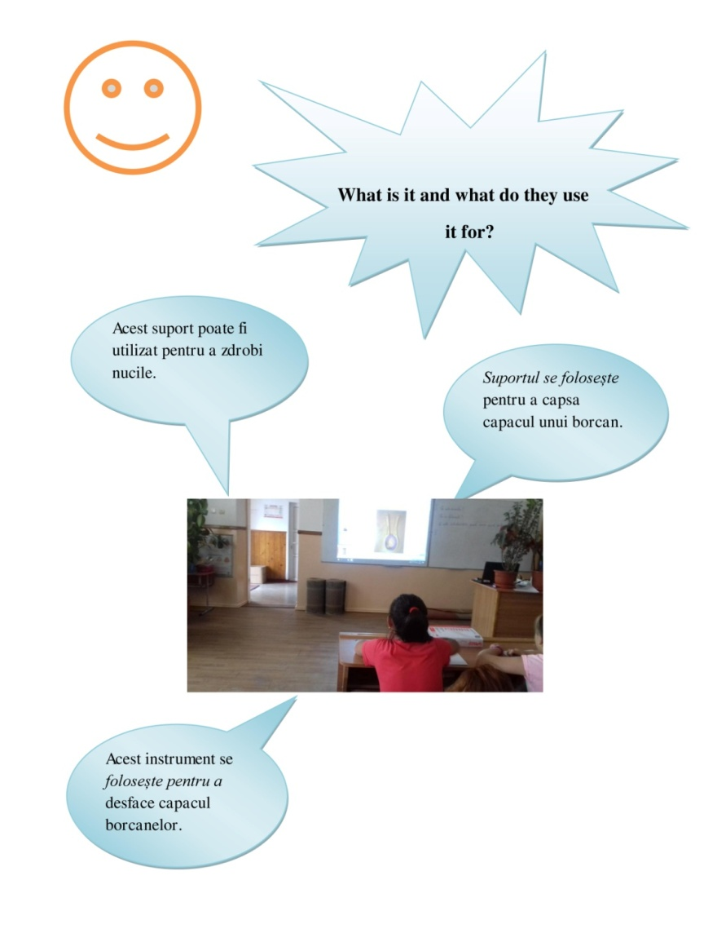
Pictures with the students and their answers in Romanian

Slide 11
Pictures with the students and their answers in Romanian

Slide 12
The object proposed by Italy

Slide 13
The students’answers to the partners’questions
What is it and what do they use it for?
What other uses can it have?
Which machine has replaced this tool?

Slide 14
pictures

Slide 16
The object proposed by Sweden

Slide 17
The students’answers to the partners’questions
What is it and what do they use it for?
What other uses can it have?
Which machine has replaced this tool?
The object represents a tool for undoing cork plugs, a support for a thread, a hanger. This tool can also be used to hold the kite and as a key holder. There is no machine to replace this bracket

Slide 18
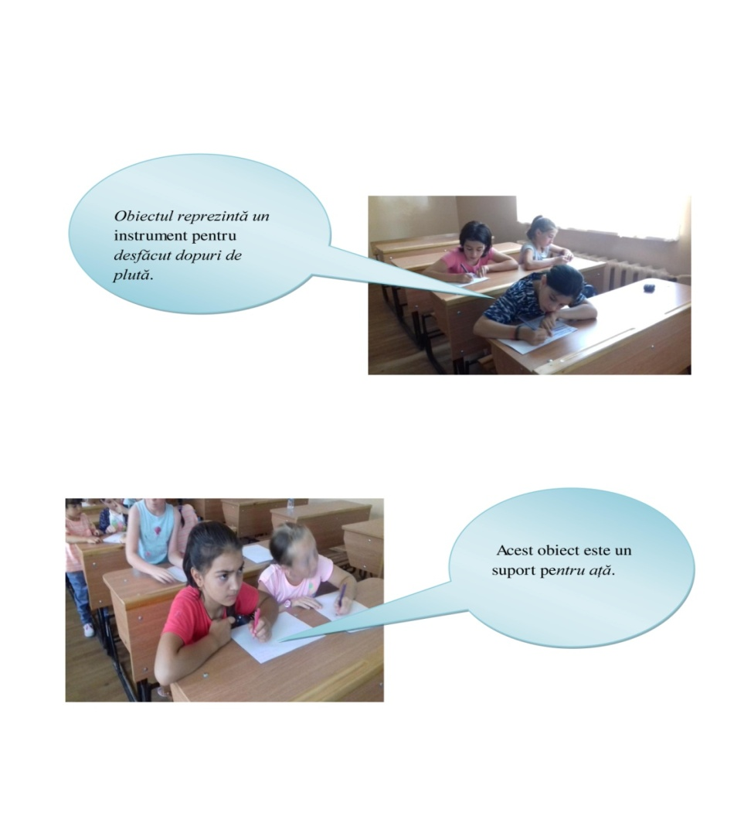
Pictures with the students and their answers in Romanian

Slide 19
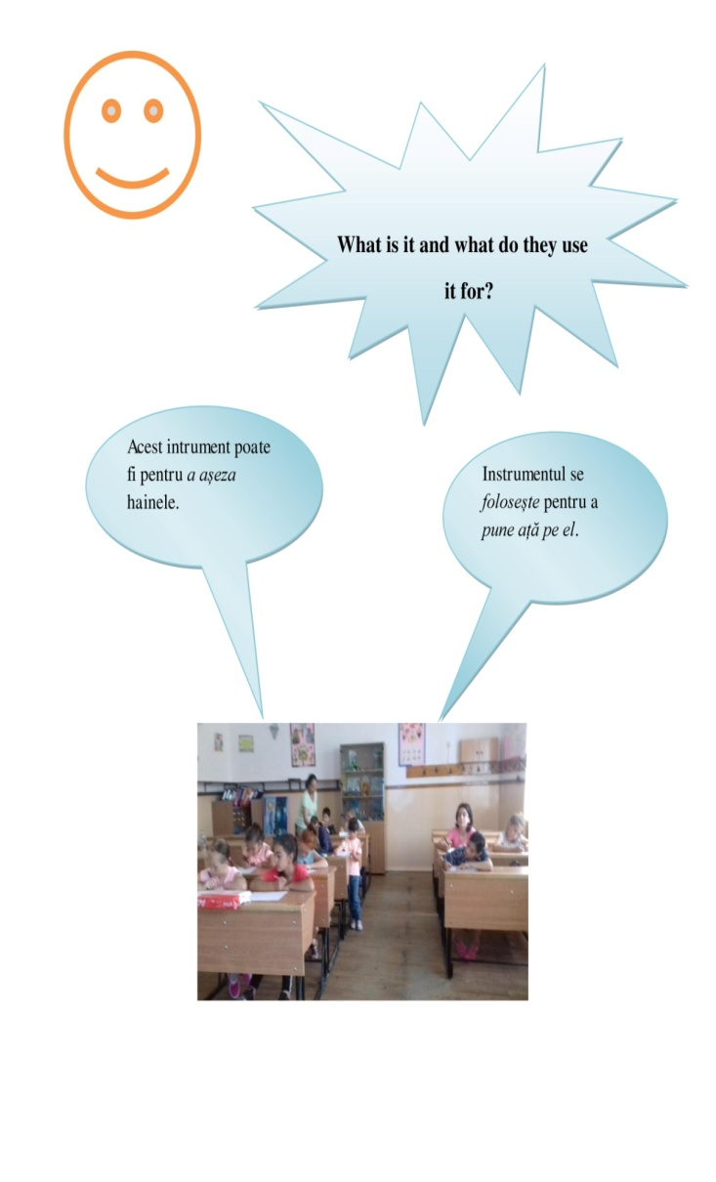
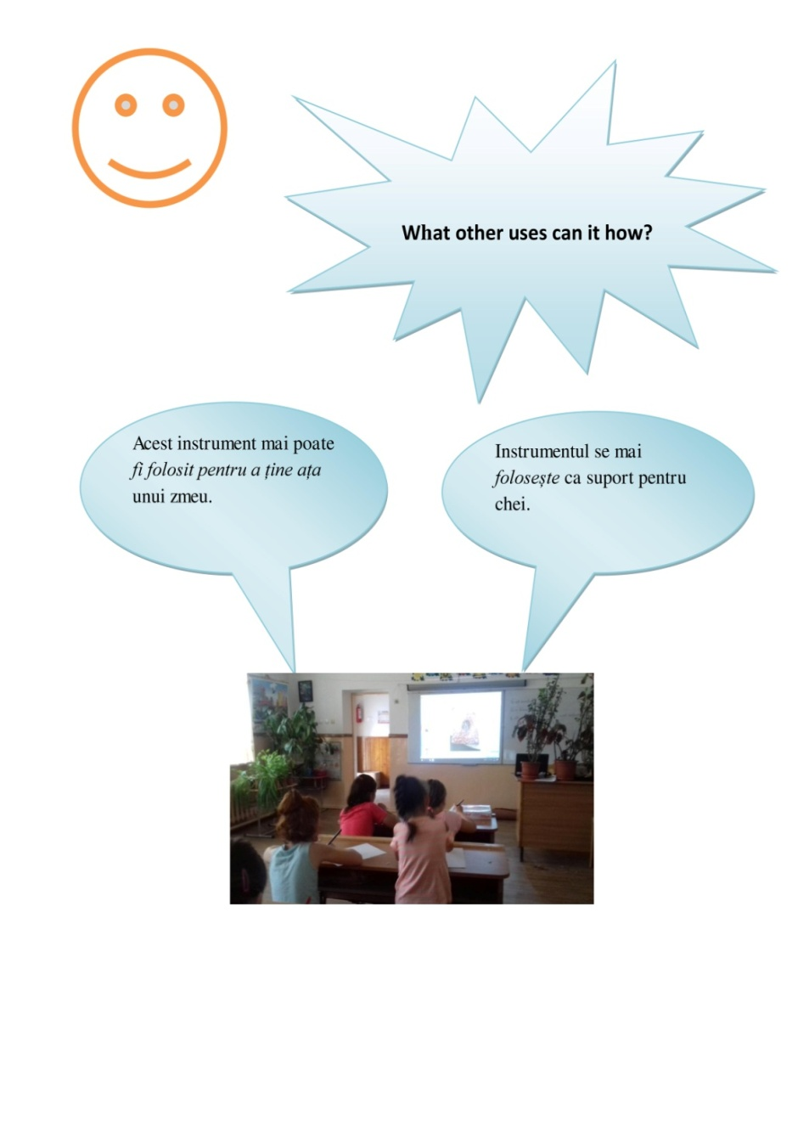
Pictures with the students and their answers in Romanian

Slide 20
Pictures with the students and their answers in Romanian

Slide 21
The object proposed by Greece

Slide 22
The students’answers to the partners’questions
What is it and what do they use it for?
What other uses can it have?
Which machine has replaced this tool?
This instrument is used for cleaning carrots and other vegetables. This tool can also be used to sharpen pencils and cleaned apples, potatoes. The instrument can be replaced with a kitchen robot or an electric vegetable washer.

Slide 23
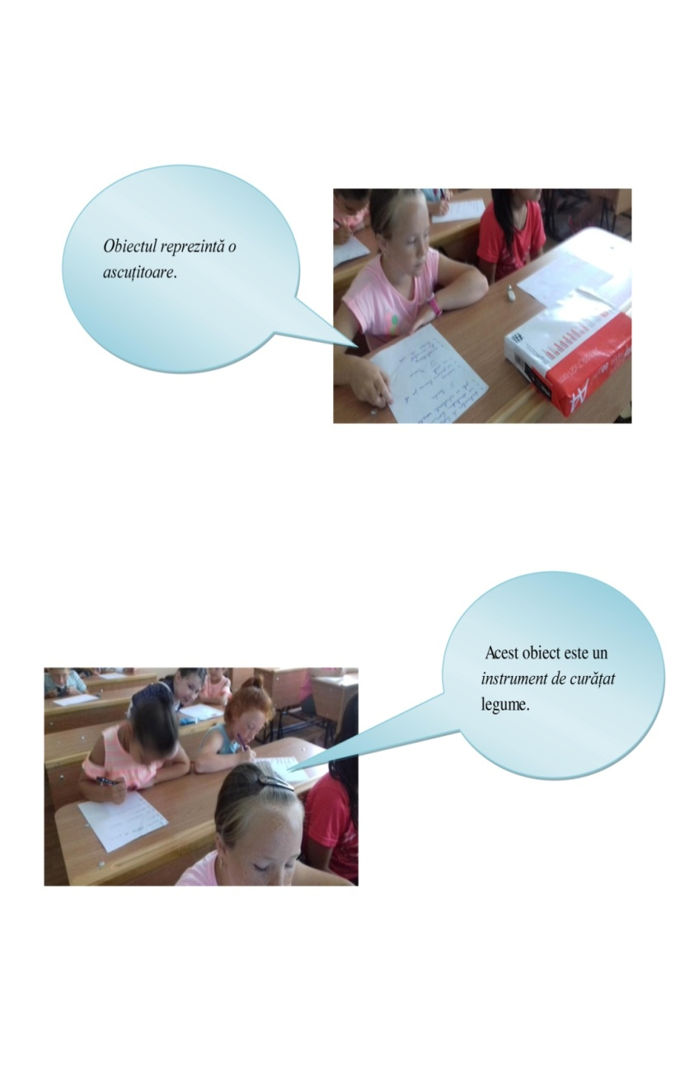
Pictures with the students and their answers in Romanian

Slide 24
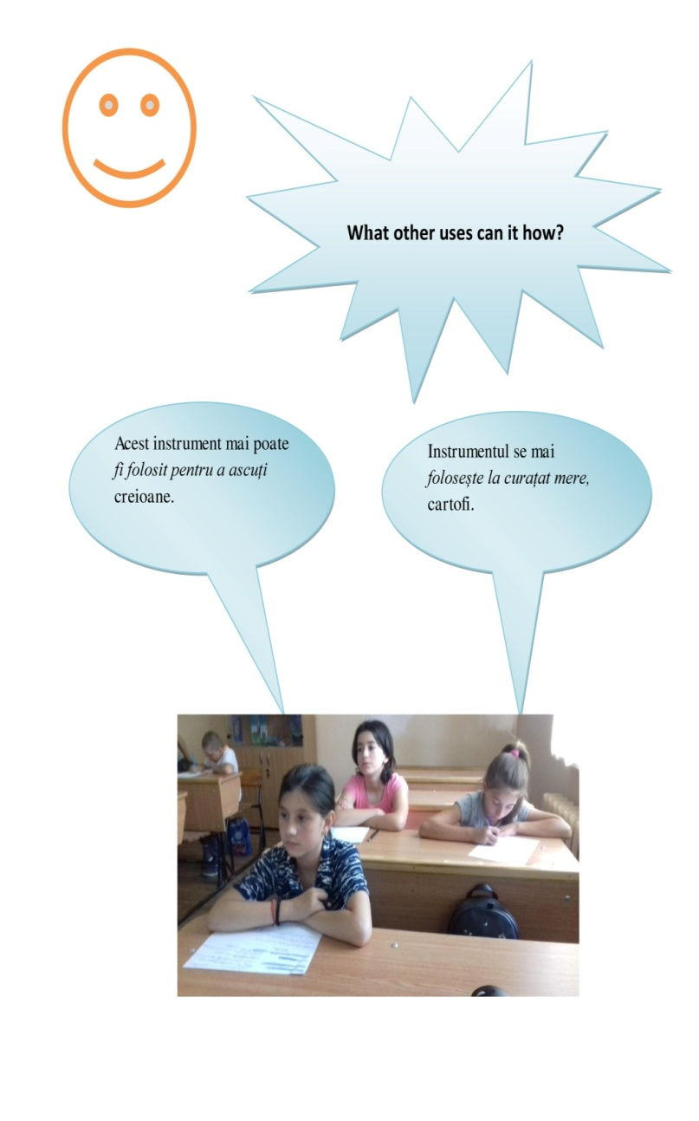
Pictures with the students and their answers in Romanian

Slide 25
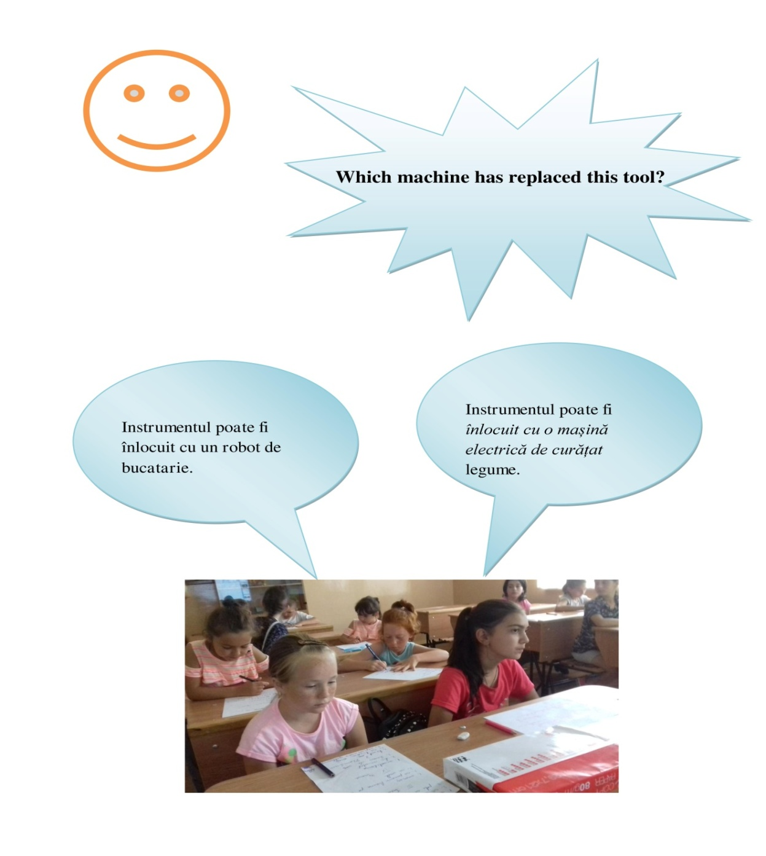
Pictures with the students and their answers in Romanian

Slide 26
The object proposed by Germany

Slide 27
The students’answers to the partners’questions
What is it and what do they use it for?
What other uses can it have?
Which machine has replaced this tool?
This instrument is used for shaving vegetables and fruits. This tool can also be used to cut biscuits and to obtain chocolate flakes. The instrument can be replaced with a kitchen robot or a blender.

Slide 28
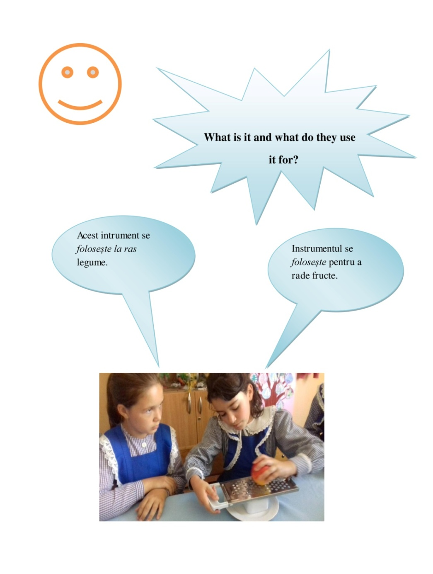
Pictures with the students and their answers in Romanian

Slide 30
The object proposed by Romania

Slide 31
The students’answers to the partners’questions
What is it and what do they use it for?
What other uses can it have?
Which machine has replaced this tool?
This instrument is used separately for the egg yolk or for slicing eggs. This tool can also be used to slice kiwifruit, apples or potatoes. The instrument can be replaced with a kitchen robot or an electric slicing machine.

Slide 32
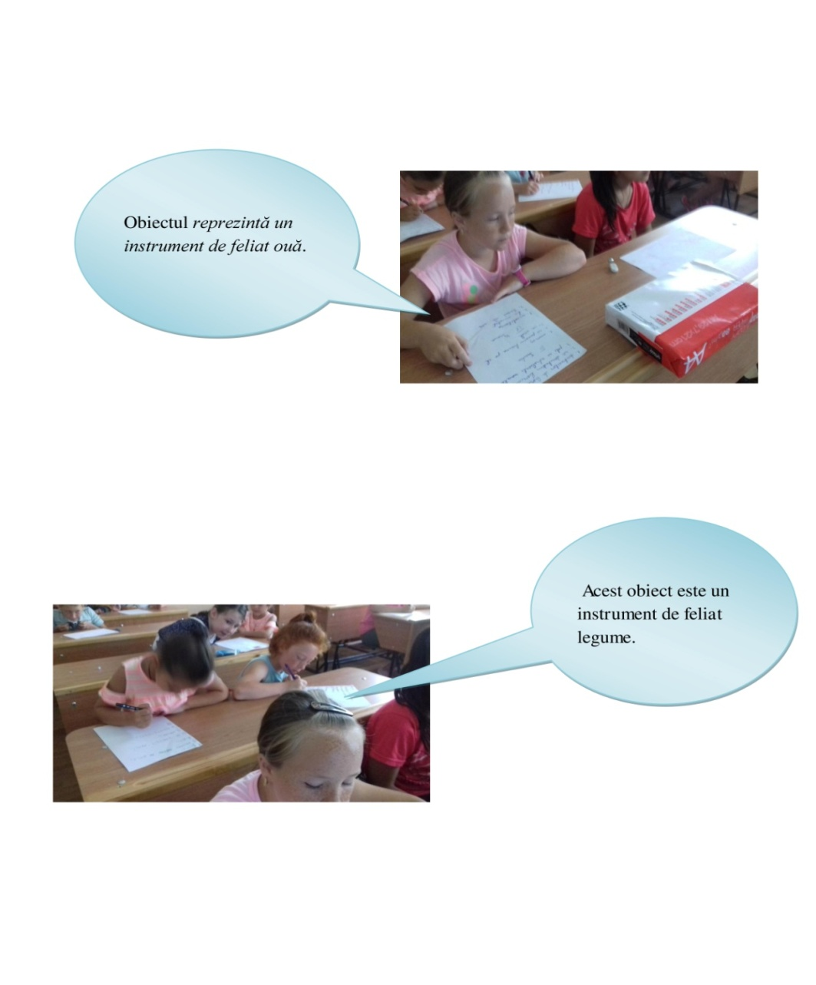
Pictures with the students and their answers in Romanian

Slide 33
Pictures with the students and their answers in Romanian

Slide 34
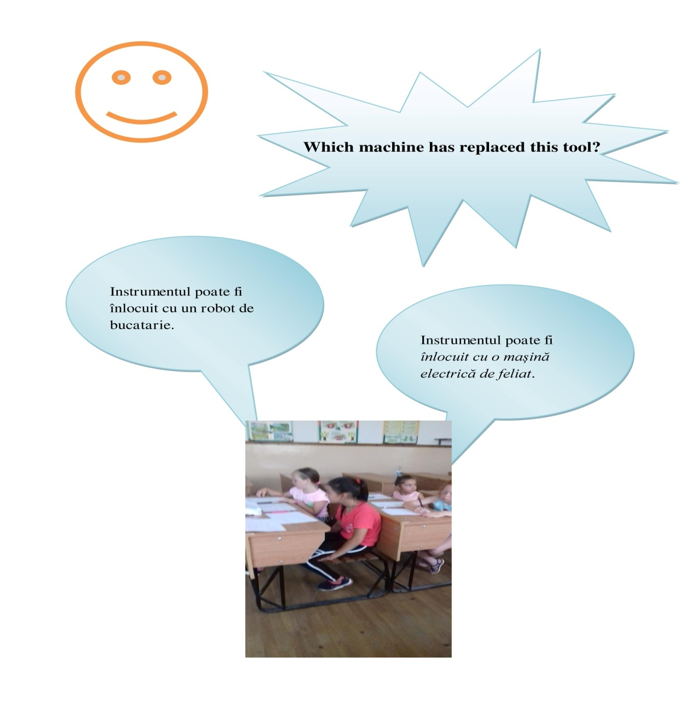
Pictures with the students and their answers in Romanian

Slide 35
The object proposed by Ireland

Slide 36
The students’answers to the partners’questions
What is it and what do they use it for?
What other uses can it have?
Which machine has replaced this tool?
This instrument is used for spinning muffins or to spread cake sheets. This tool can also be used to spin in broth, squash or spread pizza sheets. The instrument can be replaced with a mixer.

Slide 37
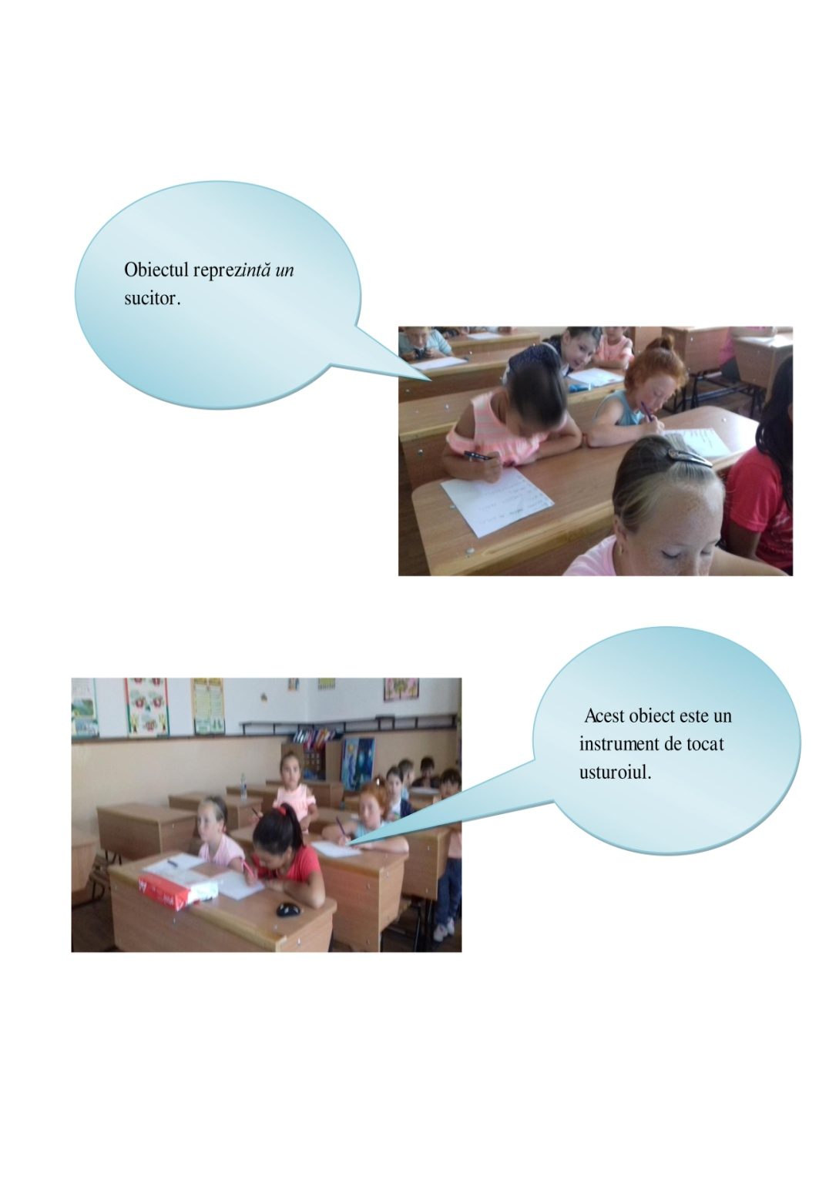
Pictures with the students and their answers in Romanian

Slide 38
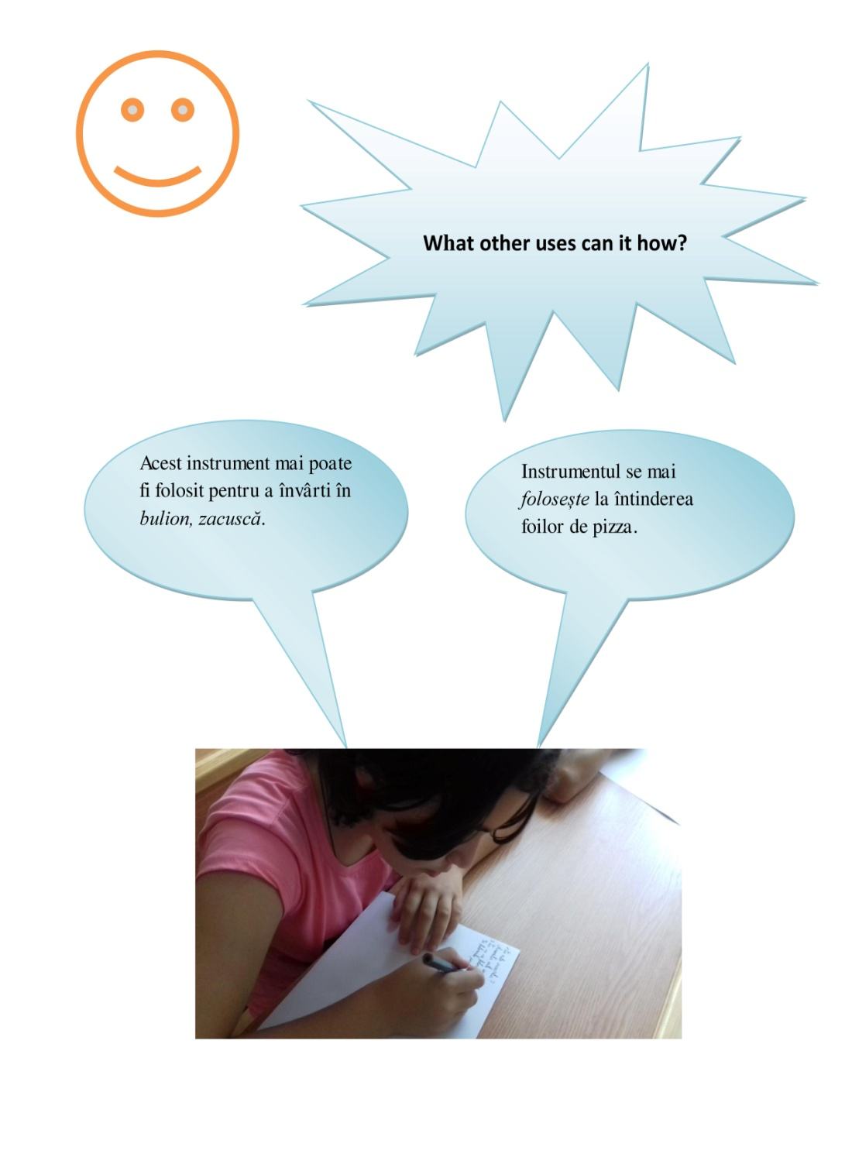
Pictures with the students and their answers in Romanian

Slide 39
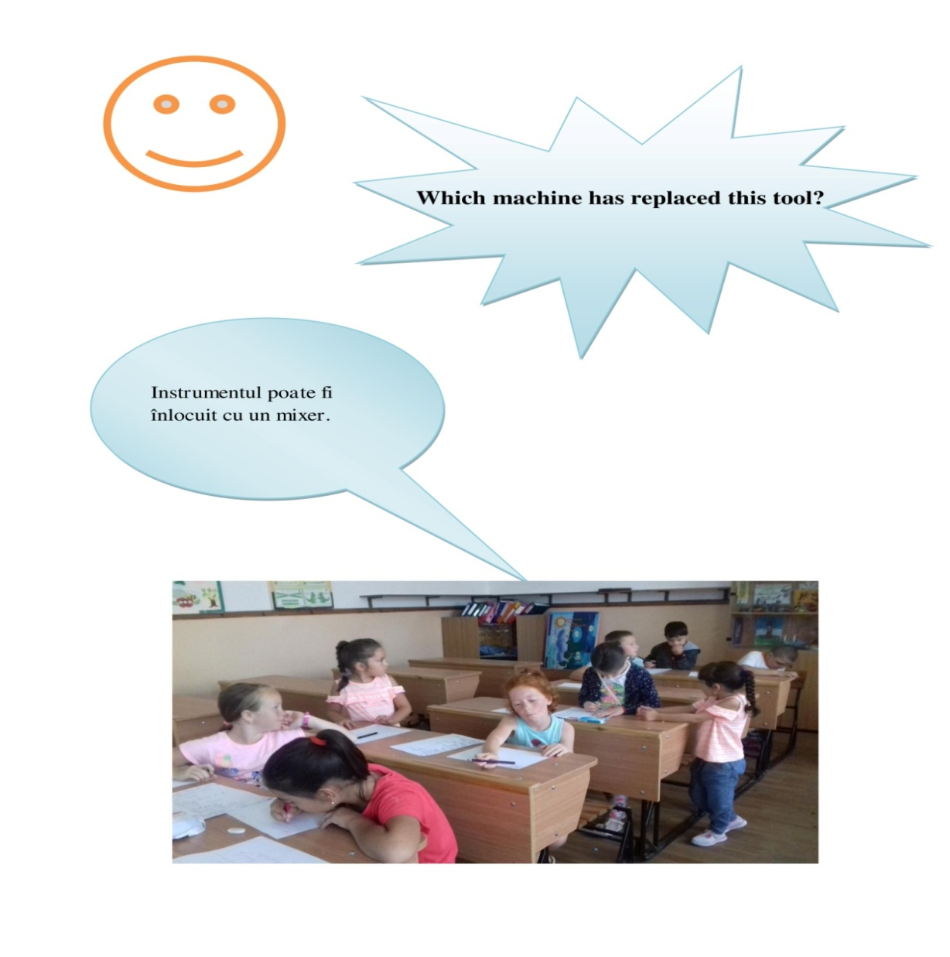
Pictures with the students and their answers in Romanian

