Slide 1
Little scientists building and design Europe ROMANIA aprilie 2018

Slide 2
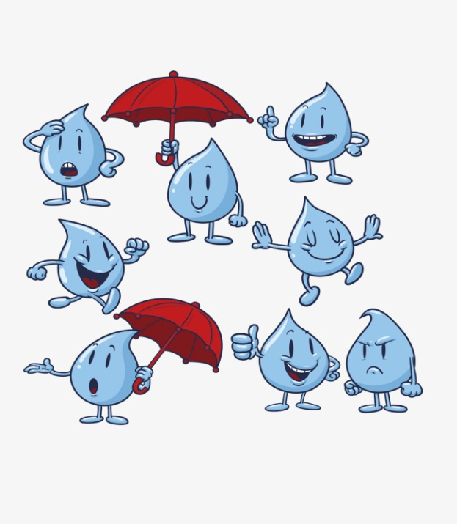

Slide 3
Where do I come from?

Slide 8
The story of the drop of water

Slide 19
How did I get to Earth?

Slide 24
The water circuit in nature

Slide 31
The water circuit in our city

Slide 36
How is water polluted?

Slide 38
The water in my town

