Slide 1
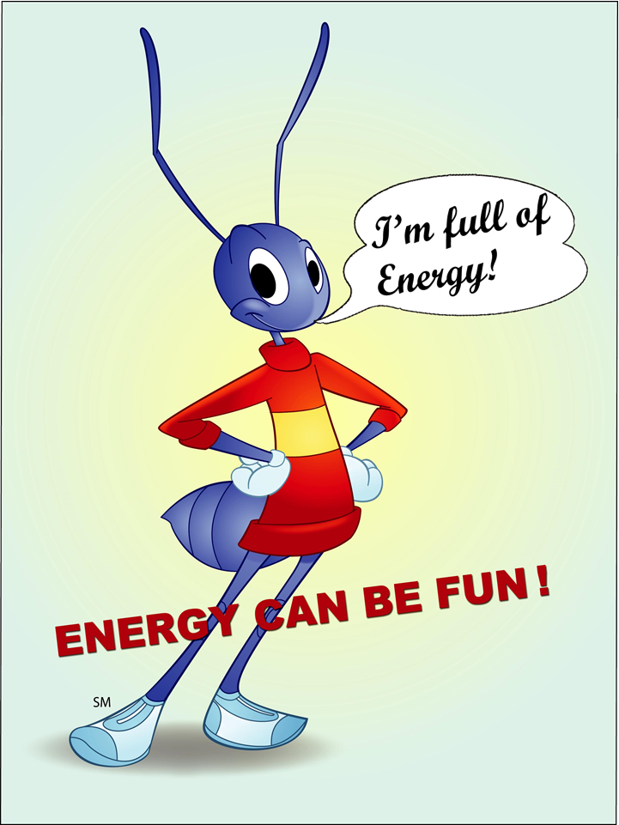

Slide 2
ELECTRICAL ENERGY/ELECTRICITY

Slide 3
ELECTRICITY Generation
Electricity can not be stored, it should be consumed / used as soon as it is produced by the generator

Slide 4
Hydroelectric generation
HYDROELECTRIC CENTRES use water as a source of energy

Slide 5
Thermoelectric generation
//
ELECTRICAL THERMOFING CENTRES use hydrocarbons and coal as a source of energy

Slide 6
GENERATION USING NUCLEAR ENERGY
NUCLEAR ENERGY uses uranium as a source of energy

Slide 7
ALTERNATIVE GENERATION (USING OTHER ENERGY SOURCES
Electricity can also be generated using biomass, wind power and solar power. Wind power centres, solar power stations

Slide 8
Transport
ELECTRICAL TRANSPORT LINES transport electricity from power centres to the distribution stations.

Slide 9
Distribution
DISTRIBUTION LINES transport electricity from distribution stations to houses, offices and factories

Slide 10
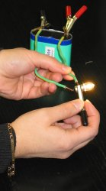
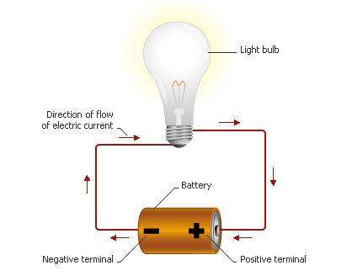
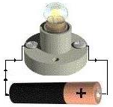
WHAT IS THE ELECTRIC CURRENT?
The electric current is the orderly movement of billions of free elecrons. In order for an electric current to circulate, it requires a closed electrical circuit made up of a generator and conductive bodies. It is characterized by voltage, intensity and frequency.

Slide 11
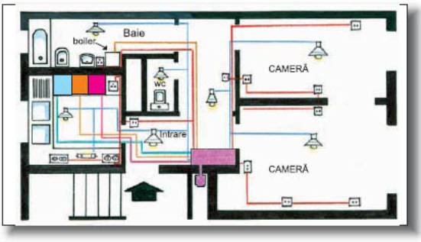
ENERGY AT HOME The electrical current into the house has an estimated value of 220V. There is a light circuit and a socket circuit in the house.

Slide 12
Discover the keyword!
Transports power from power centres to distribution stations
Uses uranium as a source of energy
Can not be stored, it should be consumed / used as soon as it is produced.
Uses hydrocarbons and coal as a source of energy
Transforms primary energy into electricity
Water is the primary energy source
L | I | N | E | S | E | L | E | C | T | R | I | C | A | L
 |  |  |  |  | N | U | C | L | E | A | R
 |  |  | E | L | E | C | T | R | I | C | I | T | Y
 |  | T | H | E | R | M | O | E | L | E | C | T | R | I |  | C
 |  |  |  |  | G | E | N | E | R | A | T | O | R
 |  |  |  | H | Y | D | R | O | E | L | E | C | T | R | I |  | C

Slide 13
Electrical security
Electricity assures us everyday comfort, it is not dangerous if we comply with /follow the electrical safety rules.

