Slide 1
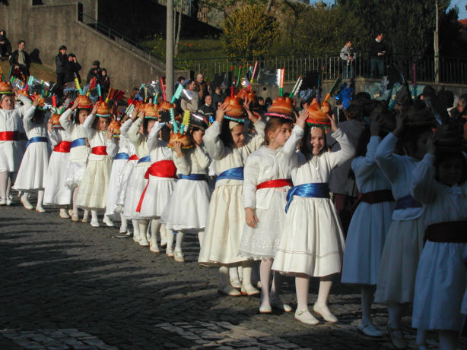
Fogaceiras Party
20th January, San Sebastian Day - Santa Maria da Feira.

Slide 2
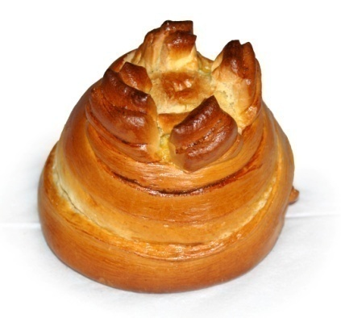
In 1505 – the plague arrived again at Portugal, in Santa Maria da Feira. Tradition says that the Counts of the Castle and people of the town, promised to San Sebastian to make every year a big party if he could send the plague away. So, every year, people offers to the Saint a fogaça - sweet bread. Its shape stylizes the tower of the castle with its four bowlers.

Slide 3
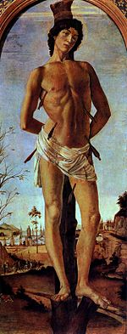
San Sebastian is the patron saint of the city.
The people did not forget the promise and every year there is this party in which the Fogaça offering is made.
The tradition exists since the XVI th century.

Slide 4
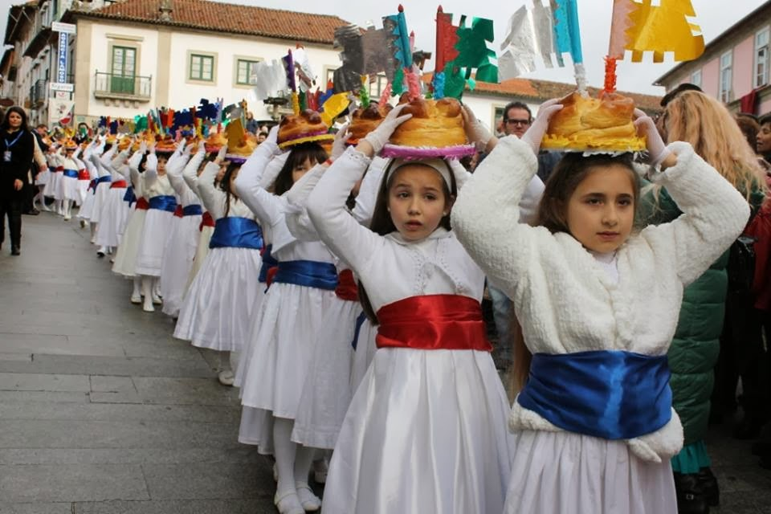
The tradition demands that during this party, the fire-breathing girls, coming from all Santa Maria of Feira, parade in the civic Procession, dressed in white, with bands of varied colors, taking to the head a fogaça . These fogaças are adorned with small flags of metallic paper.

Slide 5
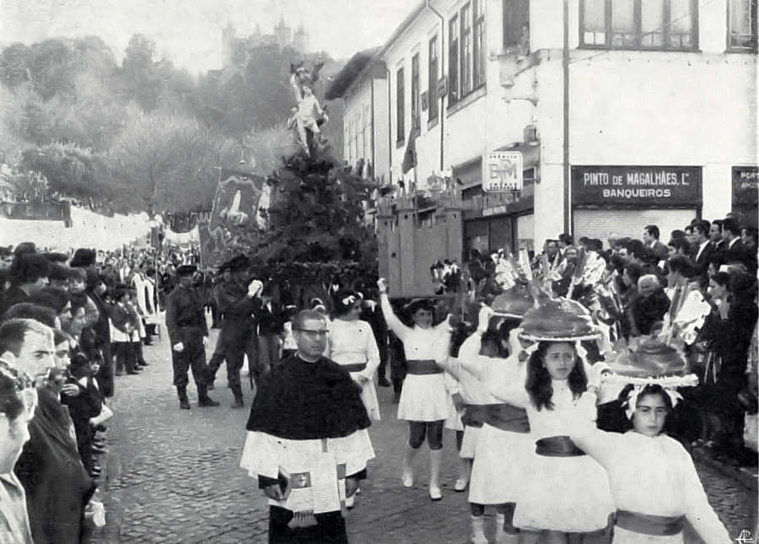
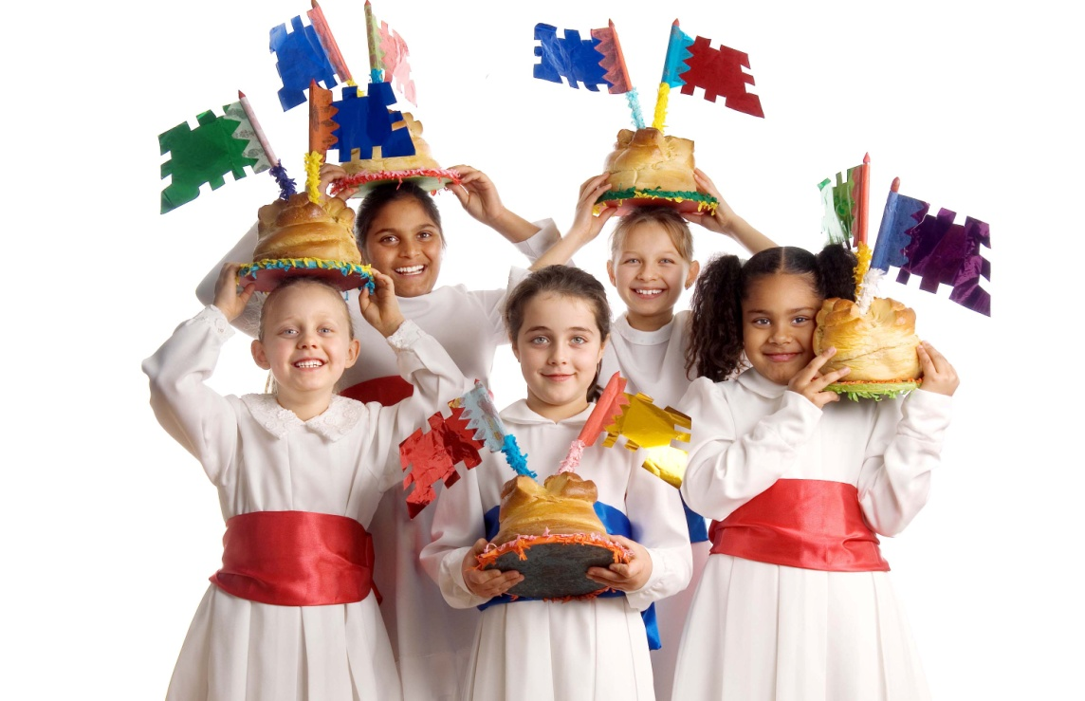
The party begins with the civic procession to the Mother Church. Here, the fogaças are blessed. This traditional folk festival has more than seven centuries.

Slide 6
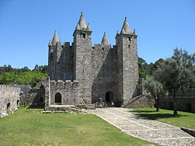
Castle of Santa Maria da Feira

Slide 7
Victória Sousa, nº 30, 5ºJ

