Slide 1
Graphs and charts of disabled students born in Italy
Source:
Fondazione Agnelli
SNE Country Data 2012

Slide 2
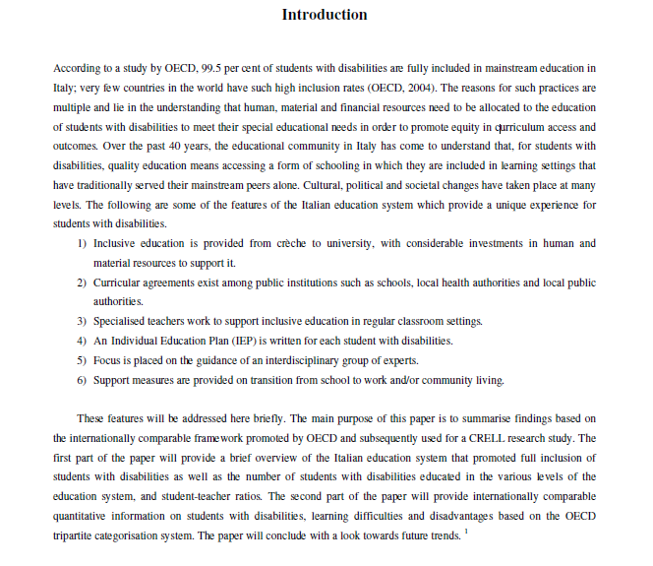

Slide 3
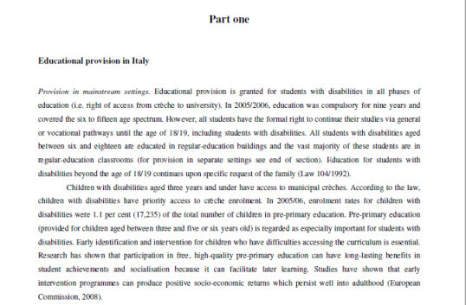

Slide 4
Primary education caters for students aged five or six to eleven and in 2005/2006 66,467 students with disabilities were enrolled in this phase of education, 2.4 per cent of the total number of students in primary education. The education of students with disabilities is based on their IEPs as established by Law 104/1992. Having an IEP allows pupils with disabilities to benefit from a more complex educational aid and teaching support from schools. Furthermore, for a small number of students with extremely serious disabilities, qualified intervention and differentiated teaching are provided with the support of rehabilitation therapists. There is strong collaboration between schools, specialists, local social and health services and structures and the wider community.
Lower-secondary education includes students who are in the 11 to 14 age range. In 2005/2006, 55.058 students with disabilities were enrolled in this level of education, 3.1 per cent of the total number of students in lower-secondary education. Educational and curricular planning at this level provides both for individualised paths aimed at tackling learning difficulties and for support activities to facilitate the inclusion of disabled pupils through specialised teaching and other means provided for by law.
Enrolment rates for students with disabilities in upper-secondary education (aged 14 to 18/19) have progressively increased over time, despite the difficulties linked with subject teaching. Recent changes to a modular curriculum have improved the planning and coordination initiatives for inclusion. In 2005/06, the total number of students with disabilities in this phase of education was 37.158 – 1,4 per cent of the total number of students in this level of education. The right to educational provision for students with disabilities extends to higher education. The number of students with disabilities attending university programmes in 2005/06 was 10.126, with an increase of 110 per cent compared to 2000/01, when the number of students with disabilities was just 4.813.

Slide 5
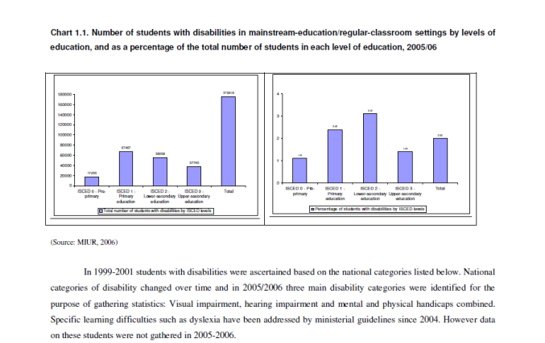

Slide 6
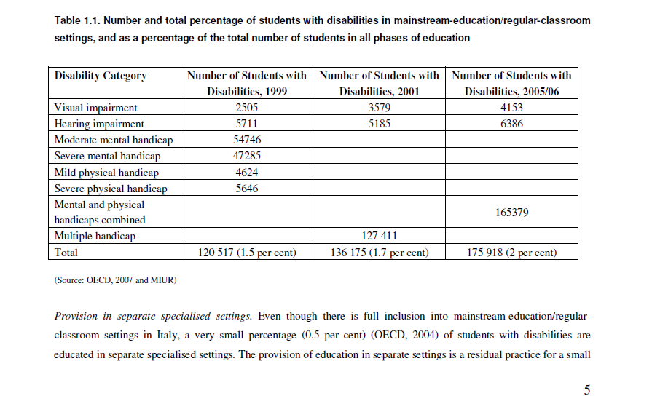

Slide 7
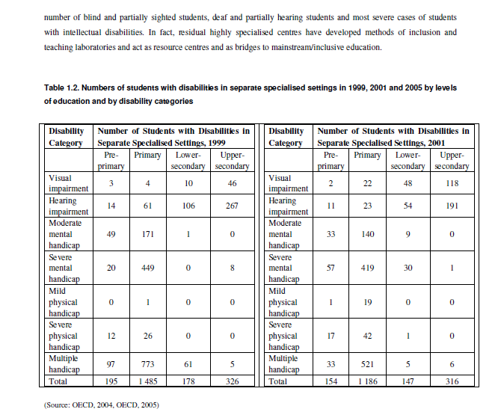

Slide 8
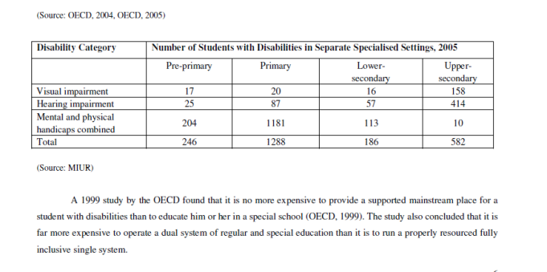

Slide 9
The table 1.2 shows the numbers of students with disabilities in separate specialised settings in 1999 (OECD, 2004), in 2001 (OECD, 2005) and in 2005/2006, by level of education and by disability category. A decrease in the number of students with disabilities being educated in separate specialised settings between 1999 and 2001 and an increase in 2005/2006 are clear.
Teachers. In 2005/2006, approximately 840.000 teachers were employed in Italy, 83,761 of whom were specialised support teachers in pre-primary, primary, lower-secondary and upper-secondary education (MIUR, 2006). All teachers are civil servants. Often classroom assistants – i.e. assistants have university degrees. While the specialised support teacher is co-titular in the classroom and a therefore responsible for the whole class, the assistant ad personam is a support measure allocated to the student with disabilities only.
The number of support-teacher posts is established by law and is based on the total number of students enrolled (one teacher post for every 138 students). It is, however, possible to employ additional support teachers under temporary contracts. The number of support teachers established at national level is subdivided at regional level by the Ministry of Education and further subdivided at school level, taking into consideration the actual numbers of students with disabilities in schools.
According to an OECD comparative study (OECD, 2005), teaching and other staff are some of the most important resources available to support the education of students with disabilities, in Italy, student-teacher ratios have consolidated over the years and have typically hardly been above 2: 1 at all phases of education. The table below shows trends over time by levels of education. It is clear that support teachers with specialised training are allocated to schools at the rate of one teacher for every two students ascertained as needing support.

Slide 10
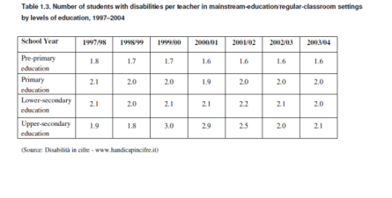

Slide 11
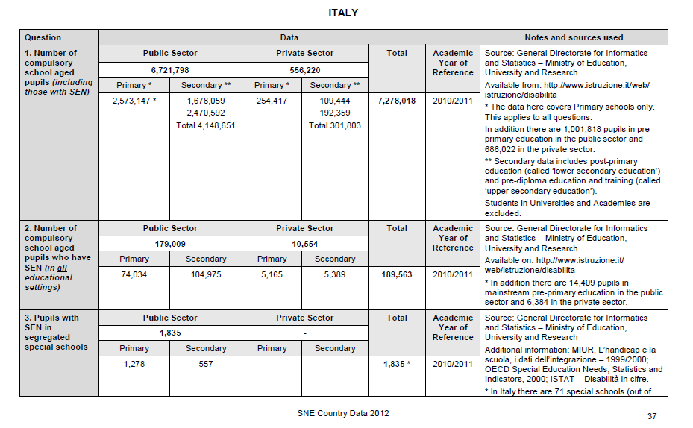
Special Needs Education Country Data 2012 European Agency for Development in Special Needs Education

Slide 12
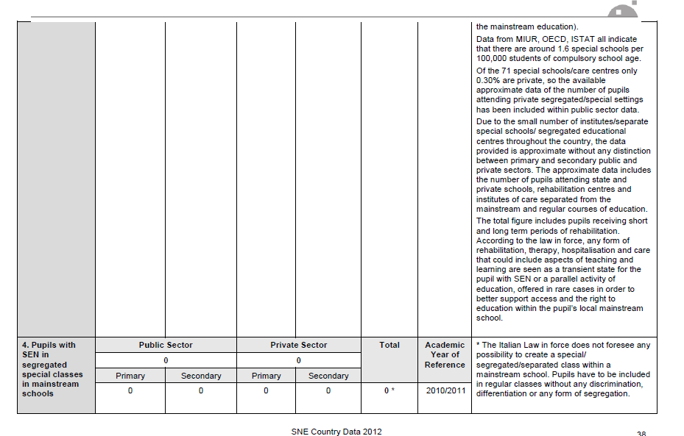

Slide 13
