Slide 1
presents

Slide 2
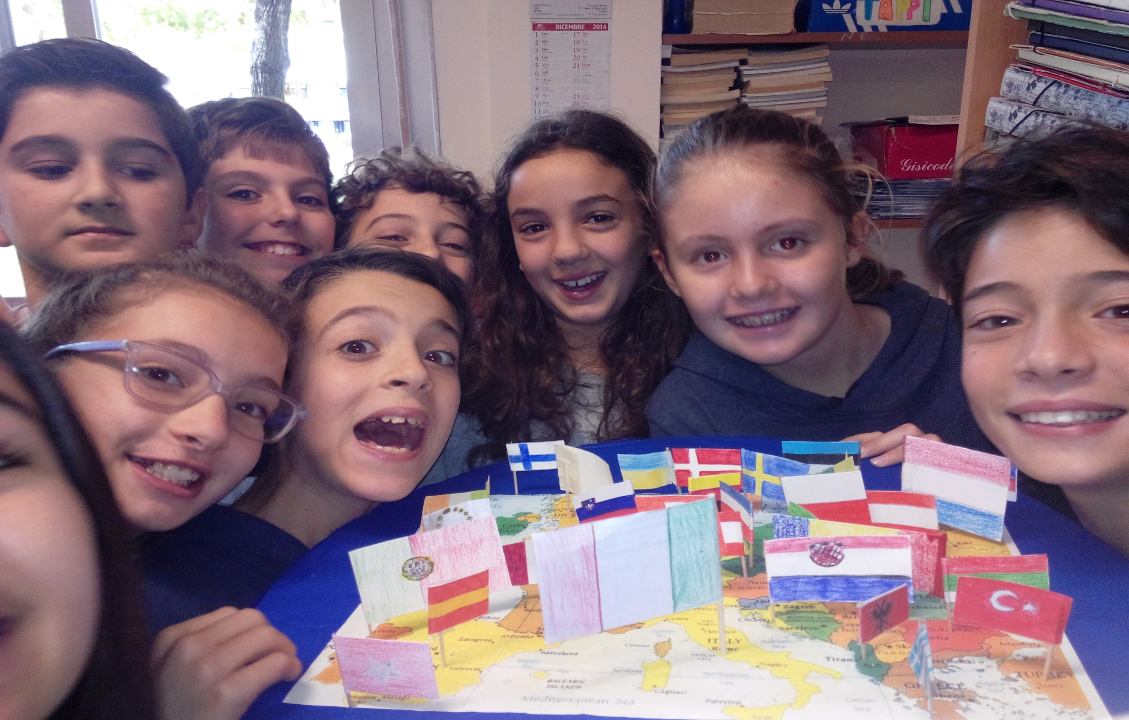

Slide 3
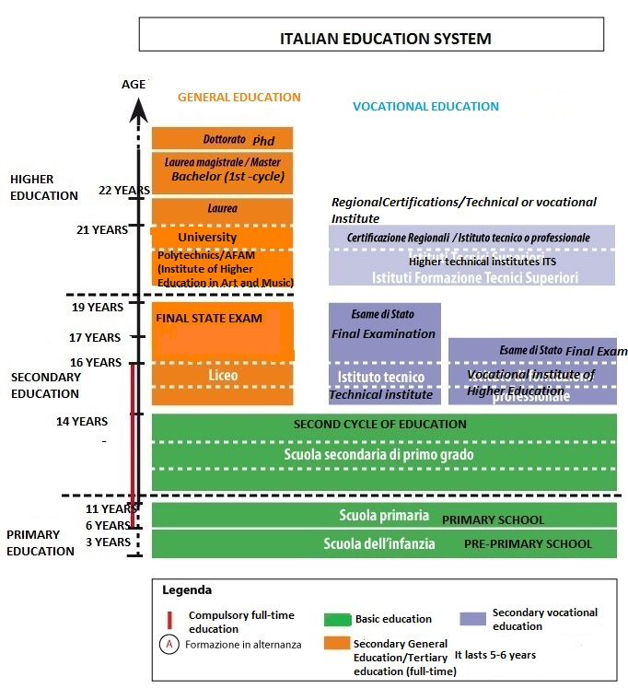
STRUCTURE
OF THE
EDUCATION
SYSTEM

Slide 4
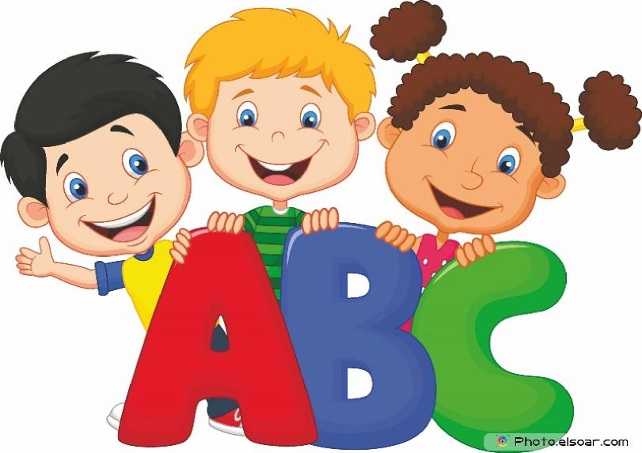
THE ITALIAN EDUCATION SYSTEM
The education system is organised as follows:
• PRE-PRIMARY SCHOOL (scuola dell’infanzia) for children between 3 and 6 years of age;
FIRST CYCLE OF EDUCATION (it lasts 8 years):
PRIMARY EDUCATION(scuola primaria) 5 years, for children between 6 and 11 years of age;
LOWER SECONDARY SCHOOL(scuola secondaria di I grado)
3 years, for children between 11 and 14 years of age;
SECOND CYCLE OF EDUCATION with two different pathways:
STATE UPPER SECONDARY SCHOOL (scuola secondaria di II grado),
5 years from 14 to 19 years of age. Students can choose licei, technical institutes and vocational institutes;
Three and four-year VOCATIONAL TRAINING courses (IFP) by the Regions.
HIGHER EDUCATION offered by universities, polytechnics included, institutes of the Higher Education in Art and Music system (Alta Formazione Artistica e Musicale,AFAM) and Higher Technical Institutes (Istituti Tecnici Superiori, ITS).

Slide 5
Education is compulsory for ten years between the ages of 6 and 16.
This covers the whole of the first cycle of education.
It lasts eight years (five years of primary school and three years of lower secondary school), and the first two years of the second cycle.
After the first cycle of education, the final two years of compulsory education (from 14 to 16 years of age) can be undertaken at a State upper secondary school (liceo, technical institute or vocational institute),
or on a three- or four-year vocational education and training course which is within the jurisdiction of the Regions.

Slide 6
Everyone has a right and a duty (diritto/dovere) to receive education and
training for at least 12 years within the education system or until they have obtained a three-year vocational qualification by the age of 18.
Private education
Article 33 of the Italian Constitution: two basic principles
The State is obliged to provide a State-school system accessible to all young people.
Organisations and private individuals are entitled to set up schools and colleges of education at no cost to the State.
Publicly subsidised schools (scuole paritarie) can issue certificates with the same legal value as qualifications from State schools of the same type and level.
Non-profit-making schools benefit from special tax relief.

Slide 7
1. Early Childhood Education and Care
It has two different stages based on child age groups.
Provision for children aged 0-3 years, offered by nursery schools, is not part of the education system and outside of the responsibilities of the Ministry of Education, University and Research (MIUR).
Provision for children over 3 years of age is called “scuola dell’infanzia”. It is part of the education system and falls under the responsibilities of the Ministry of Education.
Other pre-primary education institutions are also run at local level, by the State the municipalities and the private sector.
This level of education is not compulsory and lasts up to three years (from 3 to 6 years of age).

Slide 8
Admission Requirements and Choice of School
In general, children turning three, four or five by 31 December of the relevant school year can enrol in pre-primary school classes.
It is also possible to enrol children turning three by 30 April of the relevant school year (parents’ request/specific conditions: available places, waiting list, Teachers’ Council decisions and procedures).
Age Levels and Grouping of Children
State pre-primary schools are organised into groups called ‘sections’, containing children of the same age (different ages in accordance with the school’s organisational autonony).
Heterogeneous groups are formed to stimulate the relationship between teachers and children, increase reaction among children and enable a better and wider use of rooms, spaces and materials).
The number of pupils per section ranges from a minimum of 18 to a maximum of 26. (derogation on the basis of different factors: disabled pupils, financial conditions, social disadvantages, availability of school staff).

Slide 9
2. Primary Education
Admission Requirements and Choice of School
Primary school is compulsory (last for five years) and is attended by pupils aged between 6 and 11. Primary school and lower secondary school make up the first cycle of education (eight years).
The aim of this level in the education system is to provide pupils with basic learning and the basic tools of active citizenship. It helps pupils to understand the meaning of their own experiences.
Organization
The Constitution of the Italian Republic (art. 33 and 34) establishes that the State provides access to education to all young people living in the country, regardless of the geographical condition and of their individual social and economic situation.
The central and branch administrations of the State, regional, provincial and local administrations (municipalities) are responsible for setting up and operating educational establishments, based on the age of pupils, the geographical context and the social conditions of the families. Municipalities are responsible for the organization of transport services in accordance with criteria established at regional level.
Transport services for pupils with special needs are provided free of charge.

Slide 10
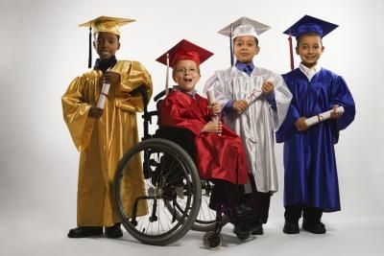
Special education support

Slide 11
In Italy, disabled pupils have been integrated in ordinary classes for more than 40 years; therefore, there is not a separate education system for these pupils. Integration started, on an experimental basis, first in kindergarten and primary schools and was progressively extended to lower and upper secondary school and universities.
Regulations are provided for the following subjects:
• classification criteria for disabled pupils; Law of 5 February 1992, no. 104, defines as disabled persons those with a physical, psychic or sensorial disability which causes difficulties in learning, relationships or work integration and which determines social disadvantage or alienation;
• composition of classes with disabled pupils; neither exceed the number of 20 pupils nor accept more than one disabled pupil;
• support educational interventions (specialized teaching staff ) and medical/assistance interventions;
• interventions to adapt school buildings in order to remove all architectural barriers and to supply adequate technical equipments and teaching materials to schools.

Slide 12
According to Law of 27 December 202, no. 289, article 35, Local health authorities provide to individuate disabled pupils on the basis of collegiate verifications. The subsequent steps are the following:
• functional diagnosis drawn up by the Local health authority and written by a physician specialised in the announced pathology, a children’s neuropsychiatrist, a rehabilitation therapist and social operators. The functional diagnosis should provide an analytical description of the psycho-physical conditions of the pupil/student.
• the dynamic-functional profile drawn up by the Local health Authority, by class teachers and support teachers after the first period of integration; it aims at the preparation of the Piano Educativo Individualizzato – PEI.
• PEI includes the descriptions of the interventions foreseen for the pupil/student in a given period of time, drawn up jointly by the operators of the Local Health
Authority, teachers and support teachers, in collaboration with parents.
Schools, in order to achieve the integration, have to be adapt their structure, with the removal of all architectural barriers, and the use of all facilities, as well as the technical and didactic equipment to the needs of the pupils, in relation to the functional or sensorial limitations. The schools can make use also of ‘’specialised centres having a function of pedagogical consultation, production or adaptation of specific didactic material’’.

Slide 13
Admission Requirements and Choice of School
Children with the age of six by 31 December of the relevant school year must enrol in the first year of primary school.
Children who reach the age of six by 30 April in the calendar year in which they begin school can be enrolled in the first year (parents’ request: early enrolment).
Parents are free to choose the school they want to send their children to. The only limitations may be due to a lack of available facilities, lack of school staff for each school by the school administration.
Since primary school is compulsory, all children must be guaranteed the right to attend including through coordination at local level between schools and local authorities.
Age is the main criterion for enrolment and inclusion in a specific class for foreign pupils (factors considered by the teaching staff: educational system of the country of origin, their previous study path, their assessed level of attainment).

Slide 14
Age Levels and Grouping of Pupils
Primary school lasts five years for pupils aged from 6 to 11.
Children are organized into groups called ‘classes and enrolled according to their age. However, pupils from different classes can be grouped together for special school activities or objectives.
A class has a minimum of 15 and a maximum of 26-27 pupils. (limits of 10% range). The maximum number of pupils per class is usually lowered to 20, if there are pupils with special educational needs*. In small villages schools or in mountain areas or on small islands the minimum number of pupils per class is 10. If the population is too low for the school to form separate classes of pupils of the same age, ‘multi-classes’ are allowed.
Organisation of the School Year
The Ministry of Education is responsible for setting the calendar for holidays, for all school levels. The Regions are responsible for defining the school calendar according to local needs (start and end of school activities, length of breaks for national holidays, other holidays).

Slide 15
The school year starts on 1 September and ends on 31 August. Teaching activities, including end-of-term assessments, final assessments and examinations, as well as in-service training activities are carried out between 1 September and 30 June.
There are 200 teaching days in a year. For pupil evaluation purposes, the school year can be divided into two or three terms (3 or 4 months).
The teaching timetable offers the following options:
• 24 hours a week;
• 27 hours a week;
• up to 30 hours a week, involving additional activities to the 27-hour timetable
(i.e. up to 3 extra hours per week);
• 40 hours a week, including the lunchtime meal, known as ‘full-time’.
The District/School Council establishes the daily and weekly timetable.
Lessons are usually held from Monday to Friday but some schools offer a six-day week with lessons on Saturday.
Schools can adopt flexible solutions on the basis of the requirements of families, the teaching staff they have available, their facilities and services.

Slide 16
A sample 30-hour-week timetable (lunchtime not included):
 | Out-of-hours provision | Lessons | Lunch-break | Lessons | Out-of-hour-provision
Monday | 7.30-8.30 | 8.30-12.30 | 12.30-13.30 | 13.30-16.30 | 16.30-17.30
Tuesday | 7.30-8.30 | 8.30-13.00 |  |  | 13.00-14.00
Wednesday | 7.30-8.30 | 8.30-12.30 | 12.30-13.30 | 13.30-16.30 | 13.00-14.00
Thursday | 7.30-8.30 | 8.30-13.00 |  |  | 13.00-14.00
Friday | 7.30-8.30 | 8.30-12.30 | 12.30-13.30 | 13.30-16.30 | 13.00-14.00
Saturday | ---- | ------- | -------- | --------

Slide 17
A sample 27-hour-week timetable
 | Out-of-hours-provision | Lessons | Lunch-break | Lessons | Out-of-hour-provision
Monday | - | 8.00-13.00 | 13.00-14.30 | 14.30-16.30 | 16.30-17.30
Tuesday | - | 8.00-13.00 |  | 14.30-16.30 | 13.00-14.00
Wednesday | - | 8.00-13.00 |  | 14.30-16.30 | 13.00-14.00
Thursday | - | 8.00-13.00 |  | 14.30-16.30 | 13.00-14.00
Friday | - | 8.00-13.00 |  | 14.30-16.30 | 13.00-14.00
Saturday | ---- | ------- | -------- | -------- | -----

Slide 18
Teaching and Learning in Primary Education
Curriculum, Subjects, Number of Hours
The curriculum is defined through the National Guidelines for the Curriculum (Indicazioni nazionali per il curricolo) implemented from school year 2012/2013. According to the new guidelines, the general aim of school is the harmonious and comprehensive development of the individual, according to the principles of the Italian Constitution and European cultural tradition, to be achieved through the promotion of knowledge, respect for individual diversity and the active involvement of students and their families.
The subjects taught during the 5 years of primary school are: Italian, English, history, geography, maths, Science, technology, music, art, sports science, Catholic religious education (optional),‘Citizenship and Constitution’ .
Freedom in teaching is a principle set out in the Italian Constitution (art. 33). The choice and use of teaching methods and materials must be consistent with each school’s educational offer plan (POF) basic methodological approaches, such as, taking advantage of pupils’ experiences and knowledge, promoting exploration and discovery activities, encouraging cooperative learning, developing awareness of one’s own learning method, carrying out in-lab learning.

Slide 19
Assessment in Primary Education
Periodic assessment takes place at the end of each term. For assessment purposes, the school year is divided into three-month or four-month terms, as established by each school. Final assessment takes place at the end of each school year. Pupils do not take final examinations at the end of primary school. Evaluation focuses on the learning process of pupils, their behaviour and their overall learning outcomes. These assessments should be consistent with the learning objectives established in the educational offer plan (POF) of each school. In the POF, the Teachers’ Council of each school also defines the methods and criteria for assuring that pupil assessment is uniform, transparent and fair.
Periodic and final evaluation of pupils’ learning outcomes in each subject is expressed in numerical marks out of ten (from 0 to 10). Conduct is evaluated through a report assessment.
The assessment of pupils with a certified disability follows the criteria described above (marks out of ten) and refers to their behaviour, subjects and the activities included in each pupil’s individual educational plan. For pupils with certified specific learning difficulties (SpLD), assessment procedures must be adapted to the specific situation.
The external assessment of pupils’ learning outcomes is conducted by the INVALSI agency. For primary education, data is normally collected in the second and fifth years.

Slide 20
SECONDARY EDUCATION
Secondary education is organized into a:
compulsory lower level, called first-level secondary school
an upper level, called the second cycle of education.
The first two years of the second cycle of education and training are compulsory. Together with the eight compulsory years of the first cycle of education, they make up the 10 years of compulsory education (from 6 to 16 years of age) State upper secondary education offers general, technical and vocational education.
The overall length of studies at upper secondary level is 5 years (from 14 to 19 years of age).
Vocational education and training (IFP) run by Regions is organised into three and four-year courses (after the first cycle of education) to complete the compulsory education in this training or receive a three-year qualification. (by their 18th birthday).

Slide 21
Enrolment in lower secondary school is compulsory for pupils possessing the admission certificate presented at the end of primary school. Examinations are only required at the end of each cycle of education (the end of the first cycle coincides with the end of lower secondary school).
At enrolment, students and their parents sign a ‘Joint responsibility agreement’. This document details the rights and duties (e.g. use of mobile telephones/at school) of all stakeholders in the school community (school/families).
Lower secondary education lasts 3 years and is generally attended by pupils aged from 11 to 14. In the first grade, a class is made up of a minimum of 18 and a maximum of 27-28 pupils. In the second and third grades, classes must have a minimum of 20 pupils. These limits can vary by 10%. (20 in classrooms with students with special educational needs).
The Regions are responsible for defining the school calendar. Teaching activities, including end-of-term assessments, final assessments and examinations, in-service training activities are carried out between 1September and 30 June.
There are a minimum of 200 teaching days in a year. The current minimum annual teaching time is 990 hours (30 hours per week). Parents choose the timetable at enrolment.
timetable’ with 30 hours per week (29 hours + 1 hour dedicated to the in-depth study of literary subjects)
the ‘extended timetable’ with an average of 36 hours a week or, exceptionally, 40 hours including mealtimes

Slide 22
The table below presents 30-hour-week timetable and 36-hour, Saturday included
 | Out-of-hours-provision | Lessons | Lunch | Out of provisions
Monday | - | 8.00-13.15
Tuesday | - | 8.00-13.15
Wednesday | - | 8.00-13.15
Thursday | - | 8.00-13.15
Friday | - | 8.00-13.15
Saturday | ---- | 8.00-13.15
36-hour-week timetable | Out-of-hours-provision | Lessons | Lunch | Lessons
Monday | - | 8.00-13.15 | 13.15-14.15 | 14.15-16.15
Tuesday | - | 8.00-13.15
Wednesday | - | 8.00-13.15 | 13.15-14.15 | 14.15-16.15
Thursday | - | 8.00-13.15
Friday | - | 8.00-13.15 | 13.15-14.15 | 14.15-16.15
Saturday | ---- | 8.00-13.15

Slide 23
Mainstream compulsory timetable lower secondary school. (30 hours* per week)
Italian, History, Geography 9 297
In-depth studies 1 33 ‘Citizenship and Constitution’ is now included in the curriculum
Mathematics and Science 6 198
Technology 2 66
English 3 99
Second foreign language 2 66
Art and design 2 66
Sports science 2 66
Music 2 66
Catholic Religious Education 1 33
30 Annual no. Hours 990
*One hour corresponds to 60 minutes.
Extended timetable (from 36 to 40 hours per week)
The most common teaching methods used are traditional lessons, exercises and group work. Generally, schools have a gymnasium, a library and ICT, science and multimedia laboratories. Increasing numbers of classrooms are equipped with interactive whiteboards (IWB).

Slide 24
First-cycle State Leaving Examination
The first-cycle State leaving examination takes place at the end of the third year of lower secondary school. Optional Catholic religious education receives a separate assessment report by the teacher.
To be admitted to the State examination, pupils are required to:
• have attended at least 75% of the annual teaching time
• have obtained, at the end of the third year, a mark of 6/10 or higher in each subject or group of subjects assessed with a single mark
have obtained, at the end of the third year, a mark of 6/10 or higher for conduct (a mark lower than 6/10 always precludes admission to the examination).
The Class council decides by majority vote whether or not pupils can be admitted.
Periodic assessment takes place at the end of each term. For assessment purposes, three-month or four-month terms. The periodic and annual evaluation of pupils focuses on the learning process, their behaviour and their overall learning outcomes. The Teachers’ Class Council assigns the final marks to each student (scrutinio). Each teacher proposes the mark for a given pupil to the Class Council for his or her subject. The final mark is approved by majority vote. If no majority is reached, the vote of the school manager prevails.
The external assessment of pupils’ learning outcomes is conducted by the INVALSI for the first and third grades of lower secondary school.

Slide 25
An examination committee is set up in every school consisting of all teachers of
all classes and chaired by an external member. The examination committee is
divided into sub-committees, each corresponding to a class.
The examination consists of a national written test set by INVALSI and four written tests in the following subjects: Italian, Mathematics and Rudiments of Science and ICT, the two community languages studied. A distinction (lode) can be assigned by unanimous decision of the Committee to students who have obtained a final mark of 10/10. Pupils who have passed the final examination receive the first-cycle leaving certificate.
According to the National Guidelines for the Curriculum, the object of certification is the skills set out in the ‘Student’s Profile at the end of the first cycle’.
The Ministry will provide schools with a specific model for certification of the competences acquired by pupils at the end of lower secondary education.

Slide 26
Organisation of General Upper Secondary Education Types of Institutions
General upper secondary education lasts five years and is delivered by six types of liceo specialising in the following areas:
art (Liceo artistico), classical studies (Liceo classico), science (Liceo scientifico), languages (Liceo linguistico), music and dance (Liceo musicale e coreutico), human sciences (Liceo delle scienze umane). The arts-based liceo offers the following branches of studies:figurative arts,architecture and the environment, design, audiovisual and multimedia design, graphics, set design. The first two years are the same for all branches. The science-based liceo offers an option in applied sciences and the human sciences liceo offersan option in social and economic studies.
Compulsory education lasts 10 years and covers the first two years of the second cycle of education. Thus, students who have successfully completed the first cycle of education must enrol in State-run upper secondary schools (general and vocational) or on the vocational training courses (IFP) organised by the Regions.
Possession of a first-cycle leaving certificate is the only admission requirement for a liceo. Joint responsibility agreement’. Liceo courses are directed at students aged 14 to 19 and are organised into two periods of two years each and the final fifth year. Classrooms have no fewer than 27 and no more than 30 students in the first grade. The minimum required number of students in the following grades of upper secondary school is 22.

Slide 27
Lessons must be spread over no fewer than 5 days a week and are held on 6 days. Schools can set daily timetables autonomously. The purpose of the first two-year period is to deepen and develop the knowledge, competences and skills acquired by students in the first cycle of education. Knowledge, competences and skills are further developed in the second two-year period they have to be completed their educational, cultural and professional profile (PECUP). Knowledge and competences are organised into four ‘cultural areas’: languages, mathematics, science/technology and history/social studies. Key competences are: learning to learn, planning, communicating, collaborating, acting autonomously, problem solving, creating connections and relations, acquiring and interpreting information. In licei specialising in languages, CLIL (Content and Language Integrated Learning)is compulsory in one language starting from the third year and in a second language starting from the fourth year. In all other types of liceo, CLIL is compulsory in the fifth year.
As in primary and lower secondary schools, the periodic and annual evaluation of
students focuses on the learning process, their behaviour and their overall learning
outcomes. Teachers also certify the competences attained by pupils by the end of compulsory education (16 years of age) and completion of the second cycle of education. Assessment procedures are the same as for primary and lower secondary schools. In the final assessment for each of the last three grades of upper secondary school, students who perform well receive points (credits) to get the final ‘school credit’

Slide 28
At the end of general and vocational upper secondary school, students take a State examination. Admission to the State examination requires students to have obtained a mark of 6/10 or higher in each subject or group of subjects assessed with a single mark, and conduct. Students are also required to make up for any gaps in their studies (‘debts’) from previous years.
The examination committee for the State leaving examination is made up of a maximum of six members – 50% external members and 50% internal – and anexternal chairman who is appointed, according to specific criteria and procedures, from among school managers, state school teachers and higher education teachers.
The examination committee is appointed by the director of the Regional School Office. The Ministry of Education selects the subjects that the external experts are to test during the final examination.
Content of the State Examination
The State examination includes three written tests and an oral test. The purpose of the first written test is to verify proficiency in Italian or the language in which the course is taught, as well as the expressive, logical-linguistic and critical skills of the candidate. The second paper tests one of the main subjects of the programme. The third paper is determined autonomously by the school. The third multidisciplinary test covers up to five of the subjects taught in the final year of study (main topics, single or multiple choice questions, problem solving and a foreign language).
The oral test is multidisciplinary in content and covers the course programmes of the final year of school. The final result is expressed as a mark out of one hundred.

Slide 29
Administration and Governance at Central and/or Regional Level
The Ministry of Education, University and Research (MIUR) is responsible for general administration at national level. School education is organised at a decentralized level by the MIUR through the Regional School Offices
The Ministry of Education, University and Research (MIUR) is in Rome.
The MIUR is organised into three Departments.
The ‘Department for the Education and Training System’ is responsible for the general organization of the school system.
The ‘Department for the Planning and Management of Human, Financial and Capital.
The ‘Department for Higher Education and Research’ responsible for higher education, specifically the guidance, general regulation and funding of universities.

Slide 30
The Regional School Office
Local Offices support and advise schools on administrative and accounting procedures and the planning and innovation of the educational offer. They monitor implementation of provisions on school buildings and safety and deal with the integration of immigrant and special needs pupils.
The Ministry of Education, University and Research (MIUR) has several bodies and agencies operating at national level:
The National Education Council
The National Institute for the Evaluation of the Education System
(INVALSI)
National Institute of Documentation, Innovation and Educational Research
The Institute for the Development of Professional Training for Workers
( ISFOL) for three-year vocational training courses
Quality assurance is guaranteed through the National Agency for the Evaluation of the University and Research System- (Anvur)
The Conference of Rectors of Italian Universities

Slide 31
The Regions have a joint legislative role along with the State on issues related to education. Education and training issues within the jurisdiction of the Regions are handled by specific education offices. Schools were granted autonomy and legal status in 2000.
Ministry of Education sets the general objectives of the educational process, Each school draws up its own Educational Offer Plan (POF) which is the basic document setting out the cultural and planning identity of the school.
The POF is drawn up by the Teachers’ Council on the basis of general objectives defined by the District/School Council and taking into account the proposals and advice of parents organisations and associations and, at upper secondary level only, students associations.
The school manager is the legal representative of the institution and is responsible for its overall management, the management of financial and material resources and the quality of the service provided. His duties are direction, co-ordination, and deployment of human resources. the school manager can delegate specific tasks to teachers. He or she is also assisted by the Director of General and Administrative Services DSGA, the administrative manager of schools which have been granted autonomy. He or she is automatically a member of the Executive Board and the District/School Council.

Slide 32
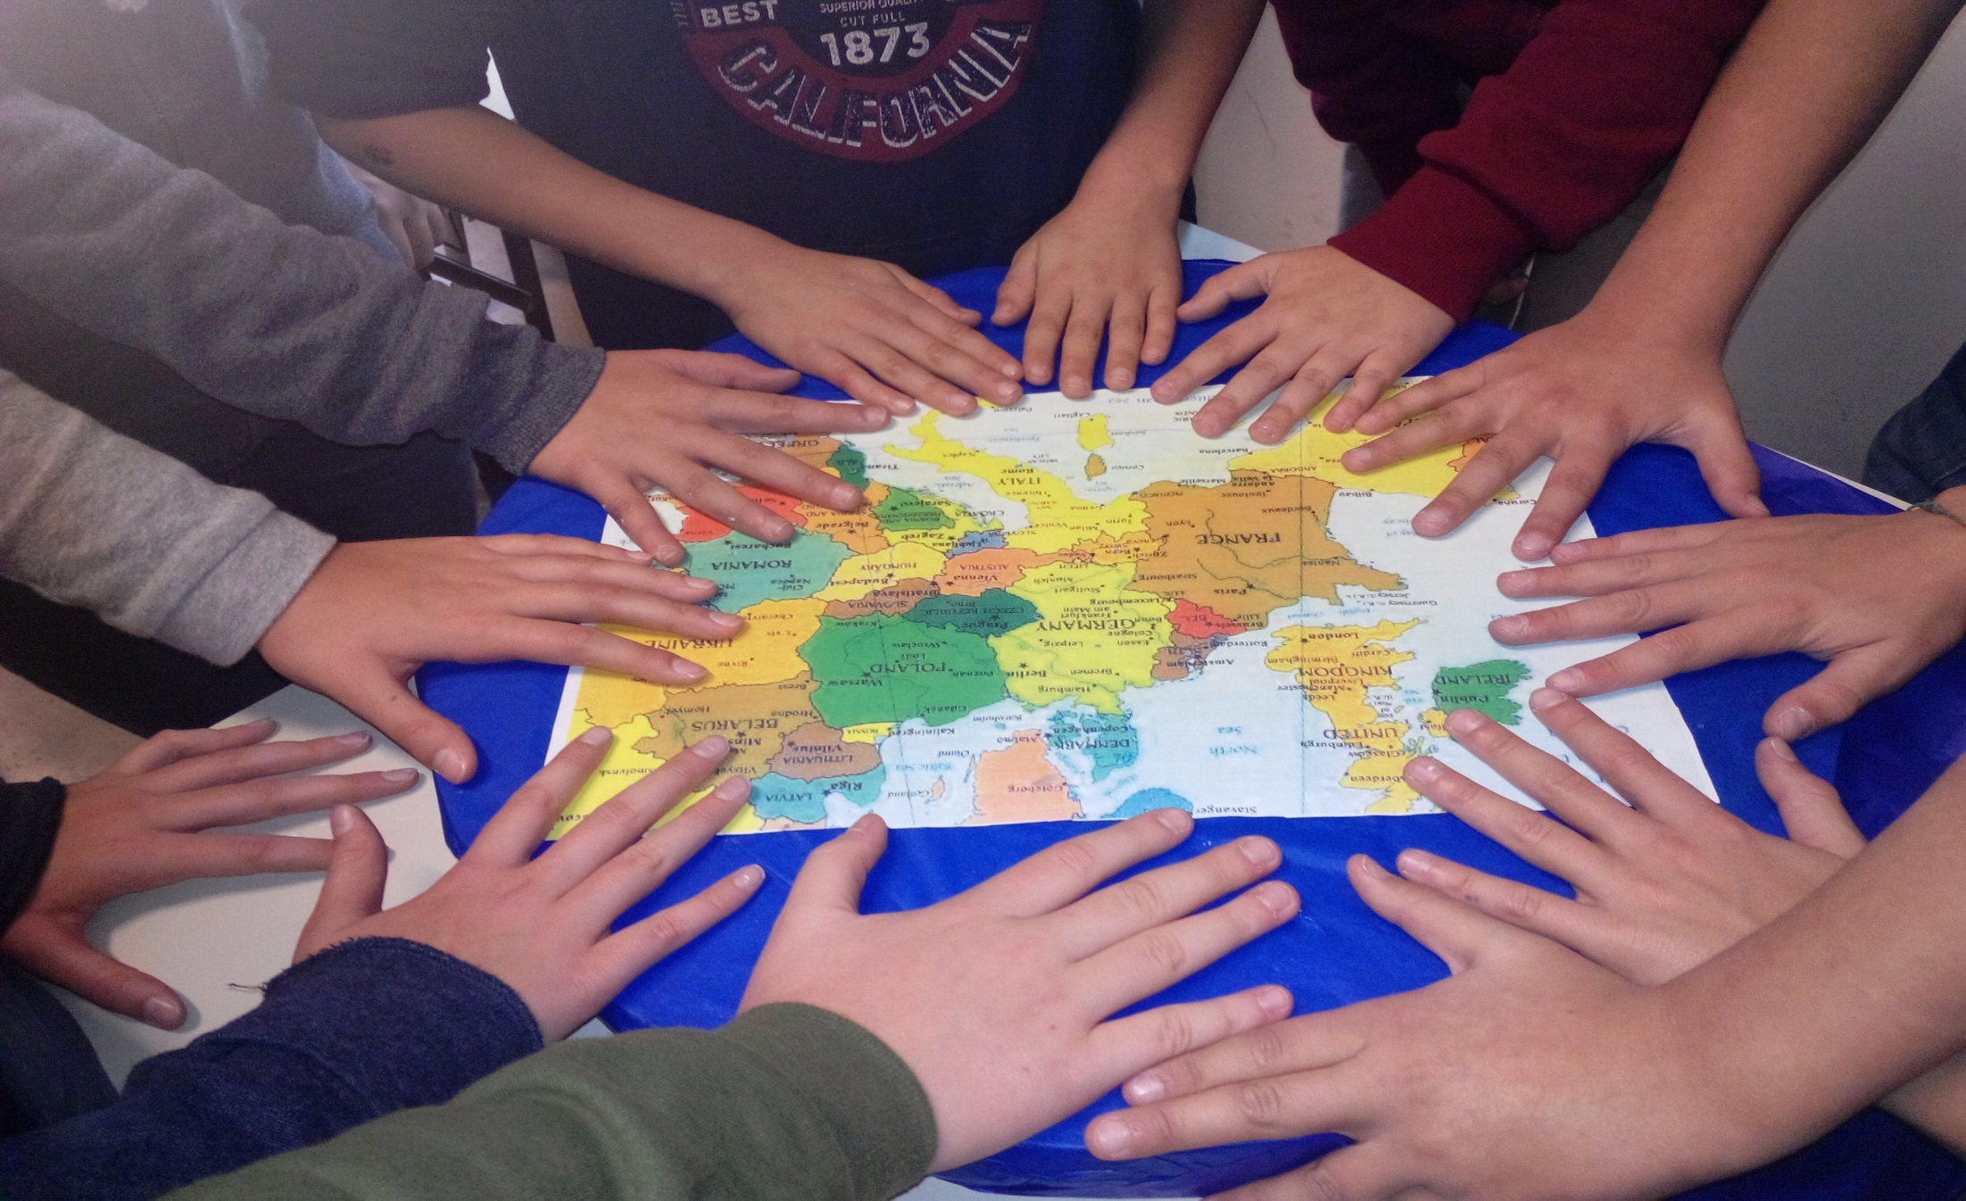
Thanks for your attention.
Maria Rosaria Monteforte
A journey of 1000 miles begins with a single step
Ministero dell’istruzione, dell’università e della ricerca (MIUR). INDIRE:
Content taken from Eurypedia(http://www.indire.it/eurydice/eurypedia/)
More information about Eurydice http://eacea.ec.europa.eu/education/eurydice

