Slide 1
„NO BARRIERS FOR EUROPEANS”
Disability situation in Poland

Slide 2
This diagram shows disability situation in 16 provinces of Poland

Slide 3
How can we help the disabled in Poland ?

Slide 4
Organizations
Office of the
Government Plenipotentiary
for the Disabled
POLAND UNION FOR THE BLIND
POLAND UNION
FOR THE DEAF

Slide 5
Programmes
THE INTERNET TV
FOR THE DEAF
NO
BARRIERS TV
Educational channels for the disabled

Slide 6
Competitions

Slide 7
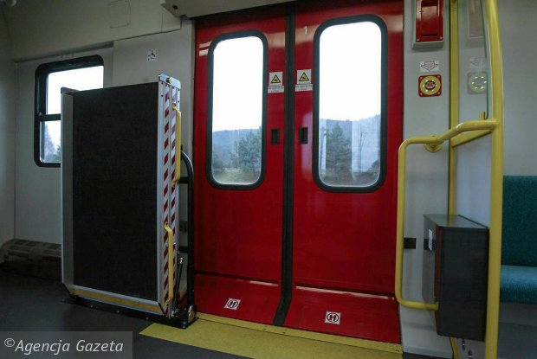
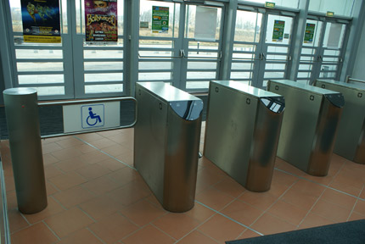
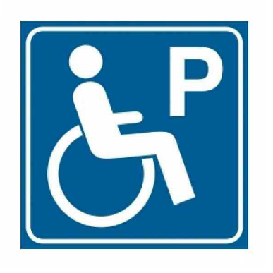
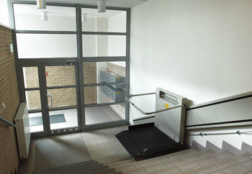
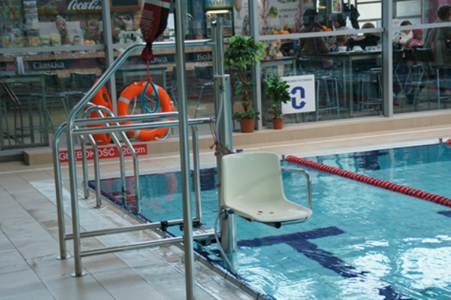

Slide 8
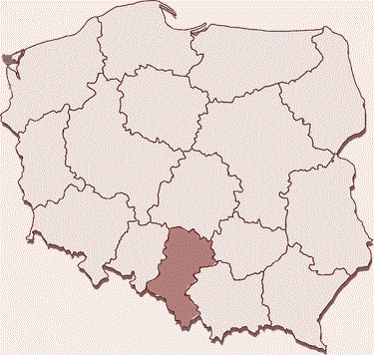
The map of the most popular Disability Centers in Poland:

Slide 9
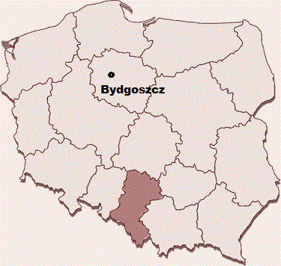
The map of the most popular Disability Centers in Poland:

Slide 10
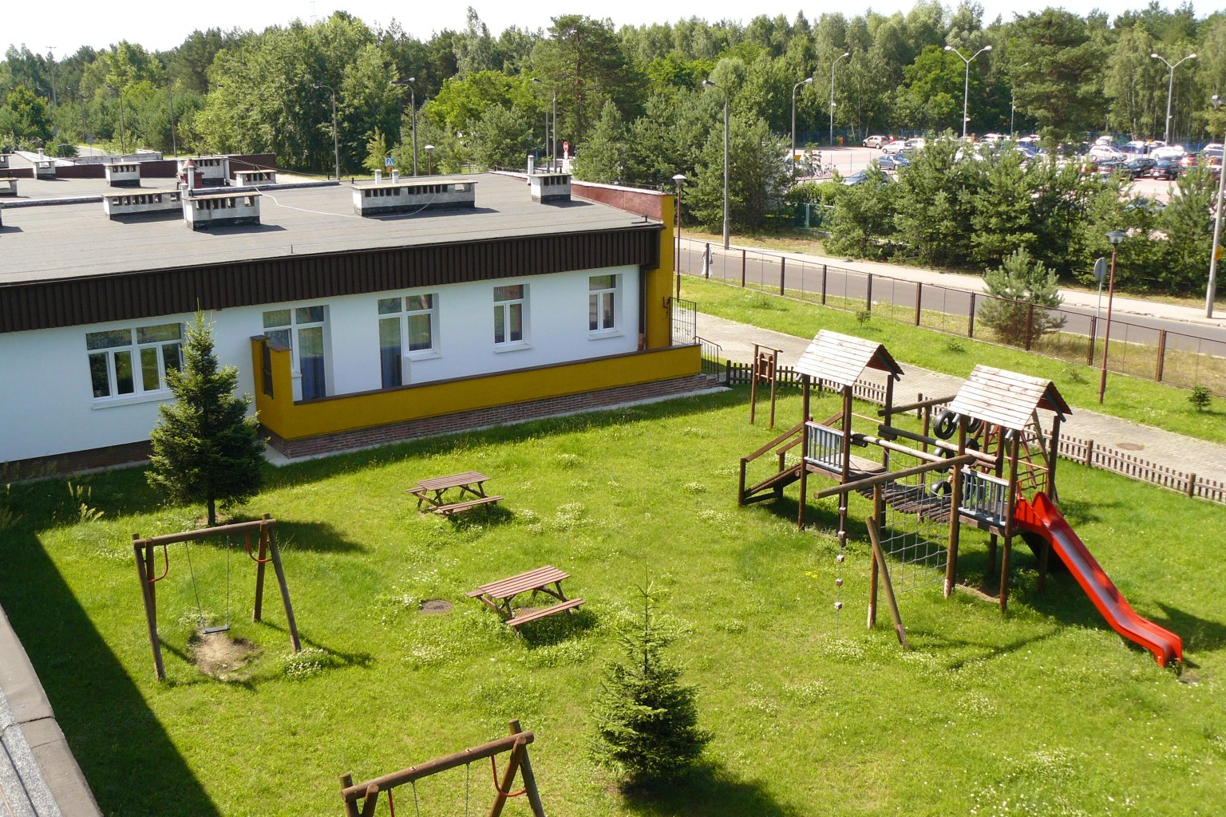

Slide 11
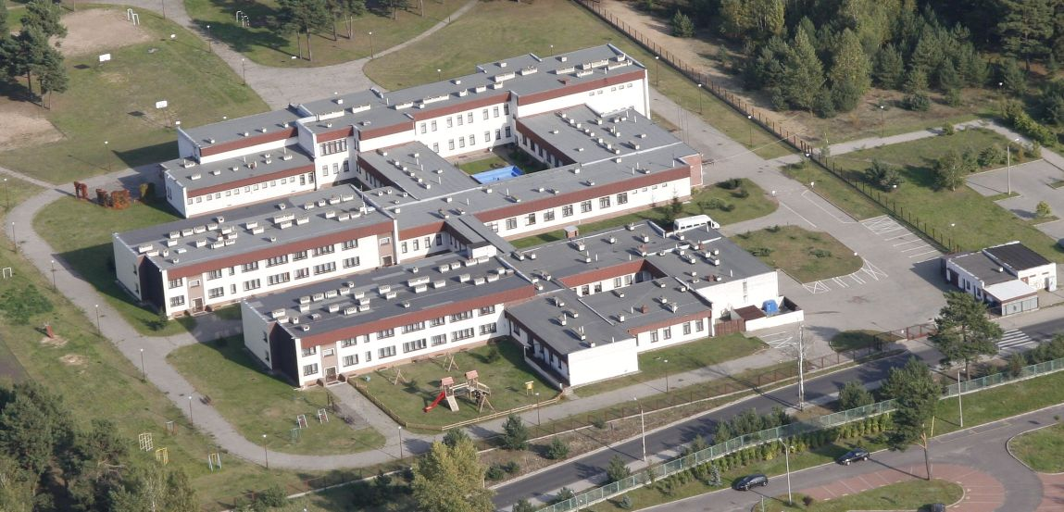

Slide 12
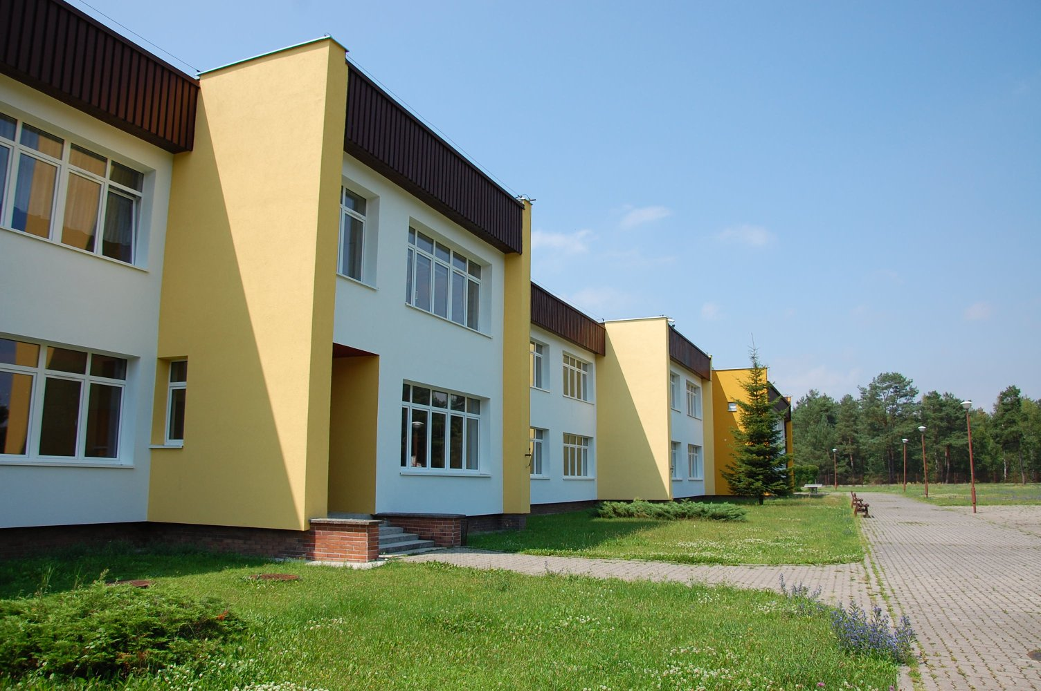

Slide 13
The map of the most popular Disability Centers in Poland:

Slide 14
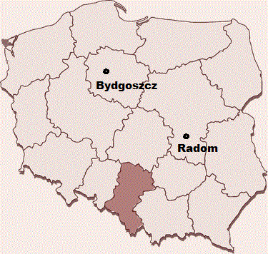
The map of the most popular Disability Centers in Poland:

Slide 15
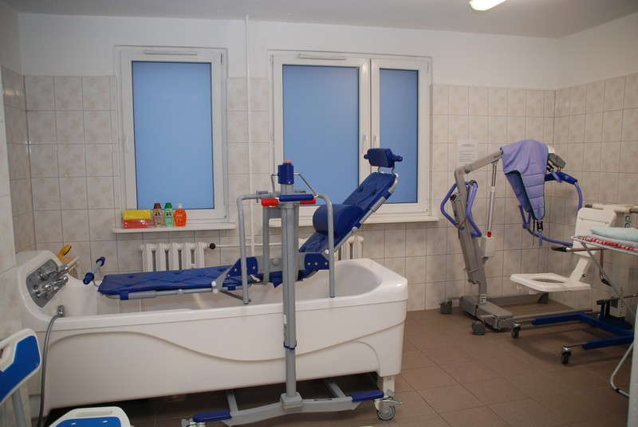

Slide 16
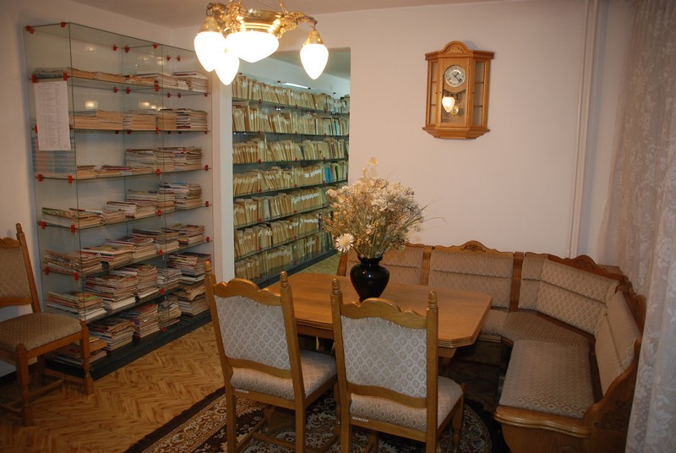

Slide 17
The map of the most popular Disability Centers in Poland:

Slide 18
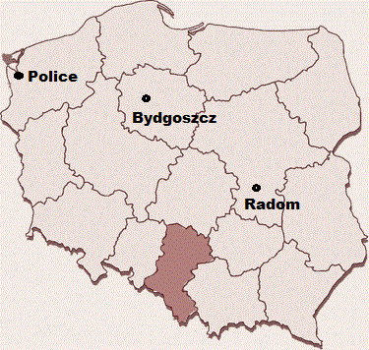
The map of the most popular Disability Centers in Poland:

Slide 19
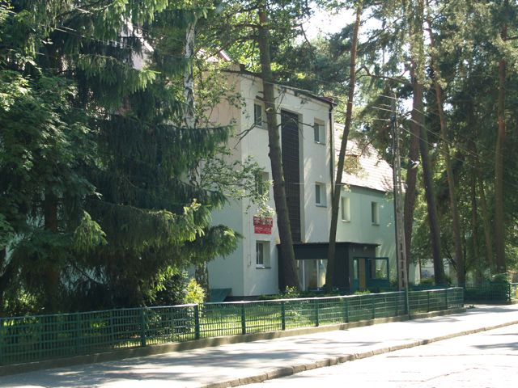

Slide 20
The map of the most popular Disability Centers in Poland:

Slide 21
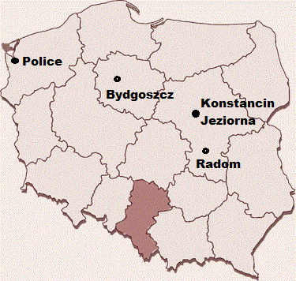
The map of the most popular Disability Centers in Poland:

Slide 22
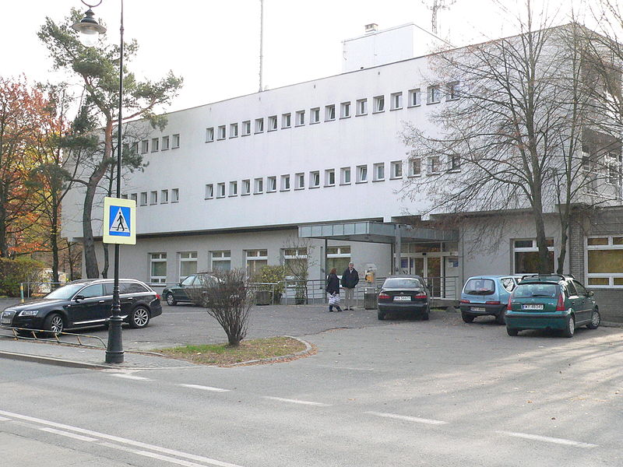

Slide 23
The map of the most popular Disability Centers in Poland:

Slide 24
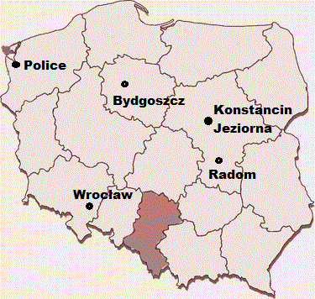
The map of the most popular Disability Centers in Poland:

Slide 25
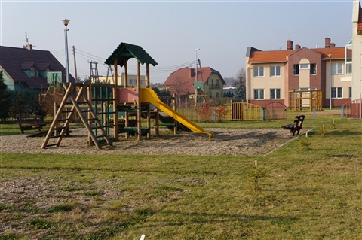

Slide 26
The map of the most popular Disability Centers in Poland:

Slide 27
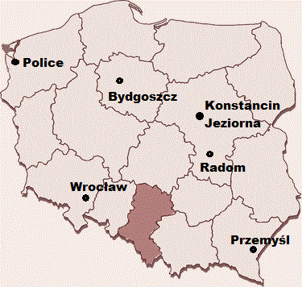
The map of the most popular Disability Centers in Poland:

Slide 28
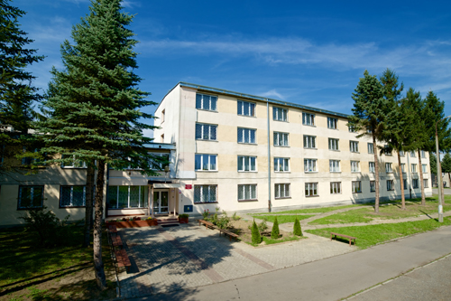

Slide 29
The map of the most popular Disability Centers in Poland:

Slide 30
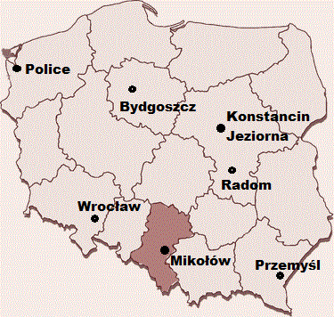
The map of the most popular Disability Centers in Poland:

Slide 31
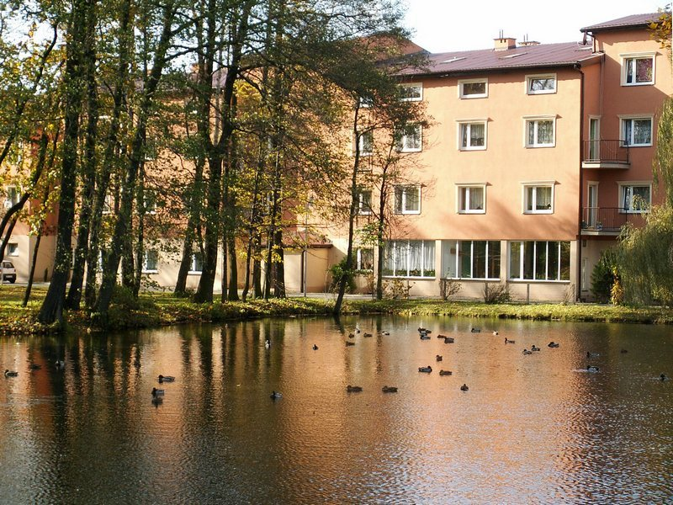

Slide 32
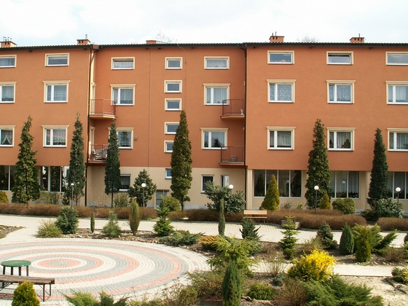

Slide 33
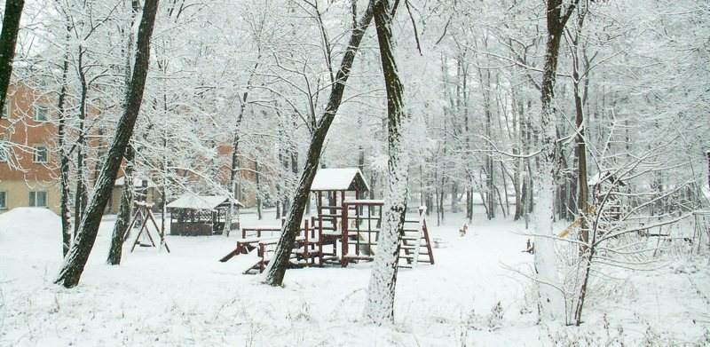

Slide 34
The map of the most popular Disability Centers in Poland:

Slide 35
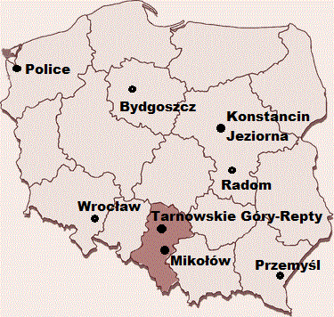
The map of the most popular Disability Centers in Poland:

Slide 36
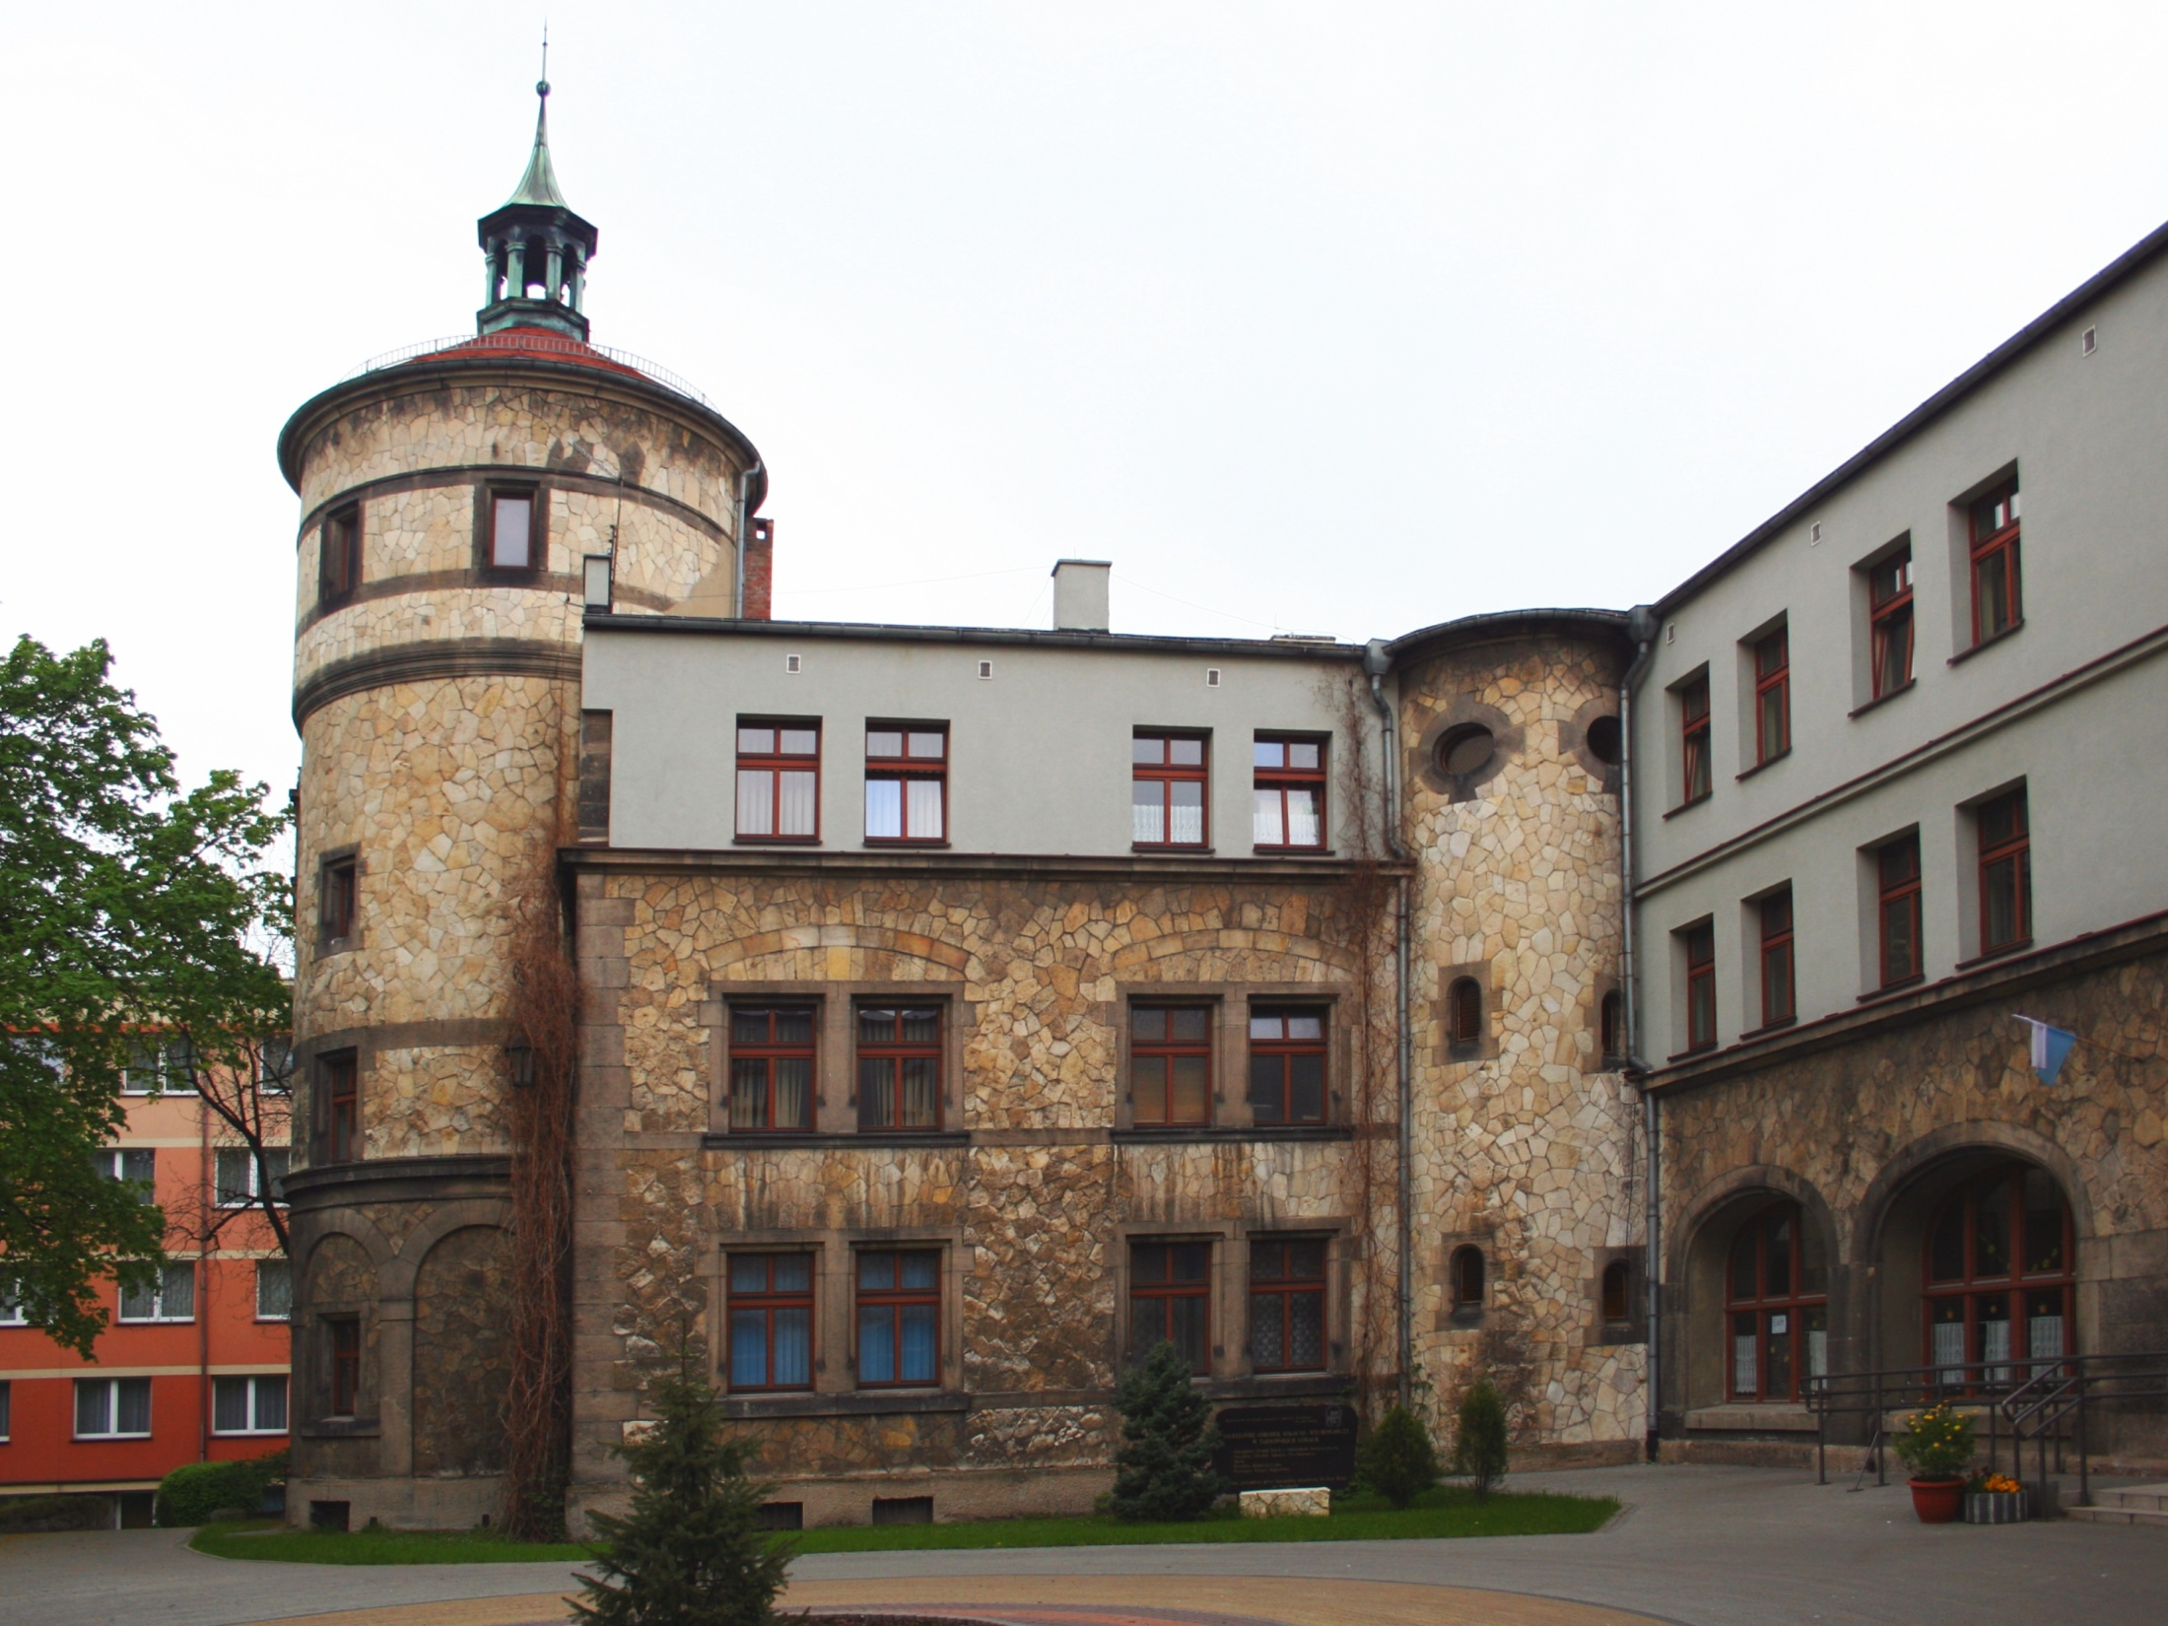

Slide 37
The map of the most popular Disability Centers in Poland:

Slide 38
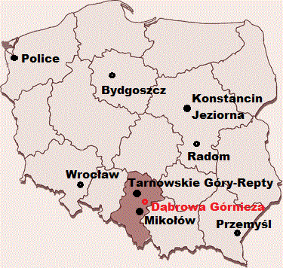
The map of the most popular Disability Centers in Poland:

Slide 39
Disability Centre in Dąbrowa Górnicza. It was bulit in 2013.

Slide 40
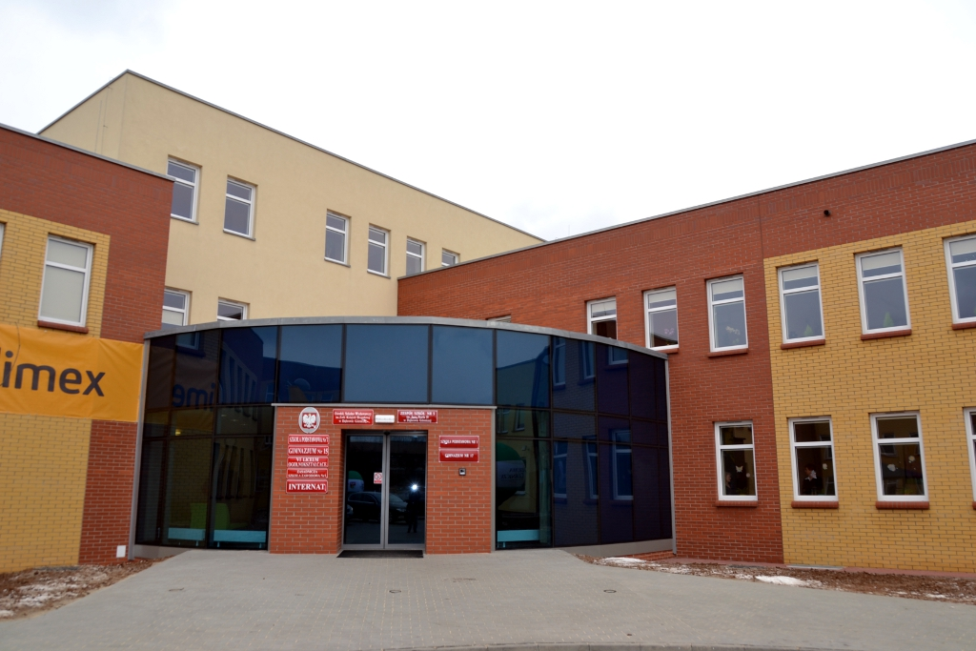

Slide 41
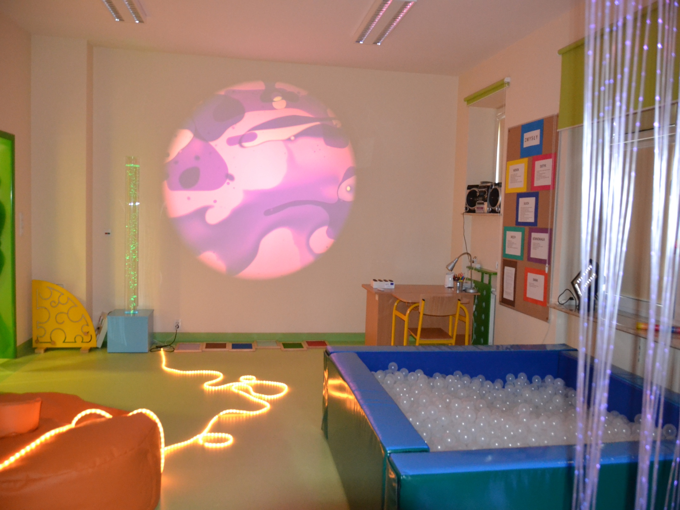

Slide 42
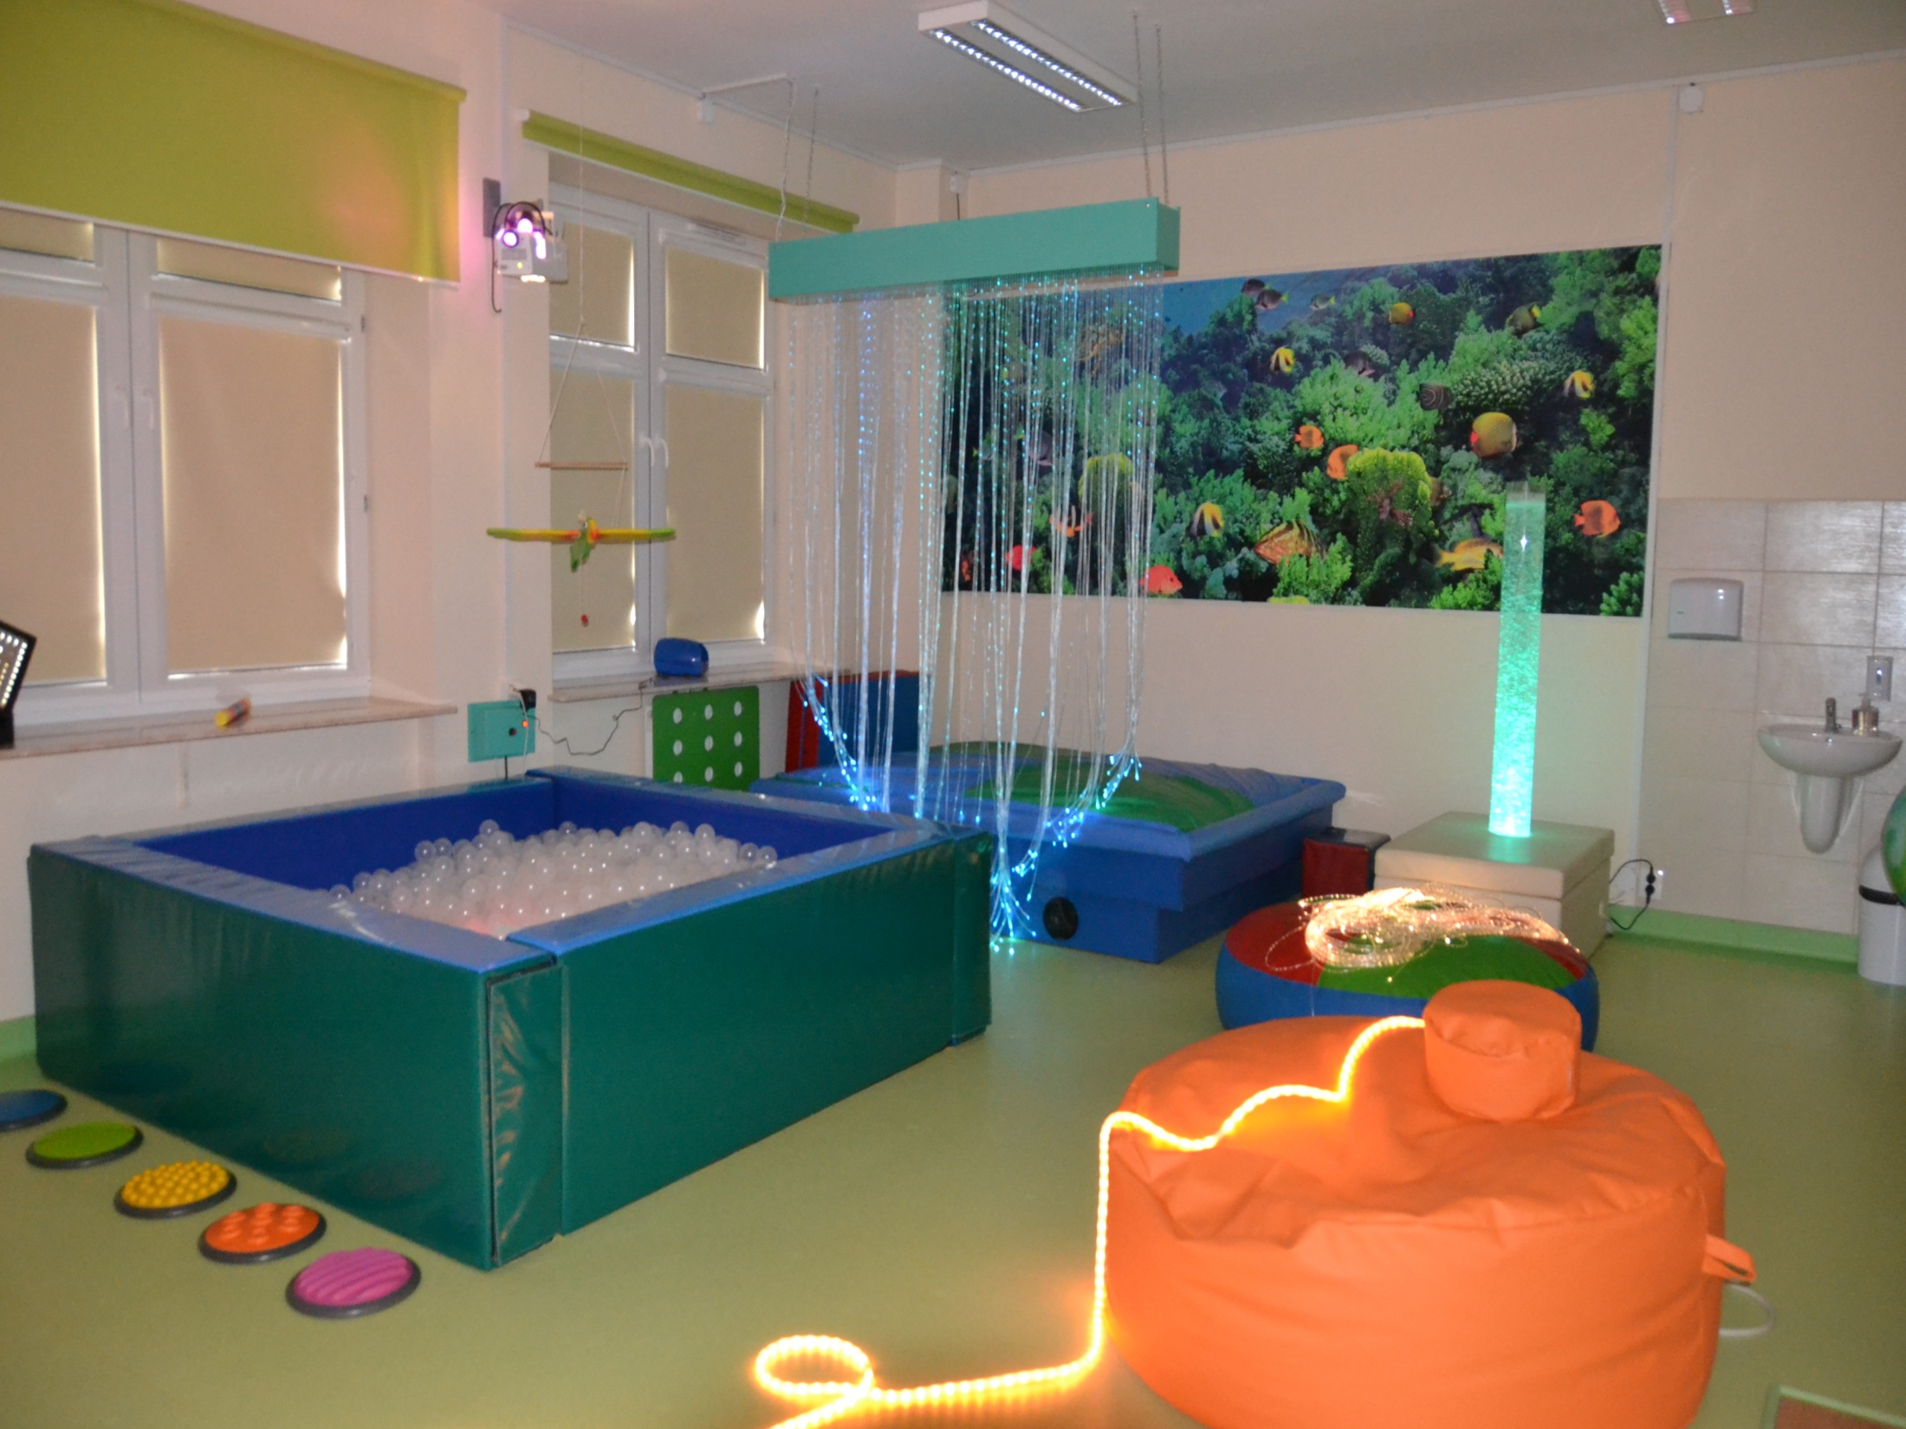

Slide 43
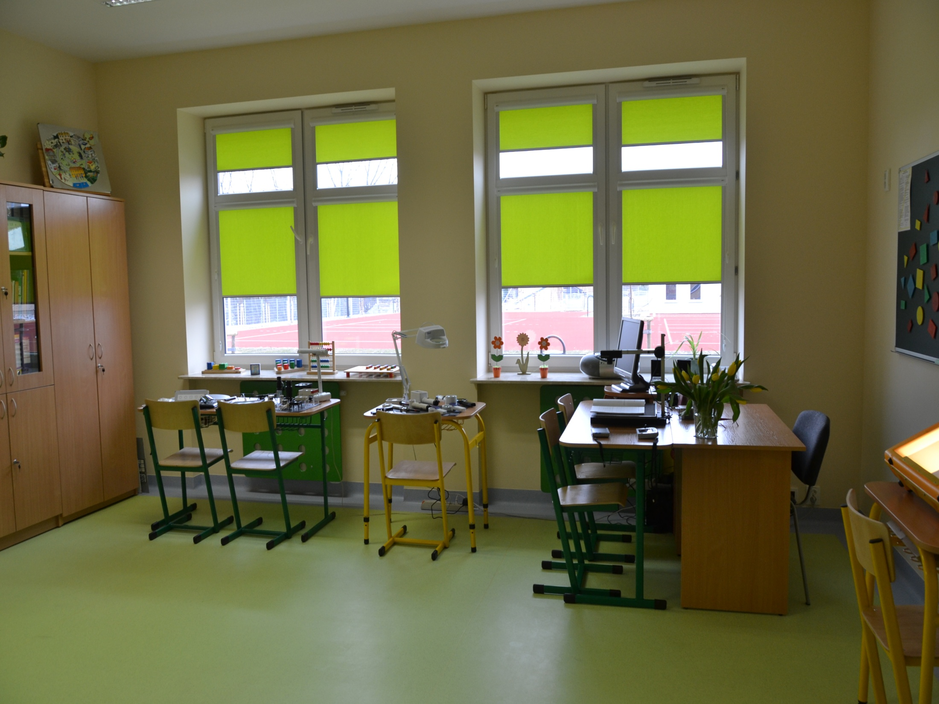

Slide 44
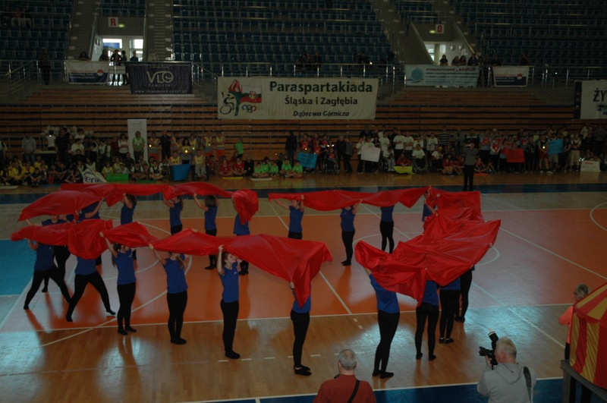
No barriers competition in Dąbrowa Górnicza

Slide 45
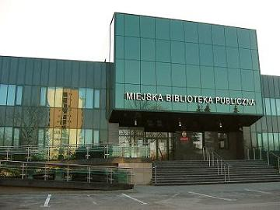
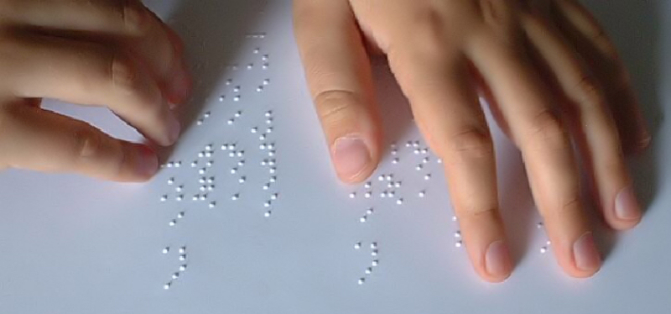
The blind can read in our local library in Dąbrowa Górnicza.

Slide 46
Disability situation in our school:
There are some pupils with special needs in our school. These ones have got the separated opinions of a psychologist and according to them the teachers have to fit the right methods and forms of working in. Additionally, two children are suffer from cerebral palsy (CP). Cerebral palsy is caused by damage to the motor control centres of the developing brain and can occur during pregnancy, during childbirth, or after birth up to about age three.

Slide 47
The integration of abled and disabled children

Slide 48
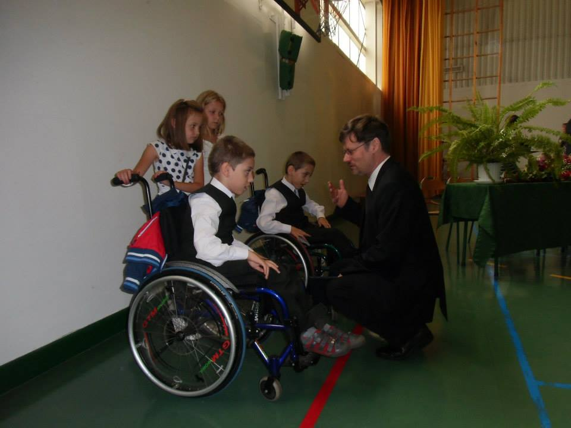

Slide 50
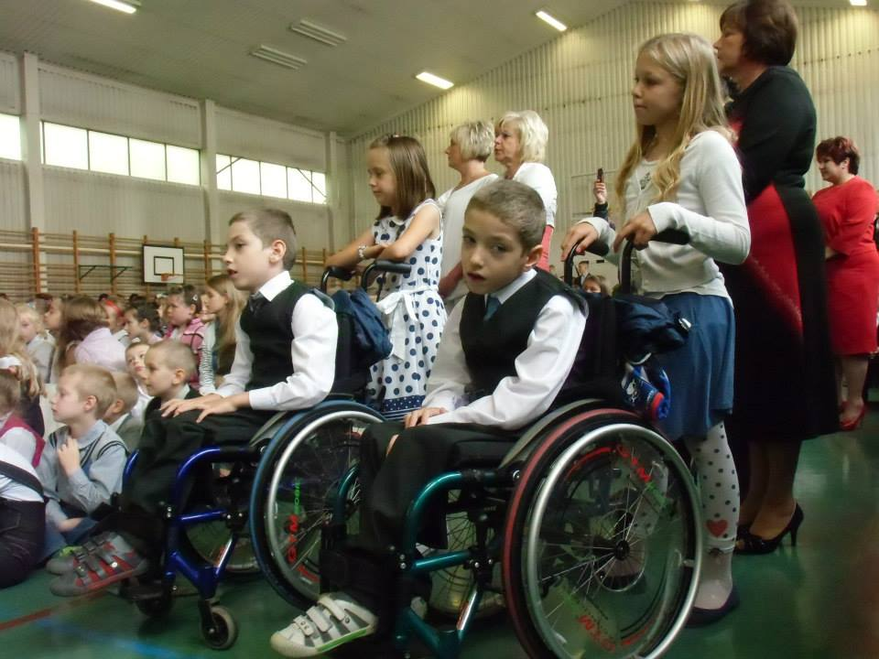

Slide 51
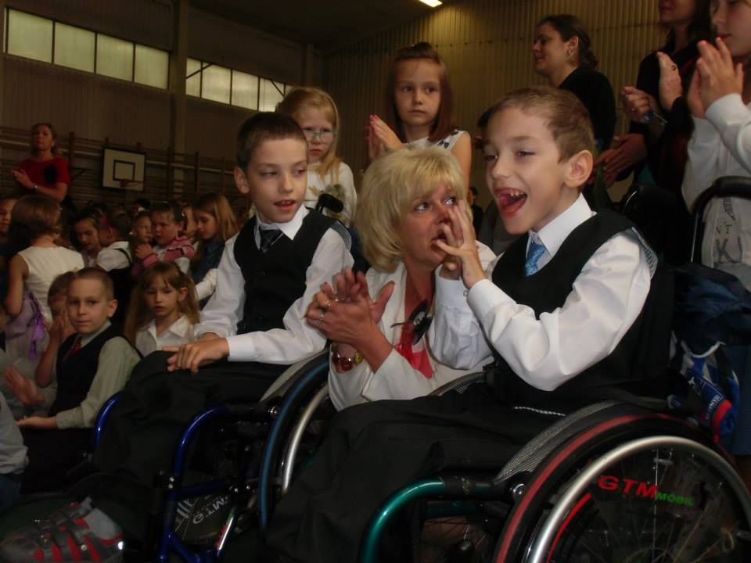

Slide 52
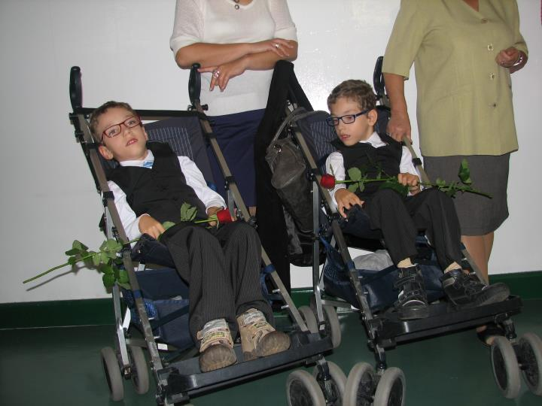

Slide 53
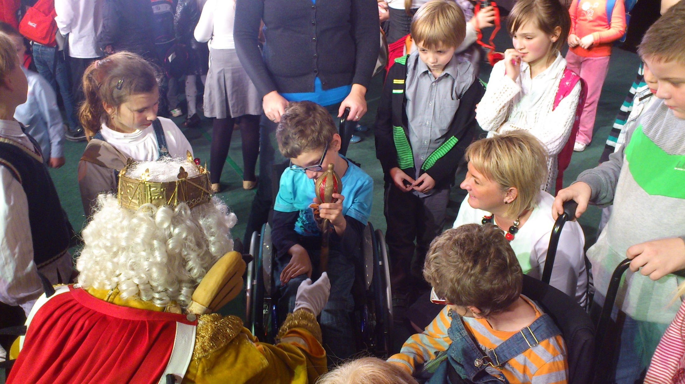

Slide 54
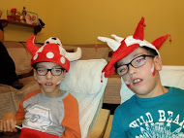
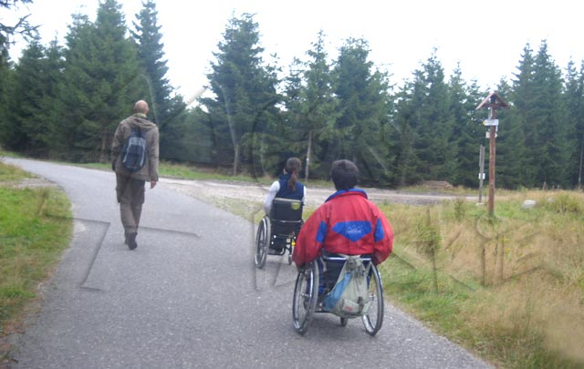
Thank you for your attention ☺

