Slide 1
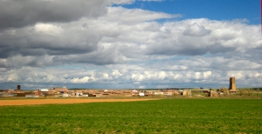
“no barriers for europeans” in the school C.R.A. CAMPOS DE CASTILLA BECILLA DE VALDERADUEY

Slide 2
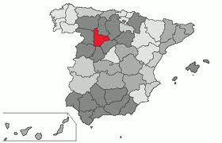
SOME INFORMATION ABOUT THE AREA
Our school is placed in the north of the province of Valladolid, in the north part of Spain.

Slide 3
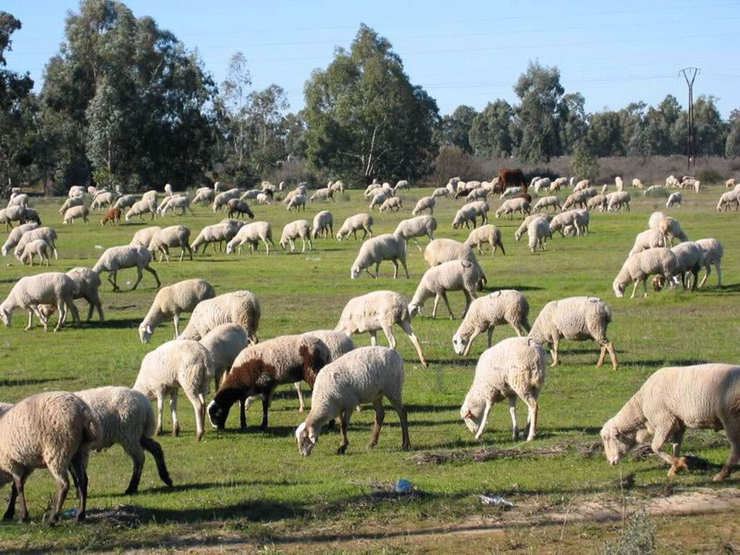
SOME INFORMATION ABOUT THE AREA
The villages of the zone are very small and the people are employed at the agriculture and the farming. The current problem is that people move to the cities to find more opportunities.

Slide 4
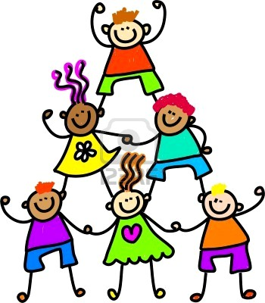
SOME INFORMATION ABOUT THE SCHOOL
This is a “special” school because is formed in 4 different schools. Each school is in a village and there are four villages.
Becilla de Valderaduey
Ceinos de Campos.
Castroponce de Valderaduey.
Bolaños de Campos.

Slide 5
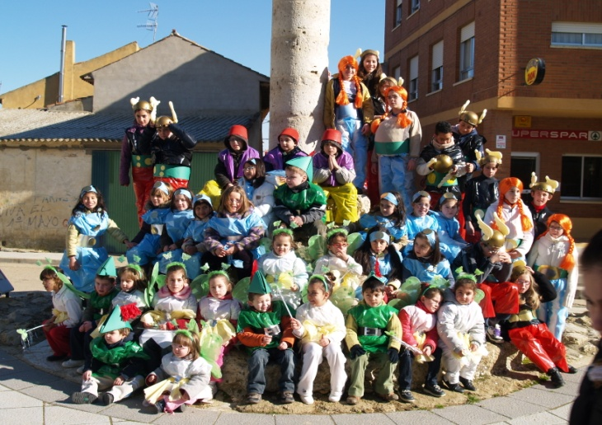
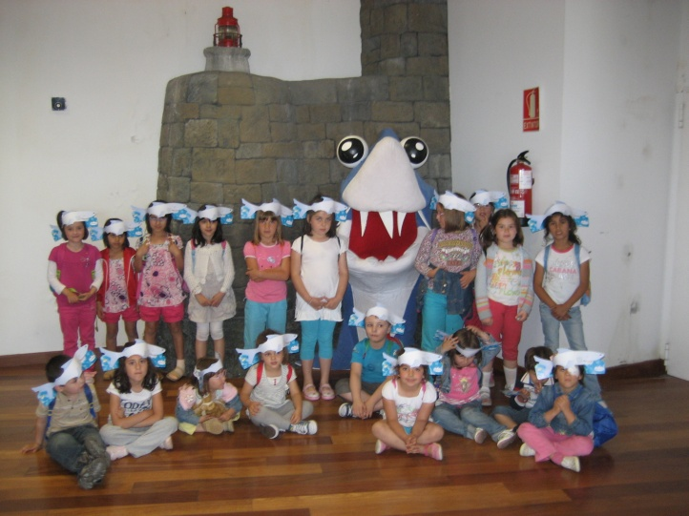
SOME INFORMATION ABOUT THE SCHOOL
The school have 46 children.
Becilla de Valderaduey. 15 pupils.
Ceinos de Campos. 11 pupils.
Castroponce de Valderaduey. 8 pupils.
Bolaños de Campos. 12 pupils.

Slide 6
Becilla de valderaduey
Population. About 300 habitants.
Clasroom.Two clasrooms.
Pupils. 15 pupils. 5 boys and 10 girls.
11 in primary education and 4 in infant education.
Only 3 children are spanish. 12 pupils are immigrants from Bulgaria and Morocco.
Teachers. 2 teacher.

Slide 7
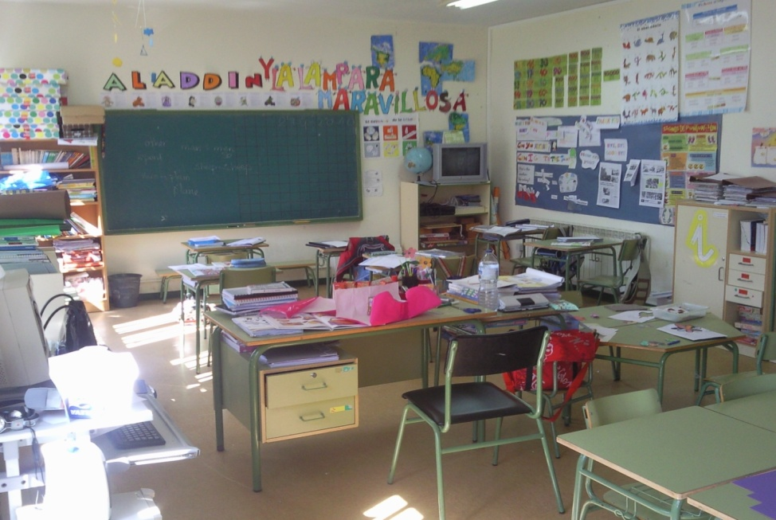
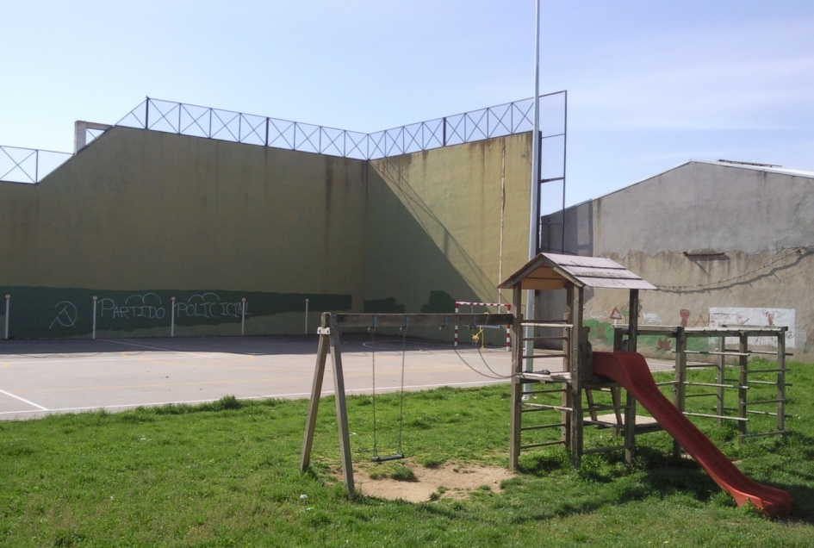
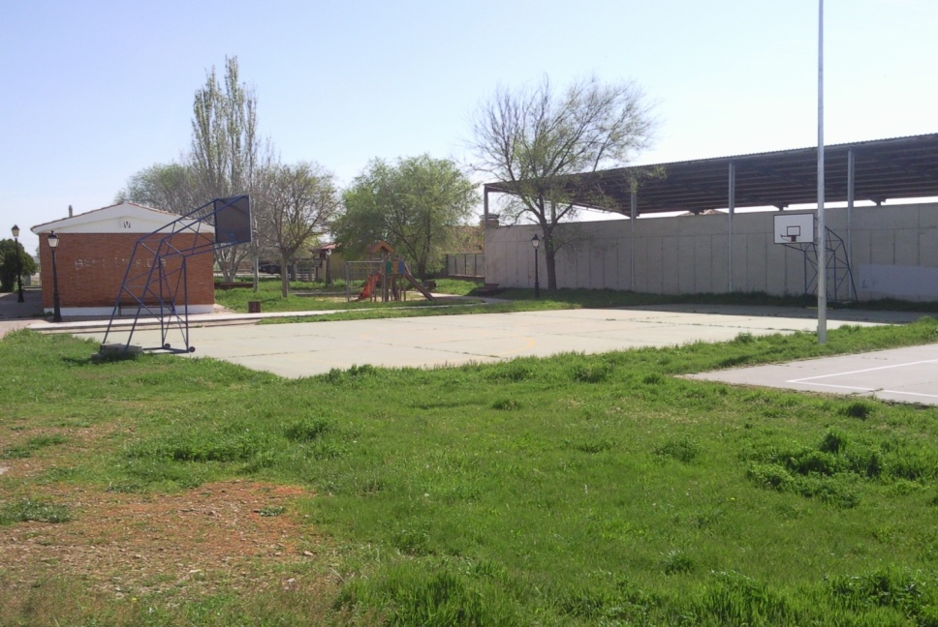
Our spaces in becilla de Valderaduey

Slide 8
Ceinos de campos
Population. About 400 habitants.
Classroom. One classroom. All children are in the same classroom, from 3 to 12 years old.
Pupils. 11 pupils. 2 in infant education and 9 in primary education.
Teachers.One teacher for all children.

Slide 9
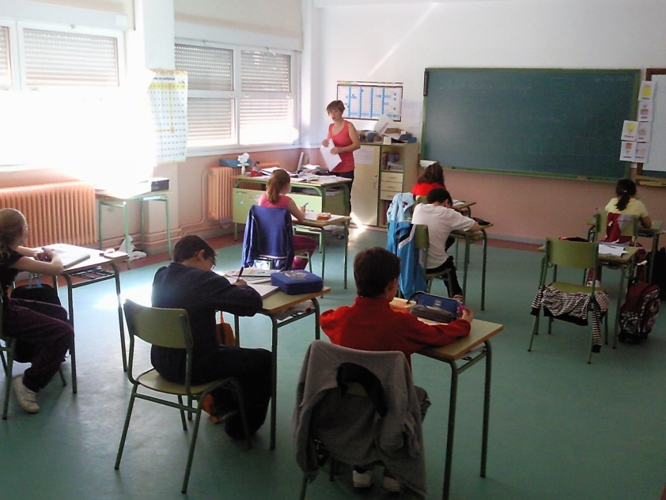
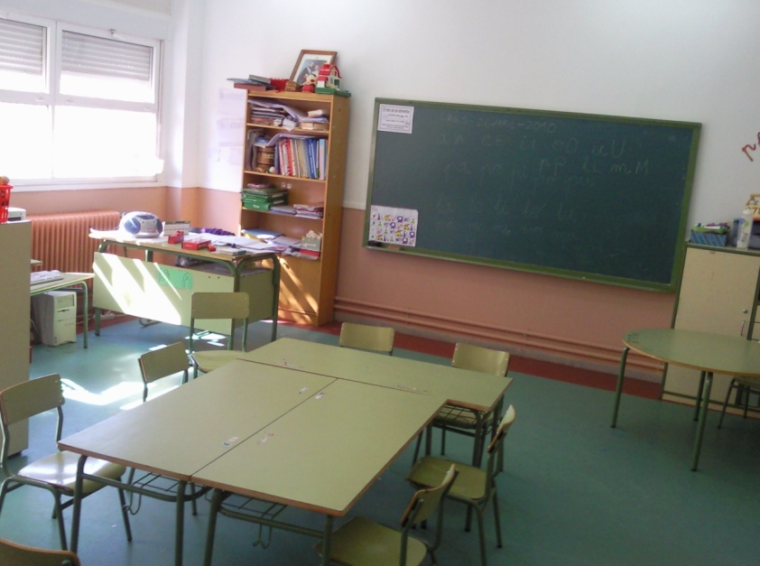
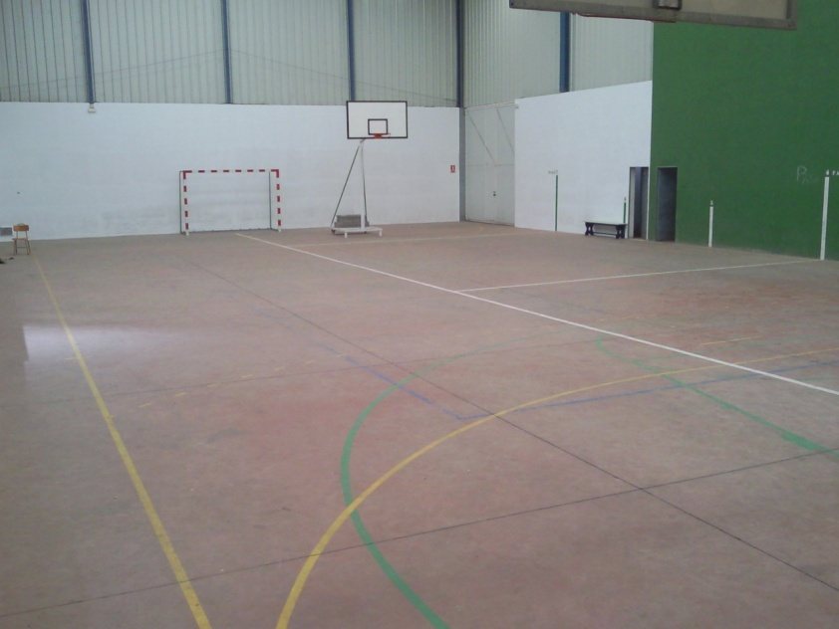
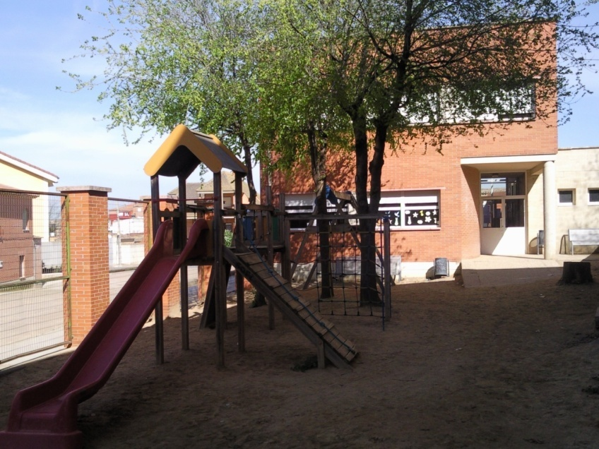
Our spaces in ceinos de campos

Slide 10
CASTROPONCE DE VALDERADUEY
Population. About 150 habitants.
Classroom. One classroom.
Pupils. 8 pupils, all in 2 in primary education.
Teachers. One teacher. One generalist teacher.

Slide 11
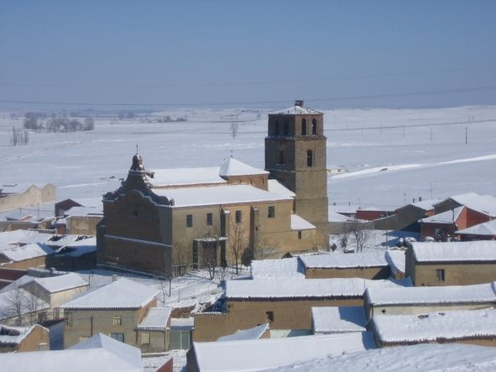
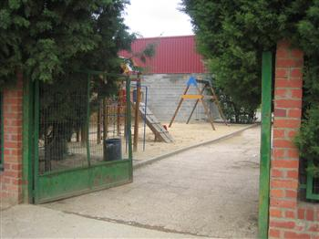
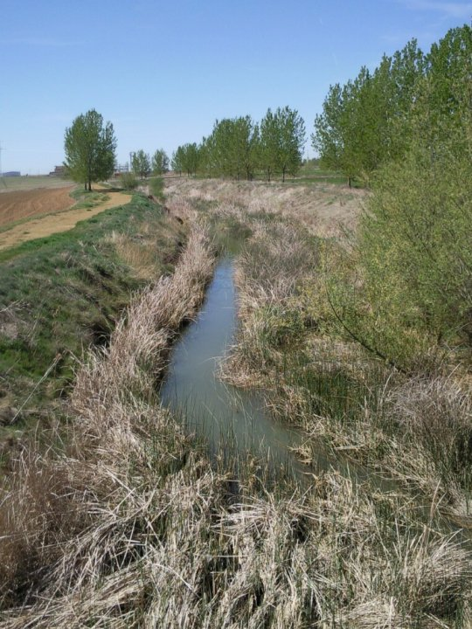
Our spaces in castroponce de valderaduey

Slide 12
BOLAÑOS DE CAMPOS
Population. About 500 habitants.
Classroom. Two classrooms. One of infant education (3-6 years) and one of primary education (6-12 years).
Pupils. 12 pupils. 4 in infant education and 8 in primary education.
Teachers. Two teachers. One generalist teacher and one infant teacher.

Slide 13
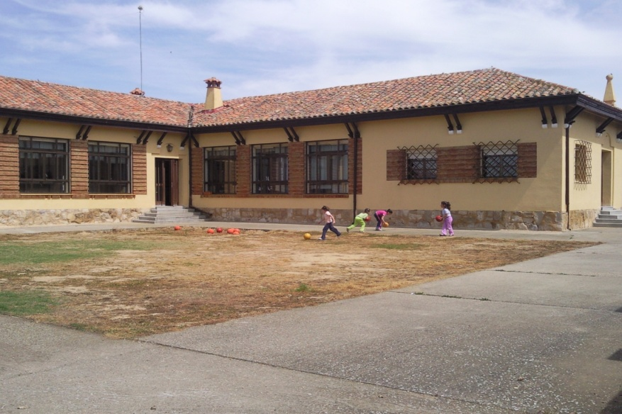
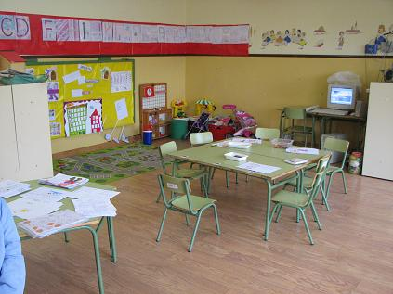
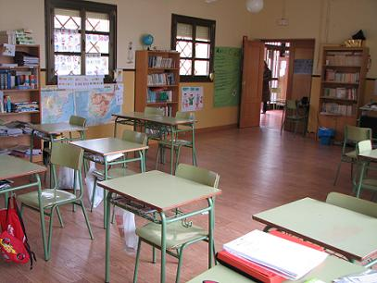
Our SPACEs in bolaños de campos

Slide 14
TEACHERS TEAM
In our school there are nine teachers.
1. Physical Education and headmaster.
1. Primary Education and second headmaster.
1. English teacher
1. Music teacher.
2. Infant education teachers.
3. Primary Education teachers.
And there are other teachers that work in our school sometimes at week.

Slide 15
SMALL SCHOOL
BIG PROJECTS
C.R.A. CAMPOS DE CASTILLA

