Slide 1
DISABILITIES IN SPAIN
C.R.A. CAMPOS DE CASTILLA. BECILLA DE VALDERADUEY

Slide 2
DISABILITIES CLASIFICATION
To see.
To listen.
To communicate.
To learn.
To move.
To move hands and arms.
To move out of our house.
To live with other people.

Slide 3
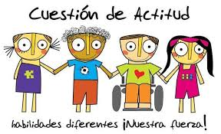

Slide 4
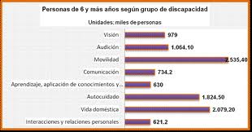

Slide 5
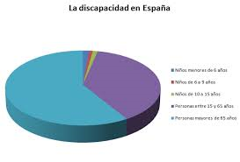

Slide 6
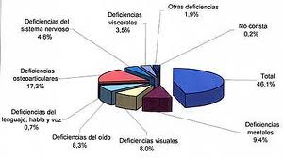

Slide 7
EVOLUTION OF DISABILITY POPULATION IN SPAIN (1986 – 2010)
TOTAL POPULATION | DISABILITY POPULATION | %
(1986) 38.341.126 | 5.743.291 | 14,98%
(2010) 39.247.019 | 3.528.221 | 8,99%

Slide 8
COMPARATIVE EVOLUTION OF DISABILITIES BY AGES GROUPS
AGE | POPULATION 1986 | % | POPULATION 2010 | %
0-5 | 43.047 | 1,8 | 49.562 | 2,2
6-14 | 157.836 | 2,8 | 61.337 | 1,7
15-24 | 215.073 | 3,1 | 110.285 | 1,9
25-34 | 211.094 | 4,6 | 185.906 | 2,8
35-44 | 282.682 | 6,4 | 230.251 | 4,0
45-54 | 647.840 | 14,0 | 305.909 | 6,4
55-64 | 1.290.312 | 27,8 | 512.304 | 13,0
+65 | 5.743.291 | 15,0 | 3.580.220 | 9,0

Slide 9
IN SPAIN, GOVERMENT, ASSOCIATIONS AND SOCIETY ARE WORKING TO GET A TOTAL INTEGRATION OF DISABLED PEOPLE
DISABILITIES IN SPAIN

Slide 10
DISABILITIES IN SPAIN
Usually children with disabilities are in “normal” schools but in Spain exists specific schools for them with the best methods. Those schools are in the cities.
If you live 70km from the town (where there are a special school), the goverment prepares a specific classroom in school with specific teachers. Depending on the kind of disability, children can keep in usual classroom or need a special school.

Slide 11
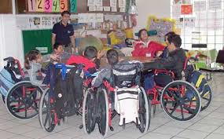
DISABILITIES IN SPAIN

Slide 12
DISABILITIES IN SPAIN

Slide 13
AWARENESS
All schools in Spain was adapted for children with disabilities.
Rest of building was adapted too during last years, our laws are very hard about this adaptations.
There are too much advertisements about disabilities. All people know this problems and our society has get to accept.
There are too much advertisements about disabilities. All people know this problems and our society has get to accept.

Slide 14
PRINCIPAL ASOCIATIONS

Slide 15
DISABILITIES IN OUR SCHOOL
In our school there are only one pupil with disabilities, mental disability.
She work 5 sessions per week with specialist teacher.
The rest of classes she is working with the group.
She needs adaptation of educational contens, during all primary education. She is six years old and she is working like she was four years old.

Slide 16
DISABILITIES IN OUR SCHOOL
In our school there are too much inmigrant children, they haven´t disabilities but they need special attention and needs.
There are two special teachers for these students.
Audition and language teacher and Teraphic teacher, they attend to 9 children with some problems, about language principally.

Slide 17
THE BEST VIDEO
http://www.dailymotion.com/video/x1cq0y9_cuerdas-el-mejor-corto-de-animacion

