Slide 1
I.C. "L. DA VINCI - G. RODARI"
LATINA
ITALIA

Slide 2
“La disabilità è una questione
di percezione. Se puoi fare anche una sola cosa bene, per qualcuno tu sei necessario.”
Disability is a matter of comprehension.
If you can also do one thing well,for someone you are necessary.”

Slide 3
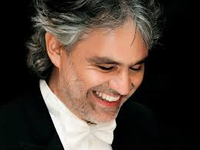
A history of success
A famous italian artist
Andrea Bocelli

Slide 4
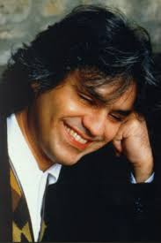
Born on September 22, 1958, in Lajatico, near Pisa, in Italy, Andrea Bocelli became interested in music at an early age. He was only 6 years old when he began studying piano.
He later learned flute and saxophone, and was often asked to sing at family gatherings. Visually impaired from birth, he became blind at the age of 12 following a soccer injury.

Slide 5
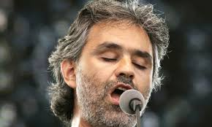
Bocelli had his first taste of success in a singing competition in 1970. He continued to hone his talent, studying voice with Luciano Bettarini. At University of Pisa, Bocelli studied law. But he did not abandon his music. Bocelli studied with Franco Corelli and took up playing piano in bars to pay for his lessons.

Slide 6
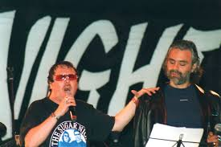
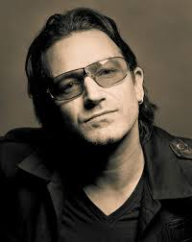
One of Bocelli's first lucky breaks came in 1992
when he recorded a demo
tape of "Miserere" for Zucchero Fornaciari,
with the
song co-written
by U2's Bono.

Slide 7
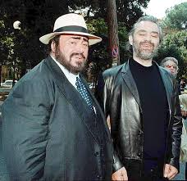
That recording was heard by famed tenor Luciano Pavarotti.
Pavarotti then encouraged Fornaciari to use Bocelli for the song. In the end, Bocelli and Pavarotti performed "Miserere" together, which became a European hit.

Slide 8
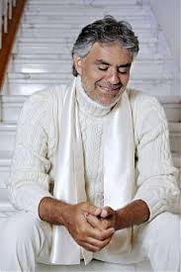
Bocelli competed in the Sanremo Festival in 1994. He won the top honors
in the newcomers' category. That same year, Bocelli released his first album
in Italy, Il Mare Calmo Della Sera..

Slide 9
He scored a major hit in Europe a short time later with Bocelli, which featured "Con Te
Partirò”. With Sogno (1999), Bocelli cemented his status as an international singing sensation

Slide 10
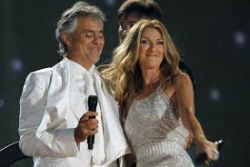
The hit record included a duet with Celine Dion on the song "The Prayer."
More popular albums soon followed, including 2001's Cieli di Toscana and 2006's Amore.

Slide 11
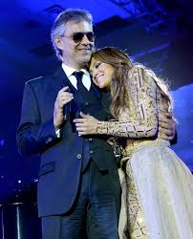
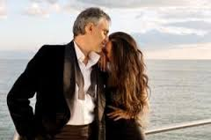
More recently, Bocelli collaborated with the likes of Jennifer Lopez and Nelly Furtado on his 2013 album Passione

Slide 12
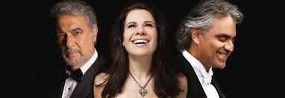
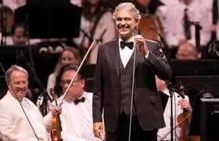
He also joined forces with Placido Domingo and Ana Maria Martinez on 2014's Manon Lescaut.
On the first of May 2015 he sang at the inauguration of Expo in Milan

Slide 13
Il mondo è nelle mani di coloro che hanno il coraggio di sognare e di correre il rischio di vivere i propri sogni. (P. Coelho)
The world lies in the hands of those that have the courage to dream and who take the risk of living out their dreams!
(P. Coelho)

