Slide 1
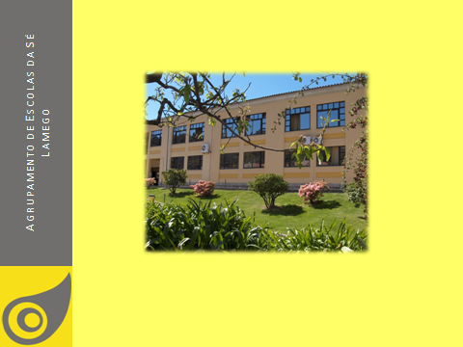
KA2 – Cooperation for Innovation and Good Practices - Strategic Partnership
1st Short-term joint staff training event
Dąbrowa Górnicza, Poland - November 2014
OUR COUNTRY, OUR TOWN, OUR SCHOOL

Slide 24
THANK YOU!

