Slide 1

Situation of People with Disabilities in Lithuania

Slide 2
Disability is a term, covering impairments, activity limitations, and participation restrictions. It is not just a physical ailment, which changes person’s living habits and potential. The main problems faced by people with disabilities are mostly psychological and social. After the restoration of independence in 1991, Lithuania has experienced a lot of positive changes. Laws that protect people with disabilities and provide them with necessary support were adopted. Despite the positive changes, Lithuania is still lagging behind other countries in the world.

Slide 3
The main problems faced by disabled people in Lithuania are:
The difficulties in daily life (the disability itself, lack of self-support, different inconveniences, etc.).
Economic problems (cost of living, benefits).
Treatment problems (medical care, medicines, medical councils).
Social integration problems (mobility, work, employment).

Slide 4
A variety of organizations brings together people with disabilities, protects them and helps to solve their problems:
The Department for the Affairs of disabled at the MSSL (Public Institution)
Lithuanian Association of Disabled People (NGO)
The Association of Lithuanian National Forum of the Disabled (15 non-governmental organizations of the disabled are the members of the Forum. This Forum brings together institutions which care about the social integration of people with disabilities. Membership is open to non-governmental organizations, educational institutions and institutes, and individuals.)

Slide 5
Institutions which provide the disabled with housing and social services in Lithuania:
36 (26 of them are state) stationary social care institutions for adults with disabilities;
More than 10 independent living centres;
Child Care Homes.

Slide 6
Children with disabilities are educated to the age of 18 at:
Secondary schools (Full integration - individuals with special needs attend general education institution and they are provided with minimum special assistance or are not provided any assistance at all. Partial integration - individuals with special needs attend are provided with combined education in special education and general education institutions)
Pre-schools;
Special education institutions for children with special needs;
In speech therapy specialised kindergartens;
Day care centres;
Day care social groups;
Might be provided with education at home.

Slide 7
Families with disabled children experience lack of:
Information.
Emotional support needs. Formal and informal sources of support and help support needs, bearing in mind that the support consists of a complex system of social relations.
Help to explain the child’s situation in a right manner. Family needs help to explain the child's condition to other people and help them understand what it means to be a parent of a disabled child.
Community support needs; needs to know about getting help and community-based services for family with disabled child.
Financial support needs. Basic living expenses and costs related to the child's disability needs.
Family operation needs. Consultation needs in order to support the successful functioning of the family roles and tasks.

Slide 8
Educational institutions face the following problems:
Lack of professionals (psychologists, teachers, assistants, surdopedagogues, tiflopedagogues);
Teachers lack for competence working with children with special education needs;
Positive approach to the process;
Unequipped physical environment of schools;
There is a lack of specialized equipment, ITC tools, methodological materials and textbooks are expensive. It is difficult to adapt textbooks and exercises for students educated under the developmental programs. There is a lack of quality of assistive technology for people with disabilities;
Transportation of people with disabilities to the special education institutions doesn’t meet a want.

Slide 9
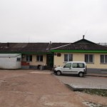
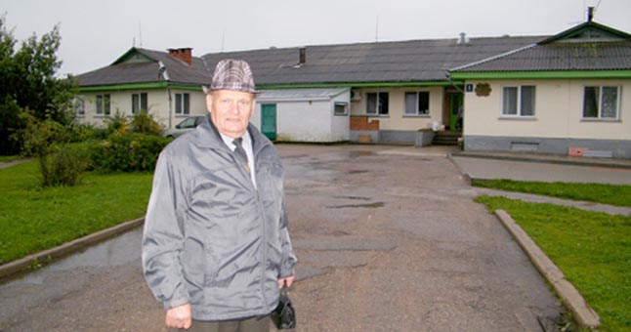
Institutions which provide people with disabilities with housing and educational or/ and occupational services in Kelmė district:
Lioliai Social Care Home

Slide 10
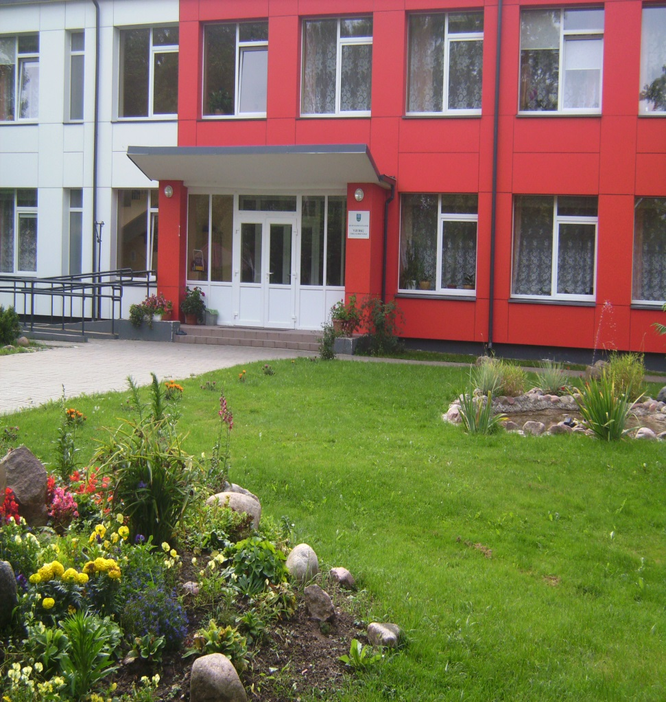
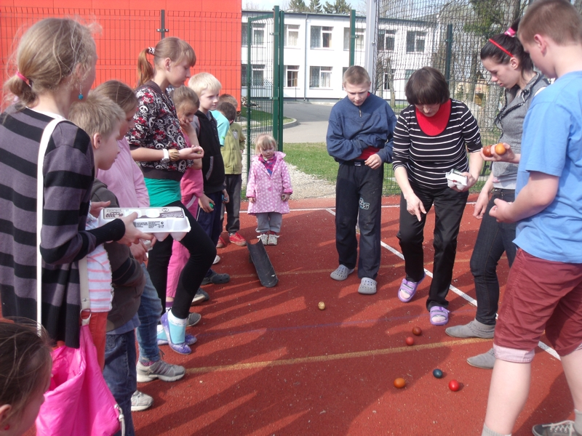
Vijurkų Child Care Home

Slide 11
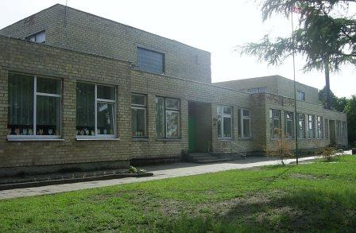
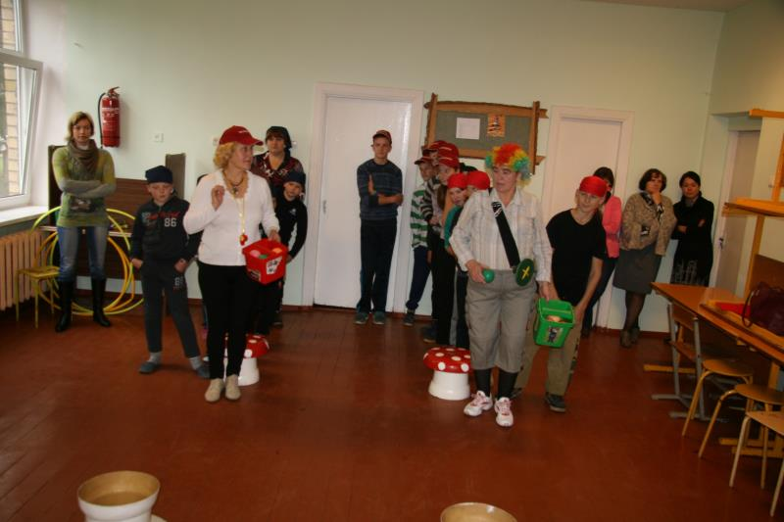
Kelme Special School

Slide 12
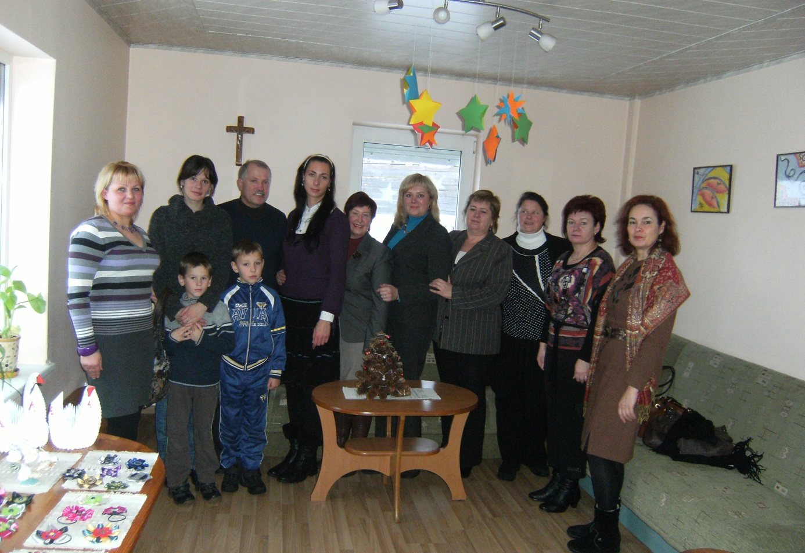
Day Centre „Parama“

Slide 13
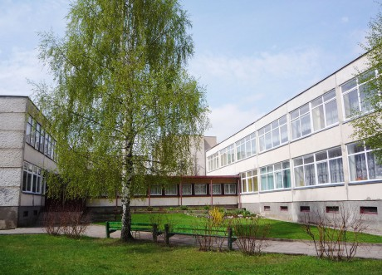
„Kūlverstuko“ Nursery-Kindergarten

Slide 14
Thank you for your attention ☺

Slide 15


The slides have been prepared by Kelmės “Kūlverstuko“ nursery-kindergarten team for 2014-2016 Erasmus+ project
“NO BARRIERS FOR EUROPEANS!“
November, 2014

