Slide 1
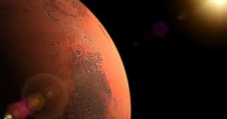
Chosen quotes from the book
"Martian"

Slide 2
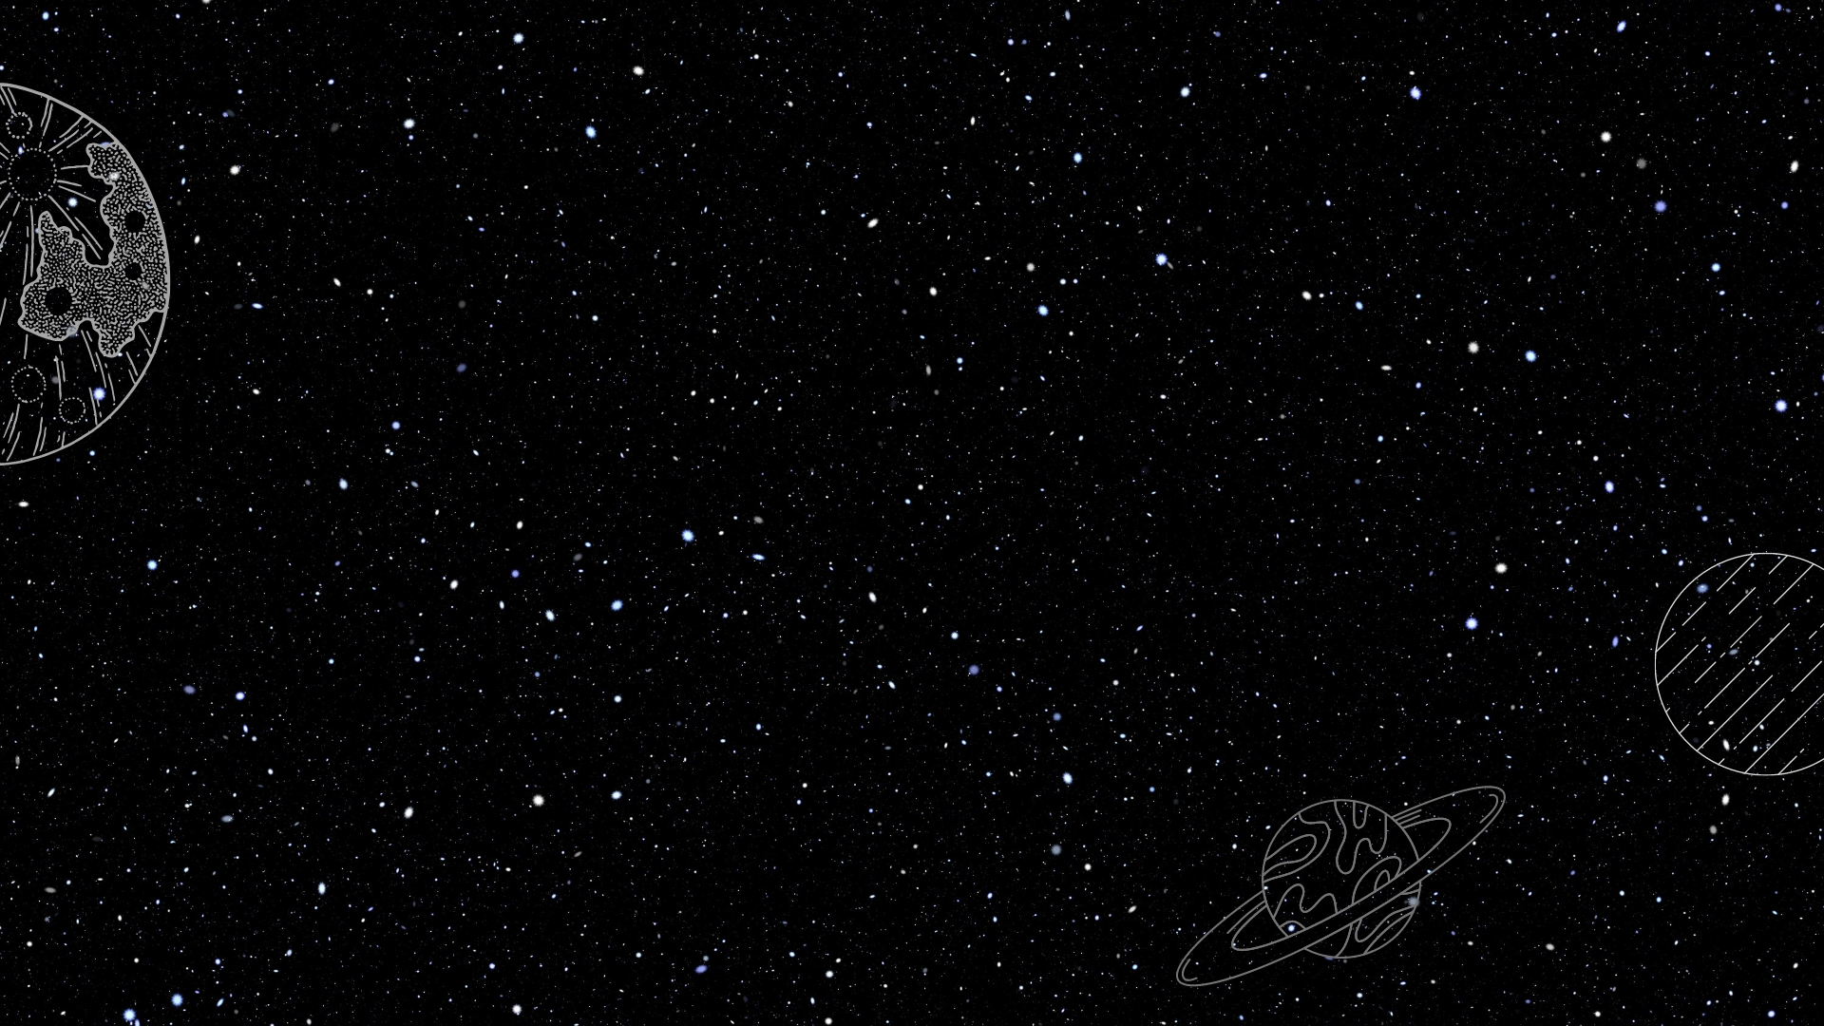
''Maybe I’ll post a consumer review. “Brought product to surface of Mars. It stopped working. 0/10.''

Slide 3
''Yeah, I know, it’s a stupid thing to think about, but I have a lot of free time.''

Slide 4
''They say once you grow crops somewhere, you have officially ‘colonised’ it. So technically, I colonised Mars. In your face, Neil Armstrong!’
''I’ll spend the rest of the evening enjoying a potato. And by “enjoying” I mean hating so much I want to kill people.''

Slide 5
''Yes, of course duck tape works in a near-vacuum. Duck tape works anywhere. Duck tape is magic and should be worshipped.''

Slide 6
’
‘I’m pretty much screwed. That’s my considered opinion. Screwed`.

Slide 7
Earth
civilisation
in space
SURVIVAL GAME

Slide 8
It`s the year 2150. The temperature on the Earth has risen by 10 degrees. Floods, extreme tornadoes never-ending droughts have brought the humanity, focused on fighting for the remaining natural resources, to the verge of extinction. Most people are starving or living their lives like people in the Middle Ages. But there is still hope humanity will survive. But how and where? You are set off for Mars to see if the planet can be our new home.
INTRODUCTION

Slide 9
You are preparing to leave the Earth. You can only take one of those things with you. Which one will you choose?
Food & Water
b) Tools
c) Medicine

Slide 10
2. You took off. You have to choose a destination. Which place is the best choice?
Moon
b) Jupiter
c) Mars

Slide 11
3. Your spacecraft has landed successfully. Now you have to find a place to live. What do you do?
Stay in the rocket
Look for caves
Stay on the surface

Slide 12
4. The amount of food is limited. The land isn't very fertile so you can only plant one type of seeds. What's your choice?
Apples
Wheat
Potatoes

Slide 13
5. You have a chance to discover the planet and maybe find some new resources. Do you take the risk?
Take a walk
Use a drone
My cave is enough

Slide 14
6. You are missing your family and need some support. How would you contact the Earth?
Satellite
Shouting
Radio

Slide 15
7. Afterall, you are the only human being on this planet. How would you take care of your mental health?
Jogging
Talking to plants
Talking to people on the Earth

Slide 16
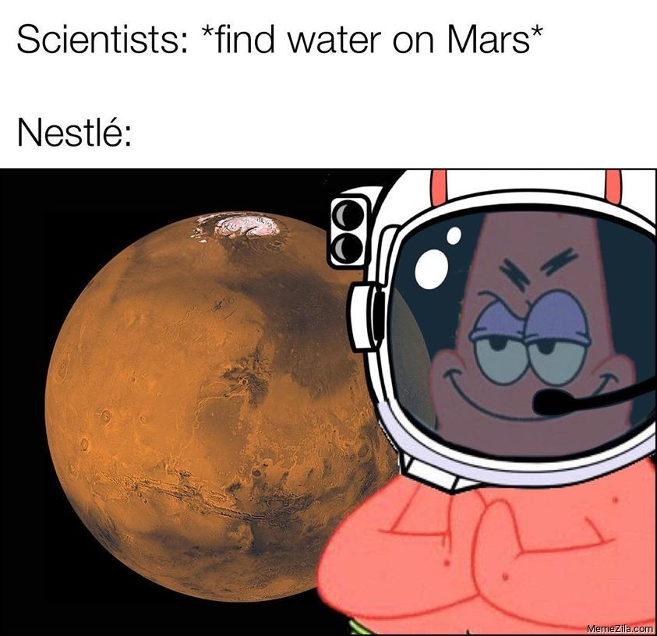
https://www.youtube.com/watch?v=ej3ioOneTy8

Slide 17
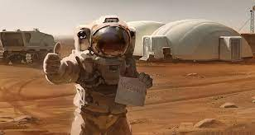
Thank you for your attention!!!

