Slide 1
STUDIES

Slide 2
The kinds of studies.
There are some kinds of studies in Poland. The divisions are based on:
a) the time of lectures:
stationary studies – lectures are from Monday to Friday and they last only some hours per day
weekend studies – lectures are during the weekend (sometimes even from Friday) and they last all day long

Slide 3
the graduation:
a) first degree studies – to start up these studies, you have to graduate from a high school and pass the matura exam; they last 6 or 7 terms and you finish them with the bachelor’s or engineer’s degree
b) second degree studies – to start up these studies, you have to graduate from first degree studies; they last 3 or 4 terms and you finish them with the master’s degree
c) steady master’s studies – to start up these studies, you have to graduate from a high school and pass the matura exam; they last 9 or 12 terms and you finish them with the master’s degree; they are accessible only for some professions like psychologist, doctor or lawyer

Slide 4
d) third degree studies – to start up these studies, you have to have the master’s degree; to finish them with the doctor’s degree, you are obligated to write a thesis and assert it
e) the conditions of being accepted – the most important is the matura exam’s score but some universities (the University of Fine Arts, the Film Academy, the Music Academy or the University of Sport) also do the entrance examination
f) the property (next picture)

Slide 5
 | private universities | public universities
the cost | you have to pay a tuition fee that can vary from university to university (about 9 000 Euros per year) | a) stationary studies are for free despite of the situations when someone fails a term b)weekend studies are always paid (about 2 000 Euros per year)
places to offer | they depend on the interest of future students, so they are more numerous | they are limited by the law, there are about 260 complimentary places at each university
the method of governing | they aren’t centrally governed, so they can rapidly respond to some educational changes or labour market needs | they depend on the national government and they need to have its agreement to introduce some changes in their educational system

Slide 6
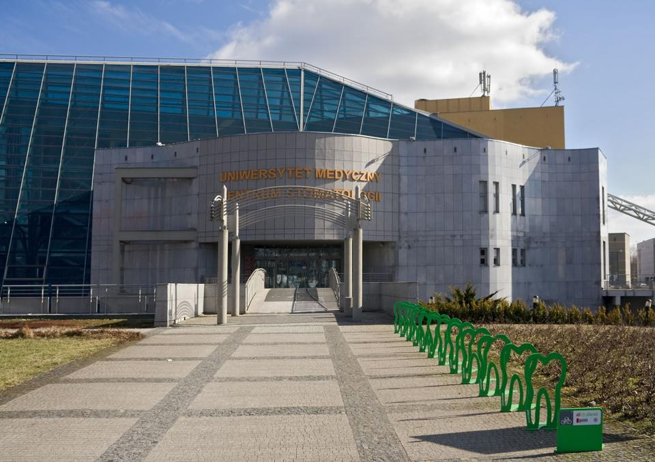
A few pictures of polish universities.
University of Medical Sciences in Poznań.

Slide 7
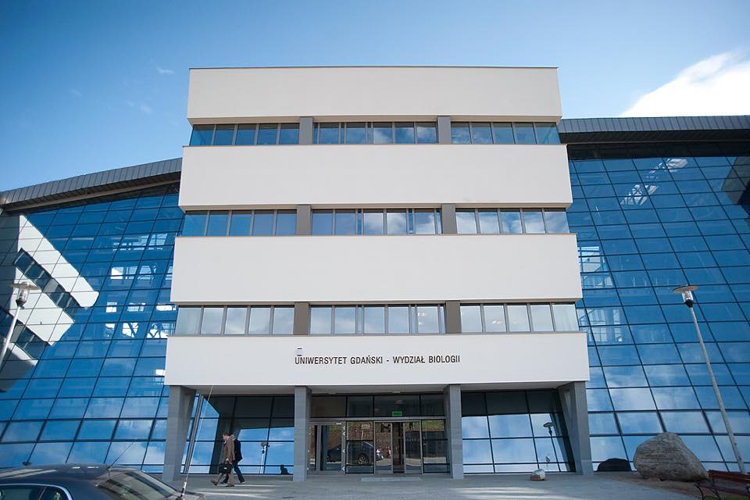
University of Gdańsk.

Slide 8
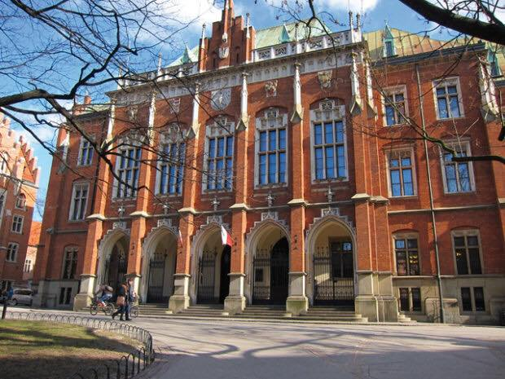
Jagiellonian University (in Cracow)

Slide 9
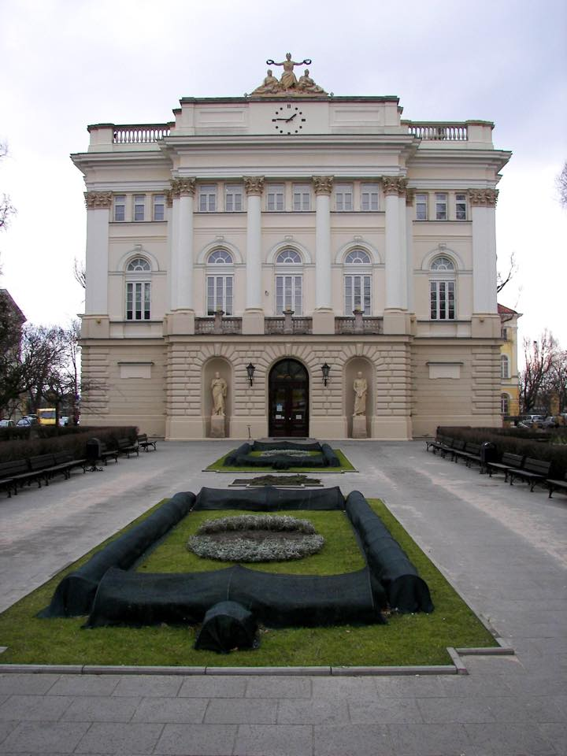
University of Warsaw

Slide 10
THE ACADEMIC YEAR IN Poland.
The academic year at Polish universities consists of 2 semesters of 15 weeks’ duration:
The winter semester:
Starts on 1 October and lasts till 14 February, with a two-week break for Christmas holidays (24 December – 3 January) and with one-week vacation period in February (1-7 February). Winter semester examination session takes place between 18 and 31 January. Make-up exams take place between 8 February and 14 February.
The summer semester:
Starts on 15 February and lasts till the end of June, with a one-week break for Easter vacations (24 – 29 March) and summer holidays from the beginning of July to 30 September. Summer semester examination session takes place between 9 and 30 June. September is reserved for make-up exams.

Slide 11
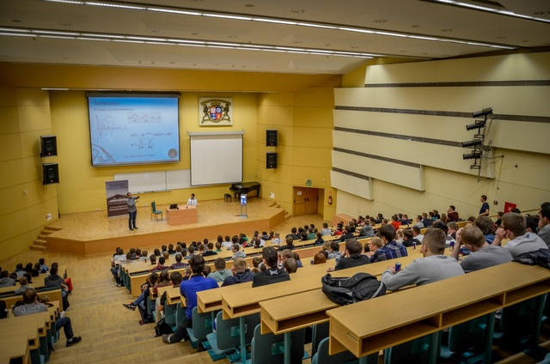
The types of activities
Lectures – for large groups of people.

Slide 12
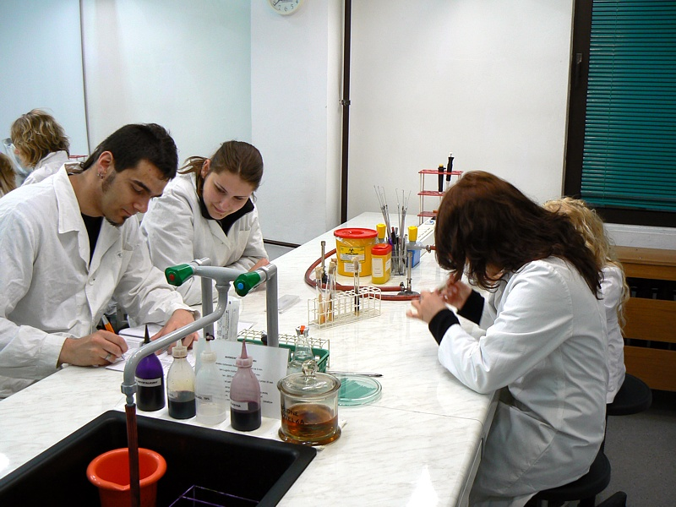
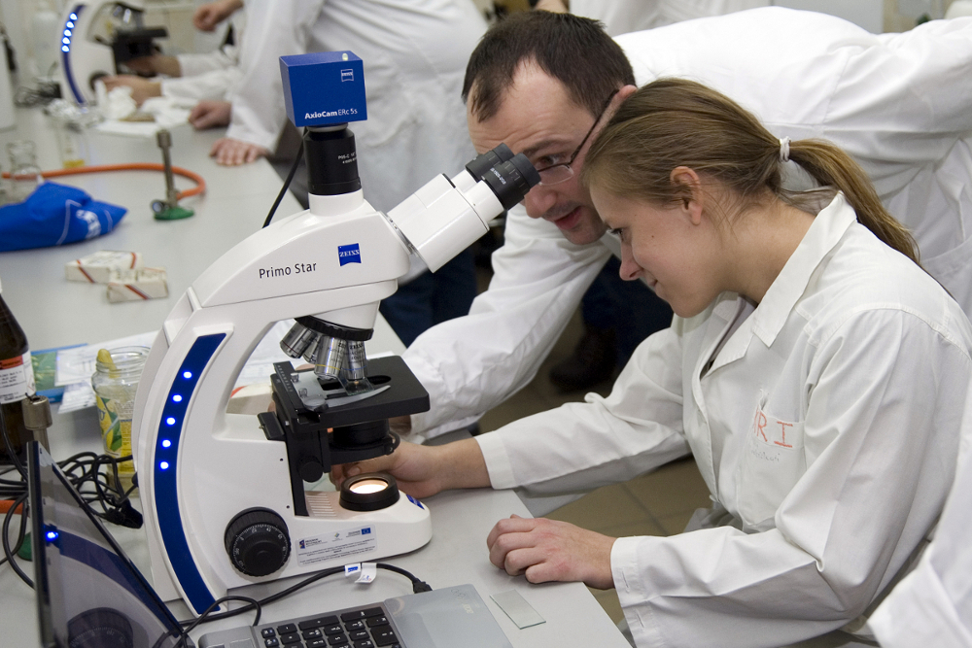
Class – for smaller groups
of students.

Slide 13
POSTGRADUTE
Postgraduate studies are for people, who want to suplement their knowledge, acquire new skills and expand their horizons . The cost of postgraduate studies is extremely diverse and consisting of a number of factors including: location studies, the popularity of the length of classes, leading… Often You can count on a refund, wheather from the employer, which leads us to these studies or from the EU funds.

Slide 14
solarships
Scholarships are paid every month or once. They admit it : universities, ministry, union, local governments, companies. Programs are addressed to different groups students. Scholarships are from tens to several thousand. We have the following scholarships in Poland :
1) In view of on achievements :
- Scholarships granted by the minister of science and higher education for outstanding achievements : for students, who have very good results in the area of research, art or sports. They are issued to support the best students in Poland. Students are paid only once up to 15.000 PLN

Slide 15
- Scholarships granted by the: for students , who have achieved the best results during a year or have other scientific, artistic or sports achievements. Students are paid up to a few hundred zloty per month.
-Diamond grant: for graduates or undergraduate students after the third year, who are doing research . Students are paid upto 200.000 PLN
-Future generation: for students, who aren’t 25 years old, they’ve a proven knowledge of at least one foreign language at a level no lower than B2, they’ve a positive opinion written by a tutor or guardium scientific circles on their previous activity, they are still studing at university for science. Students are paid between 100.000 and 500.000 PLN

Slide 16
- Scholarships for results in science awarded by other entities: for students achieving outstanding academic results designated by the founder of the scholarship achievements. The amount of the scholarship is determined by the founder.
- Scholarships for the best students studying at universities. There is a beneficiary program called " Study ordered " . The scholarships are funded by the European
Social Fund and the state budget.
Up to one thousand PLN a month .
-Scholarships Leading National Scientific Centres:
For students research units having the status KNOW .
The amount of scholarships depends on the decisions of individuals

Slide 17
- Iuventus Plus: The grant amount depends on the cost of the planned research.
- Scholarships granted by local government units: For students who are in a difficult financial situation, they exhibit significant achievements or a high grade point average .The amount of the scholarship depends on the decision of the local government. Council and local councils , take a resolution on granting scholarships for students , determine the type and mode of granting material assistance.
-College scholarship funds: For students of the university. Students get from a few hundred PLN to several thousand paid once or month.

Slide 18
2) In view of the support :
Social scholarships: for students, who are in a difficult financial situation. To receive a scholarship, income per family member cannot exceed the amount specified by law. The grant amount is determined by the university.
-Grant.: For students in need of emergency assistance. The amount of financial aid is determined by the university.

Slide 19
-bridging scholarships:
For gifted high school graduates living in rural areas or small towns , from families with very low incomes and achieving good results in science. Bridging Scholarships are awarded for the first year students of full-time study They are 5 thousand PLN in the academic year and are paid in 10 monthly installments of 500 PLN

Slide 20
Thank you for attention

