Slide 1
Junior high schools
and secondary schools
in Poland.
by Klaudia Andrzejewska , Joanna Kups , Karolina Wiacek , Magdalena Grabowska

Slide 3
Education in public schools is free of charge, in private schools and association schools it is paid (except for the students included in scholarship programs run by some private or public schools).

Slide 4
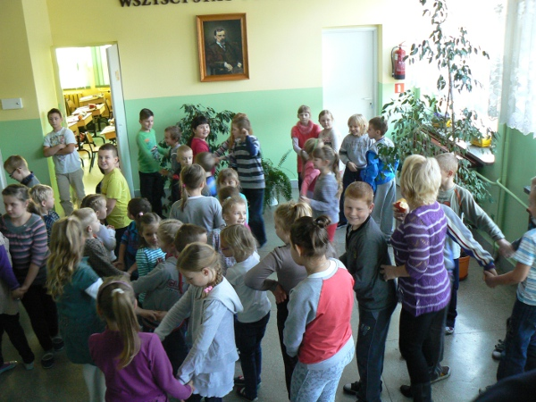
Time and days of lessons
We go to school from Monday to Friday.
Lesson lasts 45 minutes.
Between lessons we have short breaks.
Students may have up to 10 lessons a day.

Slide 5
School year and semestres
We start school year on the first of September and we finish it on the last Friday in June.
In Poland we have 2 semesteres . One semester has five months.
Both finish with a break.
First - ferie zimowe (winter holidays)- two weeks in January or February (each year its different)
Second - wakacje (vacations) – two months

Slide 6
Years (secondary school)
Years (Junior high school)
High school or comprehensive school
Three classes (from 16 to 19 years old)
Technical school
Four classes (from 16 to 20 years old)
Vocational school
Three classes (from 16 to 19 years old)
Three classes (from 13 to 16 years old)

Slide 7
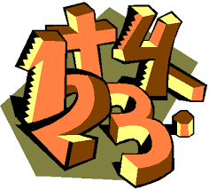
Marks
Alike in junior high school , in secondary school we can get marks from 1 to 6.
1 - the worst - niedostateczny
2 - from this mark you pass atest or an exam - dopuszczający
3 - dostateczny
4 - dobry
5 - bardzo dobry
6 - celujący -very rarely - the best

Slide 8
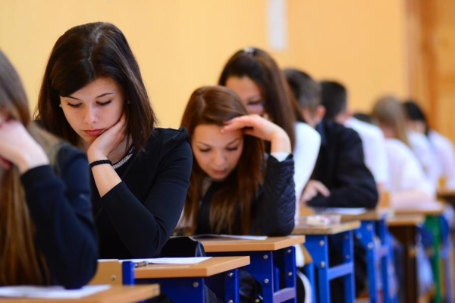
Exams (Junior high school)
At the end of lower secondary education,
pupils take a compulsory external written examination
organised by Regional Examination Boards.
They write final exams for three days :
First day : Polish, History, Social studies
Second day : Maths, Geography, Physics,
Biology and Chemistry
Third day : Foreign language

Slide 9
Exams (Secondary school)
In the Polish education system,
the exam is officially called
egzamin maturalny, but it is commonly
known as matura. It is taken to
complete high school, in May
(with additional dates in June, and retaken
available in August). The exam is not compulsory,
although Polish students must pass it in order
to be able to apply for higher education courses in Poland and elsewhere.

Slide 10
Subjects in Junior high school
Polish, English, another foreign language , History , Maths, IT, PE, Biology, Art , Chemistry , Physics, Geography, Religion, Technology and design, Social studies.
Other junior high schools may have optional classes.

Slide 11
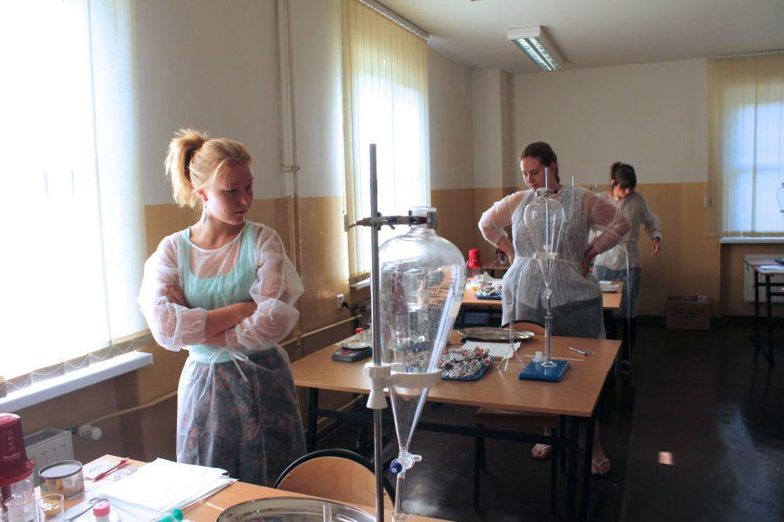
In all types of vocational upper secondary schools pupils may take an examination confirming vocational qualifications called the vocational examination which is an examination assessing the level of knowledge and skills in the given qualification defined in the examination standards. The examination is not obligatory. The vocational examination is held in two forms: written and practical. The examination is organised by the relevant Regional Examination Commission and aims at the assessment of pupils’ knowledge and practical skills related to a given occupation. The scope of the examination is defined in the vocational qualifications examination standards. A graduate of a vocational upper secondary school i.e. technical upper secondary school or basic vocational school who passes the vocational examinations for all qualifications in an occupation, receives a diploma confirming vocational qualifications. The diploma includes the name of the occupation for which the qualifications have been confirmed and the results of the vocational examination (both written and practical parts).

Slide 12
From
Google Graphic
https://www.polsl.pl/en/Documents/The%20System%20of%20Education%20in%20Poland_FRSE_2012.pdf#page=10&zoom=auto,-193,270

