Slide 1
Kindergarten
First type of school

Slide 2
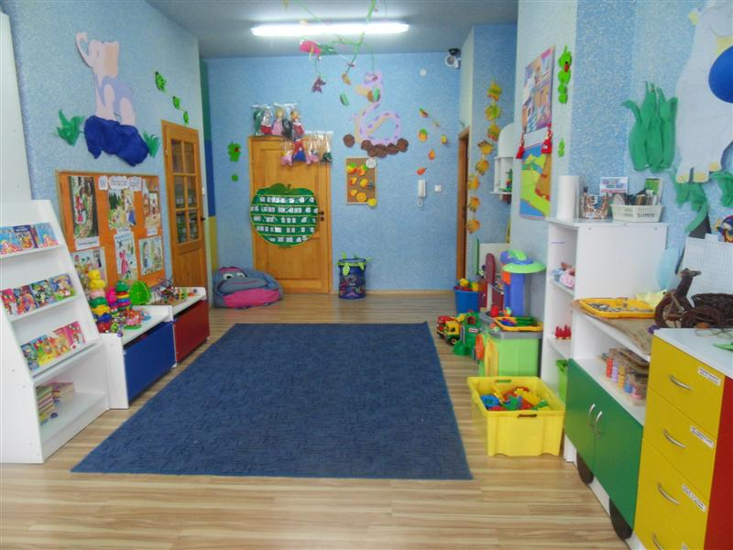
Polish kindergarten

Slide 3
Kids in kindergarten
-Kids usually go to kindergarten when they are three years old ( but they can go at the age of two and a half) and they end their education when they are 5 years old.
- kids don’t have any exams or degrees .
-there is usually one type of that kind of school but there are also musical or language kindergartens.

Slide 4
Learning through playing

Slide 5
Practice in class
- children are divided into groups in regard of their age; there are from 12 to 28 kids in one group
-teachers in kindergartens teach children how to speak Polish language correctly, how to wash and dress up, children also learn about culture, they draw or paint but the biggest aim of attending a kindergarten is good fun

Slide 7
New day
-they usually start a day at 6:00 am and end at 5:00 pm. but it can be different in different kindergartens. Weekends are free from school.

Slide 9
Time to eat
-kids usually eat 3 meals a day – breakfast, dinner ( soup and main dish) and tea.

Slide 10
Dinner time

Slide 11
What can parents do?
parents can choose a kindergarten for their child and they have to pay a monthly fee. There are optional activities for kids but they are paid extra.Kids can learn to dance,play a musical instruments,they can learn a foreign language,Maths,play chess, do karate or ballet.
-kids with special needs can go to a kindergarten only with a doctor’s permission.There are some kindergartens which are accommodated to such kids.

Slide 12
Free time

Slide 13
Holiday time
-holidays in kindergarten last two months but most kidergartens stay open all year round and children can attend them.

Slide 15
THE END
Thanks for watching

