Slide 1
“Европейска седмица в България, Италия, Румъния, Гърция и Португалия“

Slide 3
Happy Europe day!
Today is the ninth of May - Celebrating Europe Day, 13 years Bulgaria in the European Union , 70 years of Schuman Declaration,75 years United Nations, the 250th birthday of Beethoven.
The ninth of May inspires us for our actions today and tomorrow.

Slide 4
Europe day – Let’s celebrate it!
Let’s celebrate the anniversary together, right here from our homes, our rooms and take part in this moment of remembrance and thanksgiving
Europe is the place where the civilization started where we have lots of history, where we have the culture.

Slide 5
Interesting facts
The European Union (EU) is a unique economic and political union between 27 European countries with total population about 500 million people.
It includes 27 Member States located in Europe, which are: Austria, Belgium, Bulgaria, Croatia, Cyprus, Czech Republic, Denmark, Estonia, Finland, France, Germany, Greece, Hungary, Ireland, Italy, Latvia, Lithuania, Luxemburg, Malta, Netherlands, Poland, Portugal, Romania, Slovakia, Slovenia, Spain, Sweden.

Slide 6
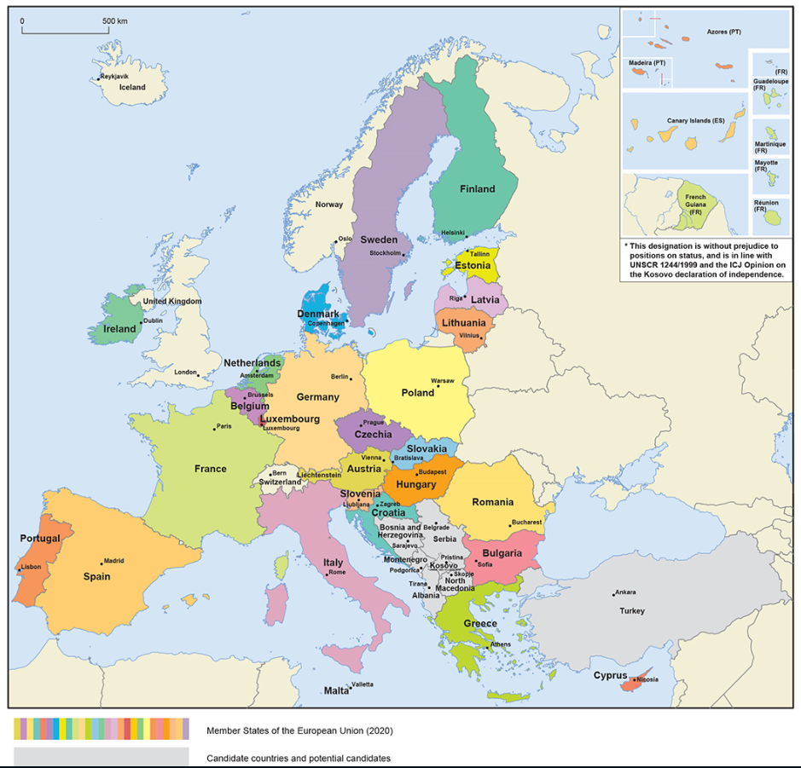
The European Union: 446 million people – 27 countries

Slide 7
24 official languages
Български
Čeština
dansk
Deutsch
eesti keel
Ελληνικά
English
español
français
Gaeilge
hrvatski
Italiano
latviešu valoda
lietuvių kalba
magyar
Malti
Nederlands
polski
português
Română
slovenčina
slovenščina
suomi
svenska

Slide 8
EU population compared to the rest of the world
Population in millions

Slide 9
How many people live in the EU?
Population in millions (2019)
446 million in total

Slide 10
Interesting facts
We can remember from where the European Union comes from 09.05.1950
Robert Schuman presented his proposal on the creation of an organized Europe.
This proposal, known as the ”Schuman declaration”is considered to be the beginning of the creation of what is now the EU.

Slide 11
The Schuman Declaration – 9 May 1950
On 9 May 1950, against the backdrop of the Cold War, Robert Schuman issued a declaration which marked the beginning of the process of building the European Community. The aim the French Foreign Minister had set himself was to establish a new supranational organization.

Slide 12
The Schuman Declaration – 9 May 1950
With a view to creating a common coal and steel market between France and Germany which was also open to other European countries. It would become the European Coal and Steel Community, or ECSC, and since 1985, Europe Day has been celebrated on 9 May every year.

Slide 13
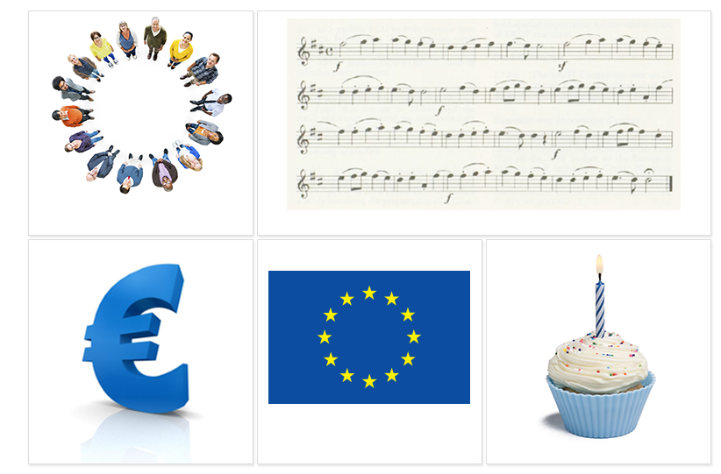
The EU symbols
The motto:
United in diversity
The European anthem
The euro
The European flag
Europe Day, 9 May

Slide 14
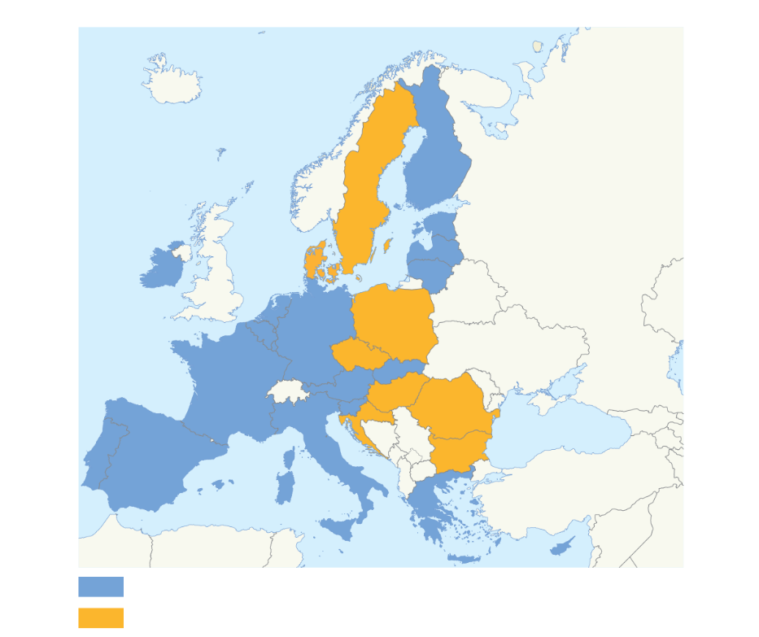
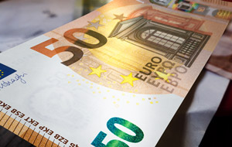
The euro – a single currency for Europeans
Why the euro?
No fluctuation risk and foreign exchange cost
More choice and stable prices for consumers
Closer economic cooperation between EU countries
EU countries using the euro
EU countries not using the euro
Can be used everywhere in the euro area
Coins: one side with national symbols, one side common
Notes: no national side

Slide 15
European Flag
It is a circle of twelve golden stars on a blue background, representing the ideal of unity among European people but their number has nothing to do with the number of European Union members. The number “12” is traditionally the symbol of unity, completeness and perfection. The number “12” is also the number of months in a year and the number of hours shown on a clock and the circle is a symbol of unity.

Slide 16
European Anthem
The melody of European anthem comes from 9th Symphony composed by Ludwig Van Beethoven. For the final movement a composer set the “Ode to Joy” which is written by Friedrich von Schiller. “Ode of Joy” expresses an idealistic vision of the human race. In the universal language of music without words this anthem expresses the ideals of freedom, peace and solidarity for which Europe stands.

Slide 17
European Motto
The motto of the European Union is “United in diversity”. This motto means that through European Union, striving for prosperity and peace, Europeans are united, and their diversity in culture, traditions and language is a positive asset for European continent.

Slide 18
Europe Day – the ninth of May
As we said on the ninth of May, 1950 Robert Schuman proposed to create an organized Europe. This is considered to be the beginning of the European Union. Because of this fact the ninth of May has become a European symbol.

Slide 19
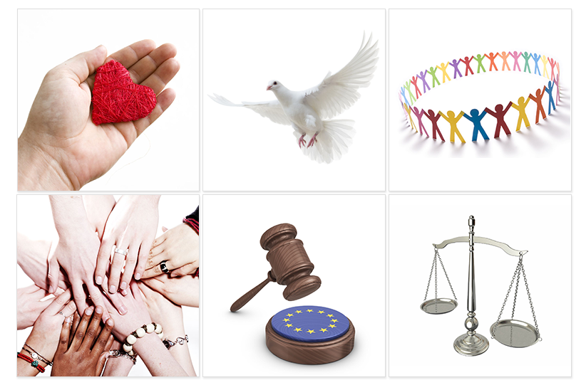
The EU Charter of Fundamental Rights
Binding for all the EU's activities
54 articles under 6 titles:
Dignity
Freedoms
Equality
Solidarity
Citizens’ rights
Justice

Slide 20
Equality is about equal rights for all citizens before the law. The principle of equality between women and men underpins all European policies and is the basis for European integration. It applies in all areas. The principle of equal pay for equal work became part of the Treaty of Rome in 1957. Although inequalities still exist, the EU has made significant progress.

Slide 21
The EU is based on the rule of law. Everything the EU does is founded on treaties, voluntarily and democratically agreed by its EU countries. Law and justice are upheld by an independent judiciary. The EU countries gave final jurisdiction to the European Court of Justice which judgements have to be respected by all.

Slide 22
Human rights are protected by the EU Charter of Fundamental Rights. These cover the right to be free from discrimination on the basis of sex, racial or ethnic origin, religion or belief, disability, age or sexual orientation, the right to the protection of your personal data, and or the right to get access to justice.

Slide 23
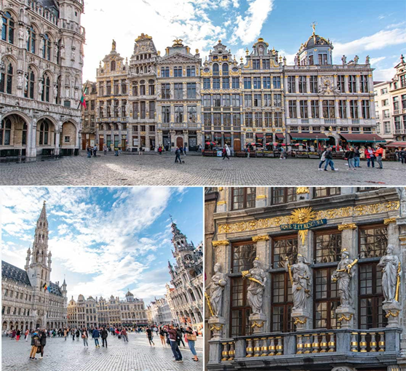
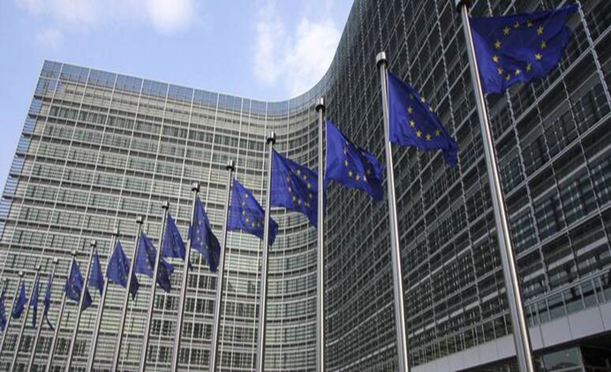
Brussels
Brussels is home to the EU's most important institutions, such as the European Commission, European Council and European Parliament.

Slide 25
Bulgaria – a part of the European Union
Bulgaria is my homeland and I am a happy citizen of Bulgaria because it's very cozy and beautiful. Bulgaria is one of the prettiest countries in the world.
I am proud of it.
I'm proud to be a Bulgaian citizen and I'm proud to be a citizen of the EU.

Slide 26
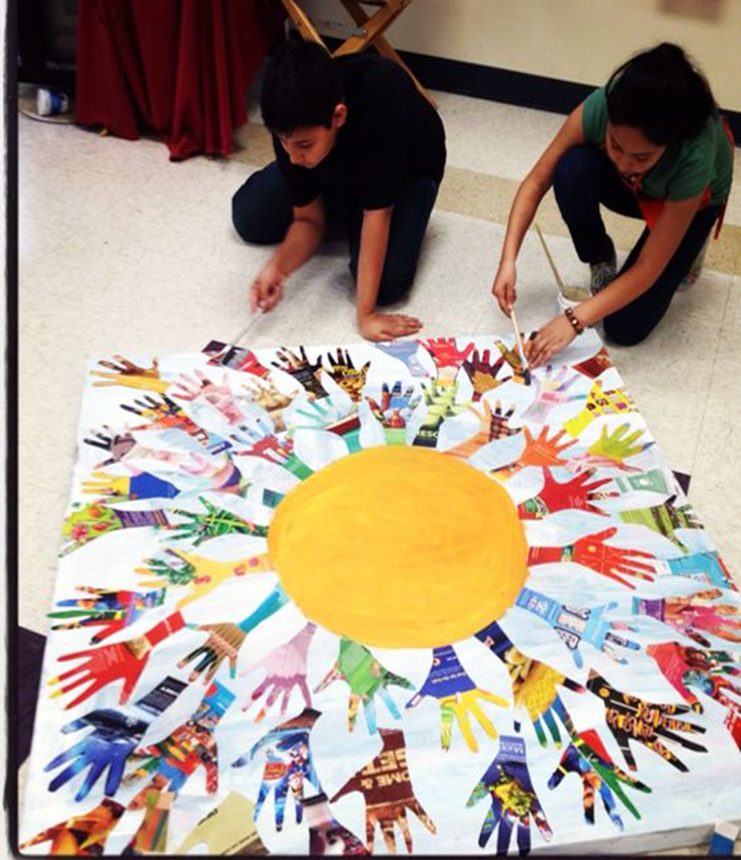

Slide 27
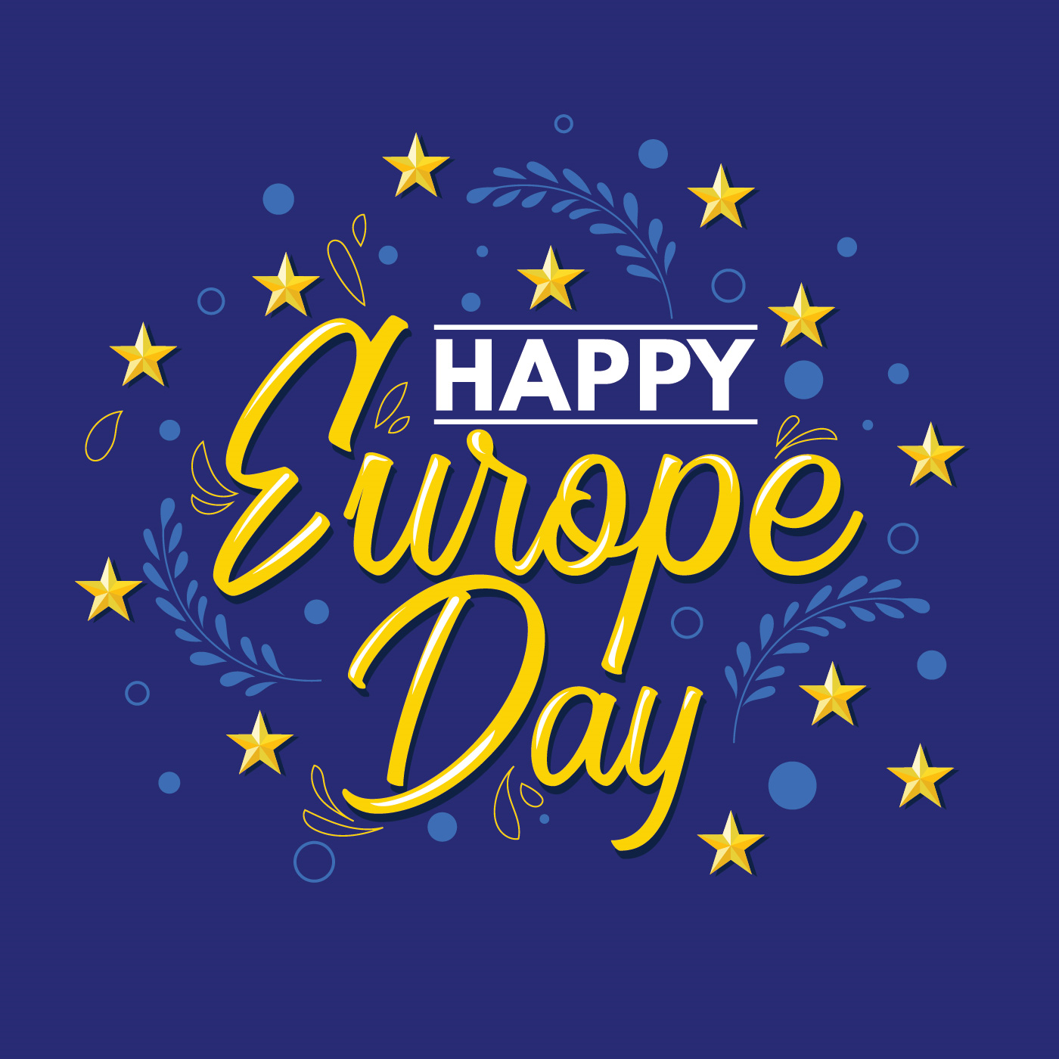

Slide 28
First primary school “St. St. Cyril and Methodius”,
Gotse Delchev

