Slide 1
Malatya Science Art Center

Slide 2
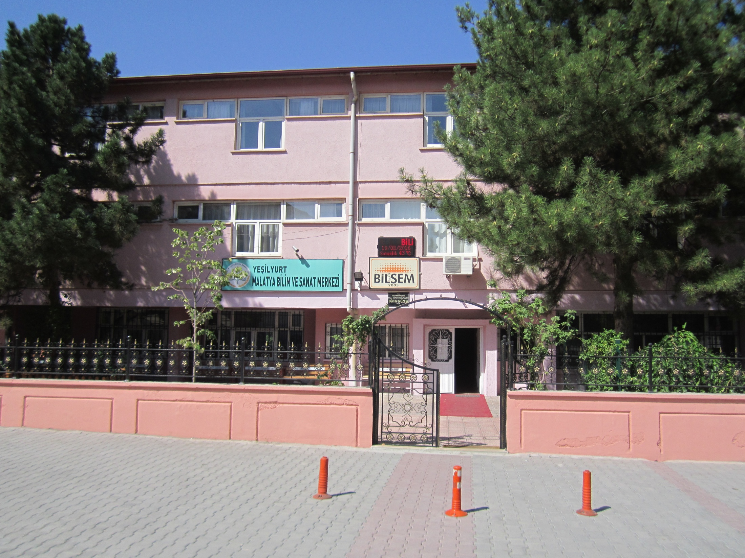
This Is Our School

Slide 3
There are three floors in our school
There is an office, a laboratory, a meeting room, a museum and a workshop on the ground floor On the 1st floor there are some classrooms and manager room On the 2nd floor there are a multipurpose hall and some classrooms.

Slide 4
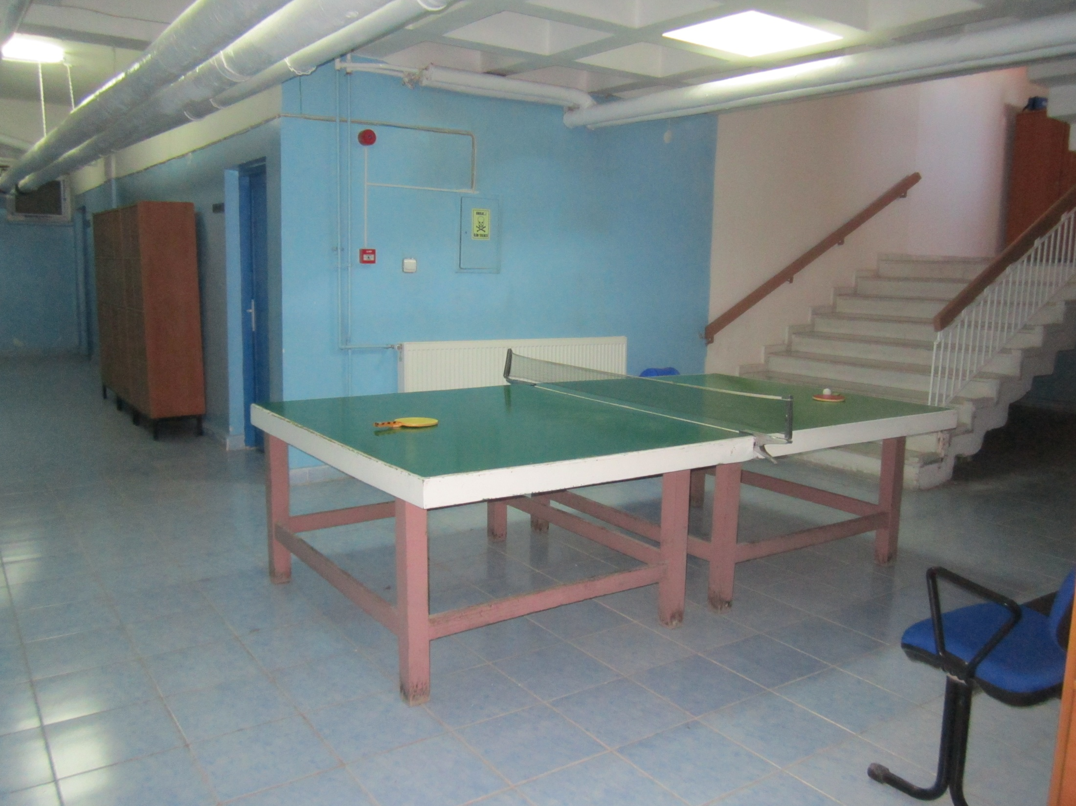
There are table tennis, archives, workshops and virtual reality room on the basement

Slide 5
Music Room

Slide 7
Multipurpose Hall

Slide 8
Waiting Room

Slide 9
Chemistry Lab

Slide 11
History Room

Slide 14
Our workshops

Slide 17
Our Plant-House

Slide 18
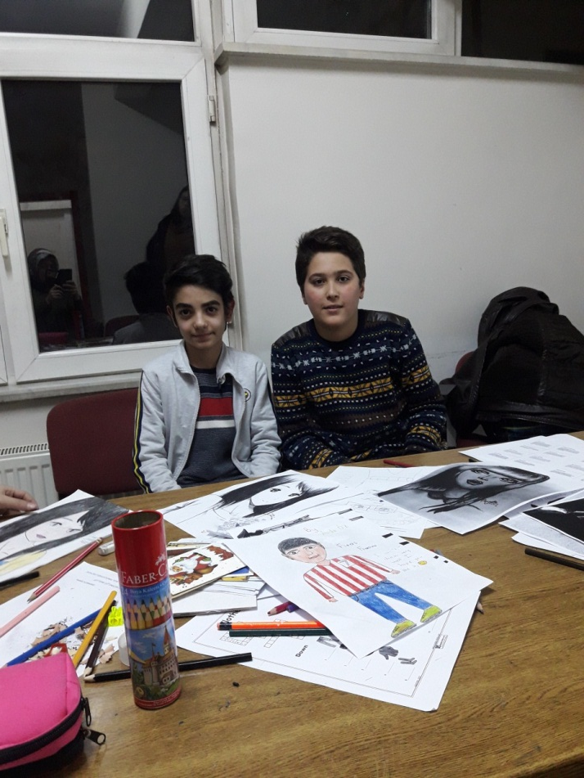
Prepared by
Ahmet Sefa Ünal
Eyüb Abacı

