Slide 1
CLIL 2018
The belle époque
3 Pitagora - IC Laura Lanza - Baronessa di Carini - a.s. 2017/18
Prof. Geltrude Macrì
Notes:
e

Slide 2
Contents
Aims and requirements of the CLIL project
Lesson plan of the course (indoor and outdoor activities)
Presentation of texts and other educational materials
Selection of homeworks
Study visit in Palermo

Slide 3
Aims of the CLIL project
Improvement of the listening comprehension reading, writing and speaking skills in English
Improvement of researching and summarising skills
Reinforcement of the (historical) knowledge

Slide 4
Requirements: basic knowledge of the topic

Slide 5
1st and 2nd Lessons (6th and 11th Dec.):
guided viewing of an educational film (Listening
comprehension skills)

Slide 6
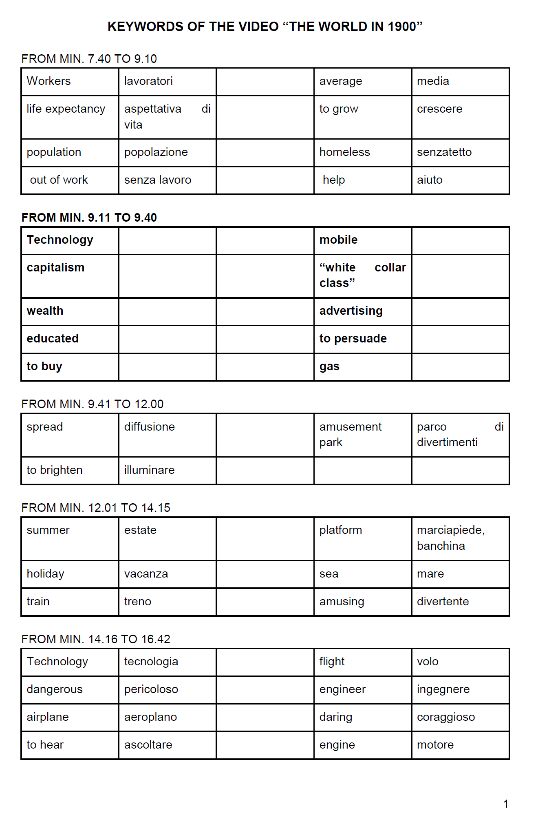
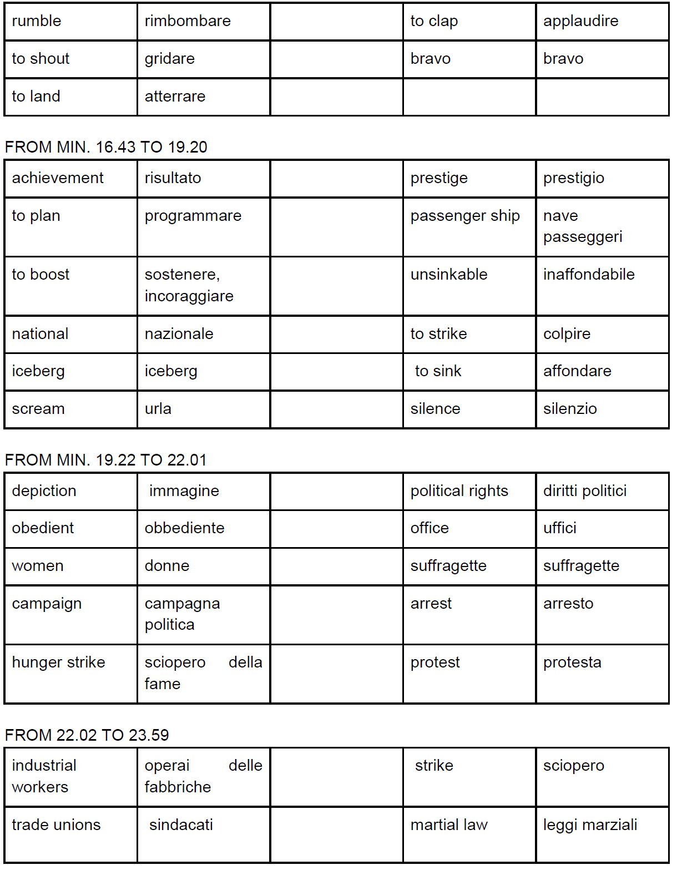
Exercises and learning activities at school

Slide 7
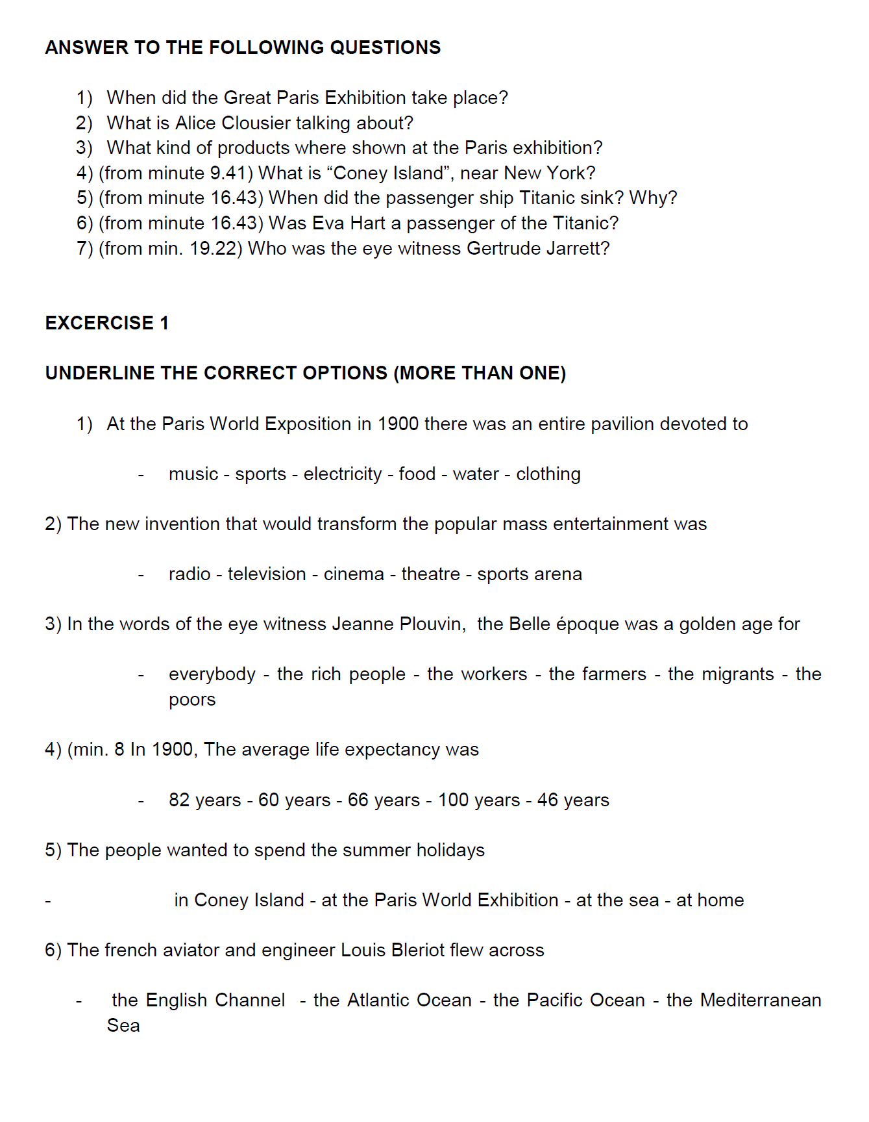
… and at home

Slide 8
3rd Lesson (18th December): texts on the Belle époque and exercises (reading and writing skills)
Belle Époque
The “Beautiful Era” was a period in European history that began during the late 19th century and lasted until 1914 (the outbreak of World War I).
It was characterised by optimism, regional peace, an apex of colonial empires and new technological and medical discoveries. The name “Belle Époque” was given in retrospect, when the period began to be considered as golden age compared to the horrors of World War I.
The Belle Époque was an era of great scientific and technological advancement in Europe and the world in general. Inventions of the Second Industrial Revolution that became generally common include the automobile, the removable pneumatic tires for bicycles and automobiles, the scooter and moped, the neon light, the airplane, the cinema, the radio transmission.

Slide 9
By the end of the 19th century the new industrial world had led to the emergence of a new mass society. Many people migrated to the cities to find work, the social structure of society changed. In the 1800s land owners were the most powerful people but by 1900 a new society of white collar workers had emerged amongst the working and middle classes. The social structure of society could now be divided into three sectors: the “Elite”, the “Middle Classes”, and the “Lower Classes”.
The development of the mass society helped improve the lives of the working classes who benefited from extended voting rights, a higher standard of living and public education.
By 1900, public education was compulsory in most western countries so most of the population was able to read. For women, access to higher education and also to jobs previously dominated by men, led to movements for women’s rights at the beginning of the Twentieth century.
In the climate of the period, especially in Paris, the arts flourished. Art Nouveau is the most popularly recognized art movement to emerge from the period. style. It was inspired by natural forms and structures, not only in flowers and plants, but also in curved lines. It is also considered a philosophy of the design of furniture
Sources:
https://www.scuolabook.it/Uploaded/rcs_s000niesum0067v1t2_preview/rcs_s000niesum0067v1t2_preview.pdf
https://en.wikipedia.org/wiki/Belle_%C3%89poque

Slide 10
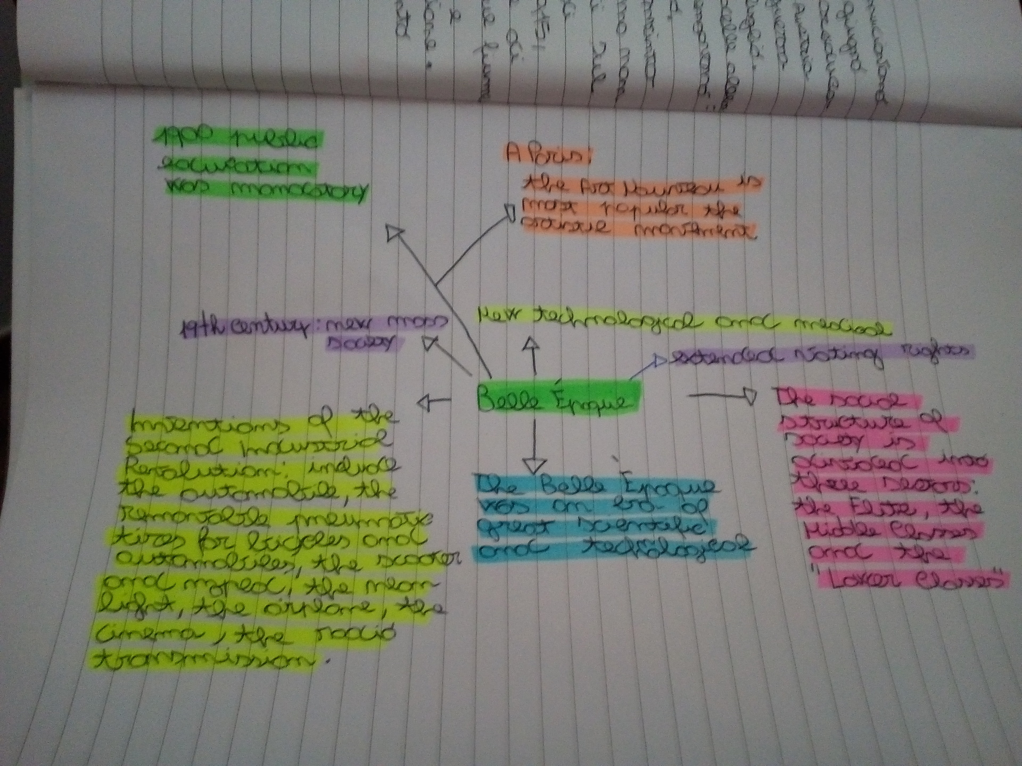
Homework: develop a concept map and post it on Edmodo

Slide 11
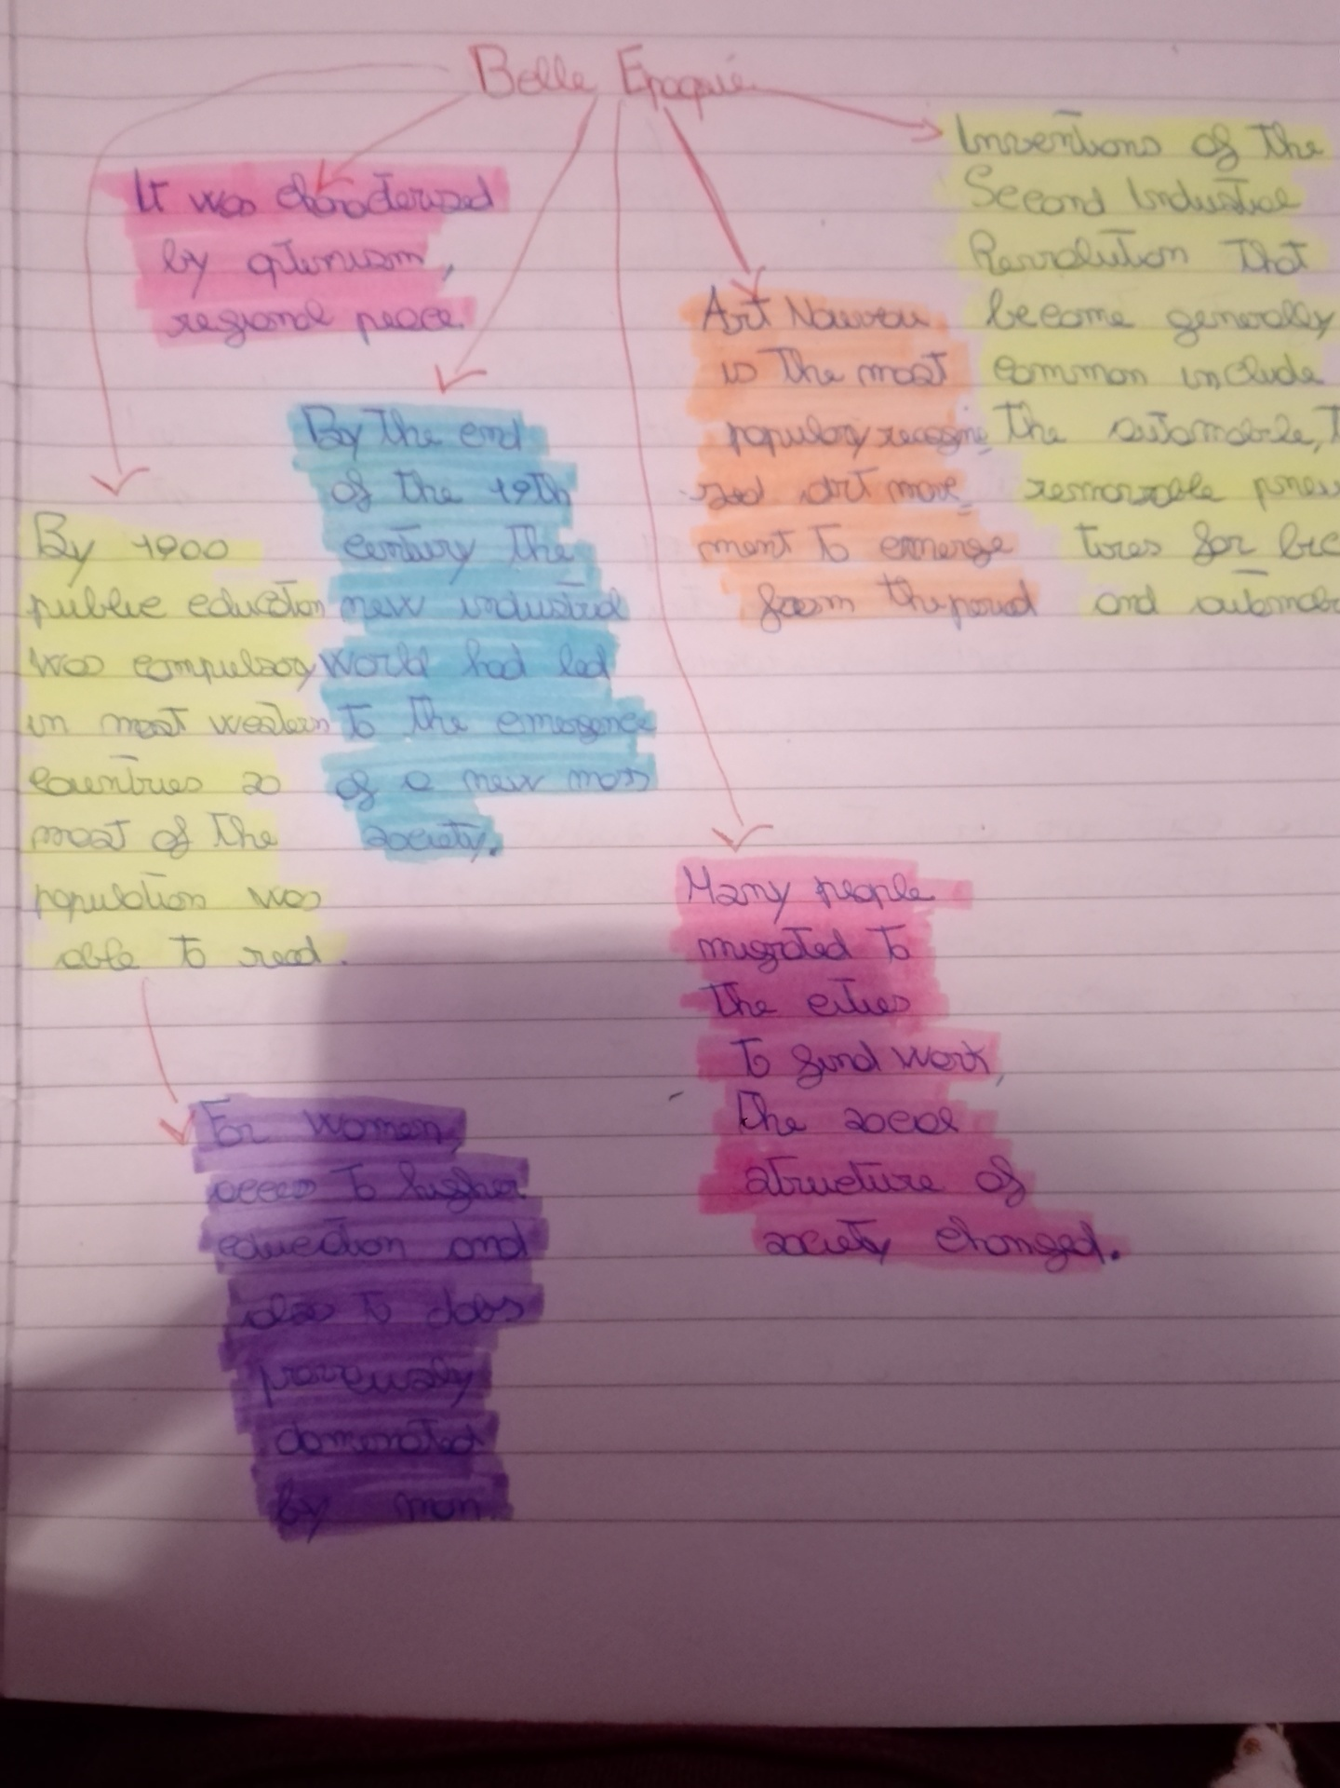
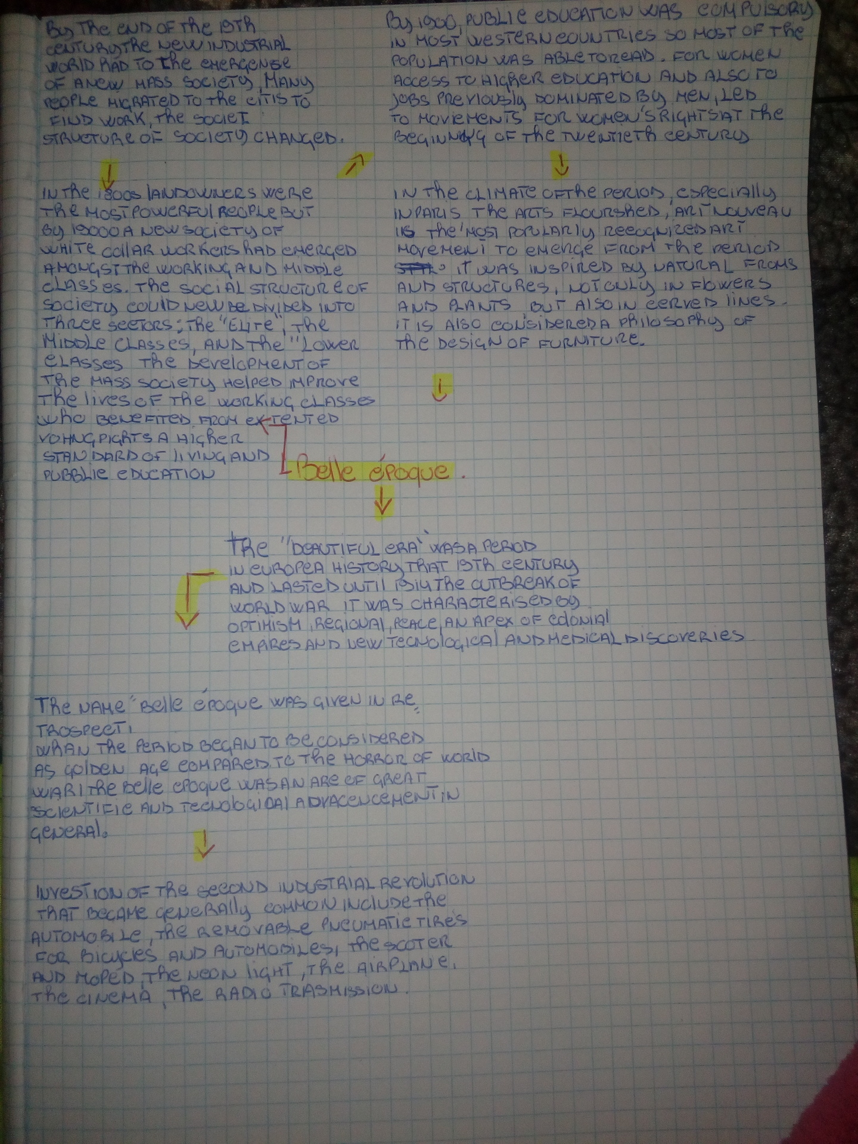

Slide 12
4th Lesson (16th December) : work on brief texts, researching and summarising (writing and speaking skills)
Palermo’s Liberty Style, like all forms of Art Nouveau, had its own distinctive characteristics. Basile and his contemporaries used not only floral motifs and curved lines but they also looked to Sicily's history to inform their own particular style. For example, the construction of turrets and splendid wooden doors was inspired by the sicilian mediaeval castles; The use of arches, mosaics and thin marble columns was inspired by the Arab-Norman past.
The fin de siècle was one of Palermo’s golden ages. The international connections of families such as the Florios and the Whitakers had turned the city into something of a playground for Europe’s elite.
The rich and wealthy families of the city asked the most famous architects of the period to build new villas and apartments.
Liberty Style buildings can be found throughout Palermo but most are concentrated in four main areas: the streets running parallel to Via Libertà between Piazza Politeama and Giardino Inglese (sadly, many Liberty Style villas that once lined Via Libertà itself were demolished to make way for apartment blocks in the 1950s and 1960s); in Via Dante and its surrounding streets; along the Via Roma and in Mondello, Palermo’s seaside resort. Mondello, once a tiny fishing village, became popular with Palermo’s elite at the end of the 19th century and soon Liberty Style summer villas were springing up at every corner. To serve these holidaymakers, a bathing station (stabilimento balneare) was built in splendid Liberty Style by the architect Rudolf Stualker.
source: https://www.thethinkingtraveller.com

Slide 13
EXERCISES:
develop a concept map
find the four main areas rich in Liberty style buildings and mark them with different colours on your city map of Palermo (if you don’t have a printed map of Palermo, just find them with the help of google maps)
post a photo of the first exercise on Edmodo

Slide 14
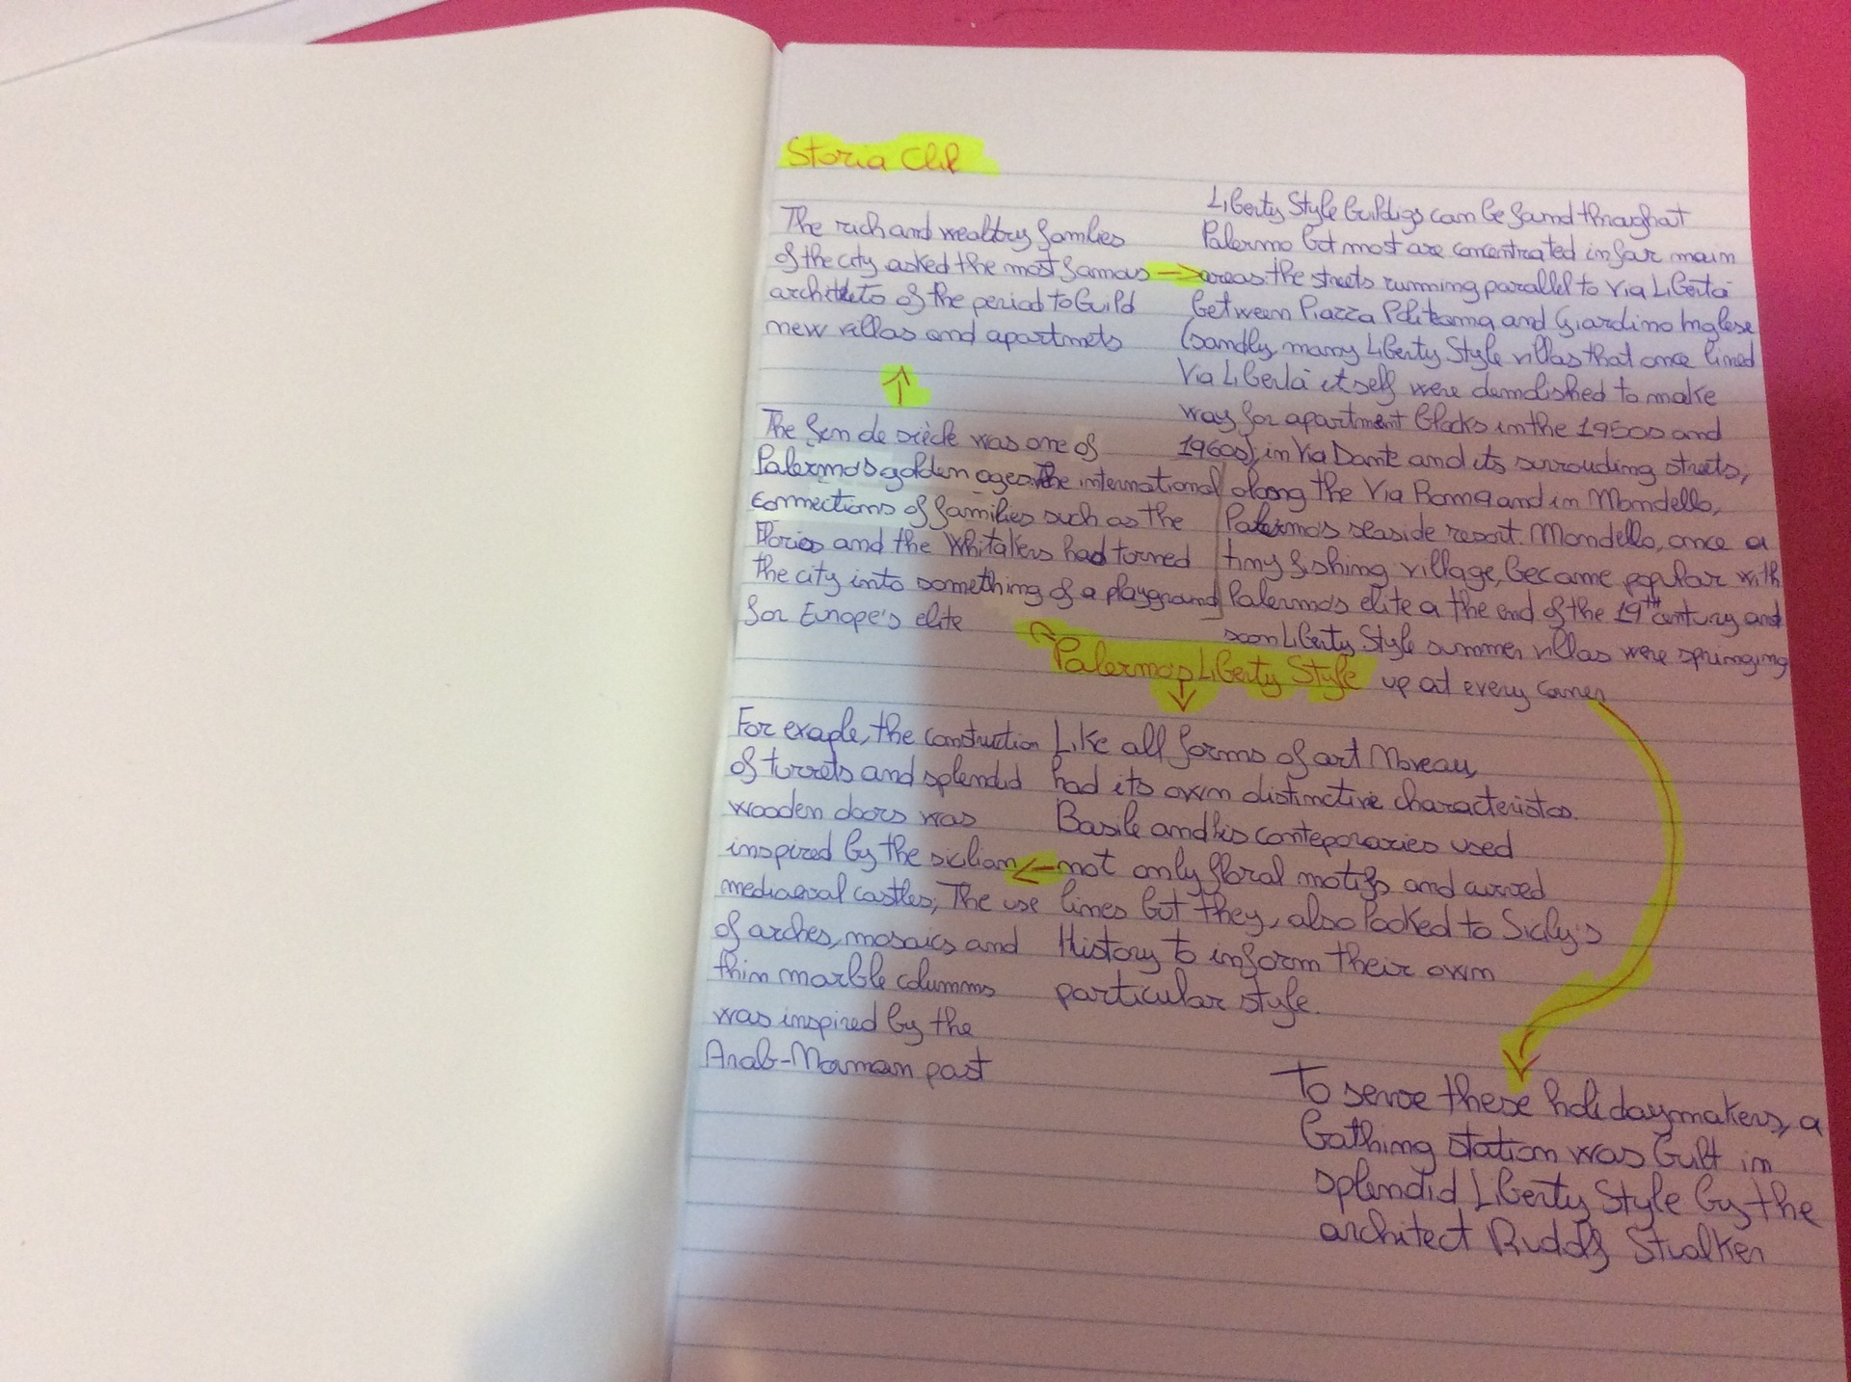
Concept map on the topic “Liberty style in Palermo”

Slide 15
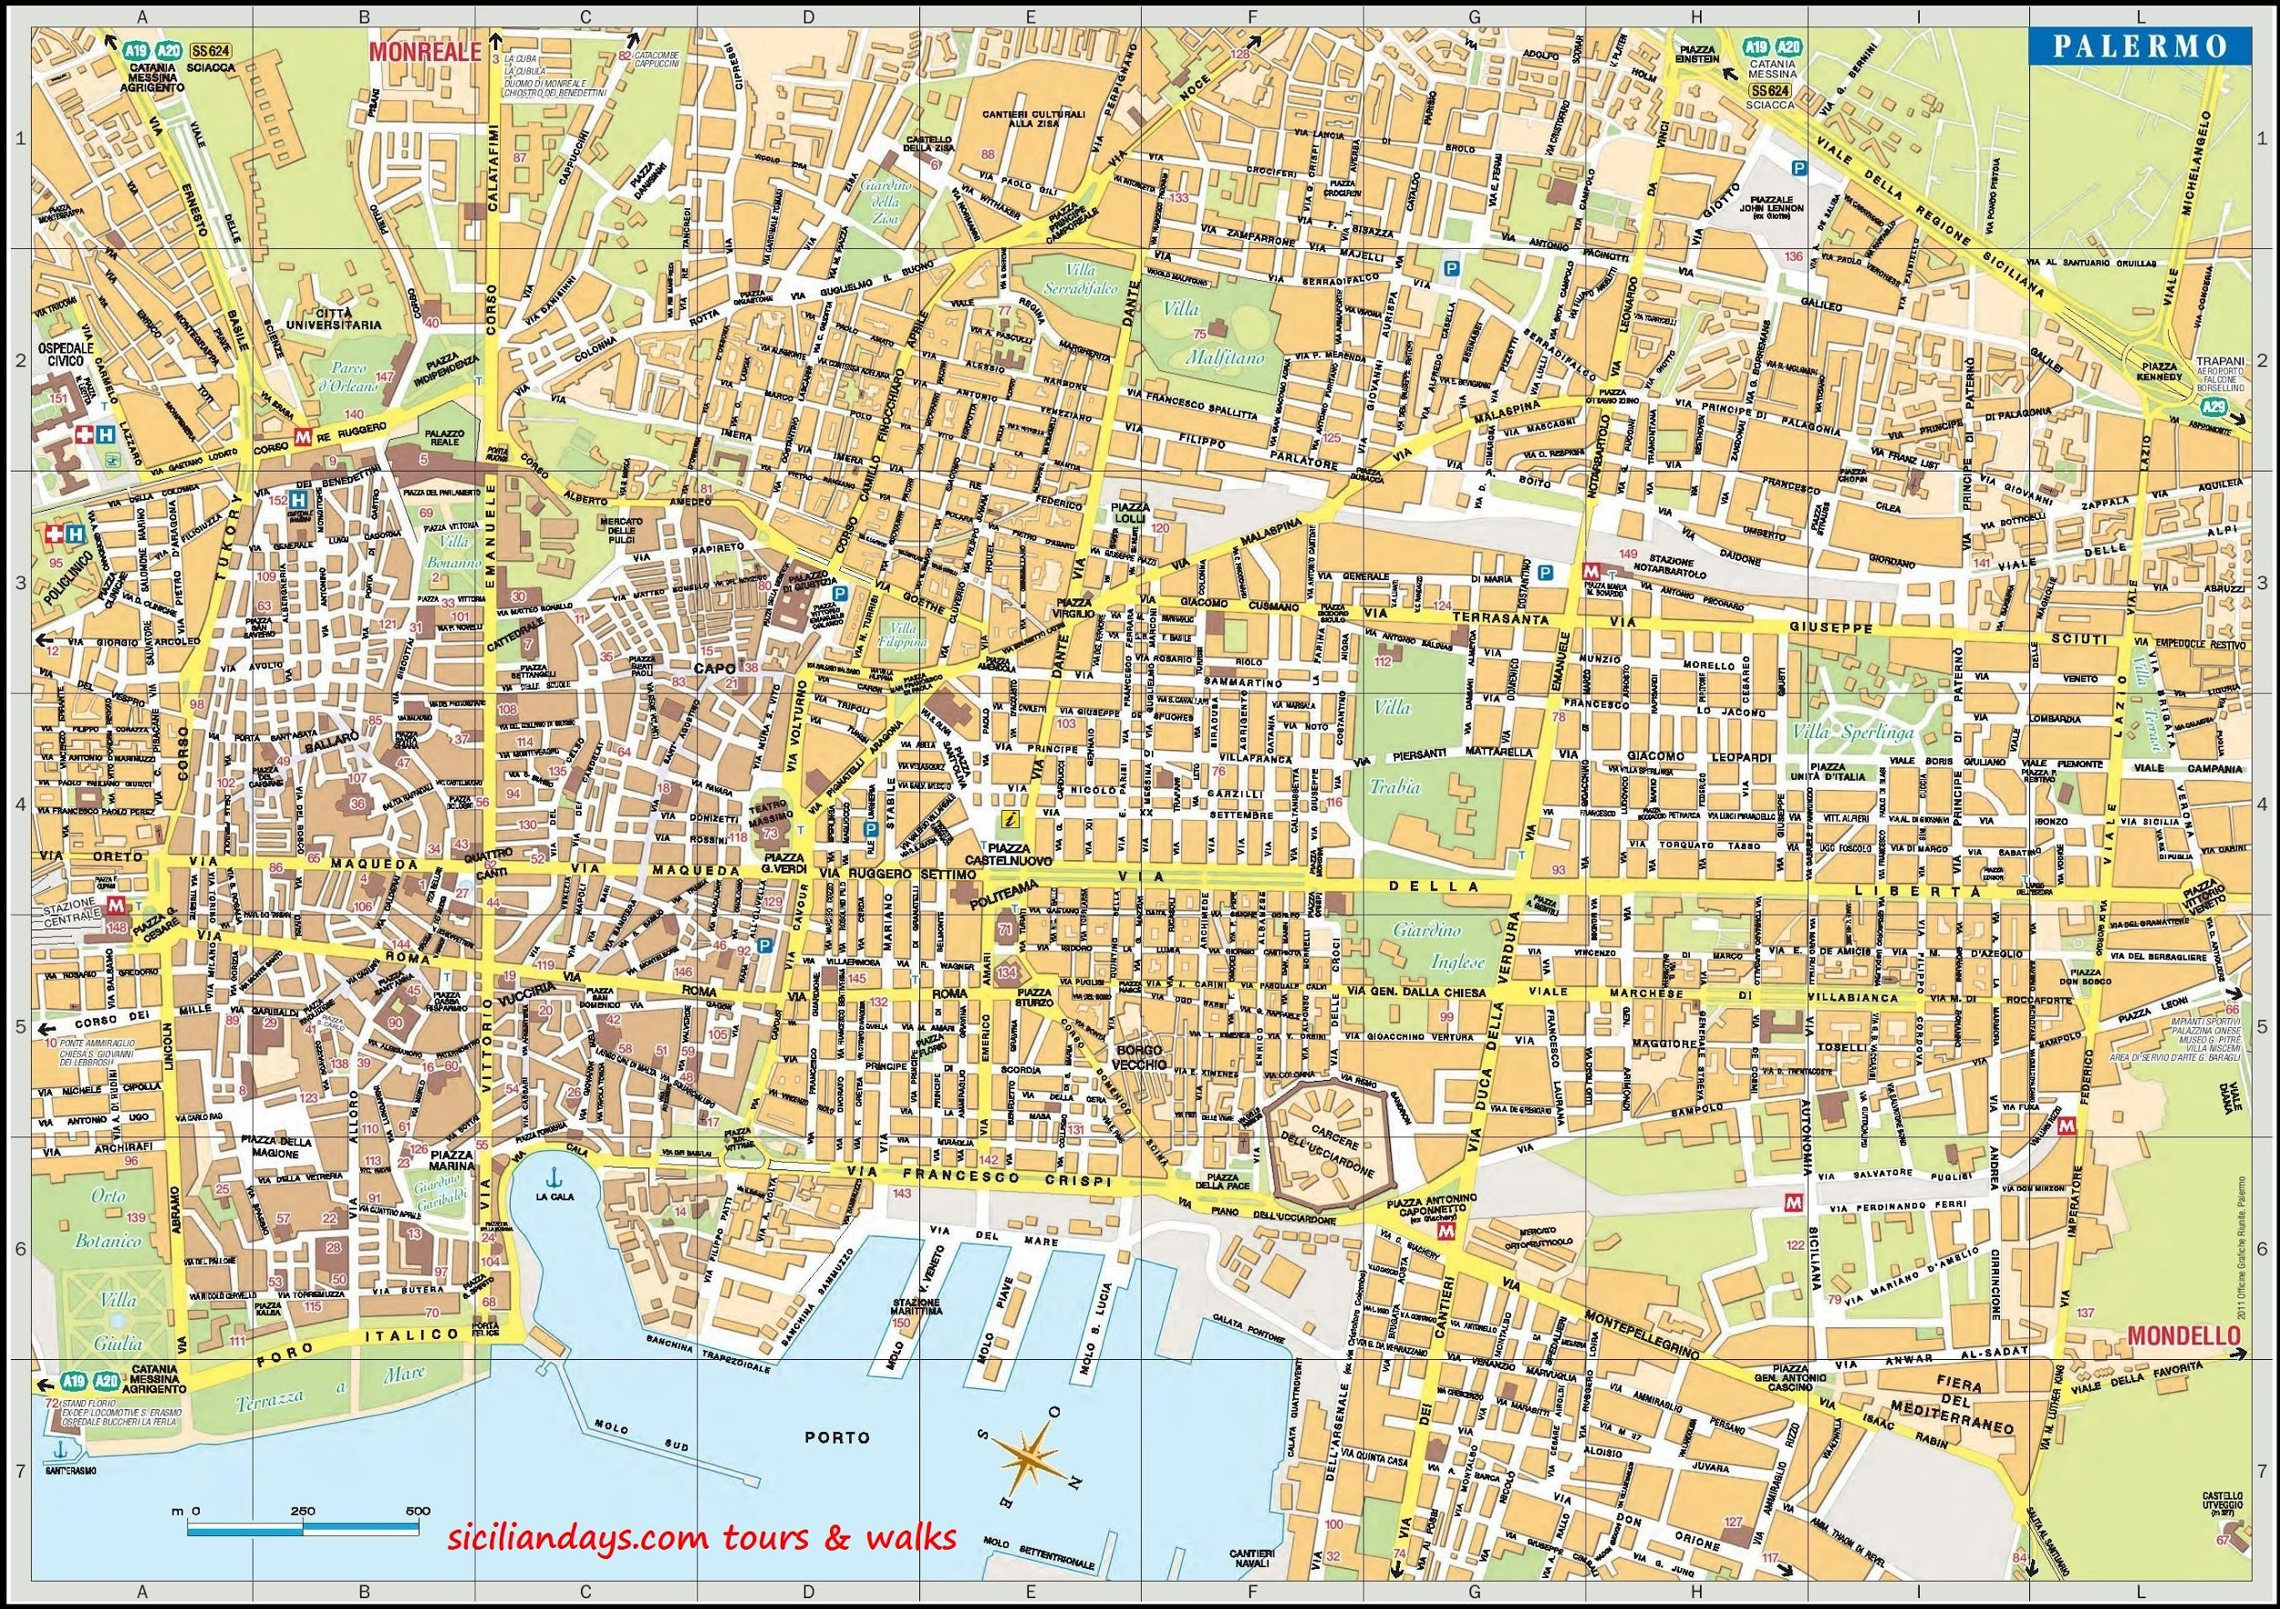

Slide 16
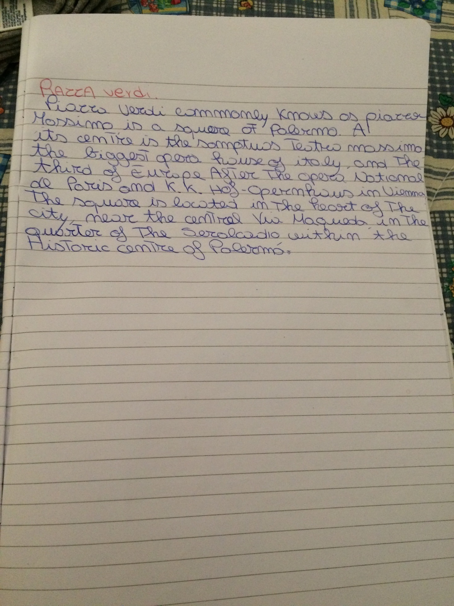
Research on Piazza Verdi

Slide 17
5th Lesson: questions and discussion on brief texts (speaking skills)
The Teatro Massimo is an opera house located on the Piazza Verdi in Palermo, Sicily. It was dedicated to King Victor Emanuel II. It is the biggest in Italy, and the third largest of Europe. It is famous for its perfect acoustics, making a performance here a truly spectacular and memorable experience.
The opera house was designed and overseen by the Italian architect Giovan Battista Filippo Basile. G. B. F. Basile was inspired by ancient and classical Sicilian architecture and the exterior was designed in neoclassical style incorporating elements of the Greek temples at Selinunte and Agrigento. The interiors are art-nouveau. The construction started on 12 January 1874, but was stopped for eight years from 1882 until 1890. From 1891, the construction was supervisioned by the architect Ernesto Basile, son of Giovan Battista. Finally, on 16 May 1897, twenty-two years after the laying of the foundation stone, the Theatre was inaugurated with a performance of Giuseppe Verdi's Falstaff. In 1974, the house was closed to complete renovations required by updated safety regulations, but cost over-runs and political in-fighting all added to the delay and it remained closed for twenty-three years, finally re-opening on 12 May 1997, four days before its centenary. The opera season started again in 1999.
sources:https://en.wikipedia.org/wiki/Teatro_Massimo, https://www.summerinitaly.com/guide/teatro-massimo-palermo-opera-theater

Slide 18
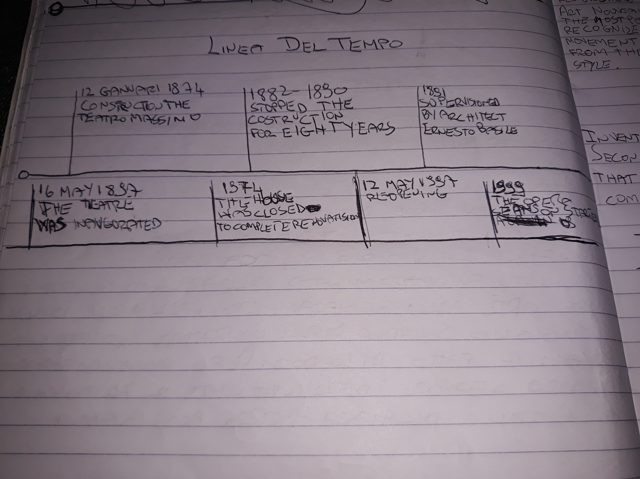
Timeline

Slide 19
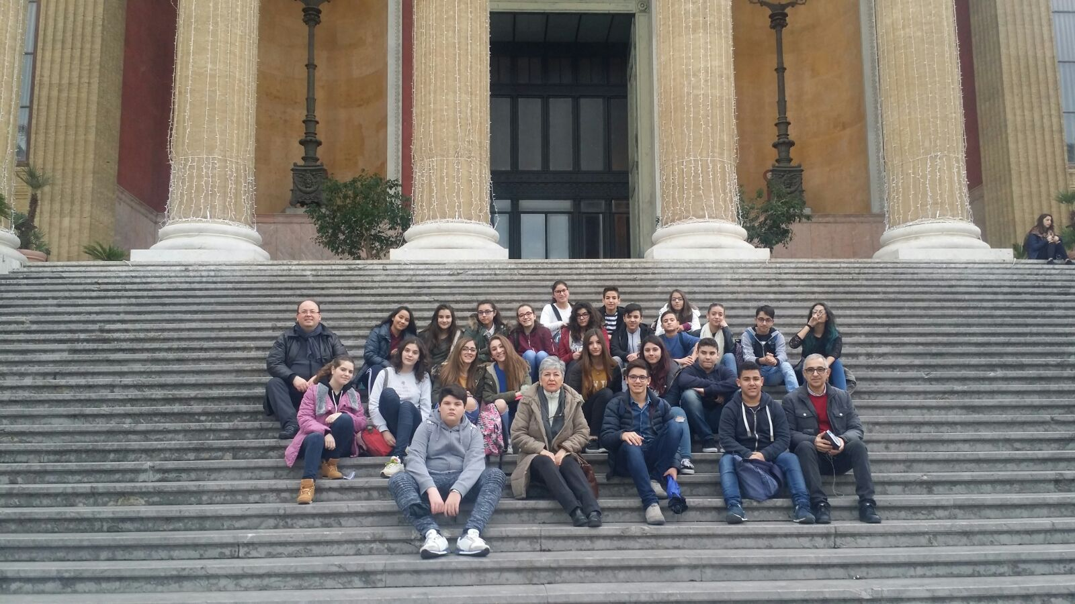
6th Lesson (17th December):
Outdoor learning - Visit to the Teatro Massimo in Palermo

Slide 20
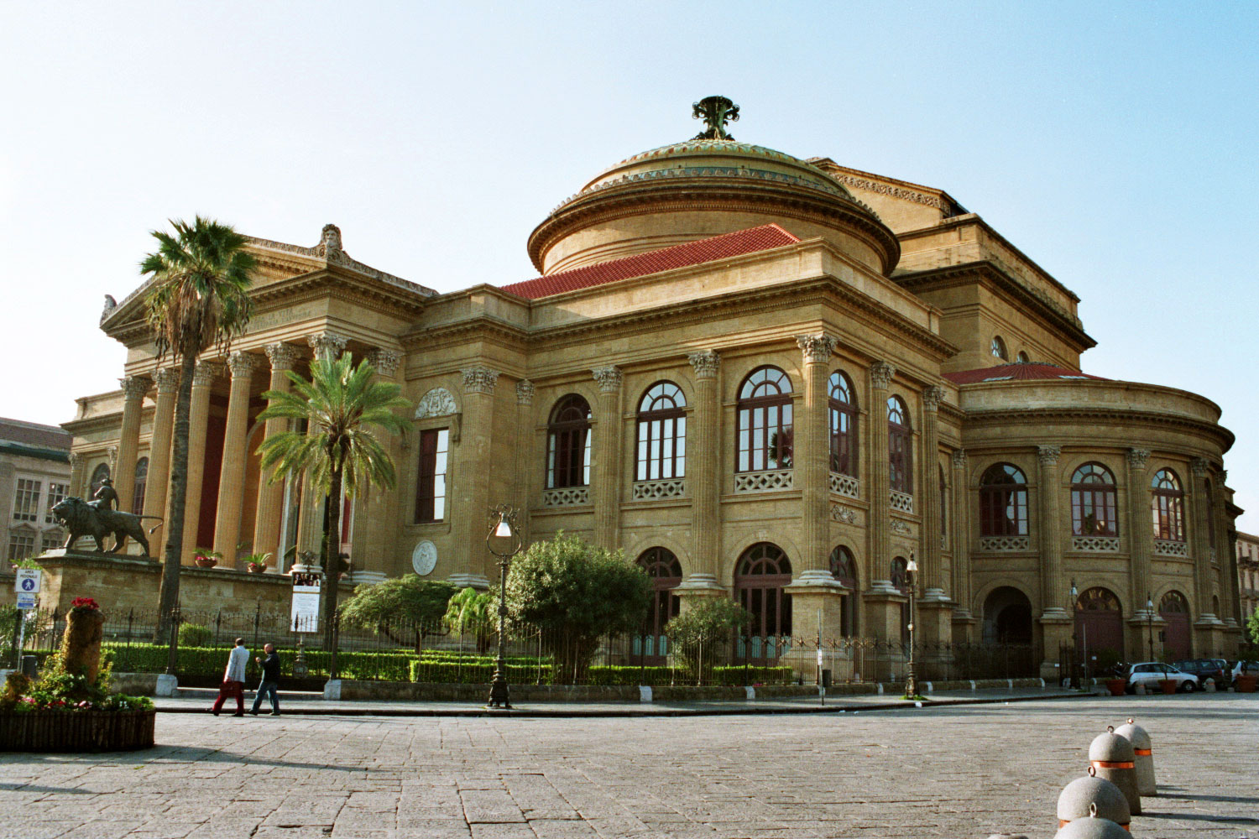
https://mobmagazine.it/wp-content/uploads/2016/11/Teatro-Massimo.jpg

Slide 21
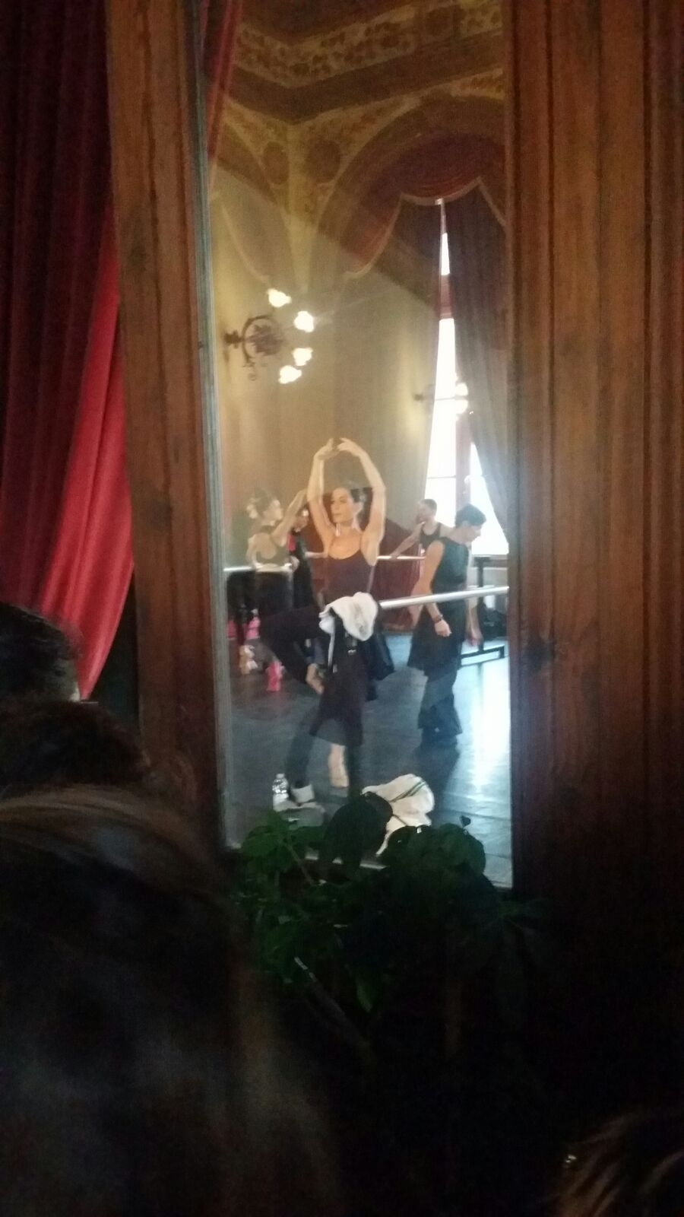
THE OPERA: In the 1800s Opera became more expressive. The stories, written in national languages,were often dramatic and based on literary or historical works. Opera developed in France and Germany, but in Italy it came out on top, growing into the most loved musical genre. Theatres were always crowded and spectators supported singers and composers, as we see today in a stadium.
In that period the most important Opera Houses were: La Scala theatre in milan, Saint Carlo theatre in Naples, Argentina theatre in Rome and La Fenice in Venice.
on the left:
Rehearsal for the Gioacchino Rossini’s “Guillaume Tell”

Slide 22
http://www.teatromassimo.it/images/gallZoom/garbo-mgl6919_957.jpg
THANK YOU!

