Slide 1
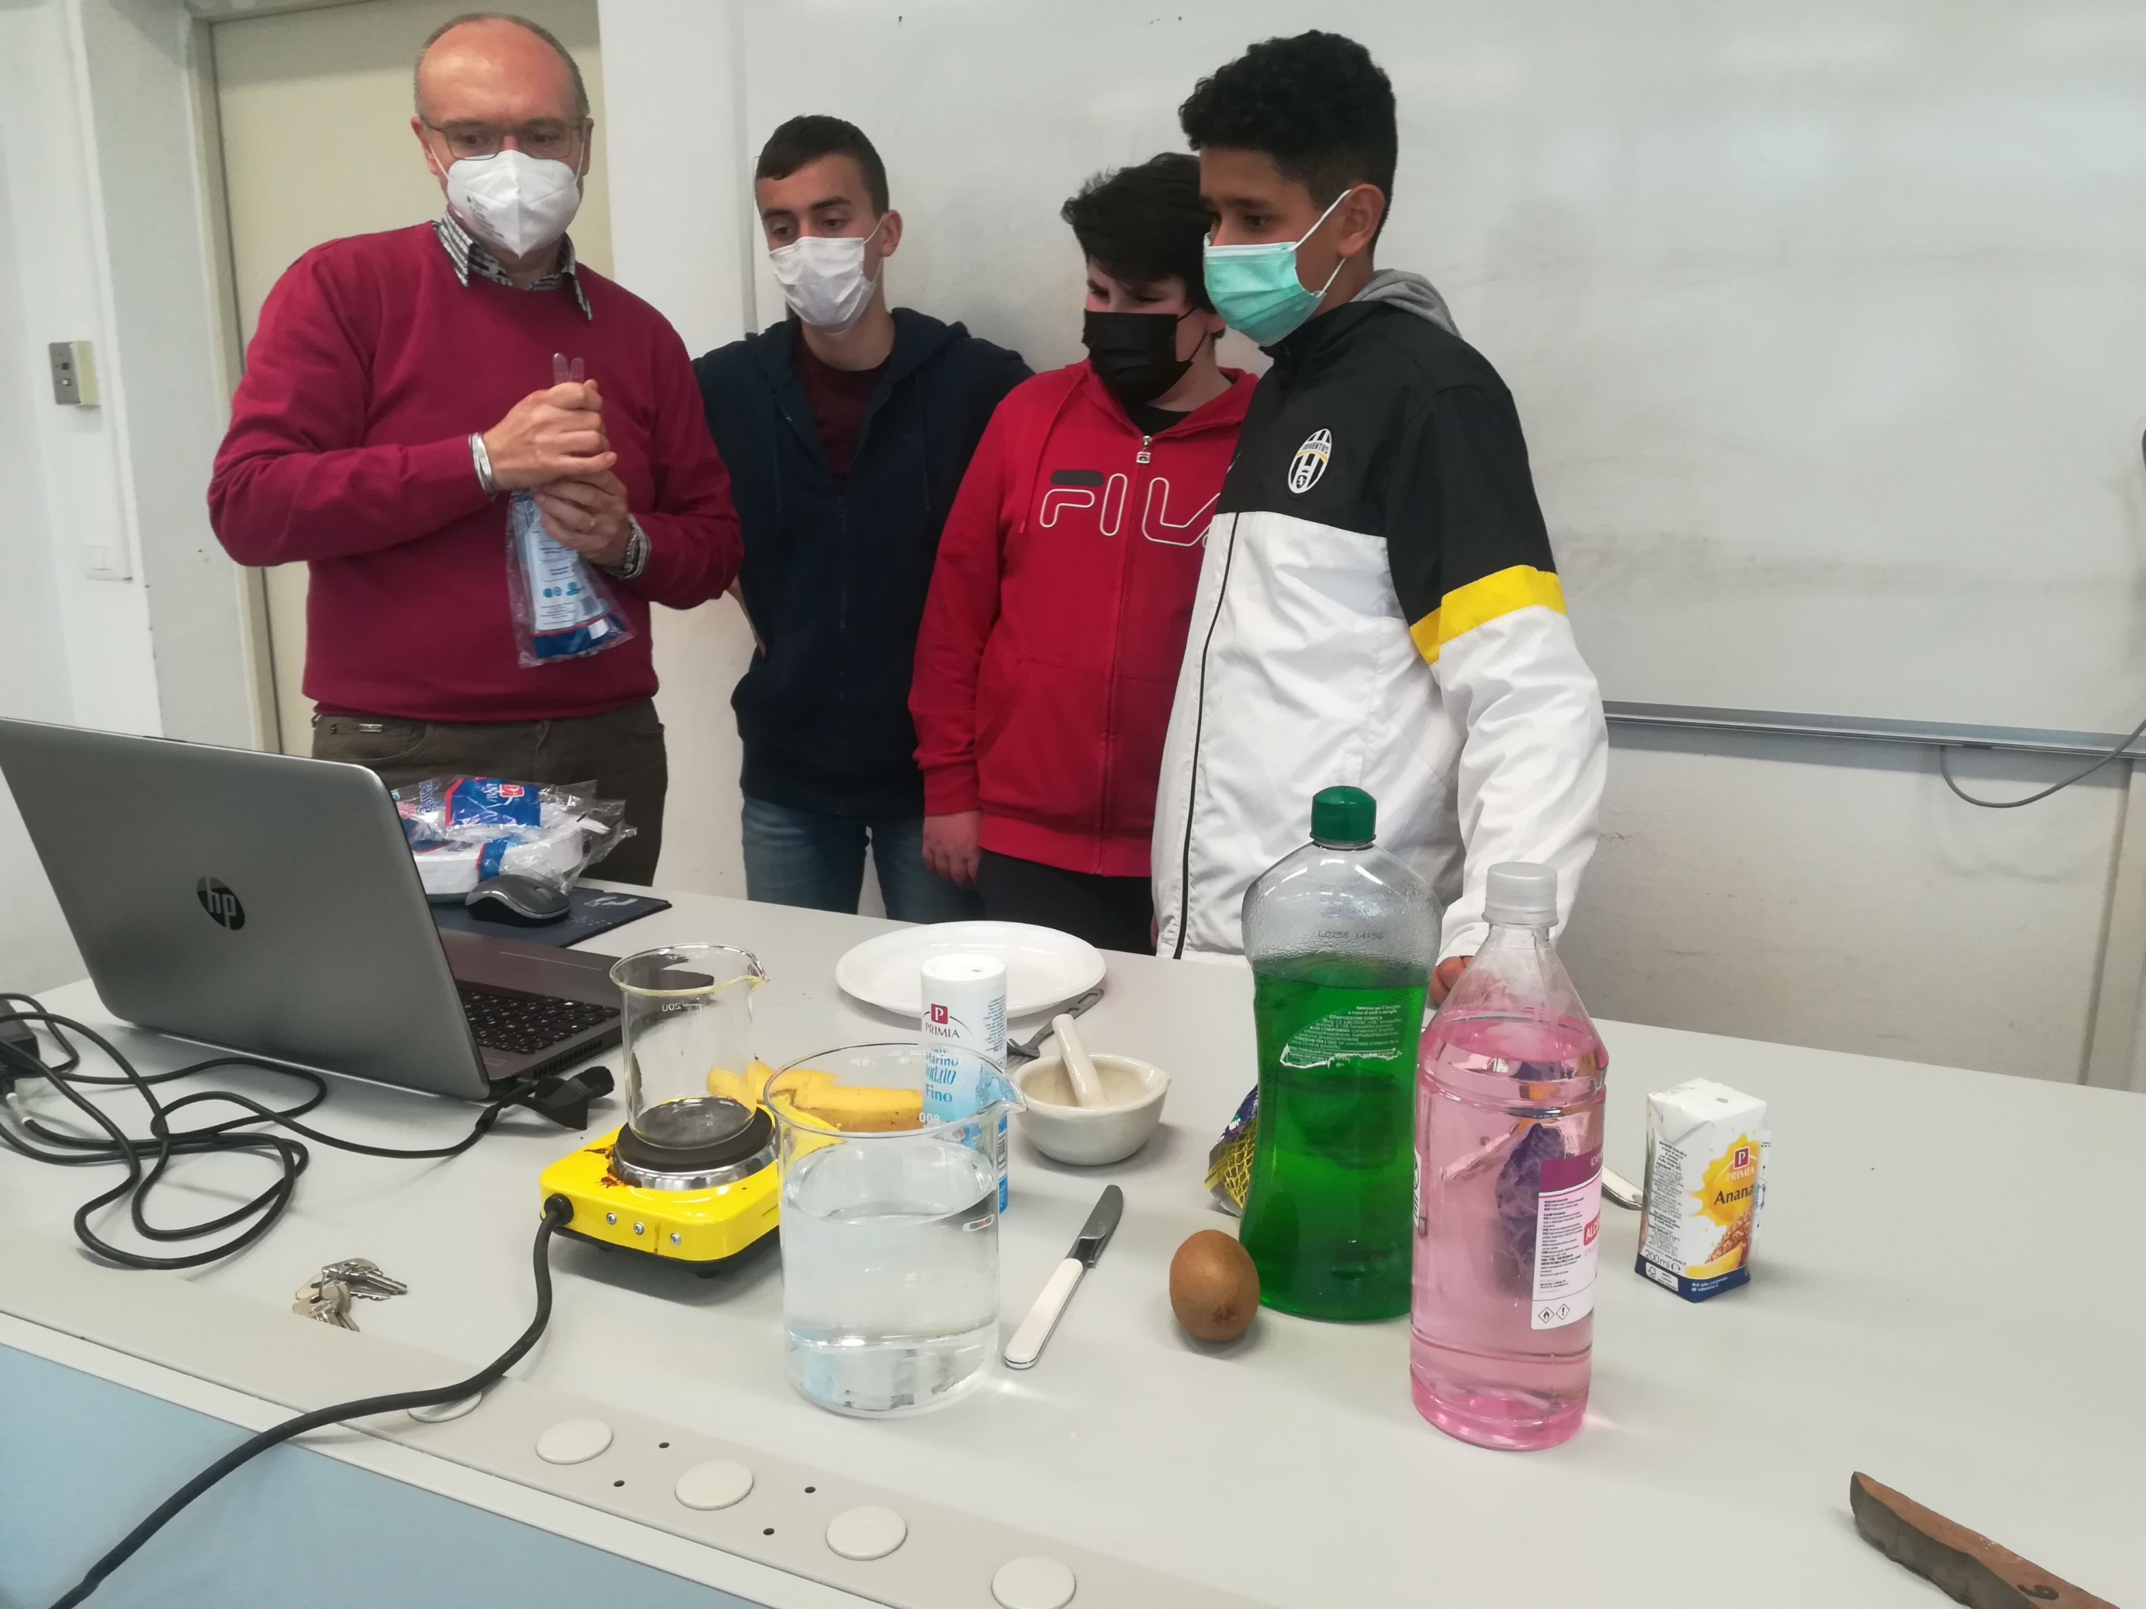
How to extract the DNA from a fruit
Class 3 C
IC «Puecher»
Erba - Italy

Slide 2
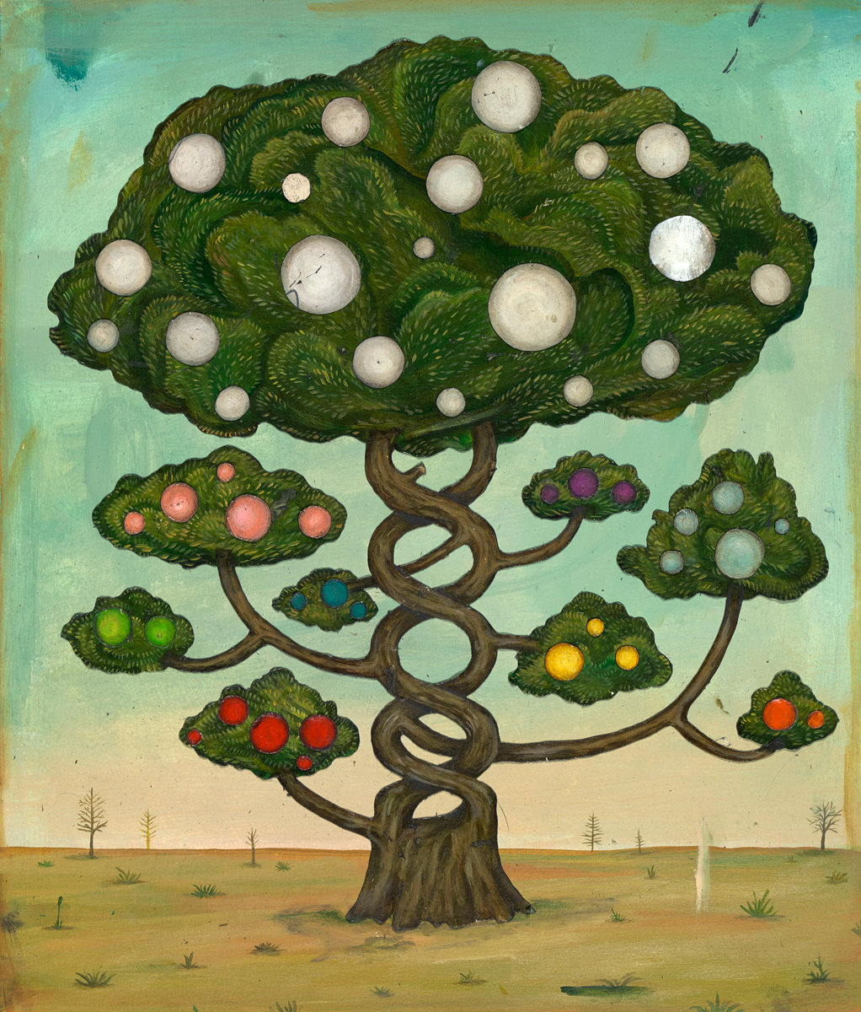
DNA is found in the CELLS of all plants and animals.
DNA is the ‘code’ that tells those cells how to grow and what characteristics a living creature will have.

Slide 3
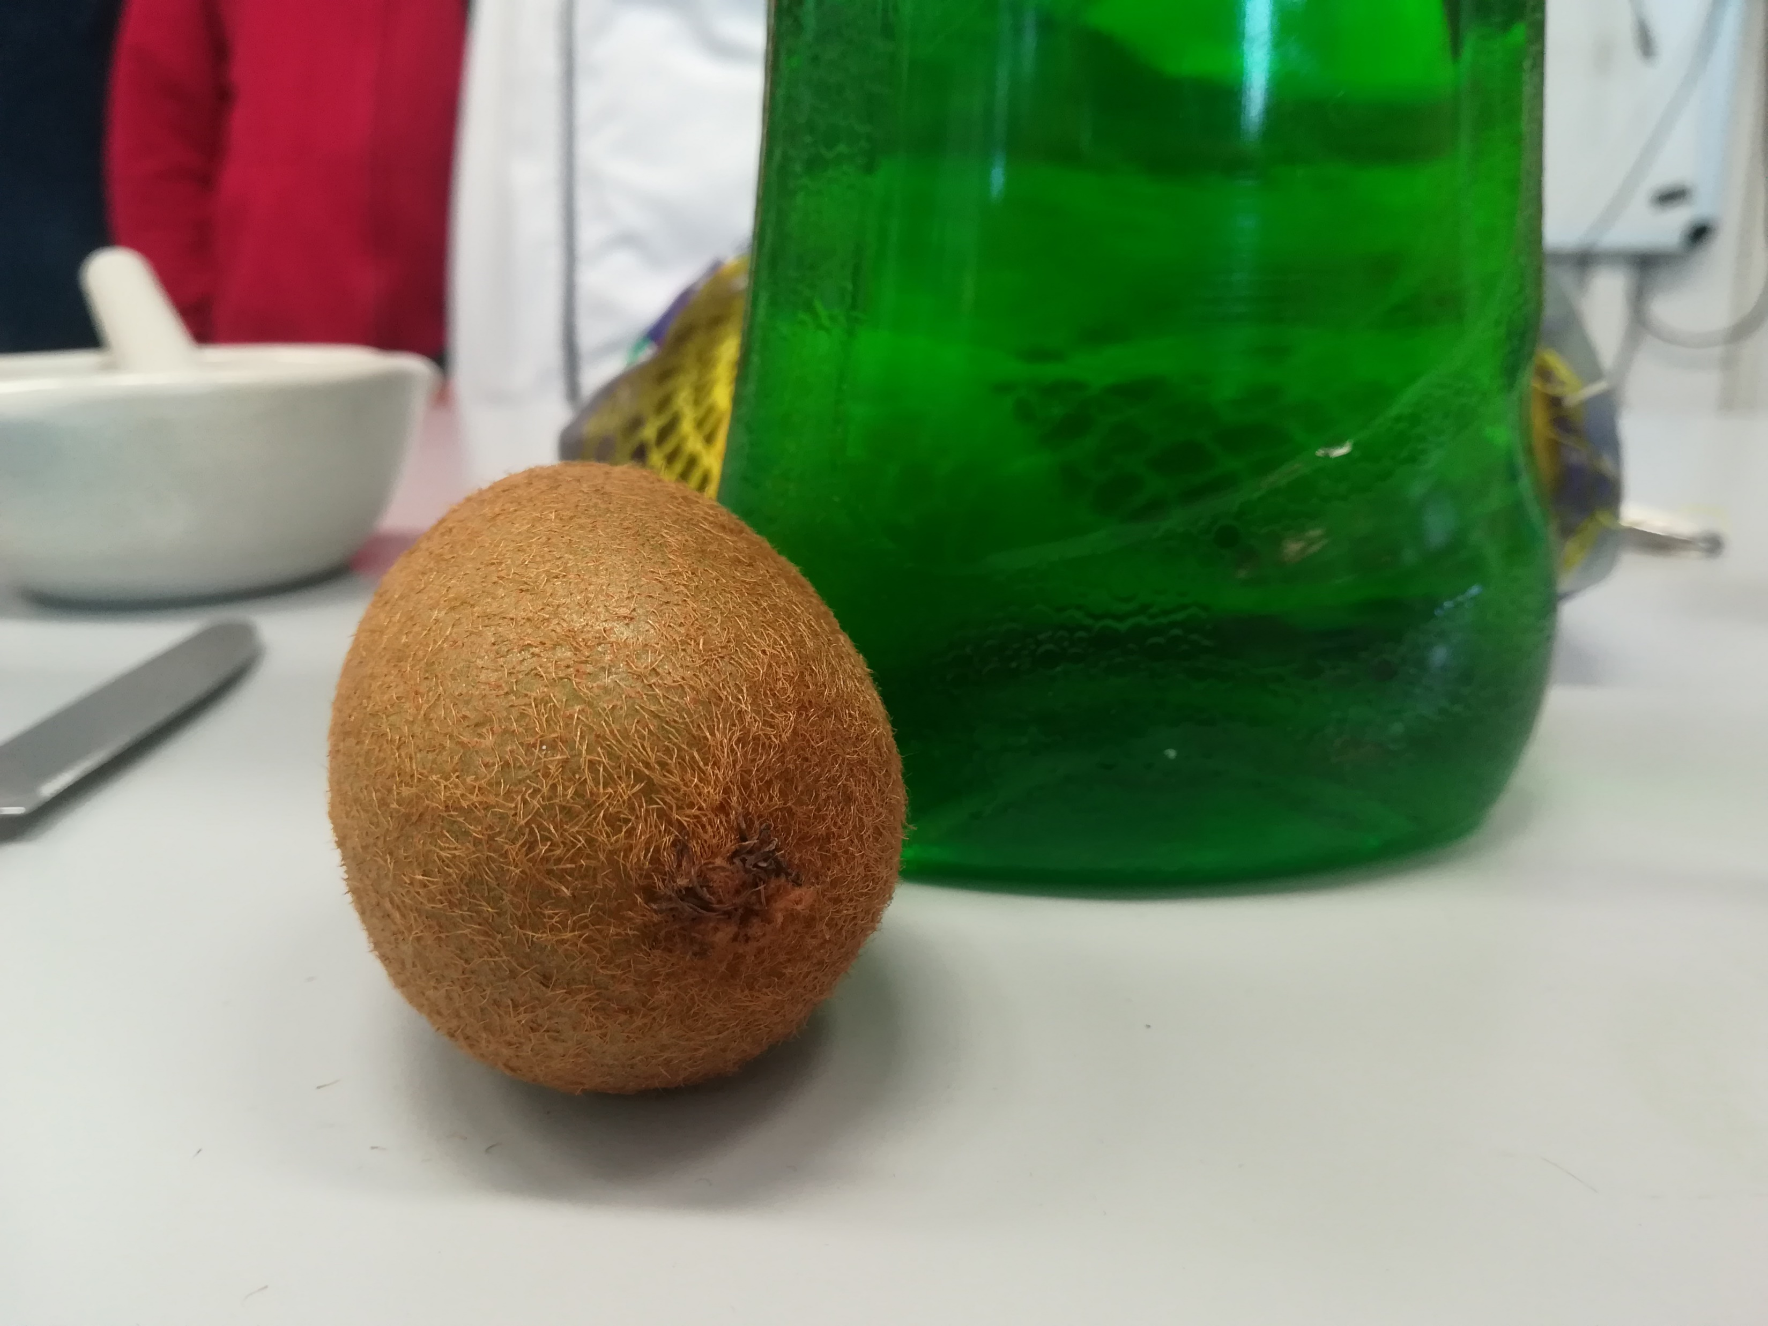
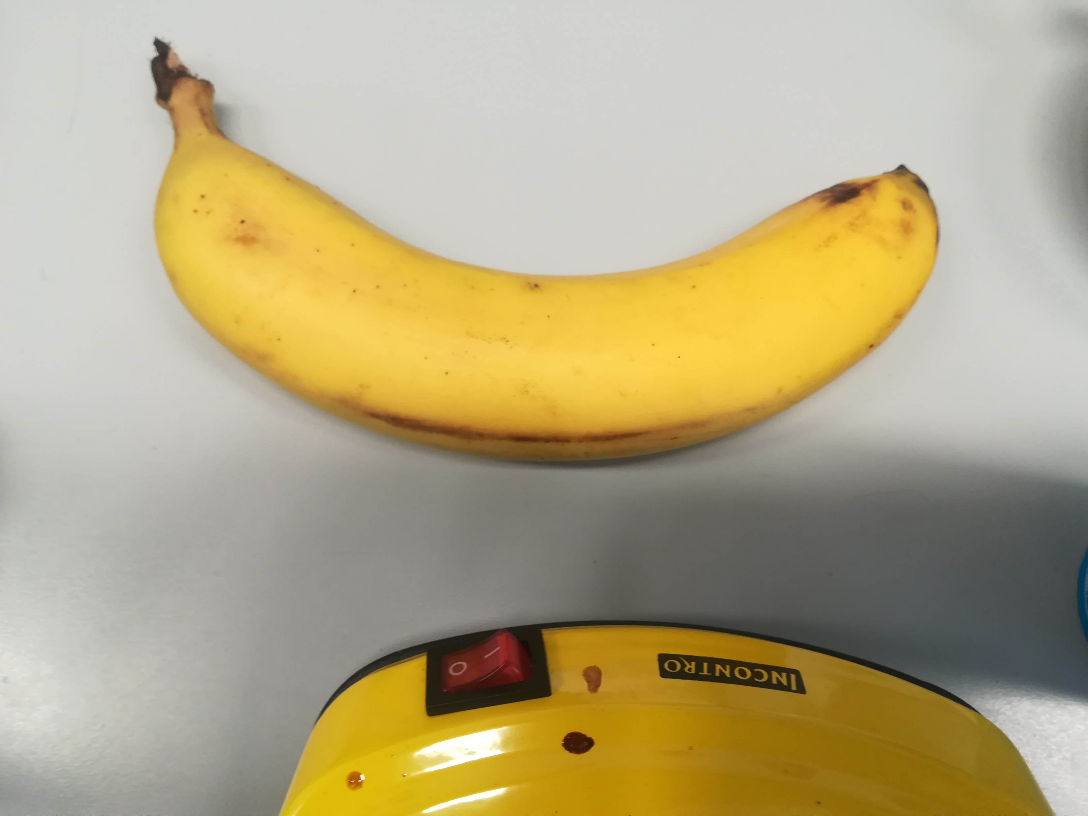
Today we try to extract DNA from some fruit.
You can choose to use a banana, a kiwi or a strawberry.

Slide 4
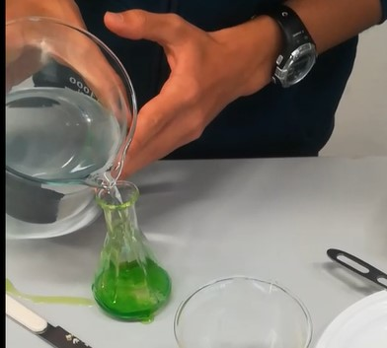
You have to create an extraction mixture using:
Water
Salt
Washing-up liquid

Slide 5
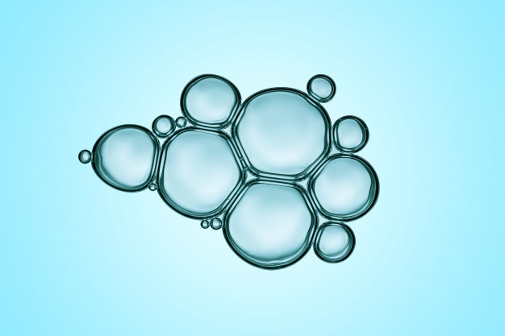
This mixture is used to disgregate the cell and to isolate the DNA. A cell is made of “fatty matter” and we know that soap can divide the molecules of lipids.

Slide 6
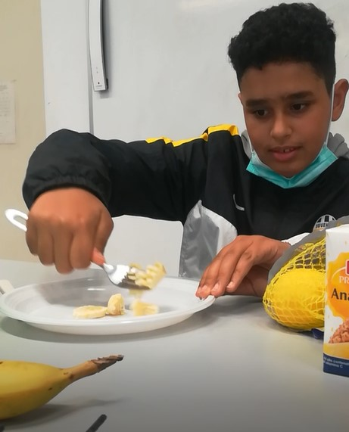
2. Reduce to pulp the banana using a fork
3. Mix the pulp of banana with the extraction liquid

Slide 7
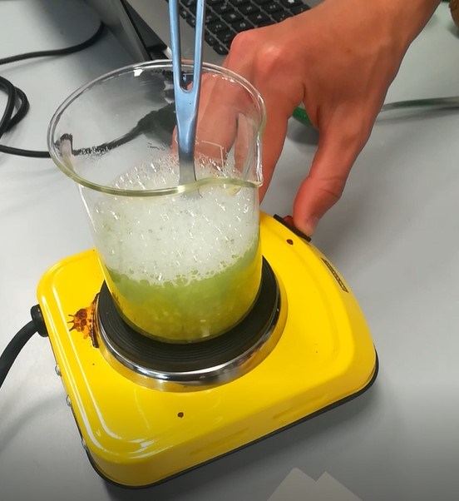
4. Heat the mixture at 60 degree (too high temperature can destroy the DNA molecula)
5. Cool down the mixture with some ice cubes. This two last steps can accelerate the process.

Slide 8
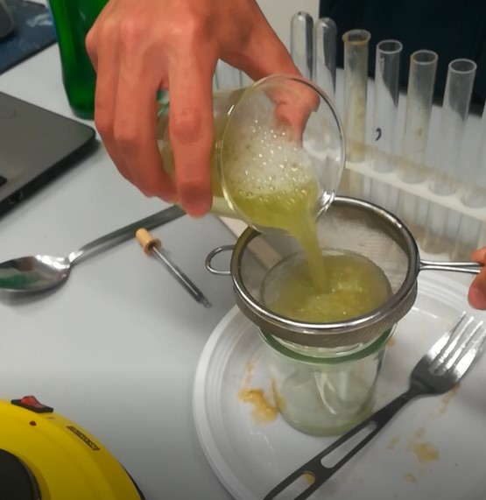
6. Filter the mix for removing the pulp

Slide 9
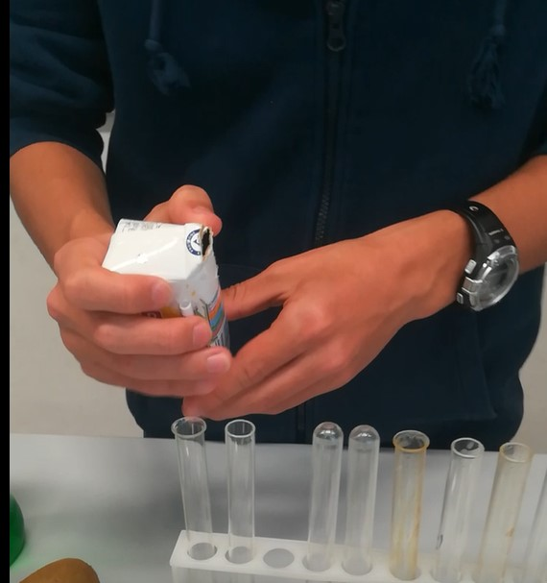
7. Add some pineapple juice. The pineapple contains the Bromelain, an enzyme that destroy the proteins surrounding the DNA

Slide 10
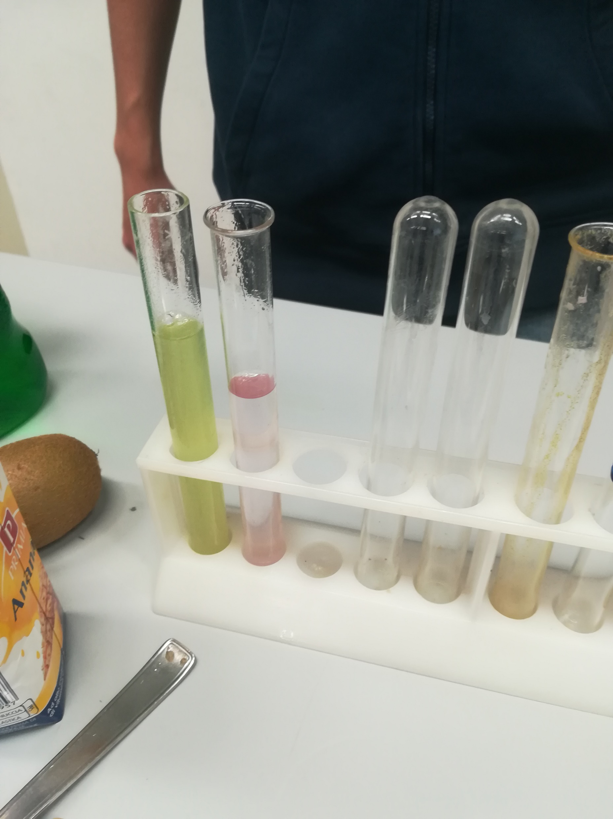
8. Add alcohol (95%) and wait for some minutes. Alcohol help the DNA to plummet.

Slide 11
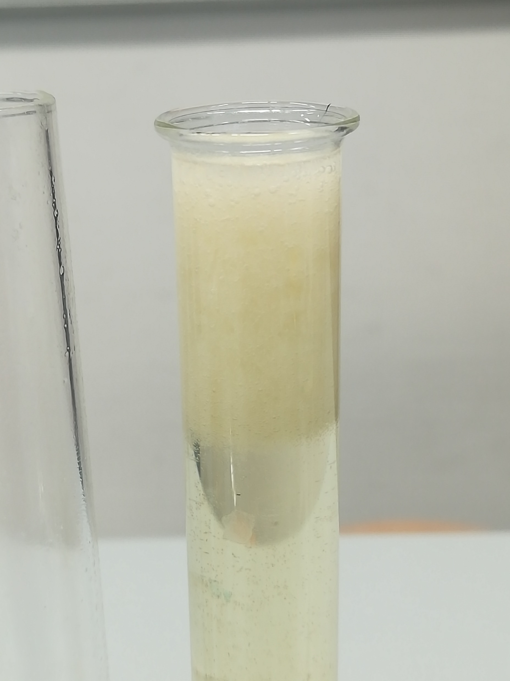
9. You can see a white substance but you cannot see the famous double helix structure. It’s too small for your eyes.

Slide 12
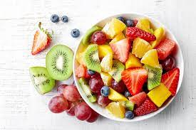
10. Eat the rest of fruits that you have bought. They are delicious and healthy!!

Slide 13
Made by:
Alessandro Carcangiu
Alessandro Miceli
Yassin Saoube

