Slide 1
Traditions of Erba and Northern Italy
By: Consonni, Ferrari , Diop e Piantalunga

Slide 2
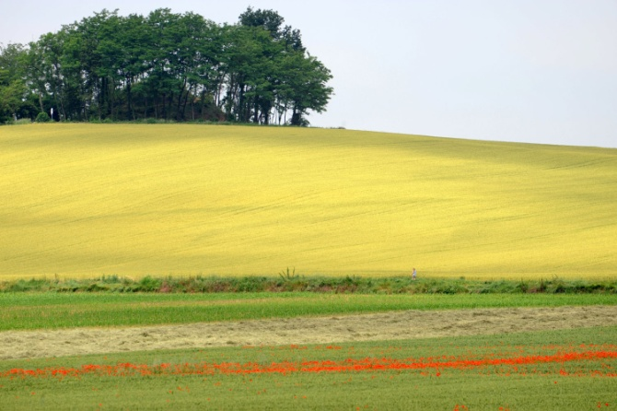
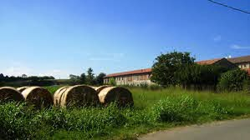
Traditions
Agriculture in Brianza is certainly one of the most widespread traditions in the area.
The Brianza peasant culture has never undergone the passing of time in fact these areas have always been inhabited and worked by willing farmers and breeders who are excellent connoisseurs of this area and its peculiarities.
One of the reasons is the fact that in the Brianza area there are excellent climatic conditions, in fact, it goes from the fog of the moors, to the high humidity rate, to the winter morning frosts, to snowfalls in the coldest periods, to the thermal excursions that manage to be exploited in the best way.

Slide 3
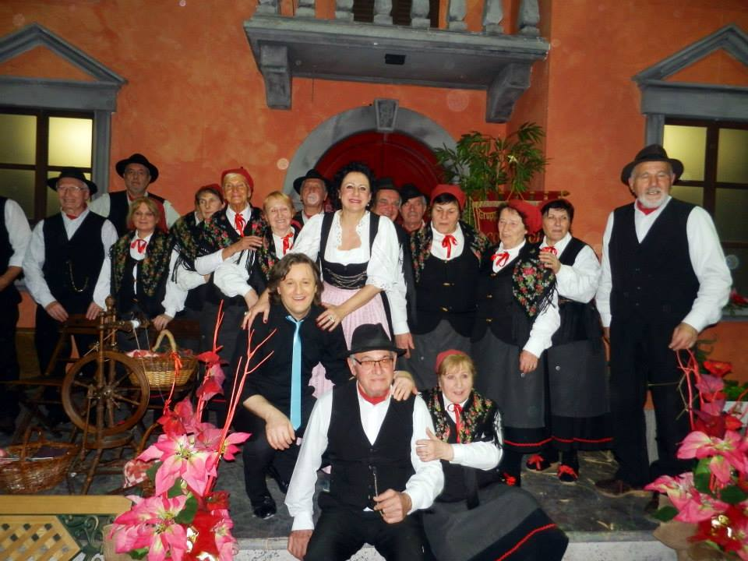
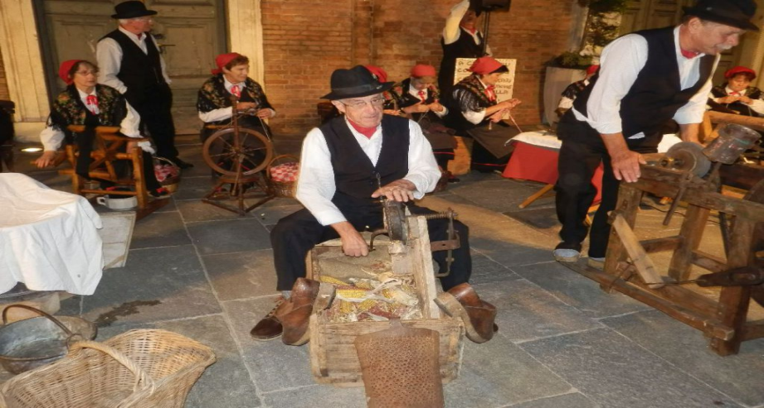
I contadini
"I Contadini della Brianza" is a folkloric group that was born in Albavilla and aims to show Brianza as it was in the past. It proposes dances and songs demonstrating the old works. Es women spinning wool, working lace and men working wood to demonstrate the use of old tools of Brianza farming culture, thus enhancing our territory

Slide 4
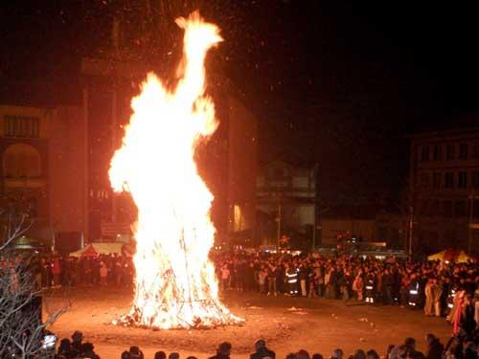
La giubiana
"La Giubiana or Festa della Giöbia" is a very popular traditional festival in northern Italy, particularly in Piedmont and Lombardy. On the last Thursday of January, large bonfires are lit in the squares and the Giubiana, a large straw puppet dressed in rags, is burned. The stake takes on different values ​​depending on the location in which you are, always maintaining a close link with the popular traditions of the place.

Slide 5
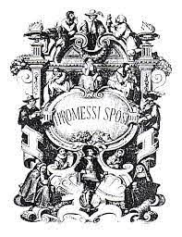
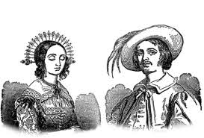
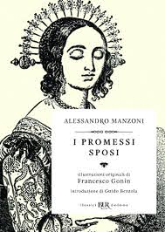
I Promessi Sposi
Lucia and Renzo are the main characters of "The Betrothed", the love story par excellence, written by Alessandro Manzoni.
The novel is set in 1600 and is about two lovers who want to marry, but a rich man of ancient nobility named Don Rodrigo, fell in love with Lucia and will do everything to prevent their marriage.
The story, despite being from other times, is still a beautiful love novel.
It was first published in 1827, revised later by the same author, especially in the language and then it was republished in the final version between 1840 and 1842.

Slide 6
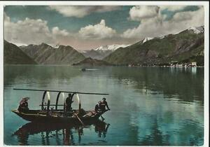
La barca Lucia
The Lucia boat (also called “barca
Batell”) is a small rowboat. It is also the most famous of the Larian boats, so much so that it has become the symbol itself of the lake.
The story of Renzo and Lucia is mainly set on Lake Como, in the Lecco area and the particular thing is that even today The betrothed are part of the life of the city, being dedicated to their streets, squares ...
The most striking thing is that mirrored on the lake's waters you can find the boats that Manzoni designed with the name of Lucia.

Slide 7
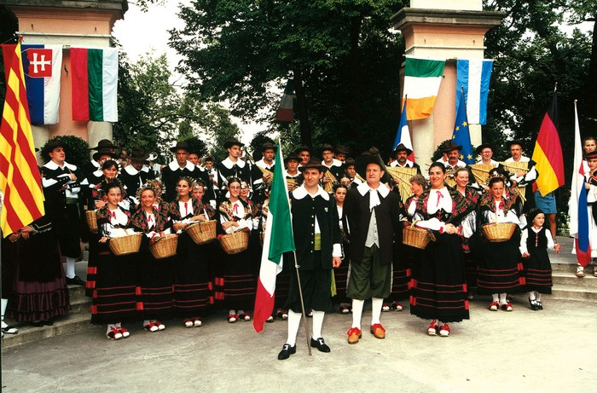
I bej
The folkloric group was born in 1927 and defends the cultural values ​​of Brianza THROUGH MUSIC TRADITIONS DANCES CHARACTERISTICS AND COSTUMES. The name "Bej" comes from a name with which the inhabitants of Erba alta were known. The first official release of the Bej of Erba was on the occasion of the Varese Carnival in 1928, where, however, the musical body was composed only of men.
The men play an instrument built with the union of several pipes called "firlinfeu".
The "bej" adopt the costumes of Renzo and Lucia by Alessandro Manzoni

Slide 8
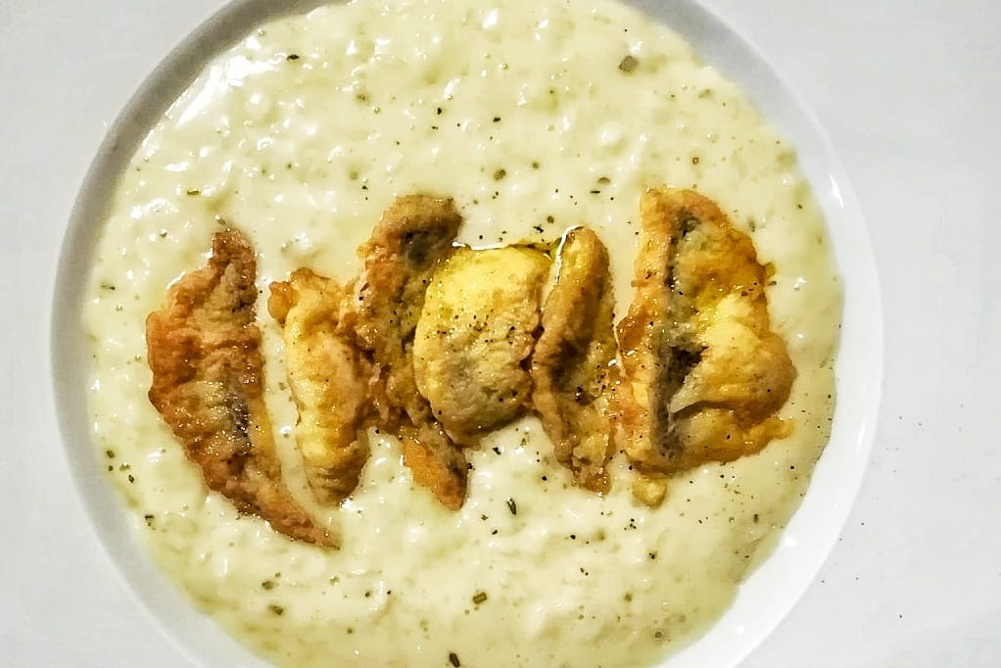
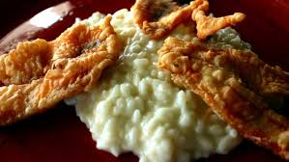
Risotto persico
Questa ricetta si è sviluppata e diffusa solo a partire dal XVIII secolo, cioè quando il pesce persico è stato importato per la prima volta in Italia dalla Svizzera e ha iniziato a stabilirsi nei laghi dell’Italia settentrionale, diventando quindi uno degli obiettivi più ambiti dei pescatori

