Slide 1
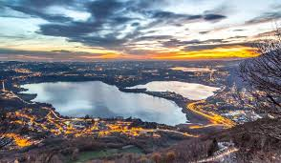
Lakes of Brianza
Consonni Dalila, Villa e Coppola

Slide 2
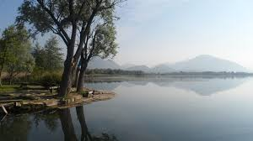
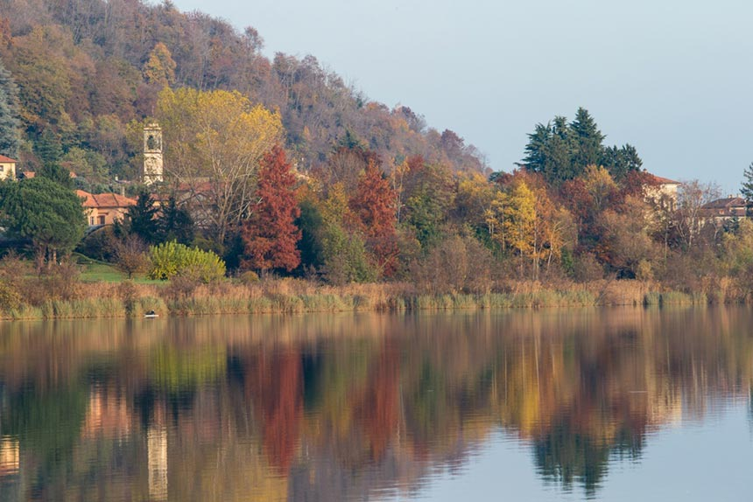
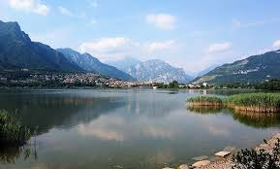
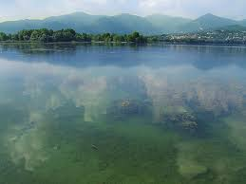
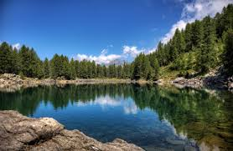
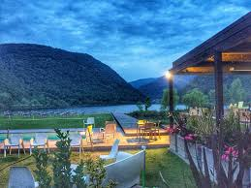
High Brianza Lakes
In the northern part of Lombardy we have several lakes; they are all of glacial origin, with smooth morain hills. They are:
Il lago di Pusiano
Il lago del Segrino
Il lago Azzurro
Il lago di Annone
Il lago di Montorfano
Il lago di Alserio

Slide 3
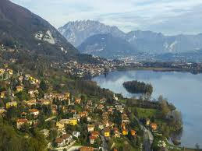
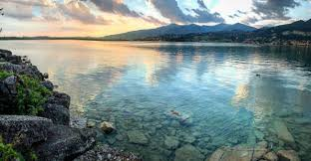
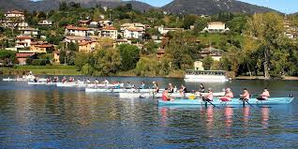
Il lago di Pusiano
Located between the provinces of Como and Lecco, in Brianza, it is the lake located further north than the others. It has a U shape and this feature shows how it was carved out of a glacial tongue. Along the five-kilometer perimeter you can take a beautiful walk reserved for pedestrians and bicycles.
In this lake you can find several boating teams, also from foreign countries

Slide 4
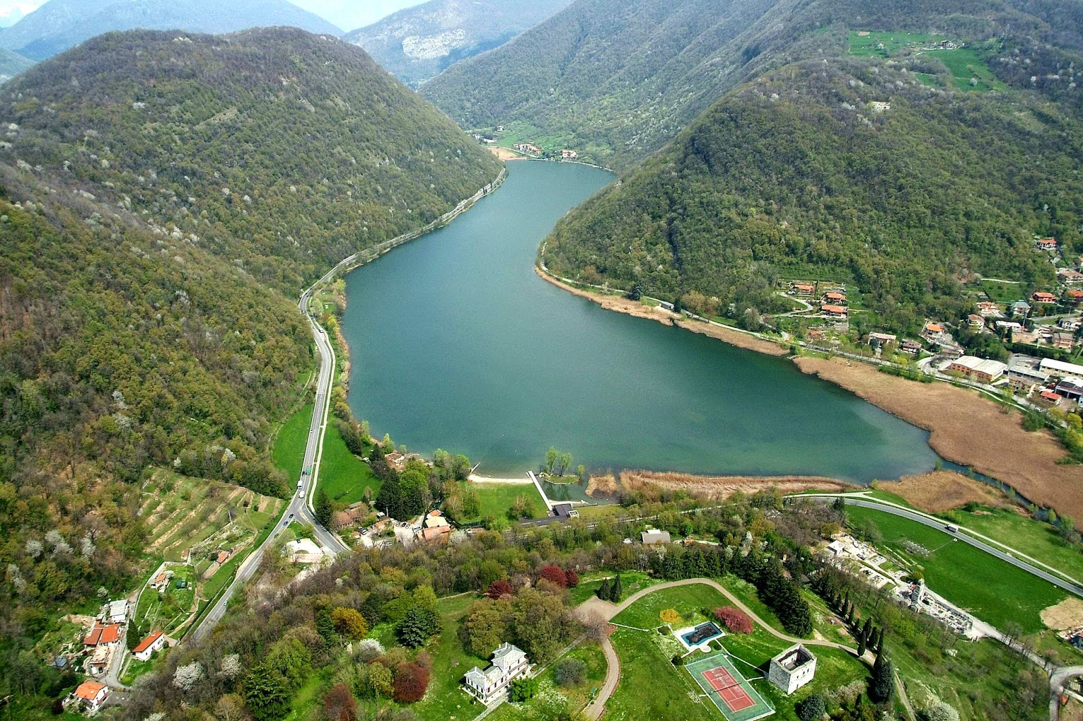
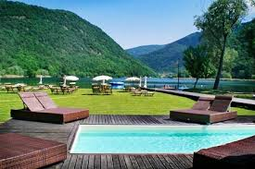
Lago del Segrino
Is the smallest of the glacial lakes and it is one of the cleanest and with the best preserved fauna of Europe.
it is located between three municipalities: Eupilio, Longone al Segrino and Canzo
All around it you can have nice walks and riding bikes because there is a bicycle lane.
IF you like bathing there is a nice lido where you can borrow deckchair and beach umbrellas .

Slide 5
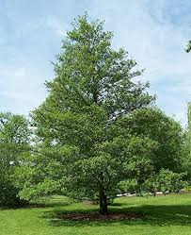
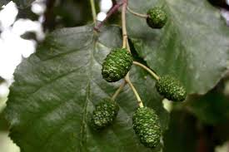
Lago Azzurro
Is a humid area in which, during different periods of the year, numerous species of birds related to lake environments find shelter because it is one of the few environments with good natural characteristics present in the area north of Milan.
This lake was formed at the bottom of a depression originating from the extraction of clay, and is also surrounded by cores of alder, that is the characteristic trees of these environments.
Sport fishing is also practiced and restaurants in the area abound.

Slide 6
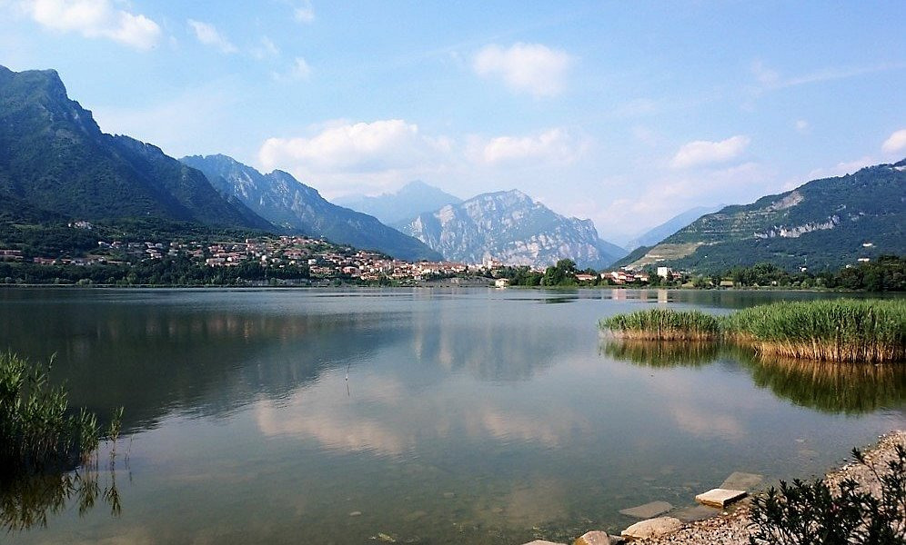
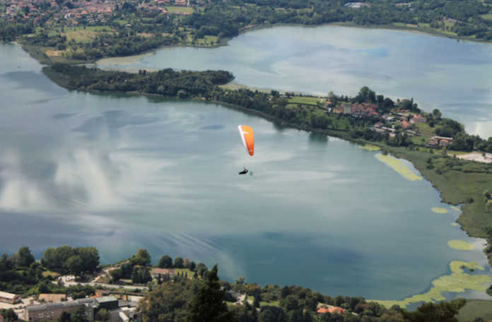
Lago di Annone
Is located in the eastern part of Alta Brianza. The easternmost part is also the largest and is also called Lake Oggiono; the westernmost part is the smallest. It is mainly fed by springs under the lake. It also has an emissary which is the Rio Torto. All these lakes and in part, for that of Segrino, have unfortunately been victims of pollution, due to the discharges of the industries that have arisen on their banks since the early decades of the 1900s.
However, since the 1980s, these basins have become protected areas, considered by the Lombardy Region as "Parks of of supra- municipal interest".

Slide 7
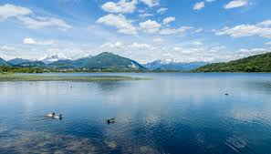
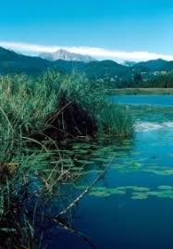
Lago di Alserio
The lake is part of the Lambro Valley Regional Park. Along the eastern shore is the Oriented Regional Reserve Eastern Shore of Lake Alserio.
The name Alserio derives from the Celtic root “ser” which means water. It is said that the emperor Frederick Barbarossa, while fleeing in retreat towards the castle of Montorfano, got lost in the marshy meadows and reeds around the lake of Alserio.In the thick of the reeds and in the intrigued woods of the Buerga hill, the main responsible for the killing of the Napoleonic Minister of Finance Giuseppe Prina, which took place in Milan in 1814 during a riot, would have found a safe refuge.

Slide 8
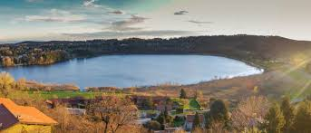
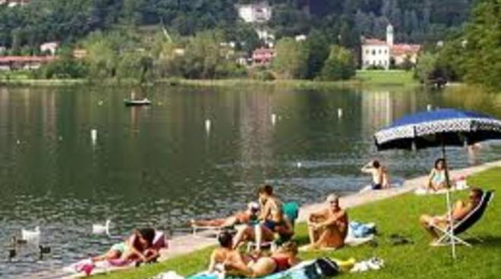
Lago di Montorfano
The lake is west of Erba; it is one of the cleanest lakes in all of Lombardy. It is placed at an average altitude of 390 m above sea level and has an area of 0.450 sq km. The depth is about 4.10 m, while the maximum depth is 6.75 m.m Along the shores of this lake there is a beautiful lido, equipped with cabins, services and bars where it is also possible to swim.

