Slide 1
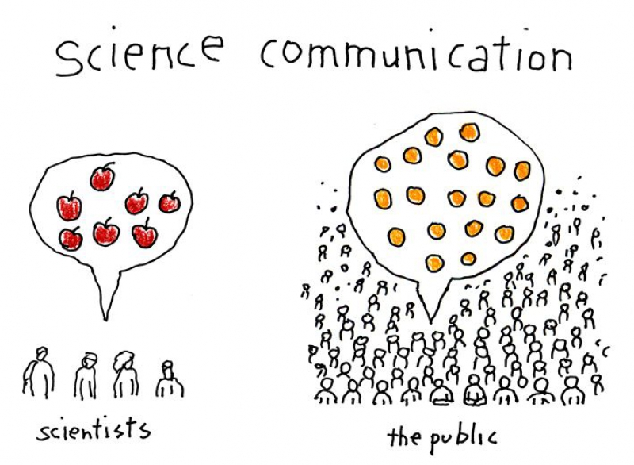
Citizen Science
Everyone can help Science!

Slide 2
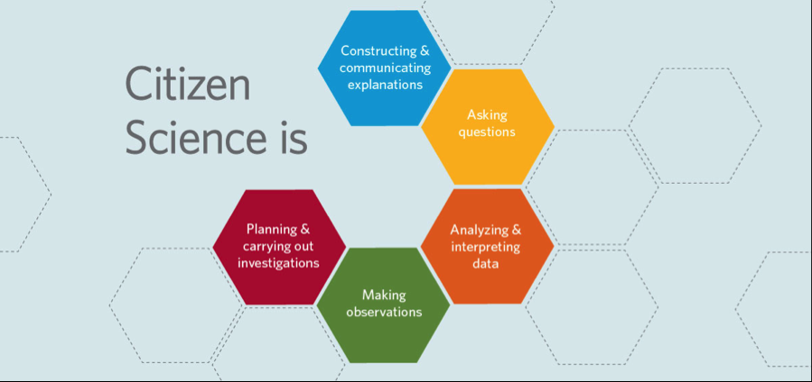
Cosa è la Citizen Science?
What is Citizen Science?
A scientific project in which citizens can actively collaborate with the supervision of researchers and scientific institutions.

Slide 3
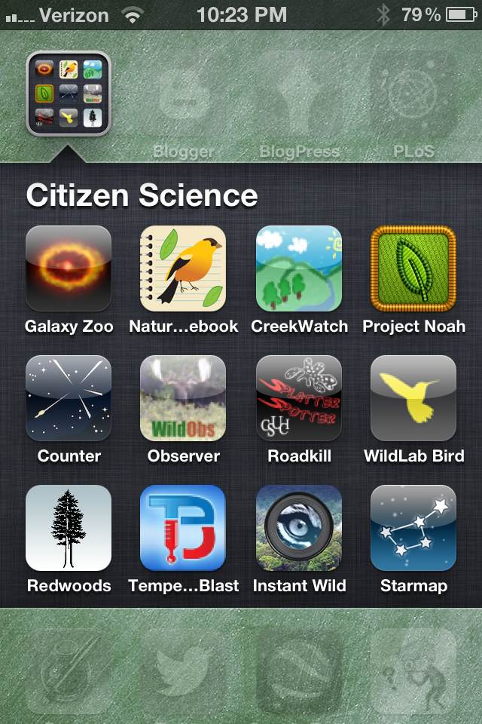
Cosa è la Citizen Science?
Why we can talk about Citizen Science today?
In the past we never thought to a Science made by common citizens (science to non-professionals was forbidden)
Citizen Science developed thanks to:
A culturale and methodological revolution : change the manner to do science, not only based on hypothesis, experiments and theories but a science made of numbers, analysis and samples. With the right instruments and a minimum preparation alla people can help.
web and mobile computing have changed everything : our smartphone is more powerful than the best computer of 40 years ago and we have in our pocket the computing power that we would have dreamed of in the last century. The web give us the chance to communicate data and observations in real time.

Slide 4
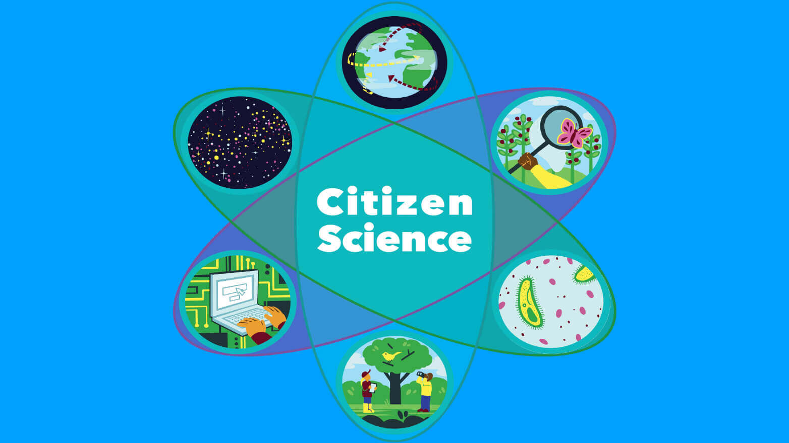
Cosa è la Citizen Science?
In which researcher sectors, Citizen Science is a protagonist?
Surely in all the researches that deal with field analysis, observations in nature, ... in this sense Biology is the master ...

Slide 5
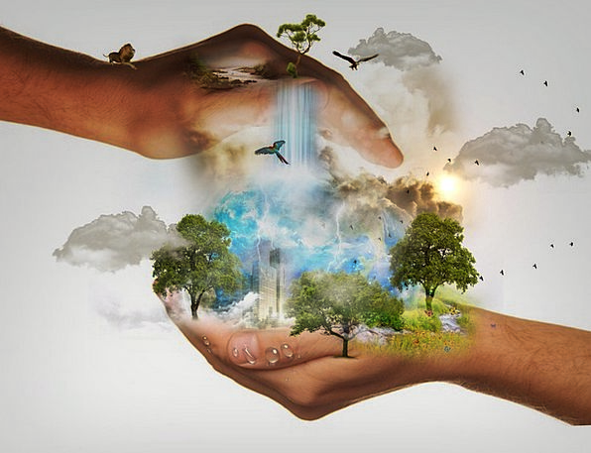
Il valore della Citizen Science
The contribution of volunteers, who participate in Citizen Science projects for the conservation of biodiversity, amounts to about 2.5 billion dollars / year

Slide 6
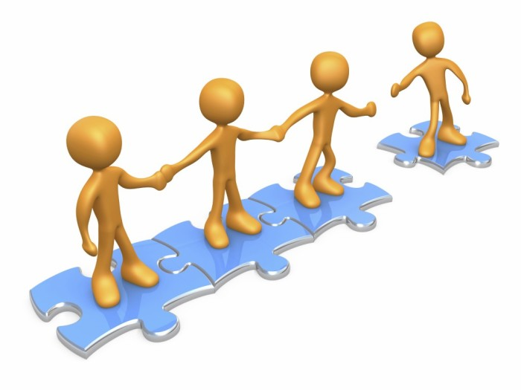
I ruoli del “cittadino”
Public participation is not just passive!
Passive role (detector)
participants provide a resource (smartphone, private property, etc.) to carry out automatic surveys using sensors.
the data collected is sent to the scientists (use and analysis)
Active role
volunteer thinking: participants contribute by offering their skills in recognizing objects or analyzing data
civic and community science: the project is proposed and led by groups of participants who identify a problem that concerns them

Slide 7
Citizen Science in classe
The laboratory is "outside": the nature that surrounds us becomes the laboratory in which to operate.
Teachers, universities, researchers become our collaborators
3 Key Words:
EXPLORE: observe the Nature
LEARN: understand something about what I’m observing
RECORD: send my registered data to contribute to scientific progress

