Slide 1
From GLOBE to ERASMUS
Izabela,Lotte and Ana

Slide 2
CULTURAL DIFFERENCES
Different languages
Others system of education (like learining some languages or time of high school)
Food
Different sense of humor
Traditions diversity

Slide 3
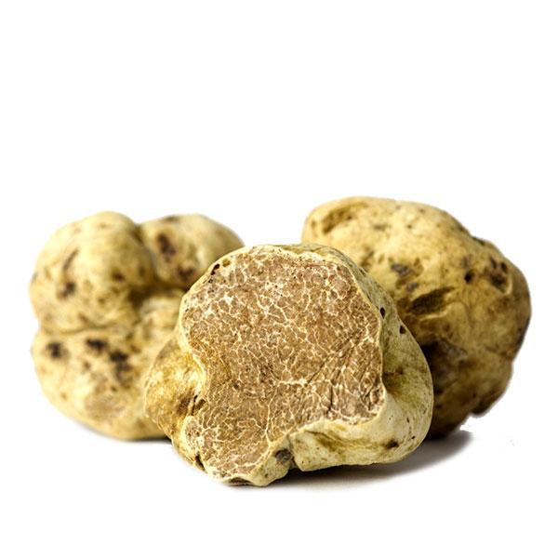

Slide 4
NEEDED FOR COOPERATION
Communication
Good attidute
Be confidente
Tell your opinion
Don’t be shy
Try to make new friends
Be nice and patient
Be understanding and polite

Slide 5
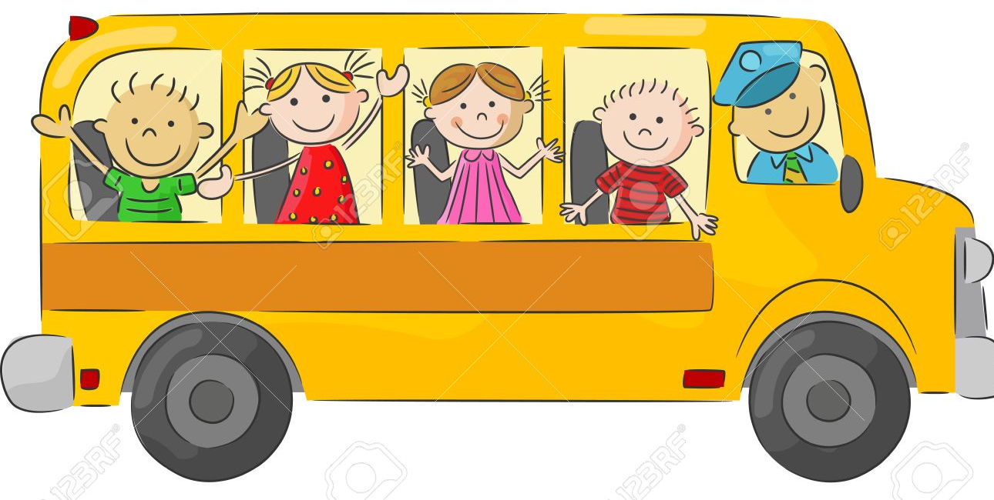
MOST FUN
Trip to Wroclaw

Slide 6
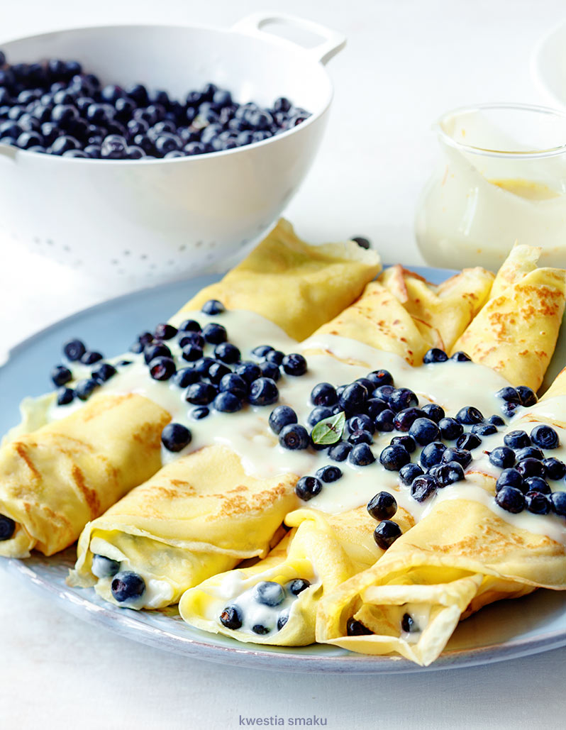
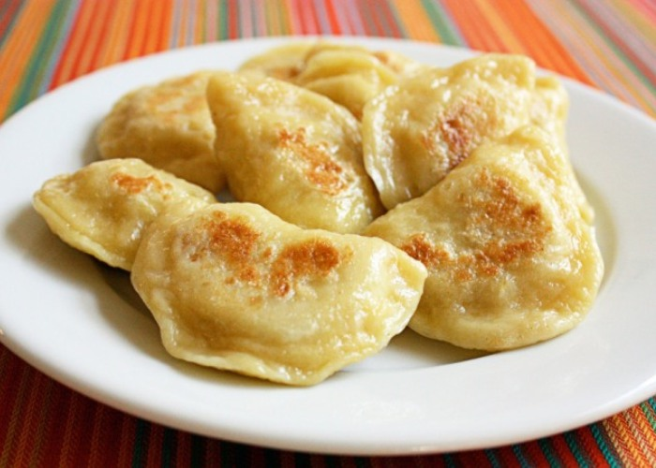
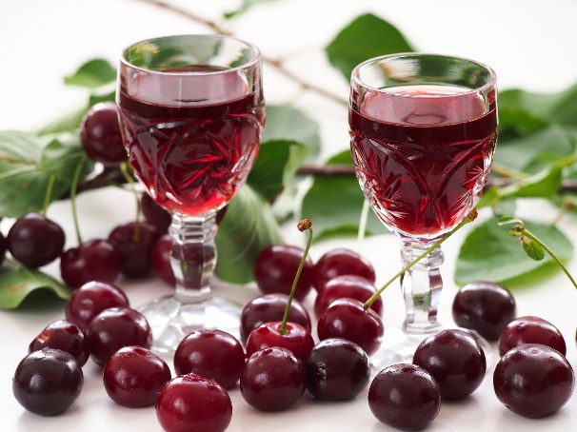
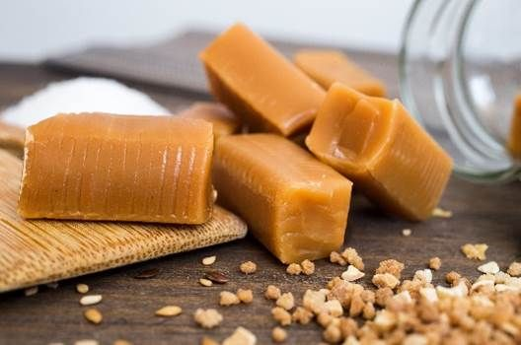
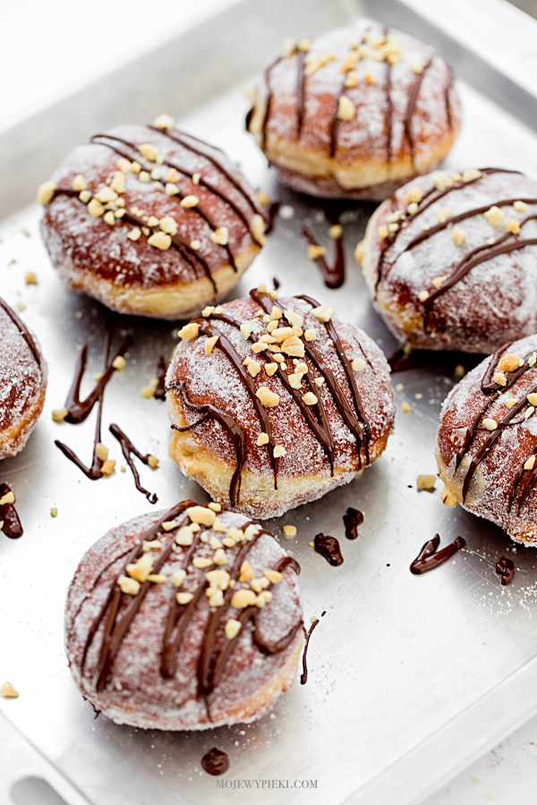
WEIRDEST FOOD

Slide 7
LEAVE OUT/ADD/ADJUST?
More free time
Free time after 5 p.m.
More involved in lessons
More trips
Goodbye party
Less lecture, more interactive task and experiments
More teachers activity

