Slide 1
BOUNCEBALL

Slide 2
ABOUT BOUNCEBALL
Type of Sport
Ball sport
Players
7 (5 girls, 2 boys)
Equipment needed
2 basketballs (different colours), 2 basketball hoops, 2 sets of bibs.
Playing facilities
Basketball court
Point system
2 points for scoring with own ball. 3 points for scoring with oppositions ball

Slide 3
Skills needed
Agility – ability to move quickly and easily
Spatial Awareness – knowing how much space the body occupies and making decisions on how to move
Accuracy – being able to perform movements with precision

Slide 4
Explanation
Each team starts in their defending half with their ball.
The aim is to get the ball to the other side of the court and score.
One girl and one boy must play in the defence positions. They cannot cross over the central line into the other half of the court.
The defending players are the only players on the team who can stand in the semi-circle.
The two forward players are the shooters. They are the only players who can move into the oppositions semi-circle.
The other 3 players can go everywhere except the semi-circles
If a goal is scored the players return to the original set up.
If the other teams ball is intercepted you can also score with this.

Slide 5
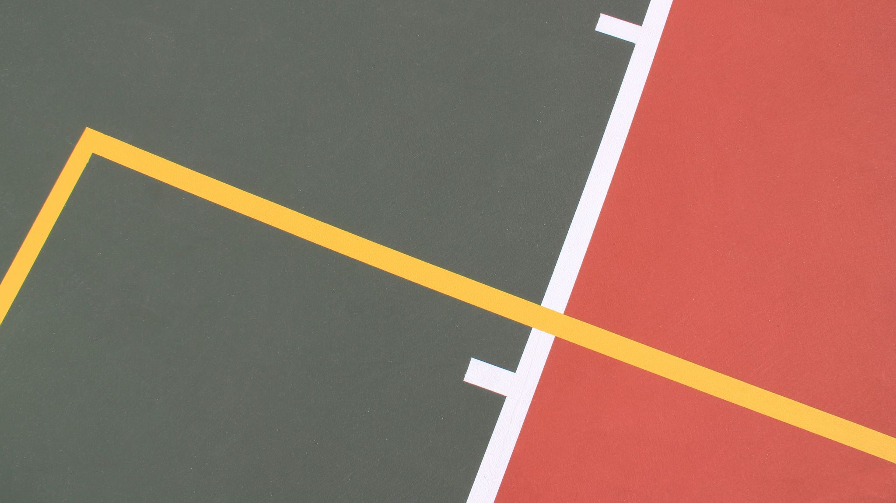
rules
The ball can only be bounced to other players. (Moving with the ball causes you to be penalised)
Defenders cannot cross into the attacking half and vice versa.
No contact with other players is allowed, you must be 1 metre away. (If you stand too close or touch another player with the ball you will be penalised)

