Slide 1
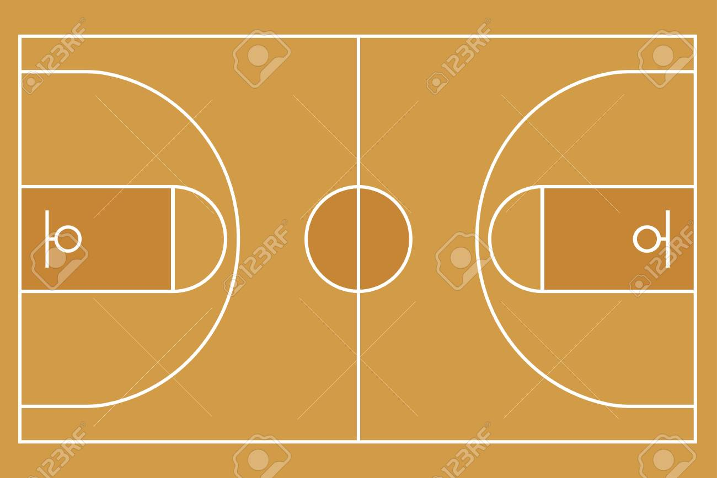
FOOTBASKET
BY: PABLO
IZAN
GABRIELA
JAVIER

Slide 2
Information
Type of sport
Ball sport
Number of players
8 in total. 4 per team
Number of boys
2 per team
Number of girls
2 per team
Scoring
If it touch the hoop, 1 point. If it enter clean, 3 points.

Slide 3
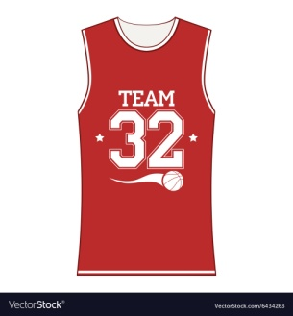
Where do you play it?
You must play it in a basketball court.
What equipment do you need?
TRAINERS SHORTS
BASKETBALL
SHIRT
What physical skills do you need?
You need some skills like:accuracy, agility, and endurance.
YOU NEED…

Slide 4
Explanation
There are two teams, one green and one red; in the teams there are two boys and two girls, in game you can only touch the ball and score with the foot, the basketball hoop is in vertical position.
To score points, you need to kick the ball inside the hoop, if it touches the hoop you score one point, but, if it goes inside and it doesn’t touch the hoop, you score three points.

Slide 5
FOOTBASKET RULES
HERE YOU HAVE THE RULES:
You can’t have the ball in your hands,or on your foot for more than 5 seconds.
You can’t catch the opponent by his back.
The hoop must be 1.5 meters tall off the ground.
The game time has to be of 20 minutes per half.
In game there can only be 4 players per team.
There have to be 4 players on the court and 4 or more out per team.
You can pass the ball with your hands, but you can’t score with them.
You can only stop the another player cathing him/her by his front.

Slide 6
PENALTIES
If you take the opponent by his back, you will be 3 minutes out, and the another player Will have a free kick.
If you’re agressive on game, you won’t play more.
If you say any bad word, you will be 5 minutes out.

Slide 7
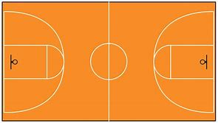
RED TEAM
GREEN TEAM
IIIIIIIIIIIIIIIIIIIII

