Slide 1
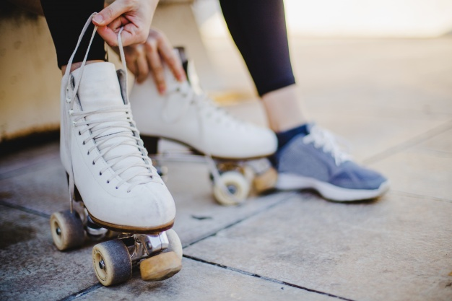
ROLLER-BALL
CLAUDIA MADERO
CLAUDIA YEPES
ALBA SORIANO
JENNIFER GALLEGO
SOFIA ROBERTO

Slide 2
PRESENTATION
Hi, we are the girls of first of E.S.O. and we are going to explain our sport.
This sport is called Roller-ball.
This sport is played with artistic skates and with a handball ball.
In this sport you have to put the ball in the goal of the opposing team.

Slide 3
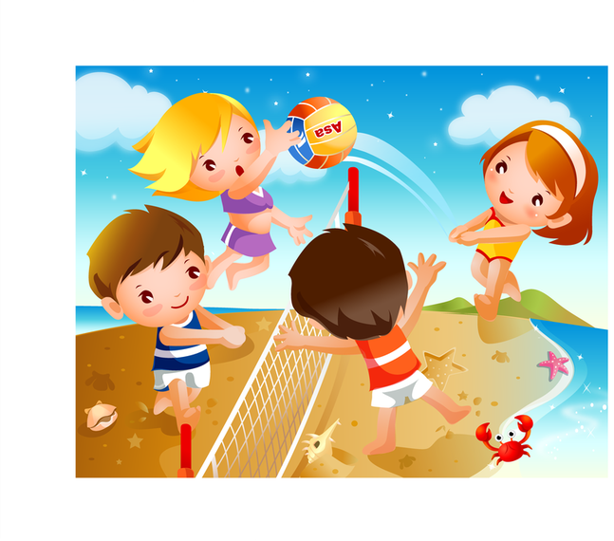
PLAYERS
There are 10 players(5 for team).
Number of boys: 2
Number of girls:3

Slide 4
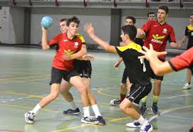
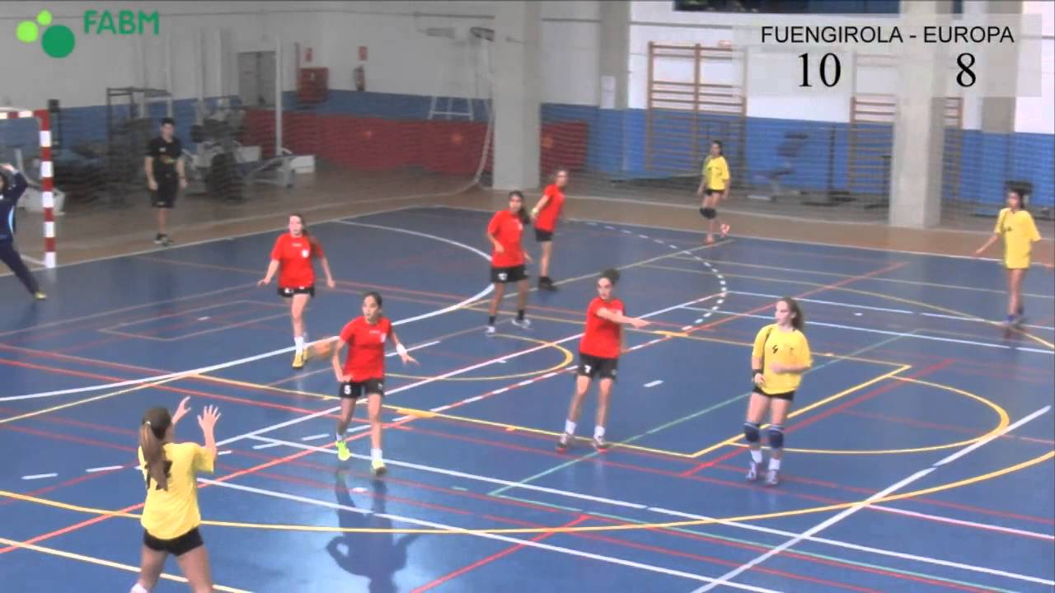
POINTS
We think that this sport should be the same for boys as for girls, that's why it's 2 points for boys and 2 for girls.

Slide 5
EXPLANATION
The sport we have created is called Roller-Ball.We call it this because most ofthe girls plays rollerskating and most of boys plays handball,this sport joins the boys and the girls.

