Slide 1
WATER-TENNIS
MEMBERS
CARLOS
CLAUDIO
ONOFRE
ALVARO
GUILLERMO

Slide 2
INDEX
1 RULES.
2 WHAT TYPE OF FIELD NEEDS.
3 WHAT MATERIAL NEEDS.
4 WHAT PLAYERS NEEDS.
5 EXPLICATION OF THE GAME.
6 THE BALL HITS AND HAS TO FALL IN THE WATER.
7 FINISH THE GAME IS A FUNNY SURPRISE.

Slide 3
RULES
When you take one point the referee puts the point on the scoreboard.
When you arrive the 10 points to 2 sets the team win.
If it falls in the water, it is point, if it falls outside point for the rival.
The poticion are:1 boy for team it’s between and 2 girls behind.

Slide 4
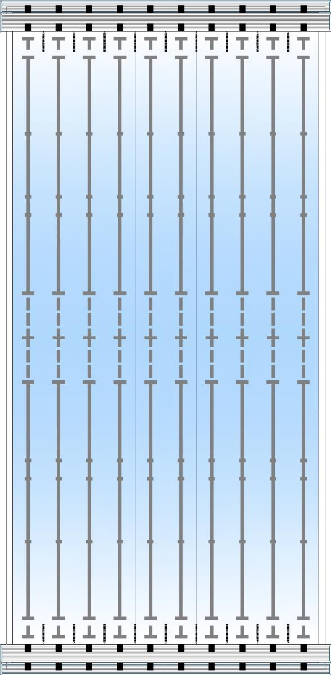
WHAT TYPE OF FIELD NEEDS

Slide 5
WHAT MATERIAL NEEDS
Need plastic ball.
Water costume.
6 raquets for match.

Slide 6
WHAT PLAYERS NEEDS
6 players.
2 boys and 4 girls.
3 per team.
1 boy and 2 girls per team.

Slide 7
EXPLICATION OF THE GAME
When you hit the ball and it falls into the water, it is a point if a boy or two does it if 1 girl does it.

Slide 8
How to play?
The ball hits and has to fall in the water.

Slide 9
FINISH THE GAME IS A FUNNY SURPRISE
If you lose tubs you swim 3 pools.

Slide 10
END

