Slide 1
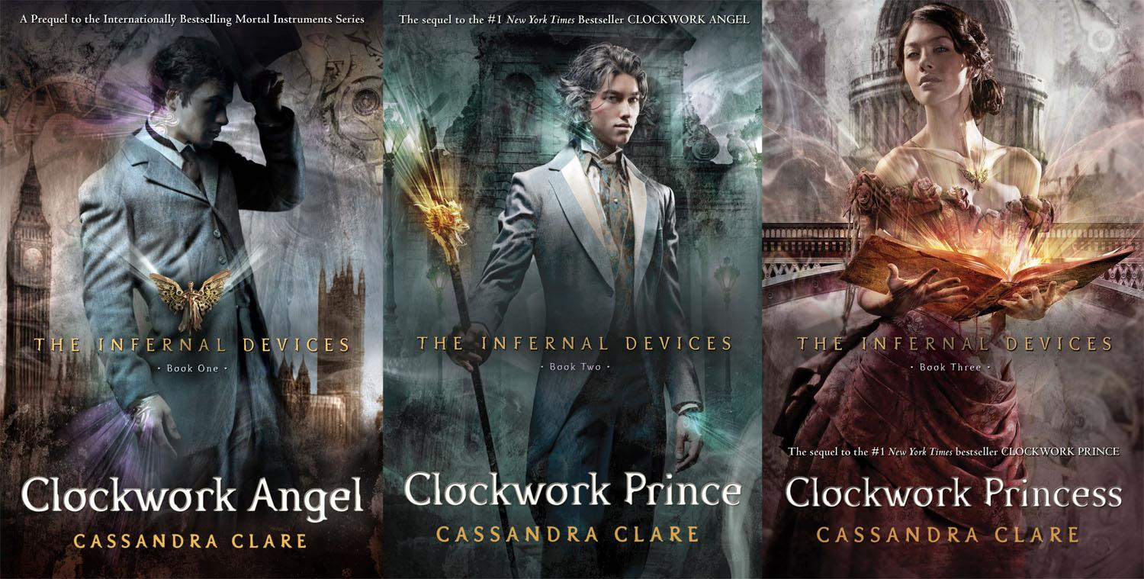
SHADOWHUNTERS The Origins
Cassandra Clare

Slide 2
INTRODUCTION
Shadowhunters The Origins is a fantasy set in London in the 19th century. It is full of action scenes and twists that make it thrilling. The location and the time have an important influence on the story because there are many wonderful descriptions of the places where the story develops and because the writer is very faithful to the costumes of that time, infact there are many details of the fancy dresses and of the hairstyles. This is in contrast with the end of the story which is set in our century where almost everything is completely different. This makes the book even more interesting, different and particular than many other fantasy books.

Slide 3
MAIN CHARACTERS

Slide 4
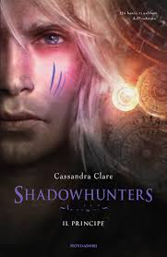
WILL
William Herondale is a seventeen years old shadowhunter. He arrived to the Institute when he was very young and he immediately bonded with another young shadowhunter, James Carstairs, because of theirs dark pasts. He has deep blue eyes and dark hair, he’s muscular and very charming. James is his parabatai, which means that they have a special and magic bond.
TESSA
Theresa Gray is a sixteen years old orphan that leaves New York after a letter she received from her brother Nathaniel, where he tolds her to come to London. She has a neckless with a mechanic angel which belonged to her mother. During her staying in London she founds out that she has a very special and unique power that will make her discover unknown things about her past.
JEM
James Carstairs is a seventeen years old shadowhunter. He’s an orphan and he came to the London Institute from Shangai. Because of his health he lives between life and death and he always feels week. He is kind and always very elegant and he would do anything to save Tessa or Will from danger.

Slide 5
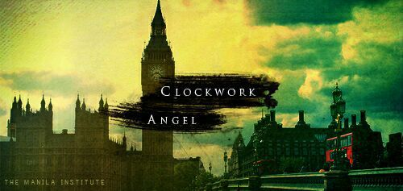
COMMENT
We personally loved Shadowhunters because it has an involving plot which is different from the other fantasy books. The author writes very well and the way she developed all the story is amazing. We also appreciated the fact that all the places where the story is set are actually real. It guides you to a new world which is full of magical creatures and we think that it deserves all the success that it had.

Slide 6
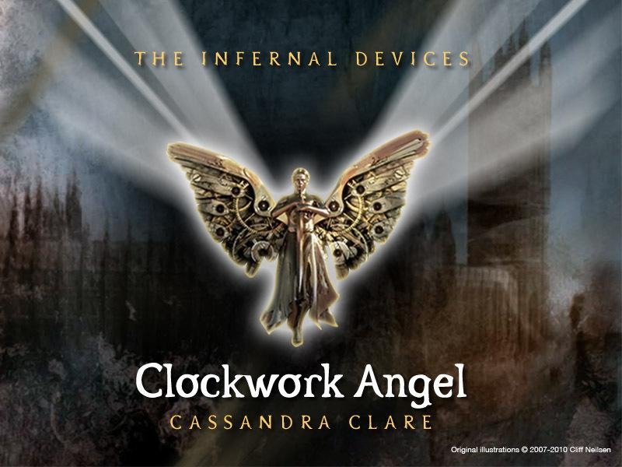
PLOT
When Tessa arrives to London she discovers a secret and fantastic world thanks to a group of people who fights demons called Shadowhunters. At the beginning of the story she got kidnapped by the Dark Sisters and there she discovers her powers before being saved by Will. When she arrives at the Institute she finds out that her brother has been kidnapped too so she tries everything with the shadowhunters to find him.

