Slide 1
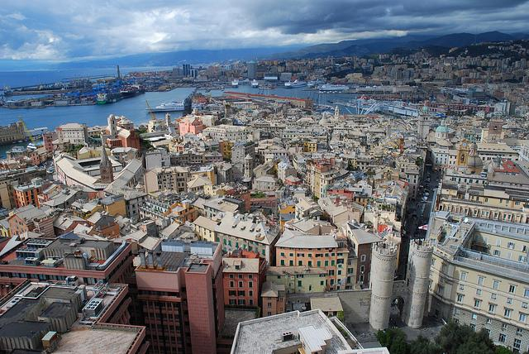
«ⓘL ⓈENTIERO ⒹEI ⓃIDI ⒹI ⓇAGNO »

Slide 2
The main character is Pin, a child who lives in Sanremo. His sister is a prostitute and then is forced to fend for himself without her help. Pin is excluded from other children so he prefers the company of adults and soldiers who meet in an inn.

Slide 3
People in the inn use to mock and to be accepted he must steal a gun from a German soldier, because at that time the Germans frightened people. Proud of himself he goes to the inn, but from the speeches of adults he realizes that they do not pay great importance to his heroic gesture: the weapon is an old model and heavy and easily jams.

Slide 4
Pin then takes his big decision, hides the weapon in the path where there is a spiders’ nest, a magical place that he only knows. Then Pin is arrested, imprisoned. He meet Red Wolf and they both escape, but during the flight he remains alone.

Slide 5
In the middle of the night he is found by Cousin, a partisan who has the features of a gentle giant, who leads him to a camp of partisans. Pin becomes the “darling” of the partisans, thanks to his brash behavior and skill in singing melancholy songs. He and his band attack the Germans.

Slide 6
Then, however, he finds himself alone again and without his gun: it had been stolen by another guy, Leather. Pin later finds his own gun and meets Cousin again, and they become fiends. In the end he finds a friend who he was looking for, the “ Great Friend”, and he isn’t alone anymore.

Slide 8
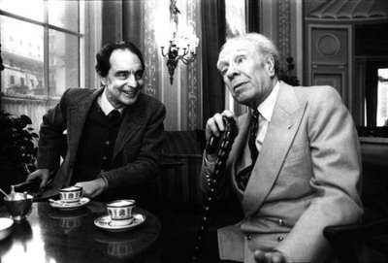
ITALO CALVINO✈
Calvino wrote this novel in 1946, immediately after the experience of war eager to show the harsh reality of a huge conflict that had involved everyone. Calvino after taking part in the Resistance in Liguria graduated in Arts in Turin.

Slide 9
Di Chio Francesca De Nardo Giordana Spadaro Federica Campagna Emanuele 1° I

