Slide 1
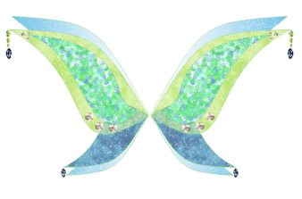
Wings
Aprilynne Pike

Slide 2
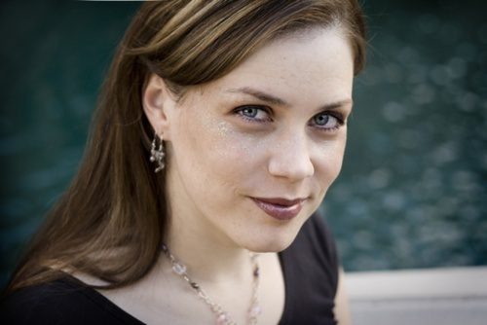
Aprilynne Pike
Aprilynne Pike is an internationally best-selling American author best known for her debut novel Wings, which was released in English on May 5, 2009. Her first novel debuted as a New York Times best-seller and reached the #1 spot on the Children's Best Seller list, making Pike the best-selling non-celebrity children's author to debut in 2009. Her second novel likewise debuted on the New York Times Best Seller list. When her debut series reached three books and was moved to the New York Times best-selling Children's Series list, it became a best-selling series. Illusions and Destined also debuted on the USA Today Bestseller list, which combines books across all genres.

Slide 3
Plot summary
Fifteen-year-old Laurel has lived her whole life on her family's land near Orick, California and the Redwood National and State Parks, where she was homeschooled by her hippie parents, Sarah and Mark. So when she moves to Crescent City, California to attend public school at Del Norte High School, Laurel has some adjustments to make. The reason for them to move is because of her father buying a bookstore, which was always a dream for the both of her parents. While she misses being outdoors all the time, she's getting along pretty well at her new school and soon befriends David, a handsome and sweet boy who understands Laurel and her strict vegan diet. Things are looking up until a bump between Laurel's shoulders sprouts into a small bud on her back.Hesitant to confide her recent affliction to her parents, Laurel seeks help from David, and together they investigate the strange phenomenon of her "wings" or blossom. Their only clue is that when she was about three years old, she was found on her parents' doorstep in a basket, with no knowledge of where she came from. It turns out that Laurel is actually a more advanced evolution of a plant; more or less a faerie. The two soon discover that Laurel's whole body is of plant cells and that she is a plant.On a trip back to the family home, Laurel's world is forever changed when she encounters Tamani. Laurel finds herself inexplicably drawn to him, and he provides many of the answers she has been seeking. It turns out she’s not even human; like Tamani, she’s a faerie. As a scion, a faerie sent to the humans, she was sent to her parents to inherit their land, which holds something very important to the fae. This plan is nearly thwarted when Laurel’s family moves and puts the land up for sale. The gate to Avalon, which the faeries have protected for ages, is now threatened, and Laurel must help save the faeries' secret, protect her family, sort out her confused feelings for David and Tamani, and figure out her own identity—and her place in both worlds.

Slide 4
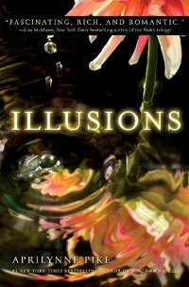
The Wings series

Slide 5
The end

