Slide 1
John Green: The fault in our stars

Slide 2
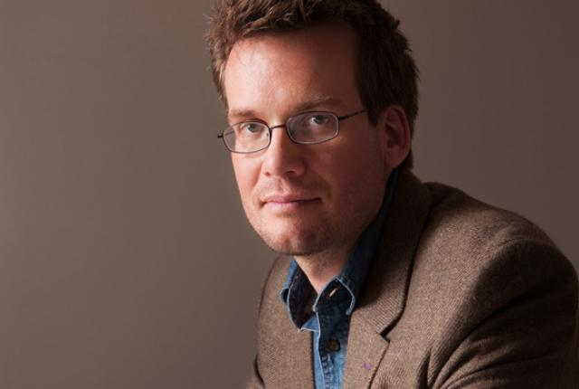
Basic information
Sixth novel by Jhon Green.
Published in January 2012.
Green stated that the first inspiration for The Fault in Our Stars came from when he worked as a student chaplain at a children's hospital. (Esther Earl)

Slide 3
Plot
The story is narrated by Hazel Grace Lancaster, a 16 year old teenager with cancer that has spread to her lungs. Her mother's ask Hazel to go a cancer patients support group meeting. During the meeting she meets a 17 year old teenage boy named Augustus Waters whose leg was amputee. After the meeting Augustus invites Hazel to his house. Before departing, the two agree to read each other's favorite novels. Hazel recommends An Imperial Affliction, a novel written by Peter Van Houten about a cancer-stricken girl named Anna that parallels Hazel's own experience. Augustus wrote Van Houten's assistant, Lidewij, and throuht her has managed to start an e-mail conversation with Van Houten, who invites Gus an Hazel to Amsterdam. The medicial team argues the trip. In Amsterdam they meet Van Houten but are shocked by his behaviour. They leave the author in anger and disappointment. Augustus tell Hazel thet his cancer was relapsed. A few days later Augustus dies.

Slide 4
Film adaptation
Published in 2014.
Directed by Josh Boone.
It was positively received by critics.
Actors:
Shailene Woodley (Hazel Grace Lancaster)
Ansel Elgort (Augustus Waters)
Willem Dafoe (Peter Van Houten)

Slide 5
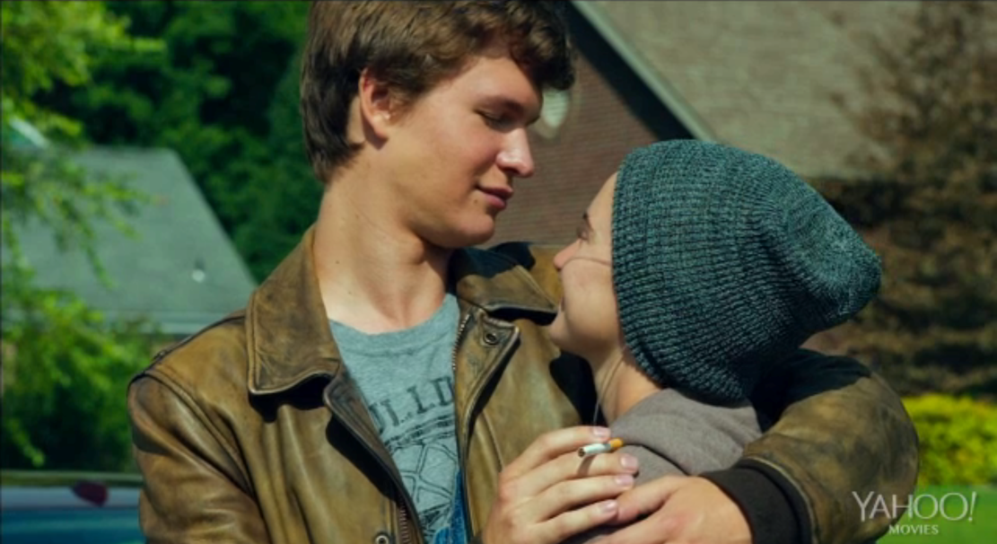
My opinion

Slide 6
Thanks for your attention!
Holobrádi Sára

