Slide 1
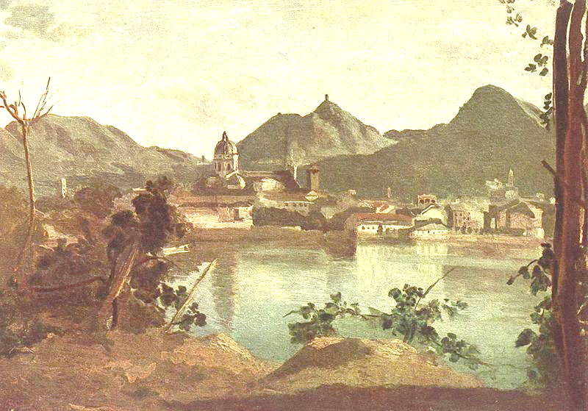
I Promessi Sposi
(The Betrothed)

Slide 2
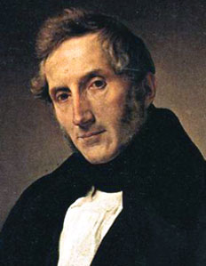
Alessandro Manzoni…
He was born in Milan in
1785 and died in 1873.
He is one of the most important Italian authors.
He used to be an atheist until 1810 when he converted to Catholicism and changed his ideals.

Slide 3
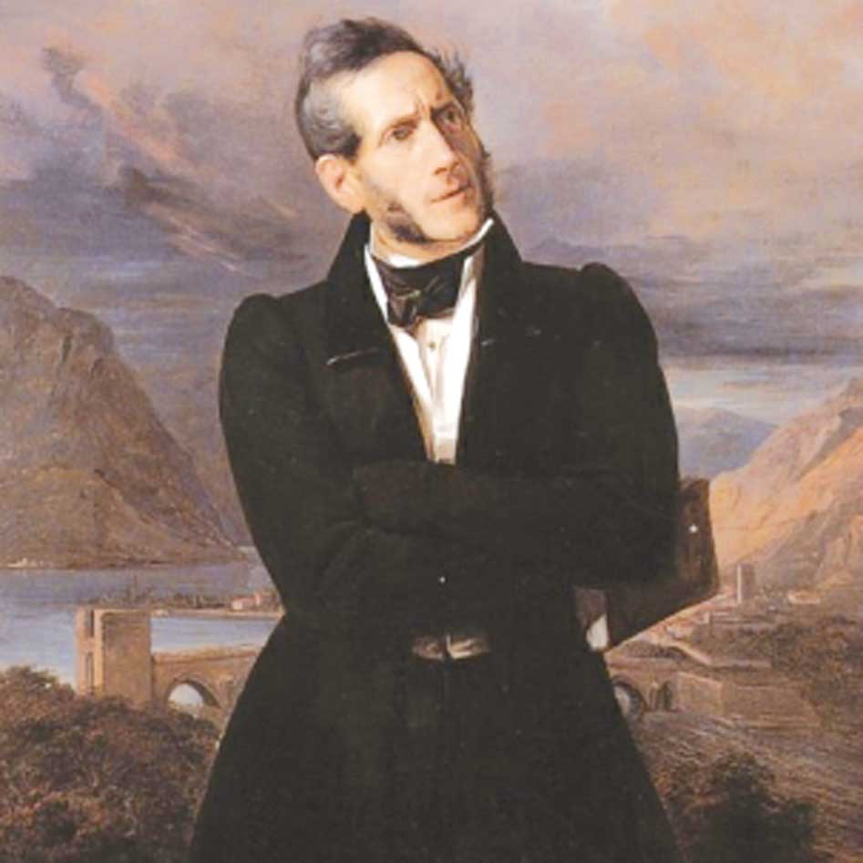
Manzoni’s literary ideal
interesting
useful
real
In 1821 he started to write the first edition of “I promessi sposi”(later he improved this work, which became his masterpiece).

Slide 4
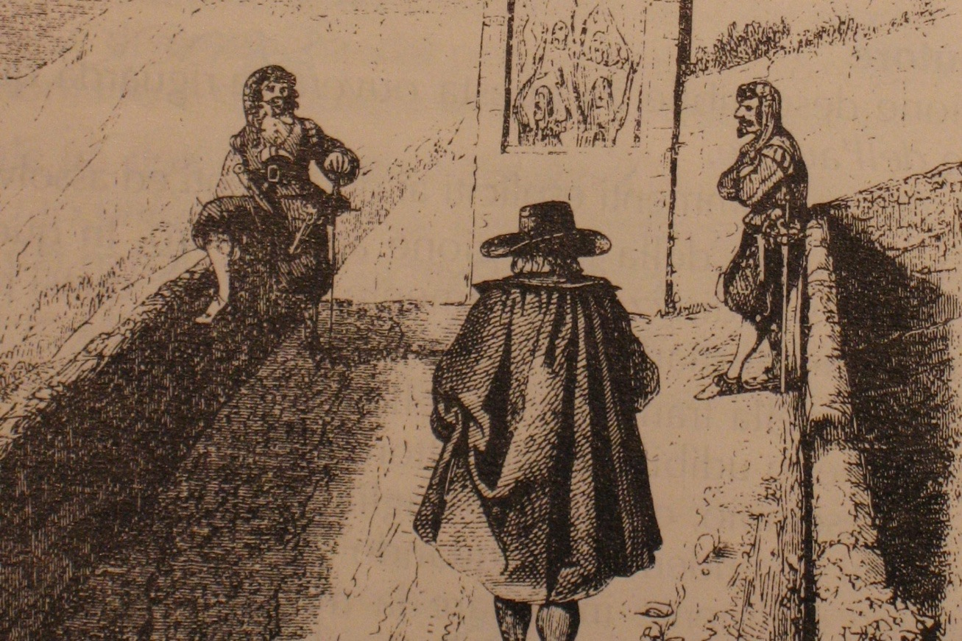
A short summary of the plot…
Renzo and Lucia’s marriage is prevented by Don Rodrigo

Slide 5
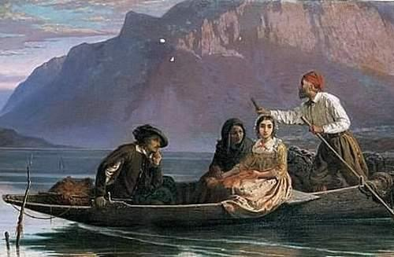
They were helped by Fra Cristoforo, a brave and generous friar. Lucia and her mother found a “home” from the nuns of Monza. Renzo instead goes to Milano.
Fra Cristoforo helps the betrothed to flee

Slide 6
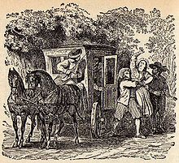
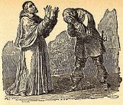
Lucia is kidnapped
The “Innominato repents

Slide 7
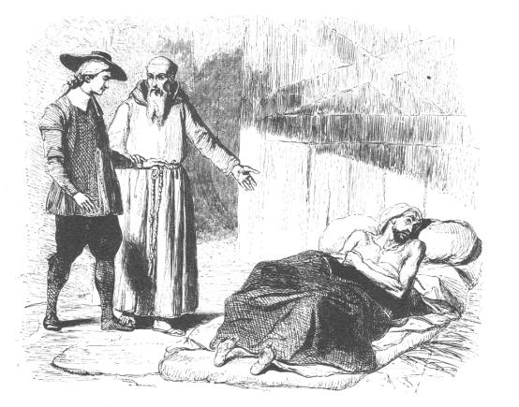
Don Rodrigo dies killed by the plague

Slide 8
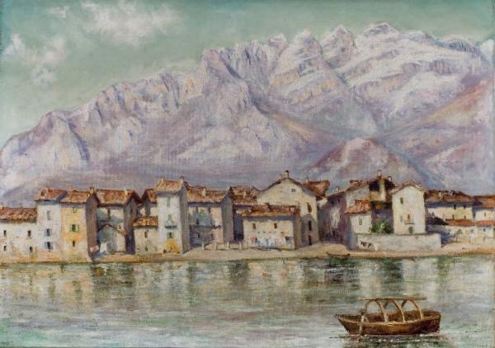
After the Black Death Renzo and Lucia will finally be able to marry.

Slide 9
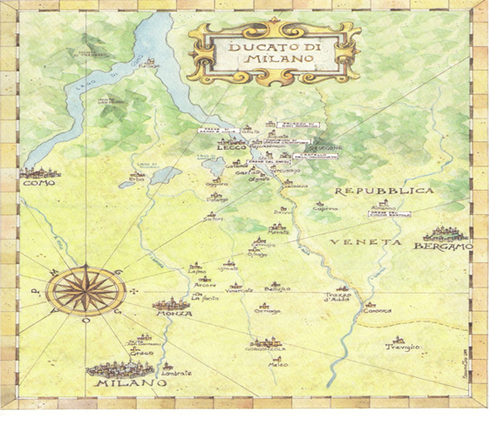
The novel’s events are set in many places in Lombardy, during the Spanish domination in 1628.

Slide 10
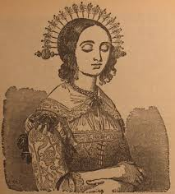
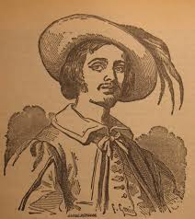
Lorenzo Tramaglino
Lucia Mondella

Slide 11
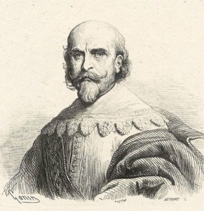
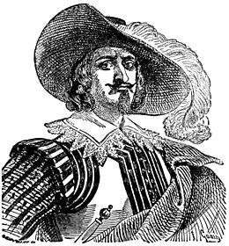
Don Rodrigo
L’Innominato

Slide 12
Renzo and Lucia are a humble couple.
The message
They had to face many difficulties.
They made it thanks to their faith in God, because it lessens human sufferings.

