Slide 1
By: Arika,Zorica,Marita,Patrizia,Nina

Slide 2
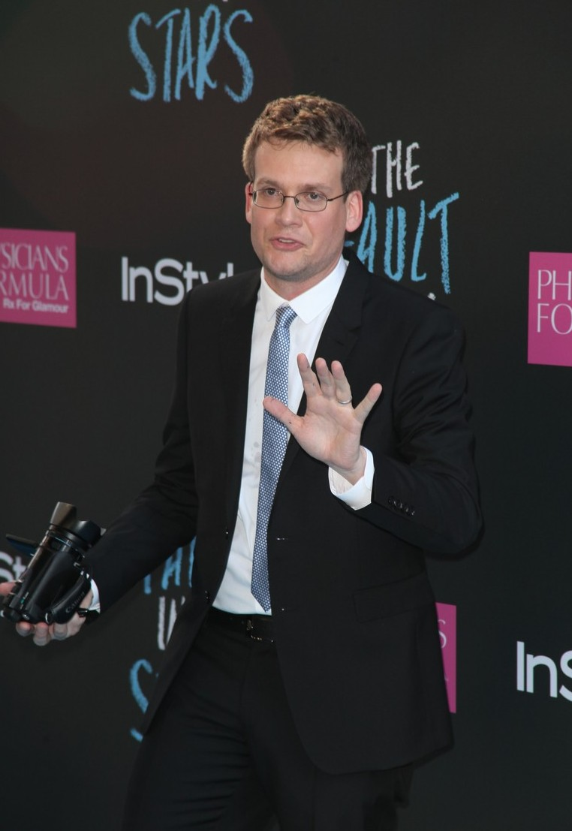
Author: John Green
Cover artist: Rodrigo Corral
Country: the United States
Genre: Realistic fiction
Publisher: Dutton Books
Publication date: January 10, 2012
Pages: 313

Slide 3
John Green
John Michael Green was born in August 24, 1977. He is an American author of young adult fiction. He won the 2006 Printz Award for his debut novel, Looking for Alaska, and his sixth novel, The Fault in Our Stars.
In 2007, he launched the Vlog Brothers channel with his brother, Hank Green.

Slide 4
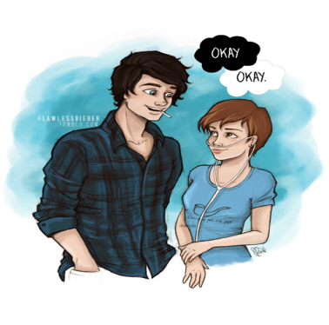
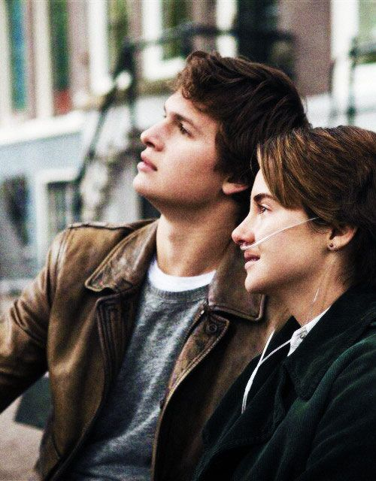
Summary
Hazel Grace Lancaster, a 16-year-old with thyroid cancer that has spread to her lungs, attends a cancer patient support group at her mother's behest. During the support meeting, Hazel meets a 17-year-old boy named Augustus Waters, whose osteosarcoma caused him to lose his leg. The two bond immediately and agree to read each other's favorite novels. Hazel recommends An Imperial Affliction, a novel written by Peter Van Houten about a cancer-stricken girl named Anna that parallels Hazel's own experience. After Augustus finishes reading her book, he is frustrated upon learning that the novel ends abruptly without a conclusion. Hazel explains the novel's author had retreated following the novel's publication and has not been heard from since.

Slide 5
A week later, Augustus reveals to Hazel that he has tracked down Van Houten's assistant, Lidewij, and through her, has managed to start an e-mail correspondence with Van Houten. The two wrote to Van Houten with questions regarding the novel's ending and the fate of the mother of Anna. Van Houten eventually replies, explaining that he can only answer Hazel's questions in person. At a picnic, Augustus surprises Hazel with tickets to Amsterdam to meet Van Houten.While in Amsterdam, Augustus confesses his love for Hazel. Hazel and Augustus finally meet Van Houten but are shocked to find that he is a mean-spirited drunk. Horrified by Van Houten's behavior, Lidewij confesses to having arranged the meeting on his behalf, angering Van Houten, who proceeds to insult Hazel's cancer, starting an argument and causing Hazel and Augustus to flee from the drunken author's home.

Slide 6
Augustus confesses that his health is not as good as Hazel had been led to believe. The two affirm their love and support for each other. Upon their return to Indianapolis, Augustus' health worsens and he ends up in the ICU for a few days. Fearing his death, Augustus invites Isaac and Hazel to his pre-funeral, where they give eulogies. An extremely sick Augustus died soon after. After this traumatic event, Van Houten shows up at Augustus' funeral to apologize to Hazel.
Hazel learns that Augustus was writing a sequel to An Imperial Affliction. Hazel reads Augustus' words. He says getting hurt in this world is inevitable, but we do get to choose who we allow to hurt us, and that he is happy with his choice, and hopes she likes her choice too. The book closes with Hazel stating that she does.

Slide 7
Actors in the movie:
Hazel Grace Lancaster (Shailene Woodly)

Slide 8
Augustus Waters ( Ansel Elgort)

Slide 9
Peter Van Houten(Willem Dafoe)

Slide 10
Frannie Lancaster (Laura Dern) and Michael Lancaster (Sam Trammell)

Slide 11
Isaac (Nat Wolff) Augustus’s best friend

Slide 12
Quotations in the book…

Slide 15
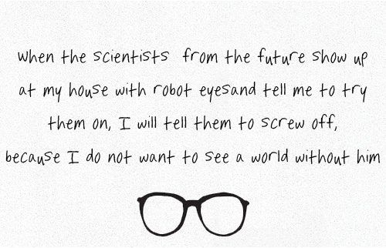

Slide 17
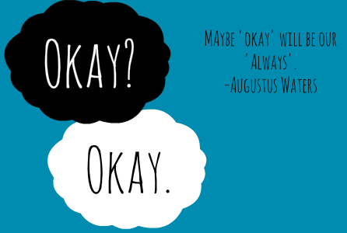

Slide 18
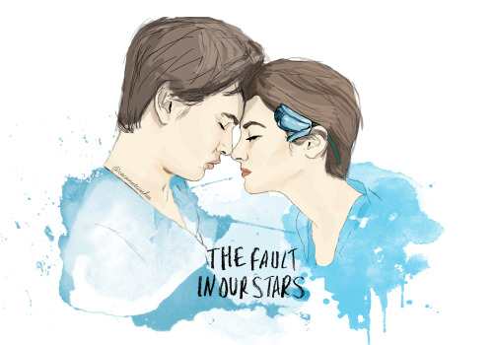
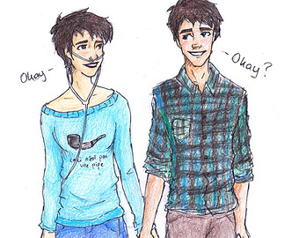
The End ☺☺

