Slide 1
Greek Letters in Art
eTwinning project

Slide 2
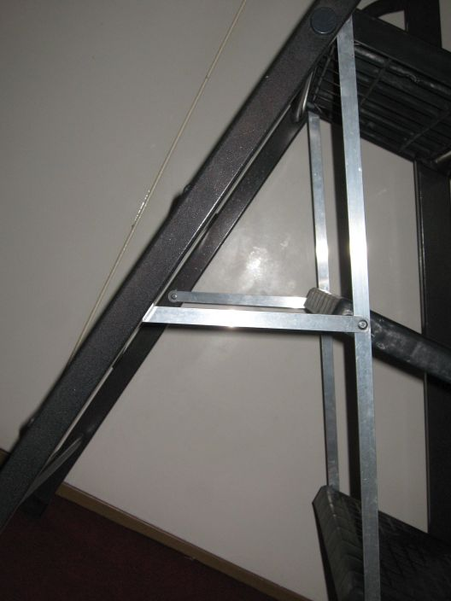
Like the Greek letter “A”

Slide 3
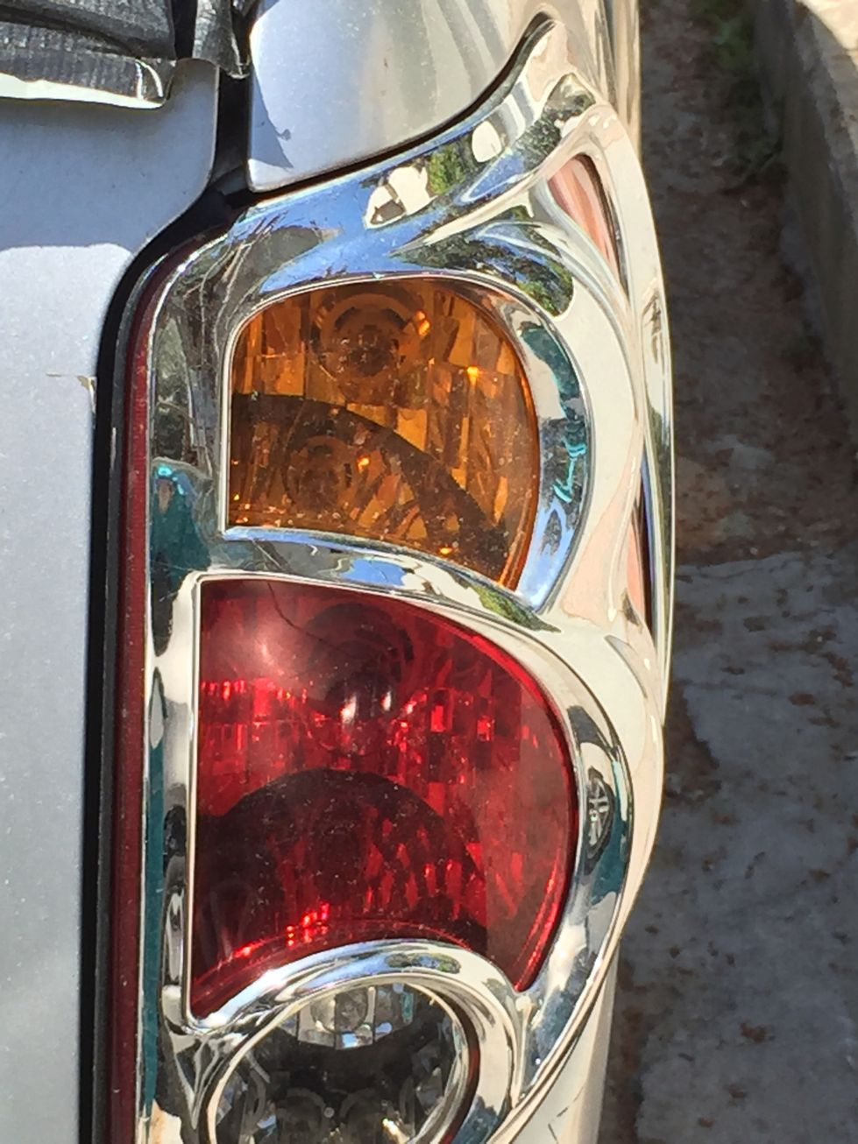
Like the Greek letter “B”

Slide 4
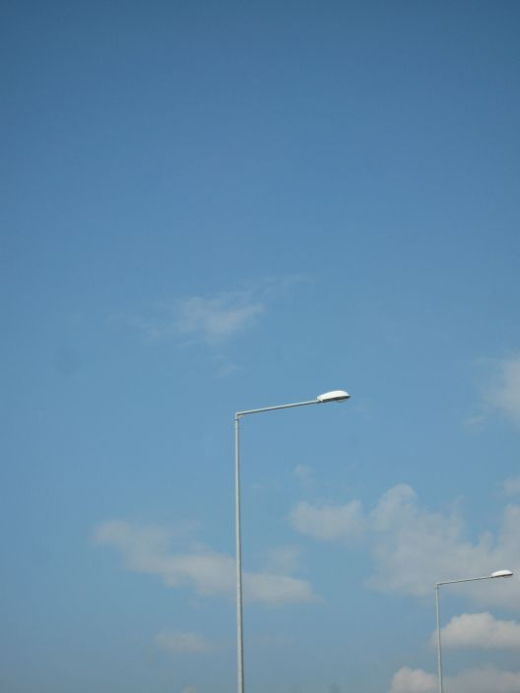
Like the Greek letter “Γ”

Slide 5
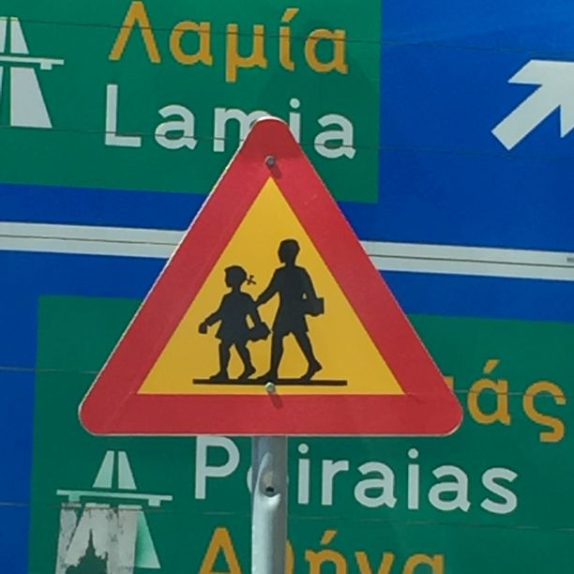
Like the Greek letter “Δ”

Slide 6
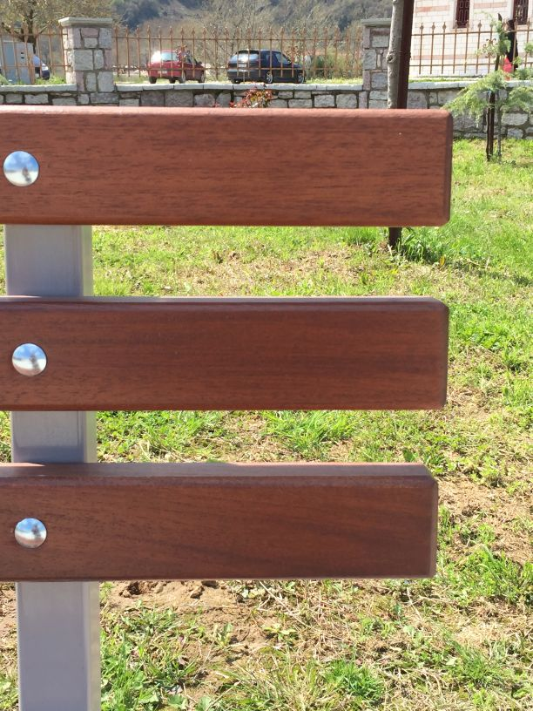
Like the Greek letter “Ε”

Slide 7
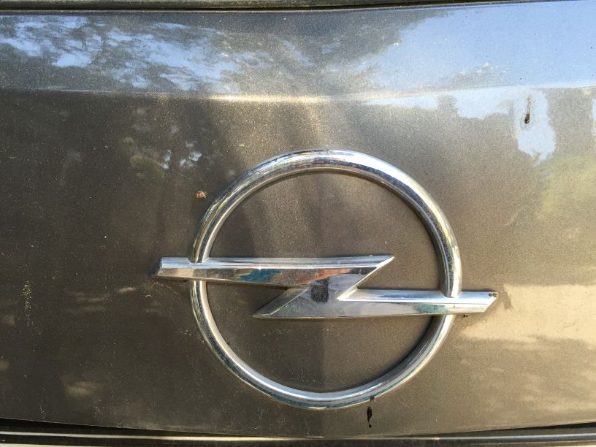
Like the Greek letter “Z”

Slide 8
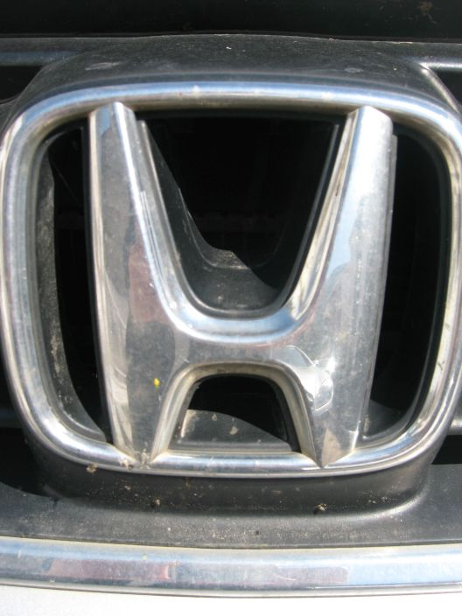
Like the Greek letter “H”

Slide 9
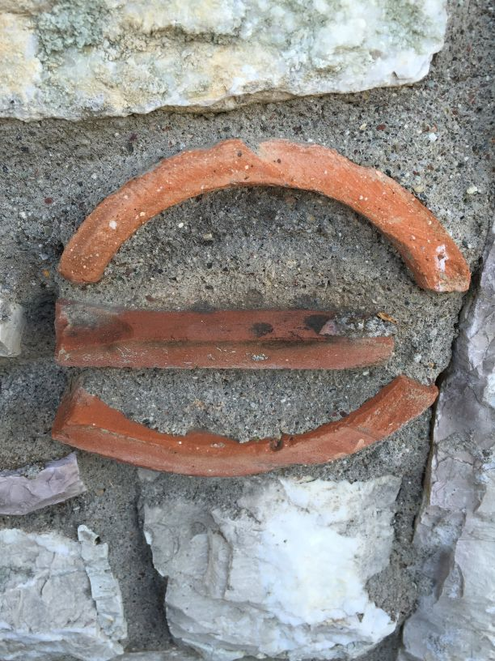
Like the Greek letter “Θ”

Slide 10
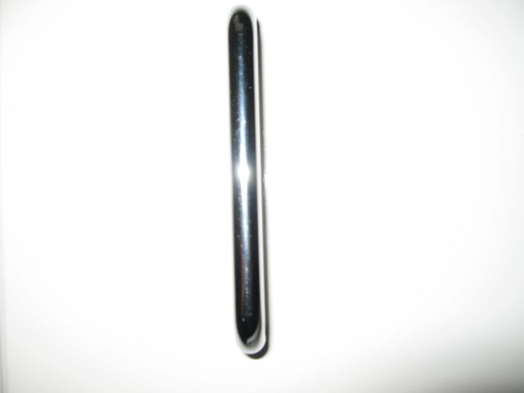
Like the Greek letter “I”

Slide 11
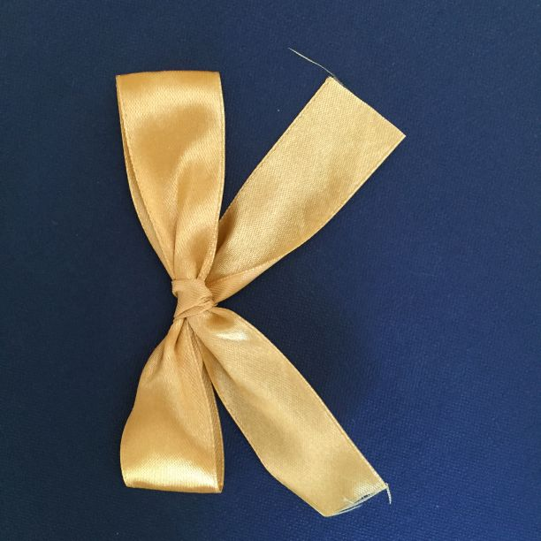
Like the Greek letter “K”

Slide 12
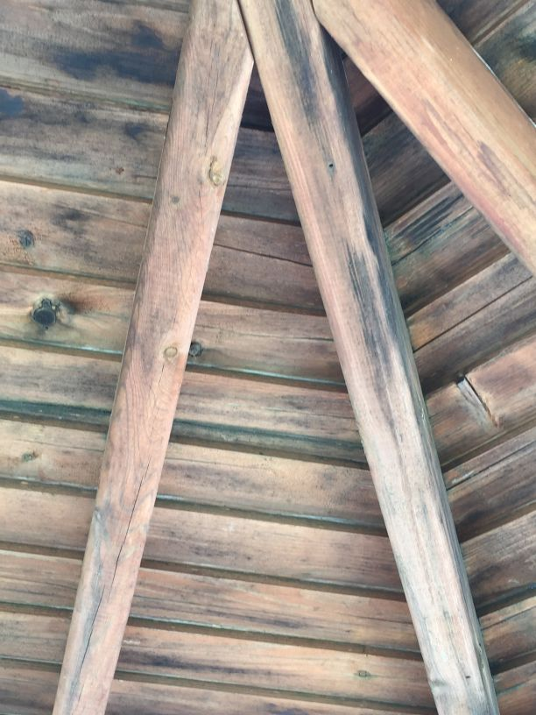
Like the Greek letter “Λ”

Slide 13
Like the Greek letter “M”

Slide 14
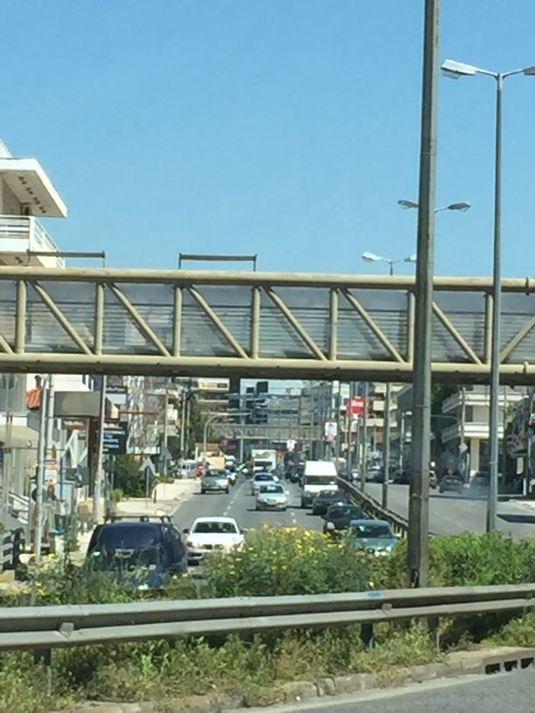
Like the Greek letter “N”

Slide 15
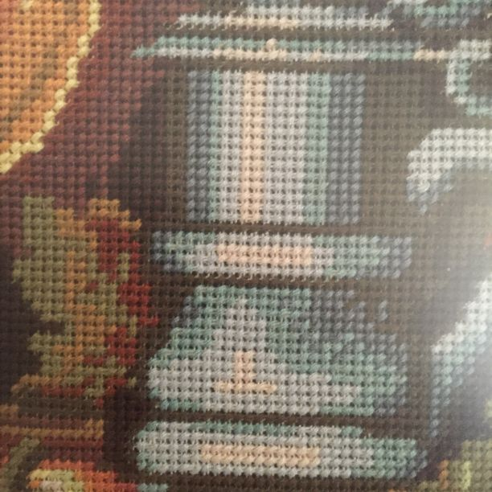
Like the Greek letter “Ξ”

Slide 16
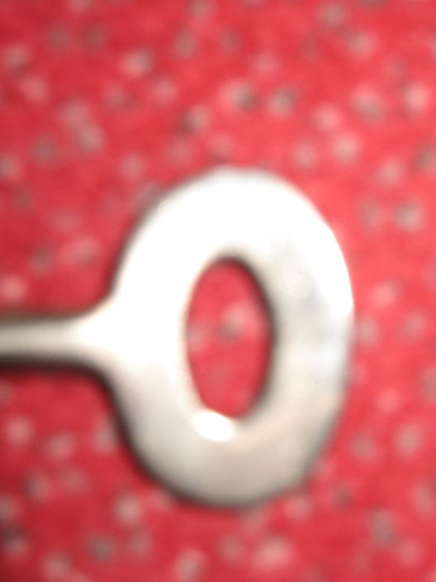
Like the Greek letter “O”

Slide 17
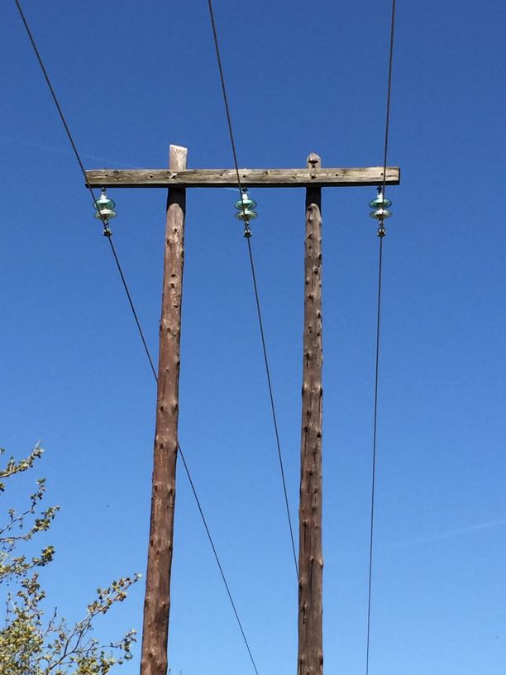
Like the Greek letter “Π”

Slide 18
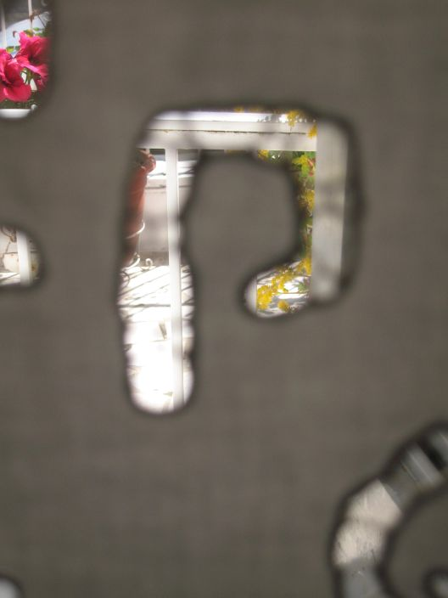
Like the Greek letter “P”

Slide 19
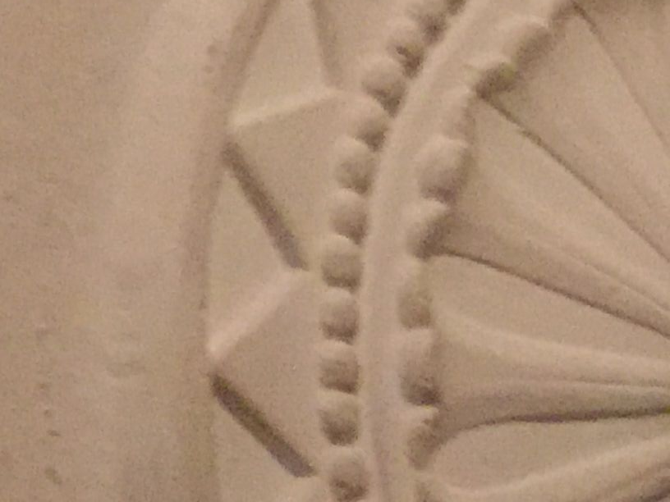
Like the Greek letter “Σ”

Slide 20
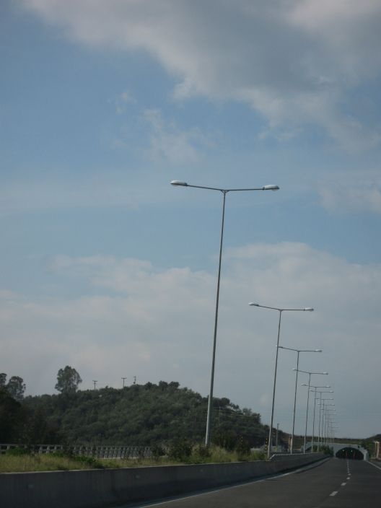
Like the Greek letter “T”

Slide 21
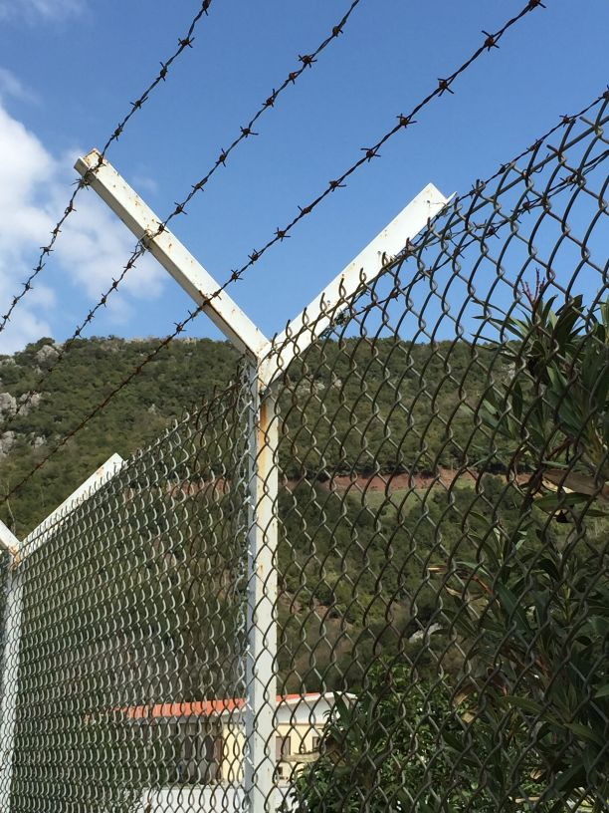
Like the Greek letter “Y”

Slide 22
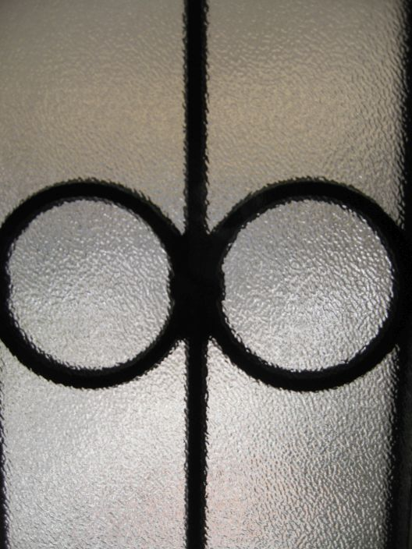
Like the Greek letter “Φ”

Slide 23
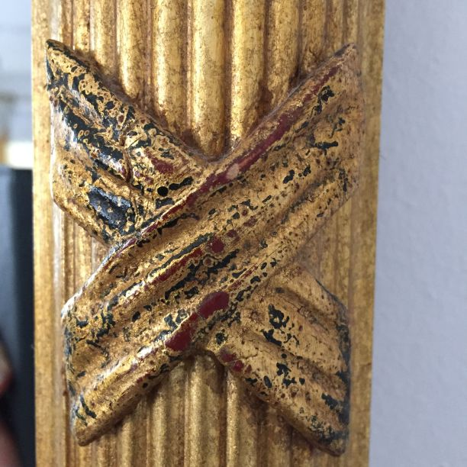
Like the Greek letter “X”

Slide 24
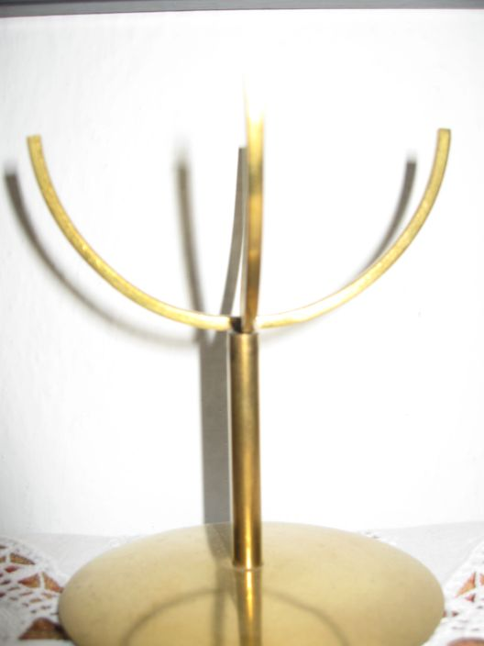
Like the Greek letter “Ψ”

Slide 25
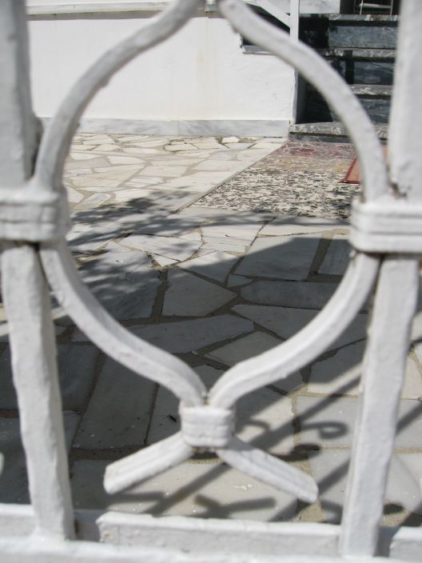
Like the Greek letter “Ω”

Slide 26
Etwinning project 2014-15
Teacher: Miariti Vanessa
Intercultural Primary School in Alsoupoli
Athens-Greece

