Slide 1
Maria Montessori
Ysgol Sant Baruc, Wales

Slide 2
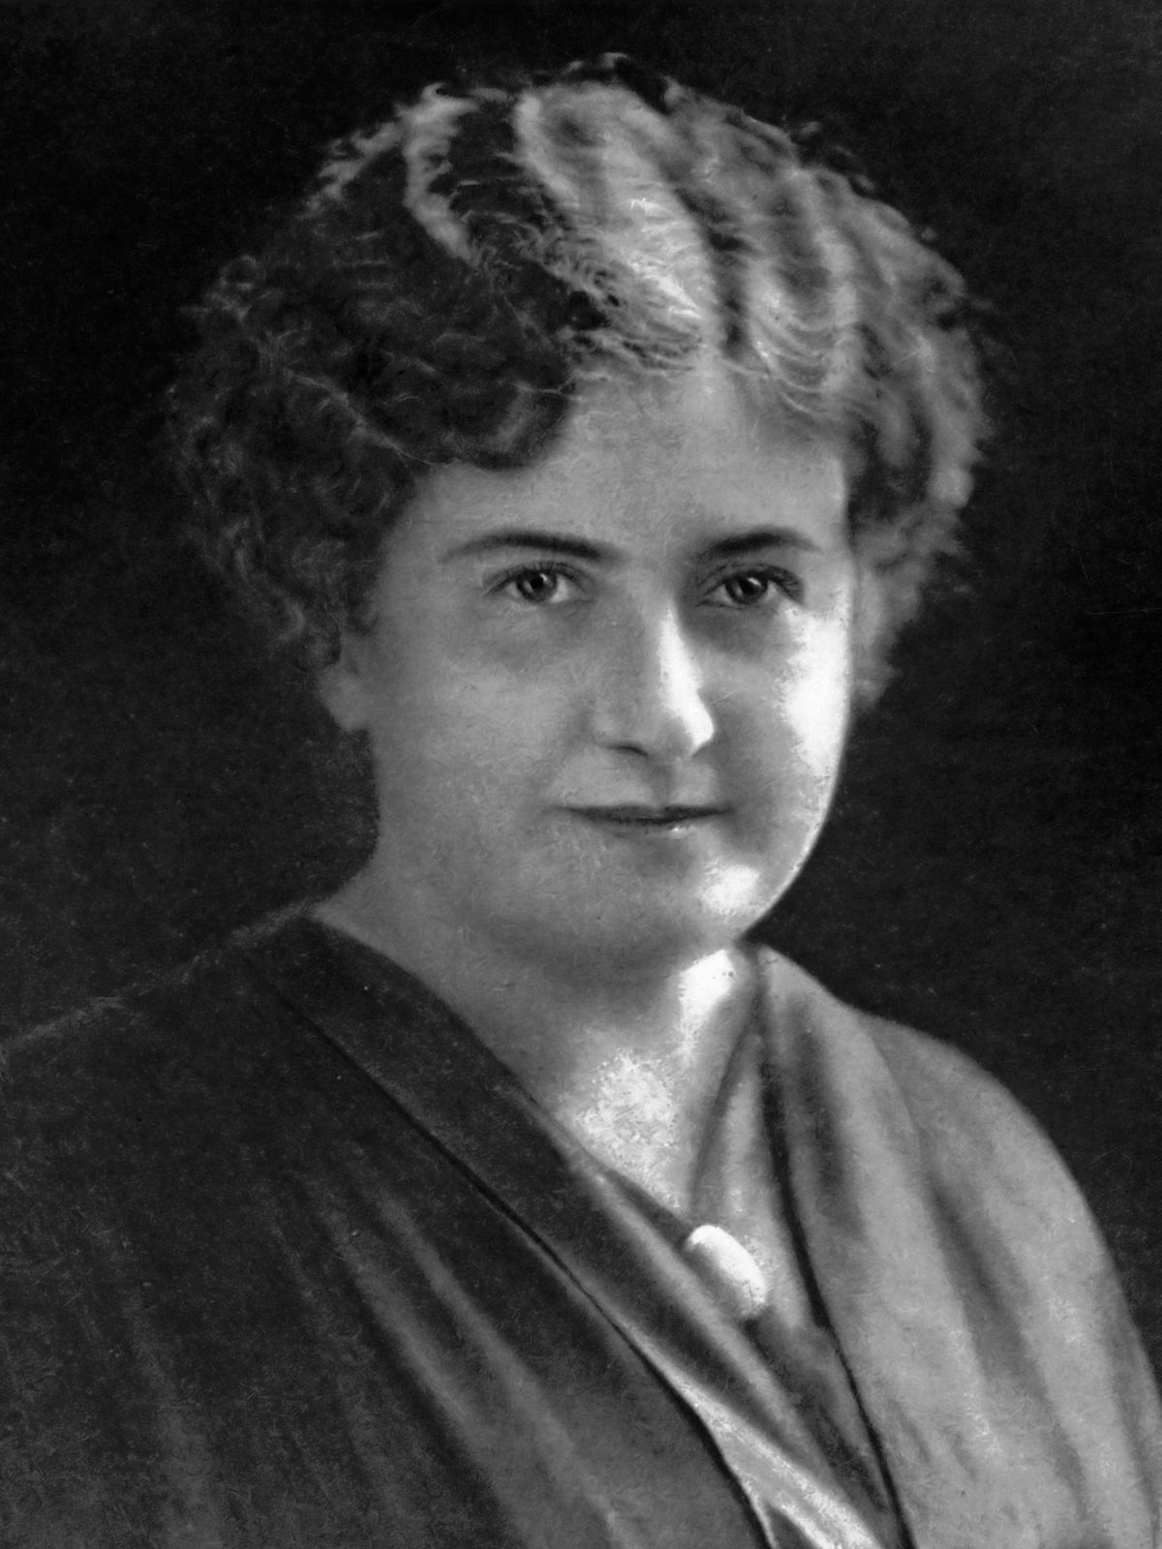
Montessori Method
Montessori is a method of education that is based on self-directed activity, hands-on learning and collaborative play. In Montessori classrooms children make creative choices in their learning, while the classroom and teacher offer age-appropriate activities to guide the process. Children work in groups and individually to discover and explore knowledge of the world and to develop their maximum potential.

Slide 3
Montessori Method…In Wales!
What did we bring back from our visit?
Children use glass to drink from…not plastic!
Children use real materials wherever
possible.

Slide 4
Montessori Method…In Wales!
What did we bring back from our visit?
Children move around the activities that
they would like to participate in.
Use of outdoor space as much as possible.

Slide 5
Montessori Method…In Wales!
What did we bring back from our visit?
Children gather their own materials for learning.
Children lead the learning using ‘Pupil Voice’

