Slide 1
Evaluation
Resources and results

Slide 2
QuestionNaires for pupils
The following questionnaire was used at the beginning and at the end of the Project in order to check the increase of knowledge of our pupils about the main contents worked. It was designed for grades 3 to 6, that means for a total of 150 students.

Slide 3
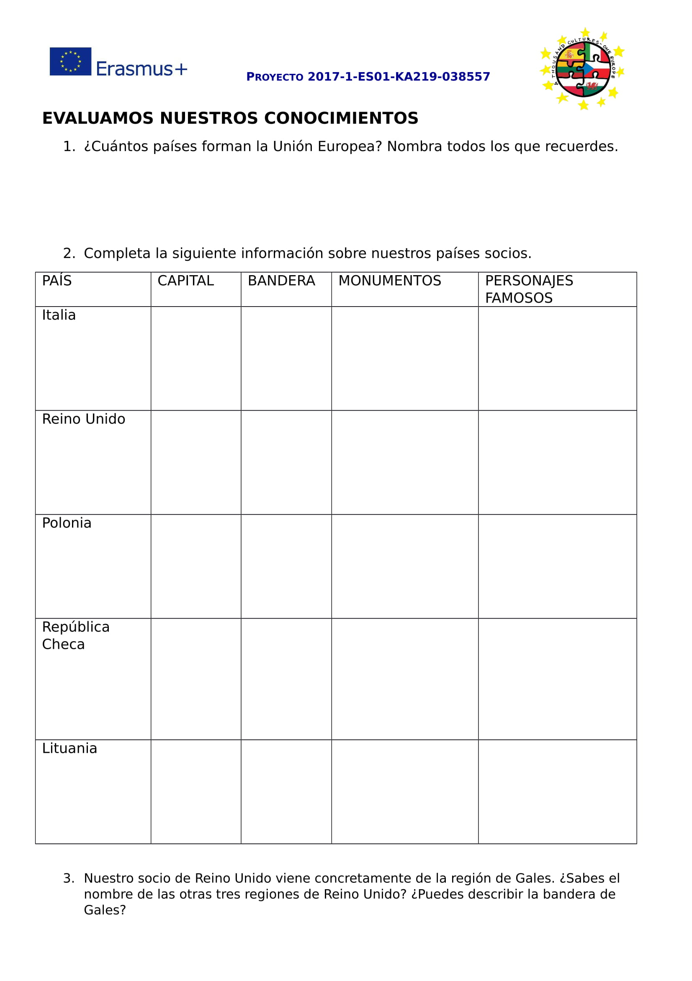
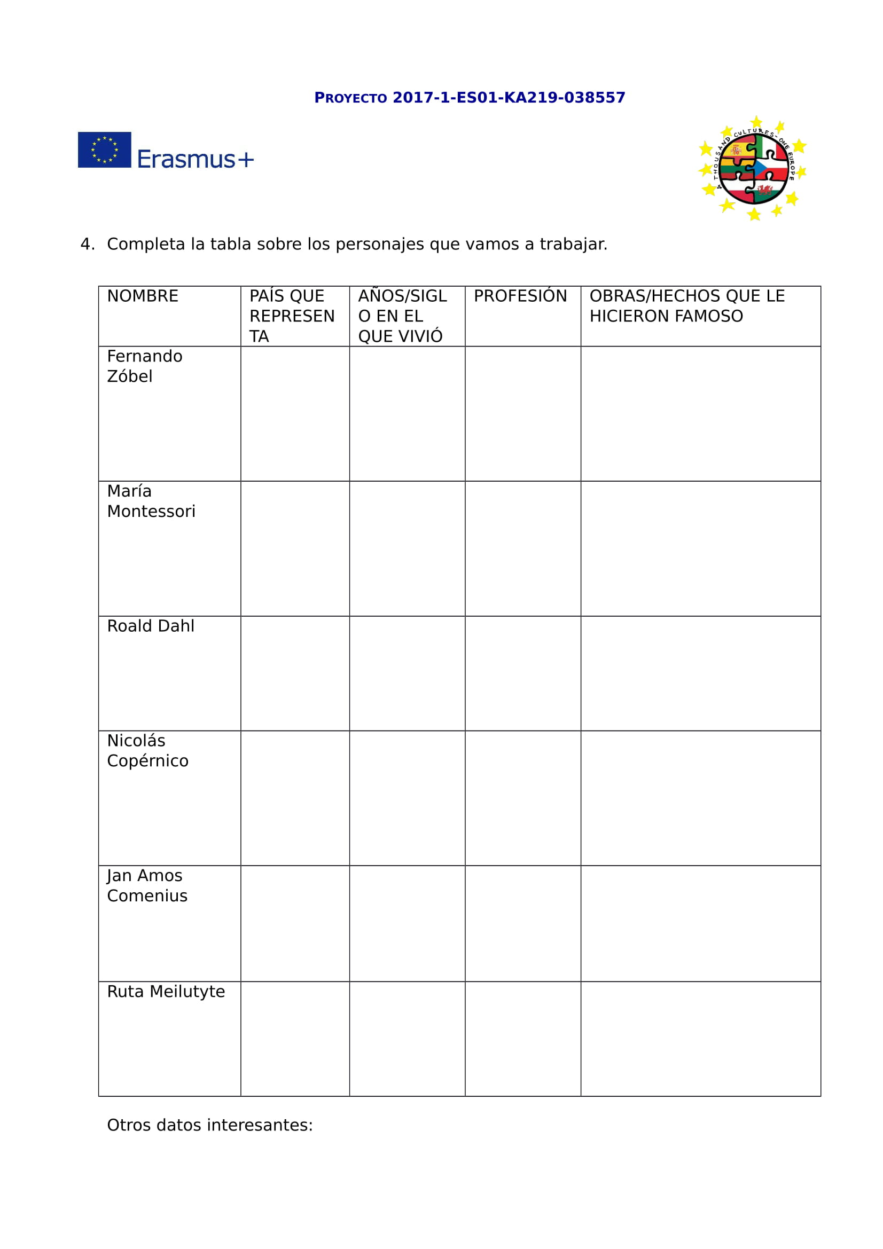

Slide 4
RESULTS
Taking into account the following results, we can conclude that our students have increased their knowledge about the European characters worked and about Europe and our partners countries in a very relevant percentage.

Slide 5
QUESTIONS | 2017 | 2019
1-European Union | 20% could name all the countries. 40% more than a half. 40% less than a half. | 50% could name all the countries. 40% more than a half. 10% less than a half.
2- Partners countries | 70% less than a half correct. 30% more than a half correct. | 20% less than a half correct. 80% more than a half correct.
3- UK and Wales | 10% correct 90% incorrect | 70% correct 30% incorrect
4- European characters | 10% wrote more than a half correct answers. 90% wrote less than a half. | 80% wrote more than a half correct answers. 20% wrote less than a half.

Slide 6
Questionnaires for teachers
The following questionnare was used for checking the increase of knowledge in the use of ICT resources. It was designed for teachers and was fulfilled by a total of 23 teachers at the end of the first year of the Project.

Slide 7
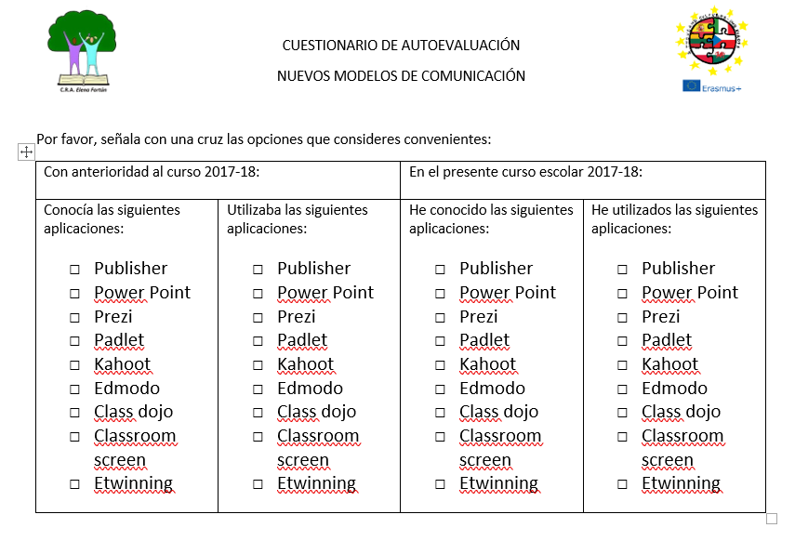

Slide 8
results
Taking into account the following results, we can conclude that:
Teachers knew 28´50% of apps and after the first year they knew 72’46%.
Teachers used 15’94% of apps and after the first year they used 31’88%.
They know and they use the double than before.
They also mentioned that they haven’t had time enough to starting to use more apps during the year, but they had the intention of introducing new ones in the classroom along the following school year.

