Slide 1
Programming and robotics in SP 34 Cracow, Poland
How we do it ?

Slide 2
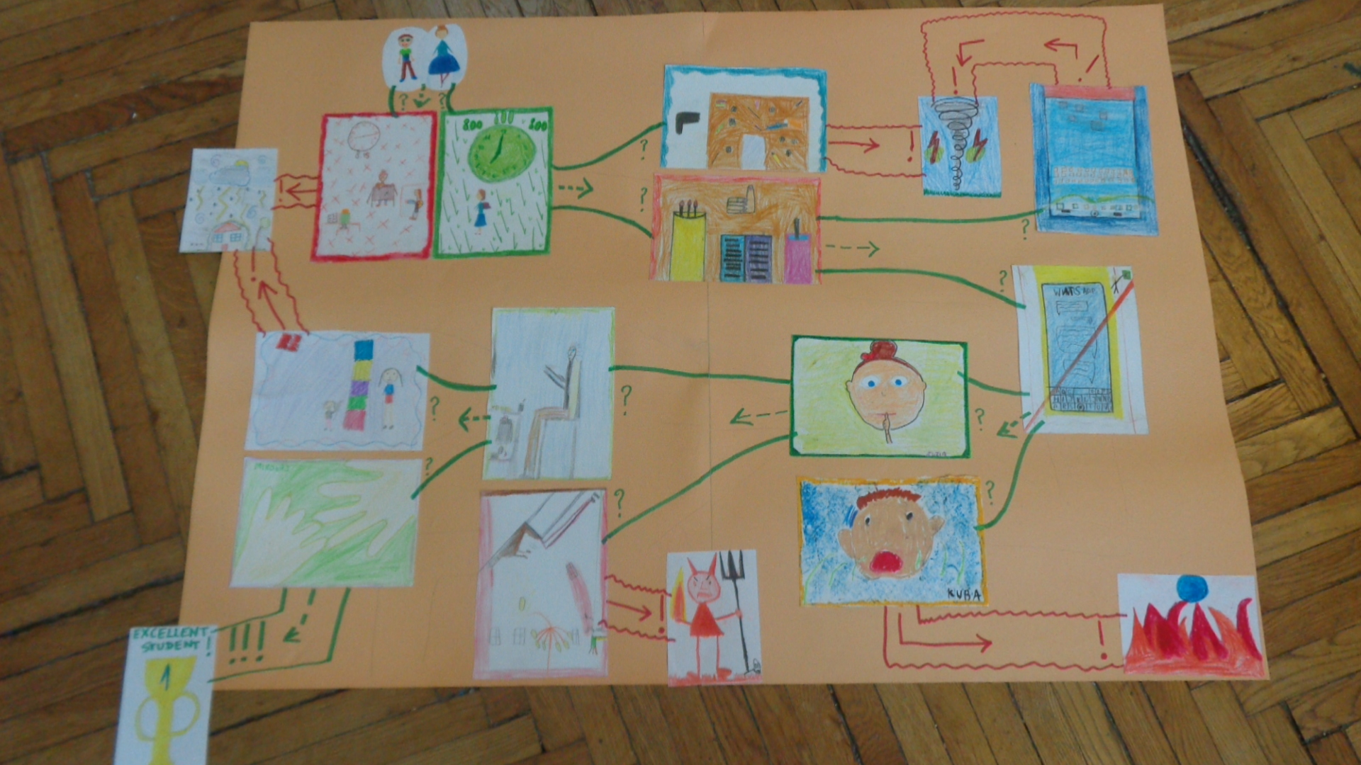
1st grade coding with no computer

Slide 3
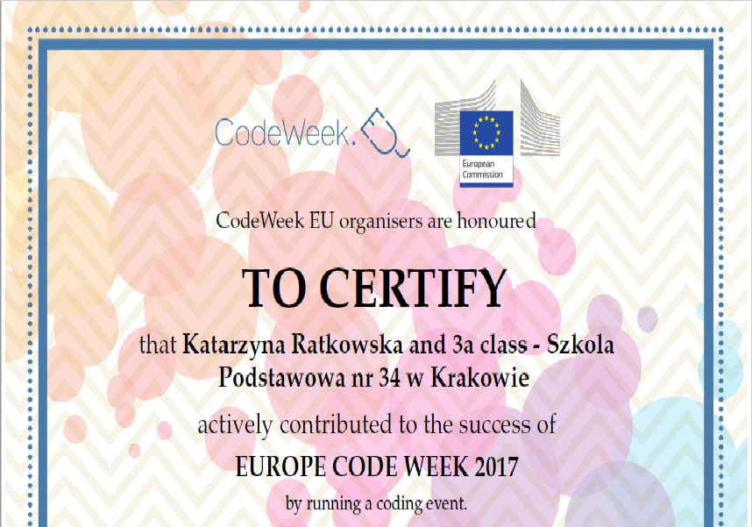
We often receive certificates

Slide 4
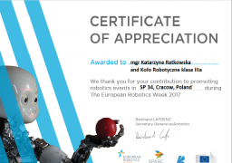

Slide 5
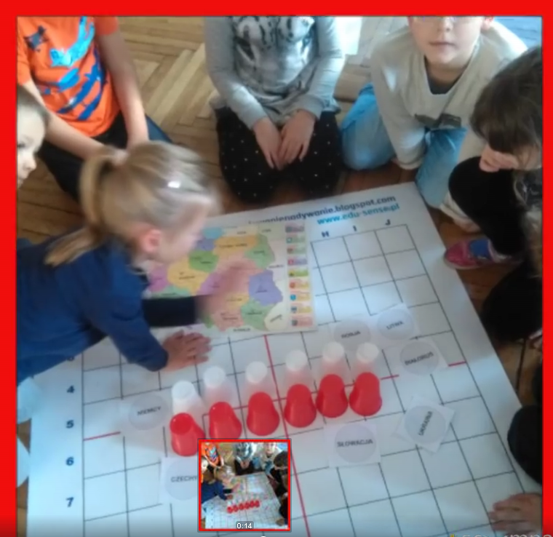
2nd grade: programming games

Slide 6
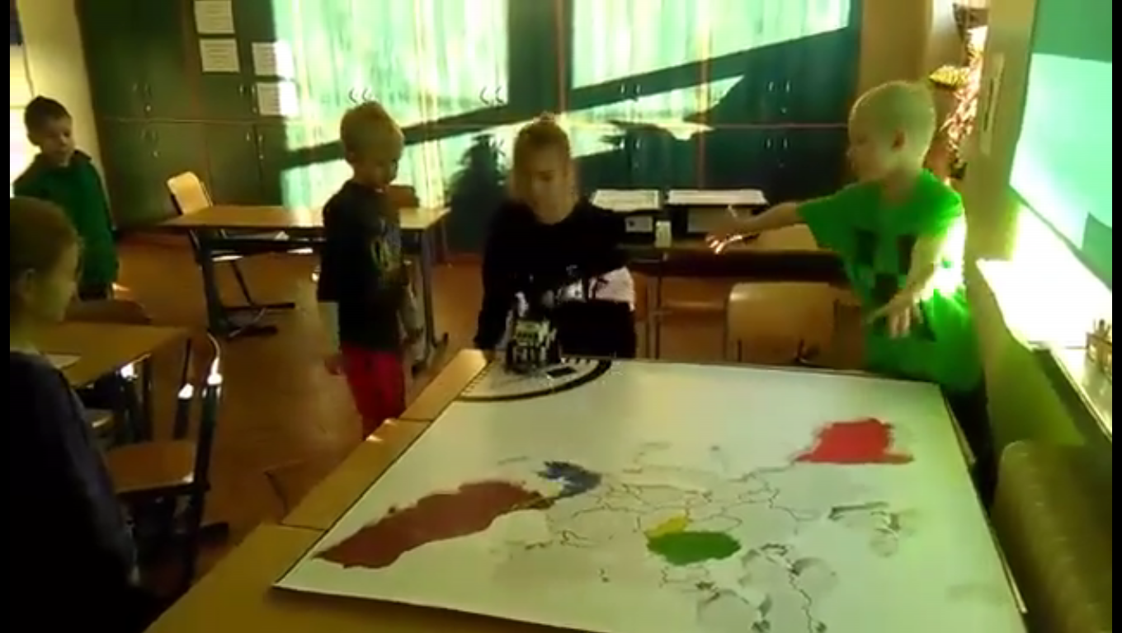
3rd grade : robotics fun

Slide 7
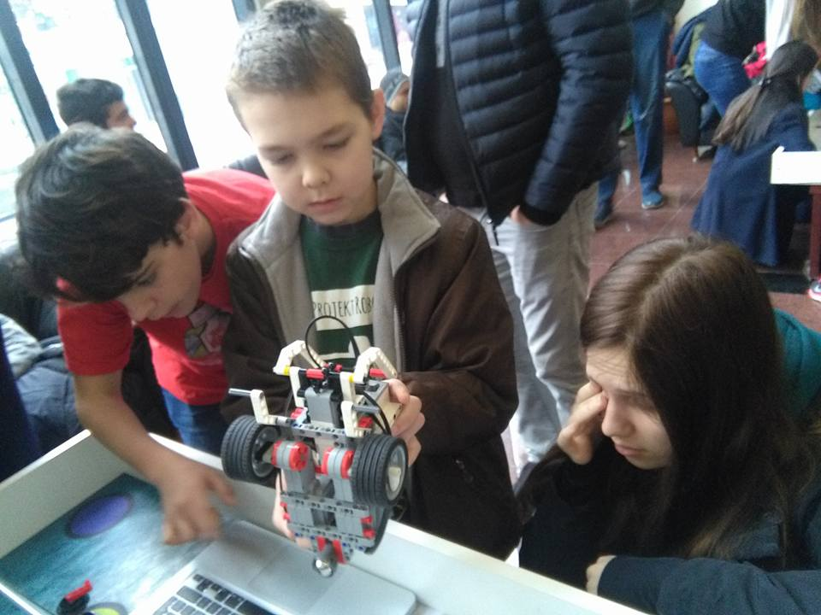
4-6th grades: programming robots

Slide 8
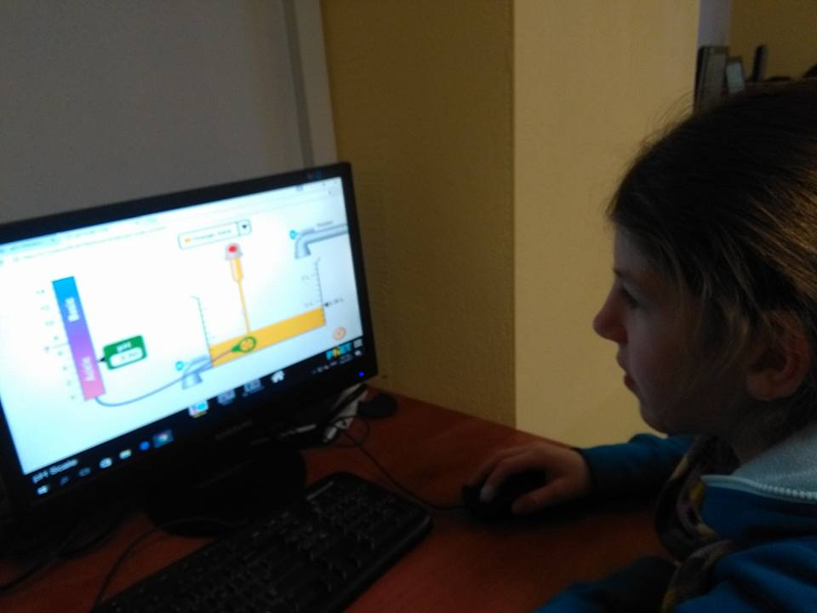

Slide 9
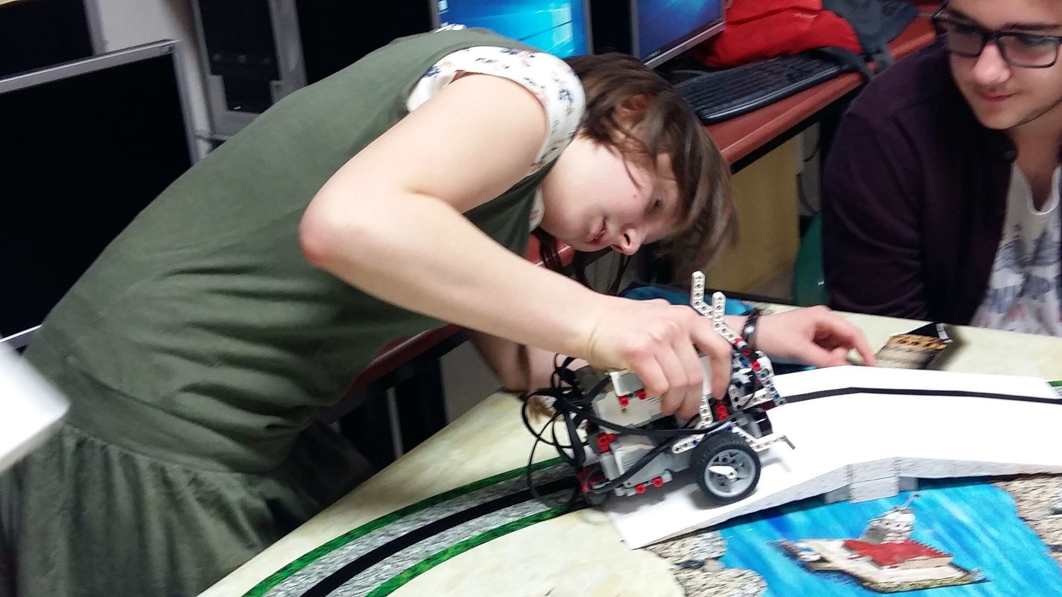

Slide 10
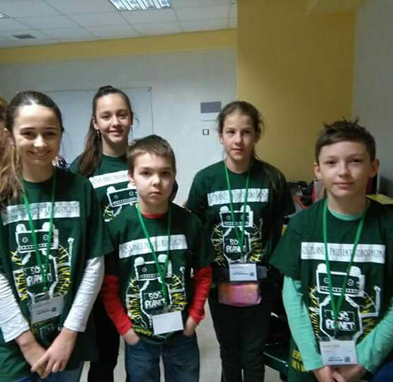

Slide 11
Thank you for the attention
Maybe you will try too ?

