Slide 1
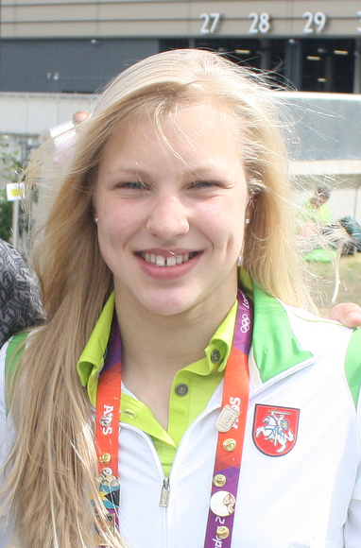
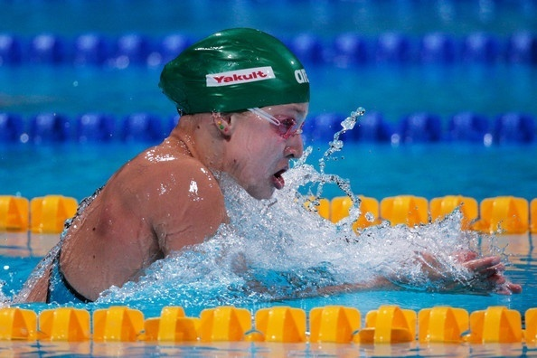
Ruta meilutyte
Ysgol Sant Baruc, Wales

Slide 2
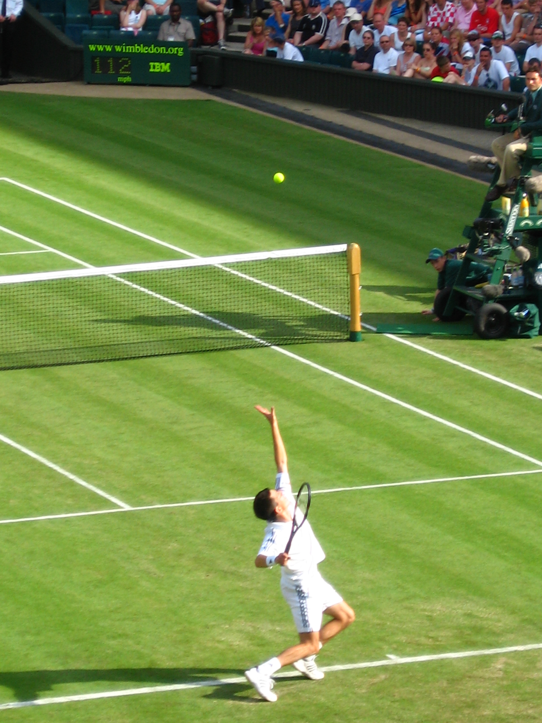
Inspiring us through sport!
We held our own Wimbledon…

Slide 3
Inspiring us through sport!
We Played tag rugby on the beach…

Slide 4
Inspiring us through sport!
Class 6 organised a fun day
of sports for the children of the school!

Slide 5
Inspiring us through sport!
We came 2nd in the local athletics
Competition!

Slide 6
Inspiring us through sport!
We played in a cricket tournament!

Slide 7
Inspiring us through sport!
We Held an outstanding sports day!

Slide 8
Inspiring us through sport!
We played even more rugby (our national sport)!

Slide 9
Inspiring us through sport!
We participated in football tournaments!

Slide 10
Inspiring us through sport!
And of course…we swam!

